Slide 1
WA105 TB
CERN – 01 February 2017
HV PS, HV feedthrough and SFTC
Franco Sergiampietri
1

Slide 2
Tasks and progresses for the 6x6x6m³ and the 3x1x1m³
HV power supplies and FTs
1.1 300 kV HV PS for the 6x6x6-DP has been ordered (DAI 6649716).
1.2 Offer for 100kV PS arrived (12,019.0 €). Order to be done (ETHZ?)
1.3 Configuration: a) Present 300kV PS do be used for ProtoDUNE-SP: new cable male connector to the new HVFT or modified HVFT female connector.
b) New 300kV PS with larger diameter cable for ProtoDUNE-DP with HVFT adapted female connector.
c) 100kV PS for the 3x1x1: new cable male connector for smaller cable.
2. HV FTs
2.1 Drawings for 300kV HVFT for ProtoDUNE-DP:
a) 3D drawing: to be completed
b) quoted tables: to be done
c) offer: to be requested.
2

Slide 3
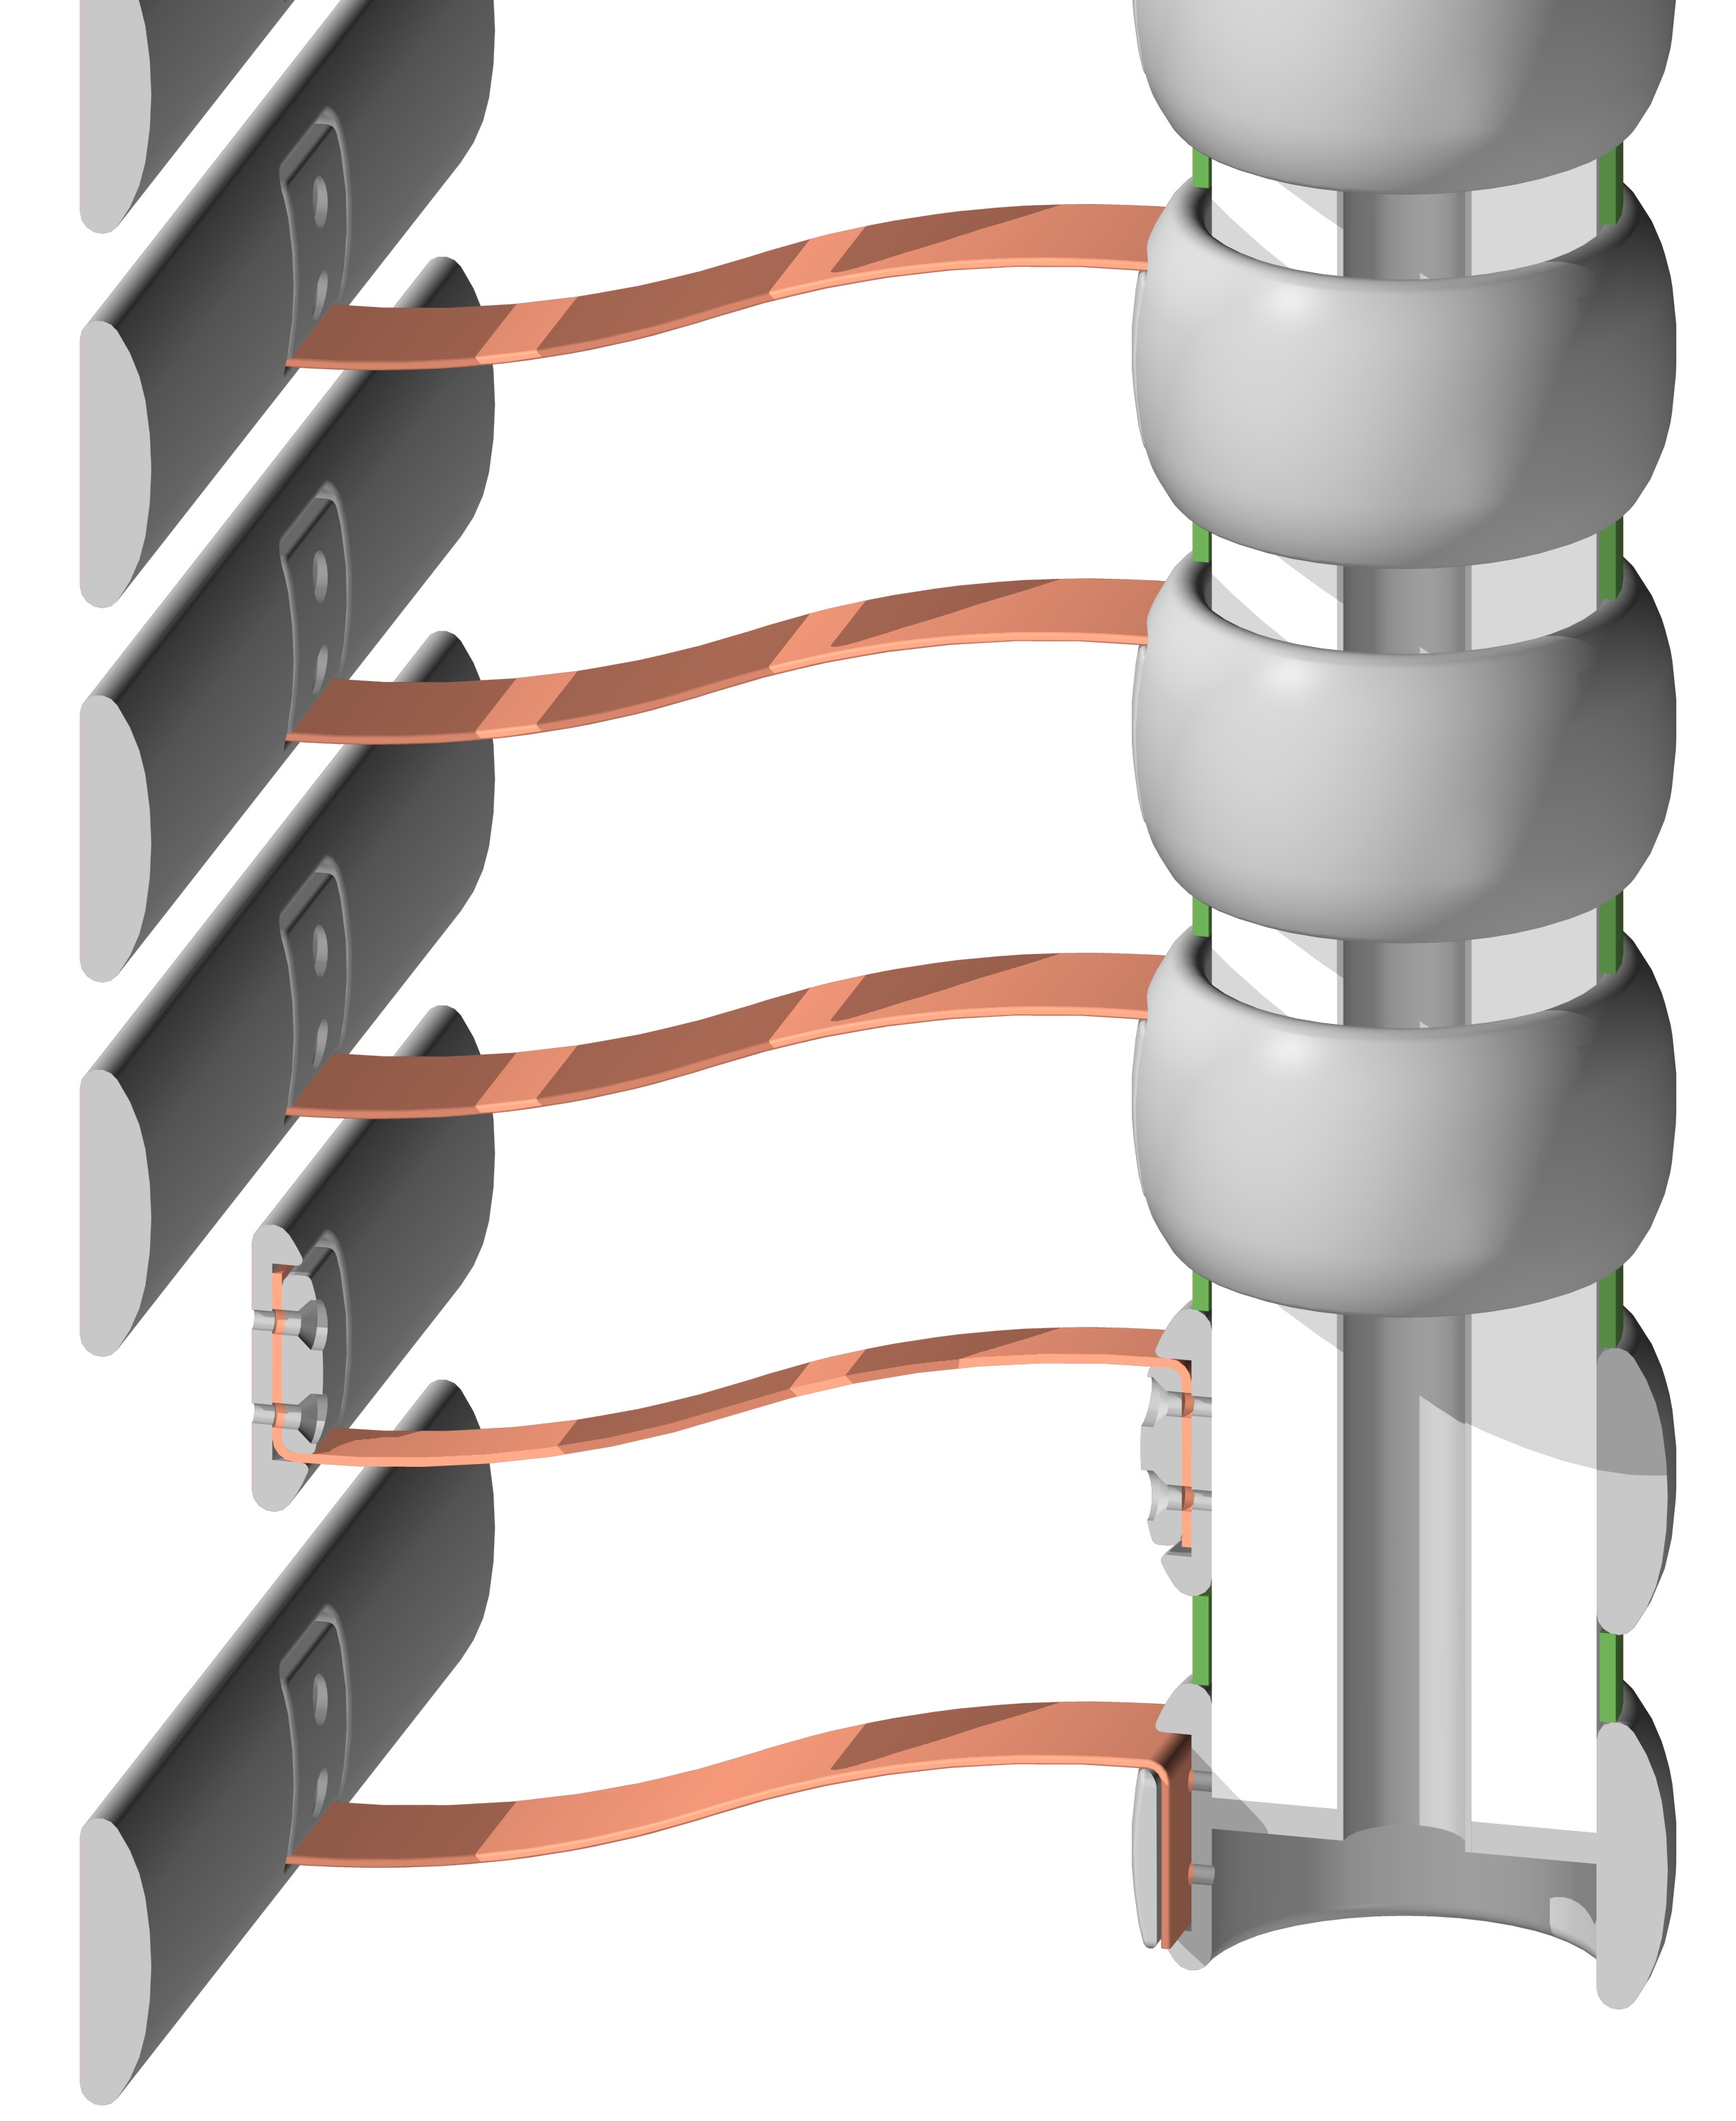
3. HV transmission from HVFT to the cathode
3.1 3D drawing: done.
3.2 Options to be decided: with or without rings connected to the field cage voltage degrader. Last ring always connected to the cathode.
Crossing pipe with inner diameter Din≥~150mm
Without the rings and the G10 spacers, with the inner SS pipe replaced by a SS rod, the weight is 36.3kg in air and 1.7 kg in LAr
Cu FLAT BRAID to the cathode
3

Slide 4
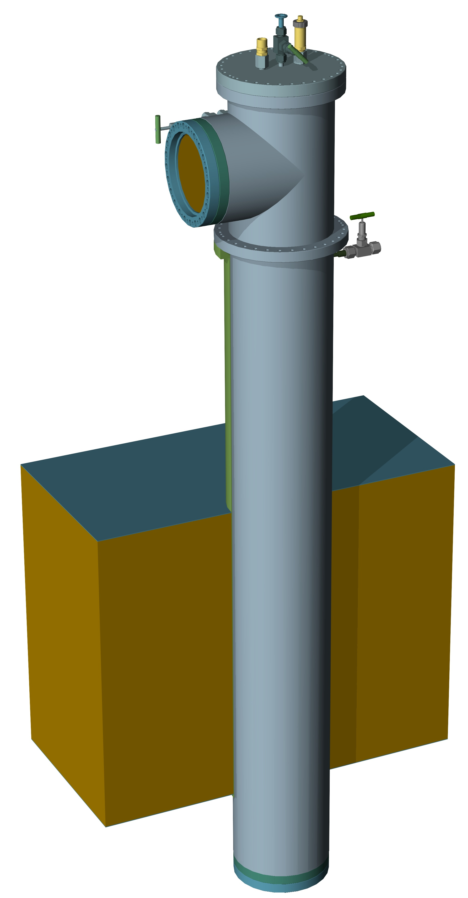
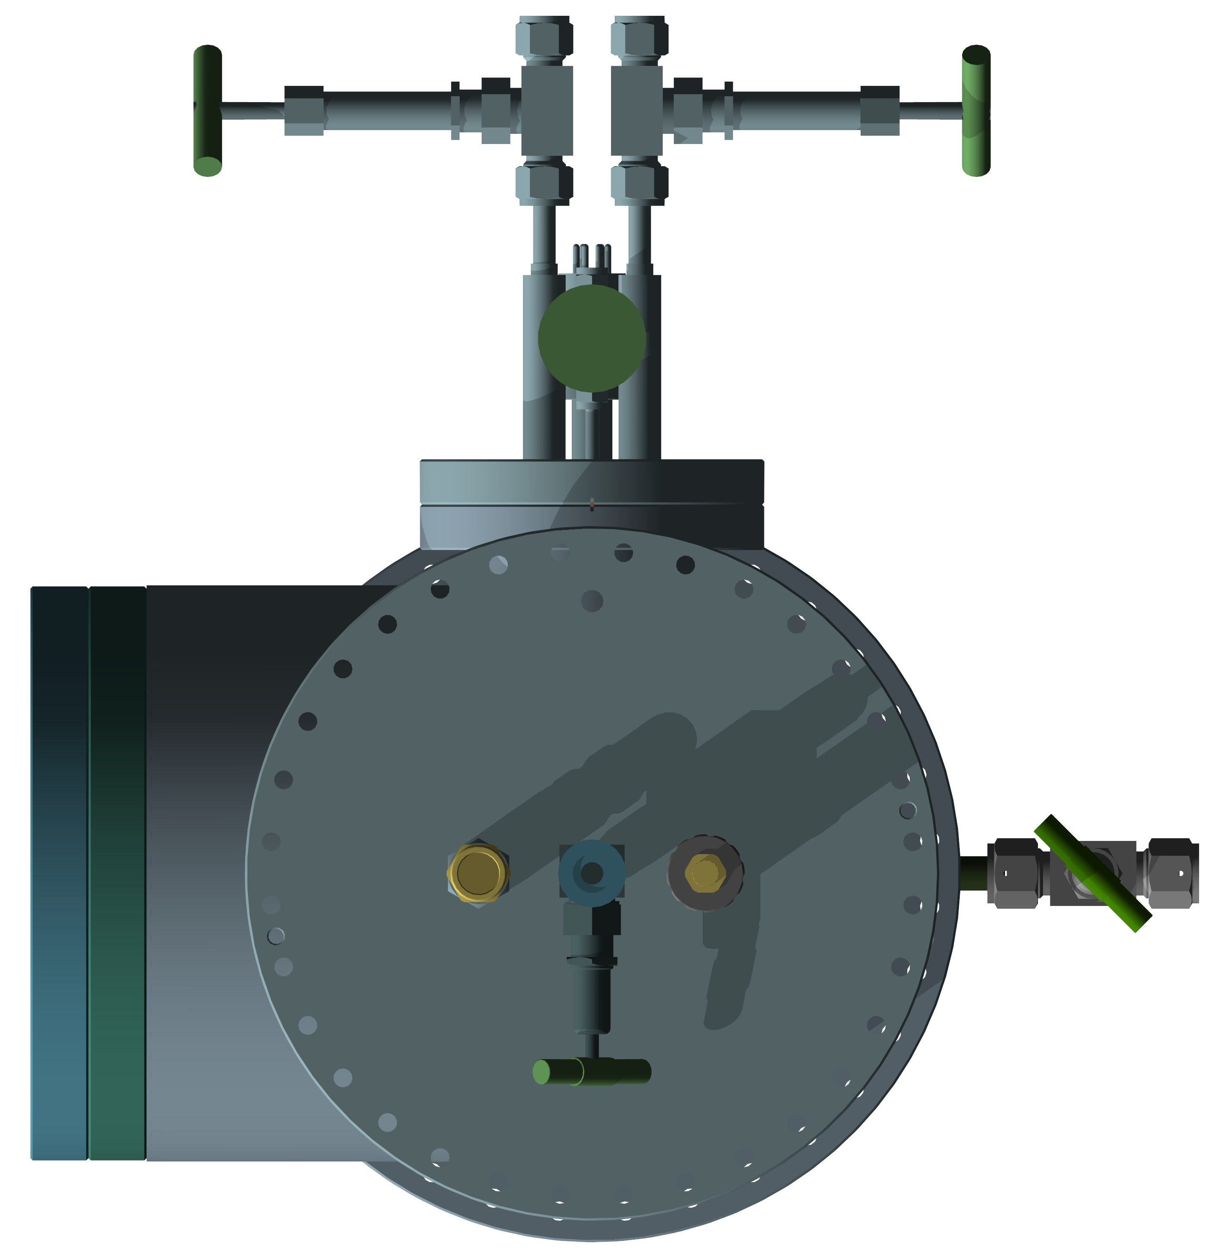
4. SFTC chimneys
3D drawing: done and passed to Adamo for their penetration in the cryostat. Internal details to be finalized.
Crossing pipe with inner diameter Din≥~260mm
Purge valve in the crossing pipe (to be remarked for cryostat design)
Outer pipe with diameter Dout=254mm
4

