Slide 1
All scientists retreat: introduction

Slide 2
Why are we here?
Strategy Overview

Slide 3
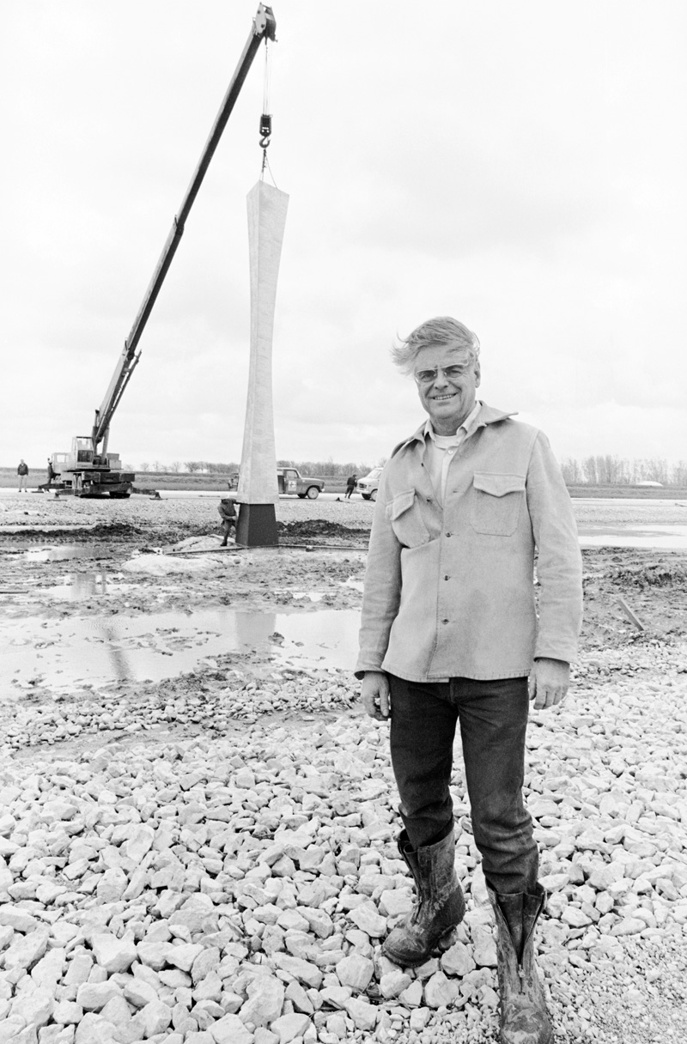
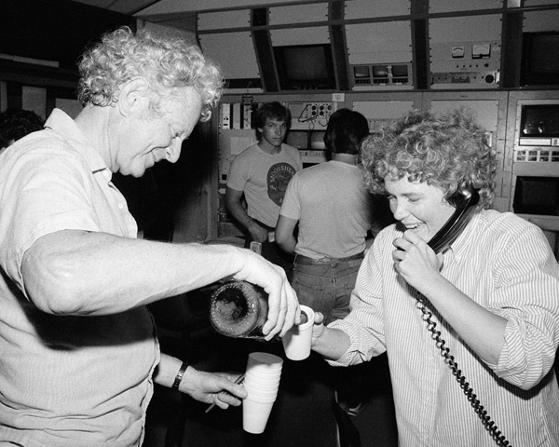
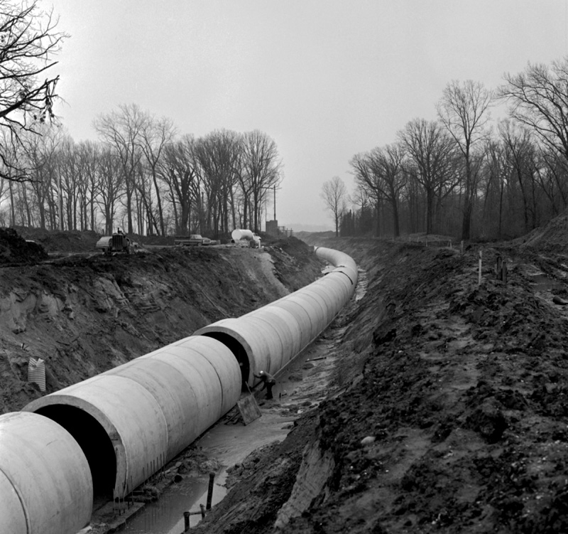
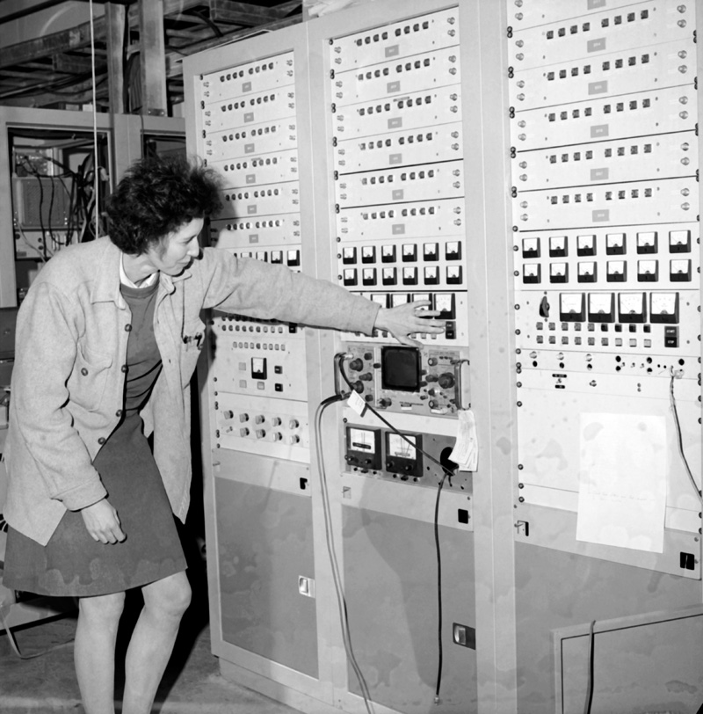
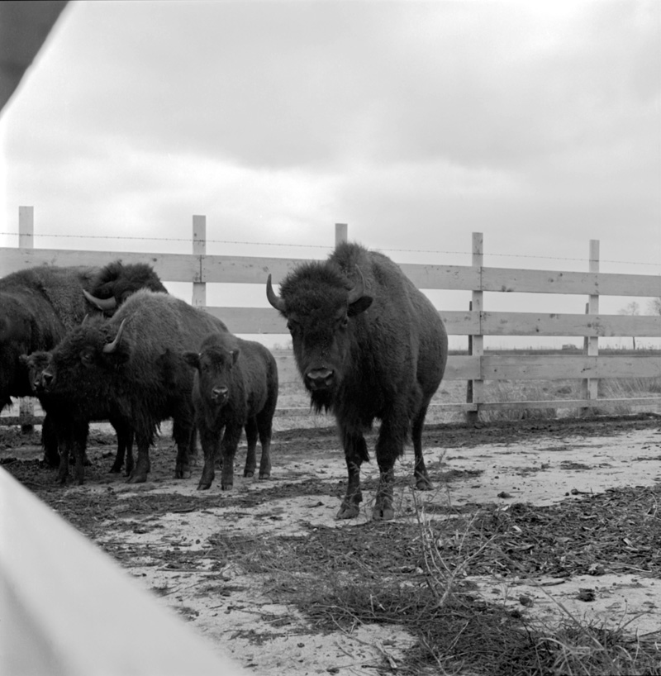
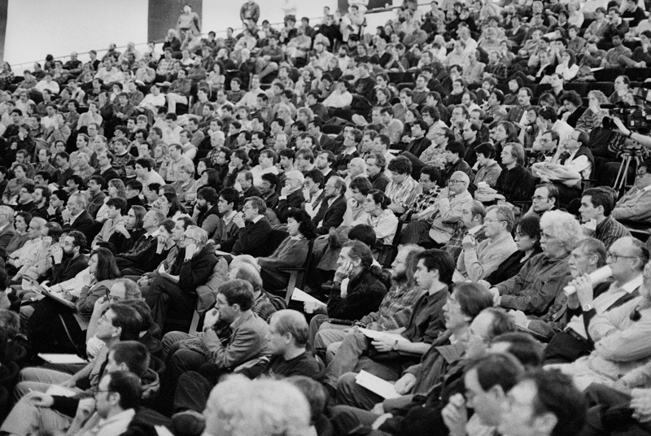
20th Century Science Laboratory

Slide 4
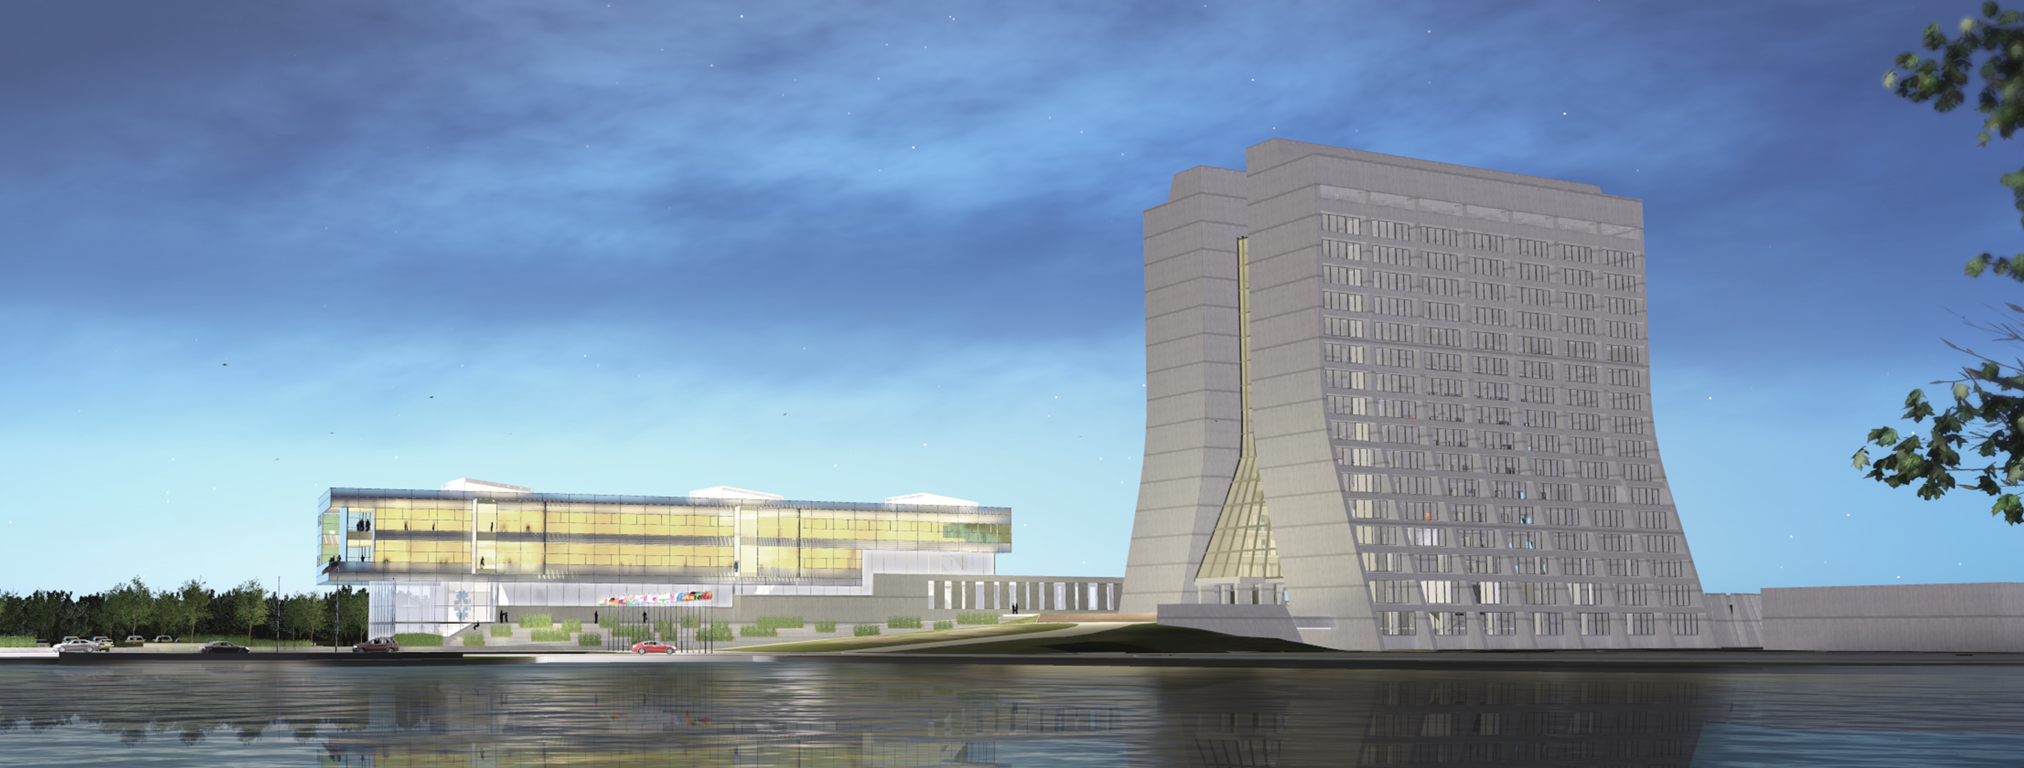
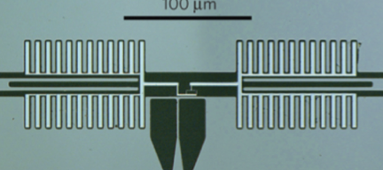
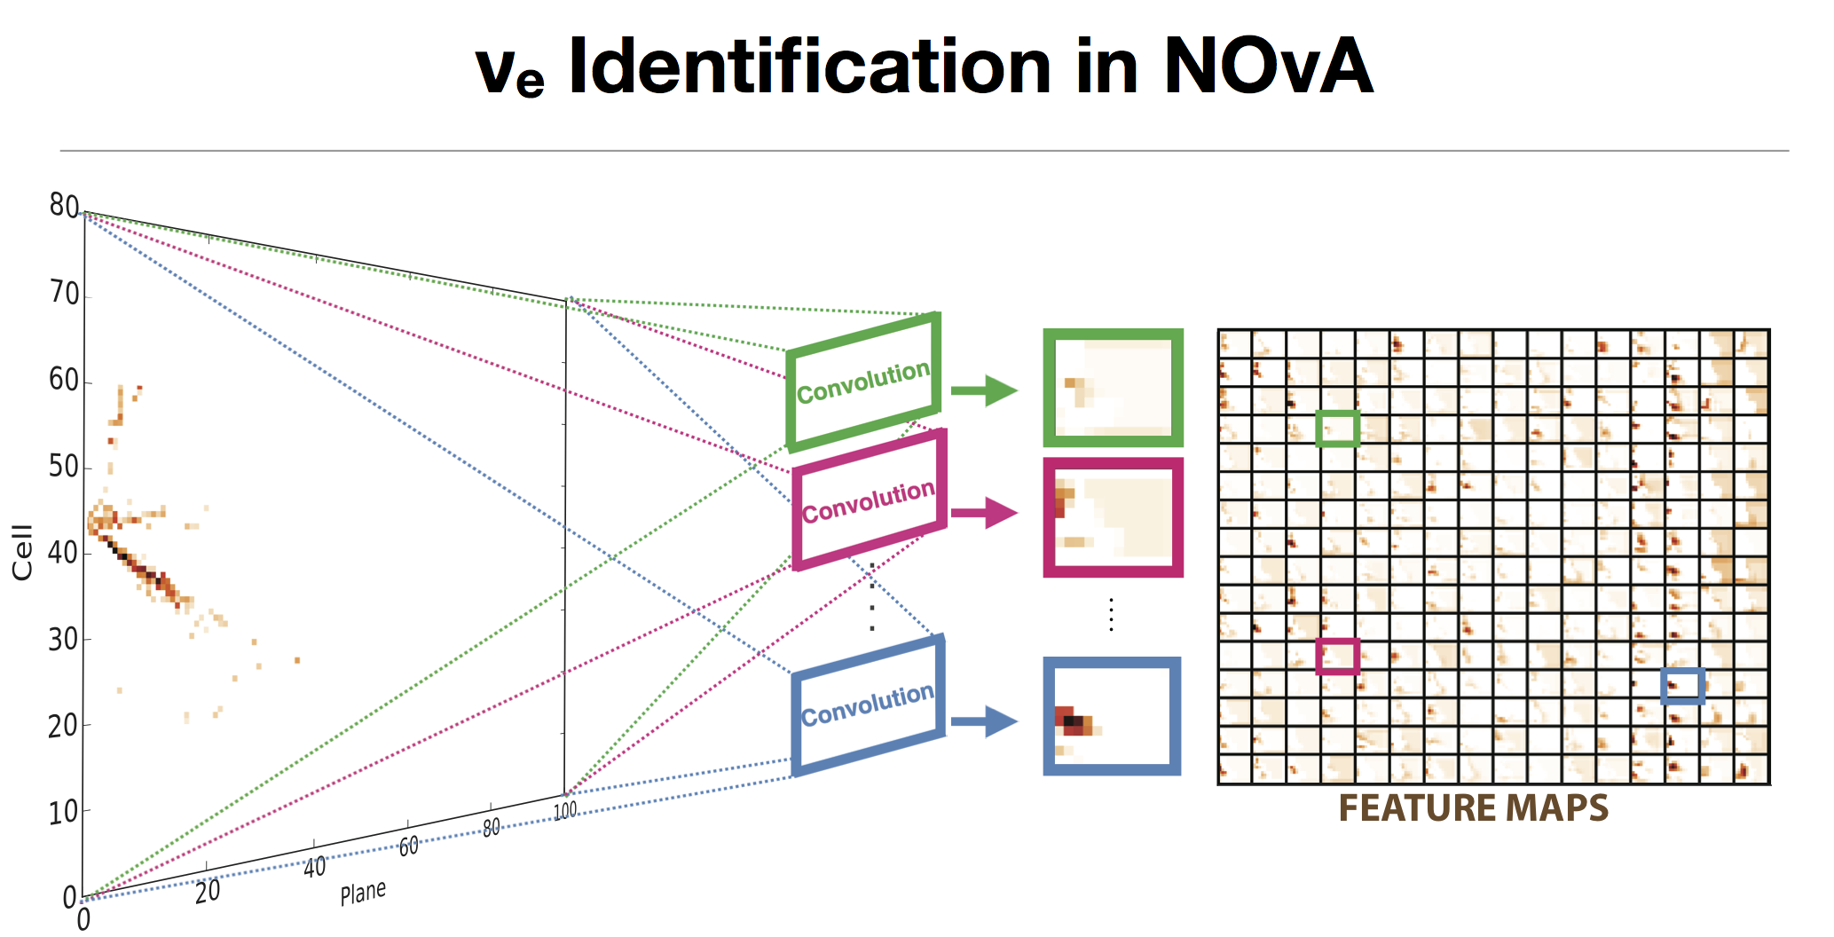

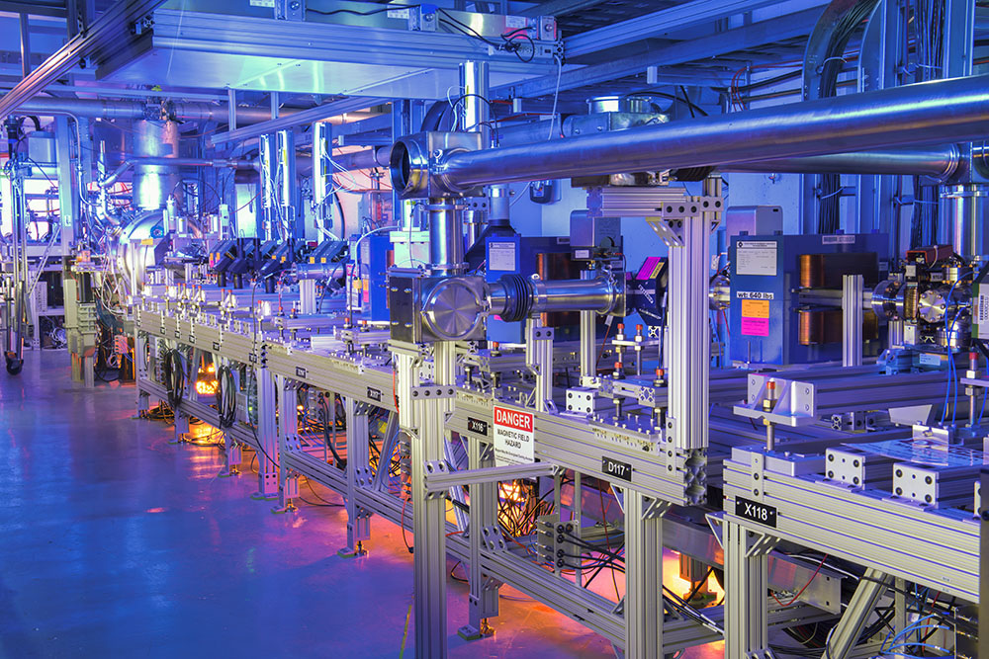
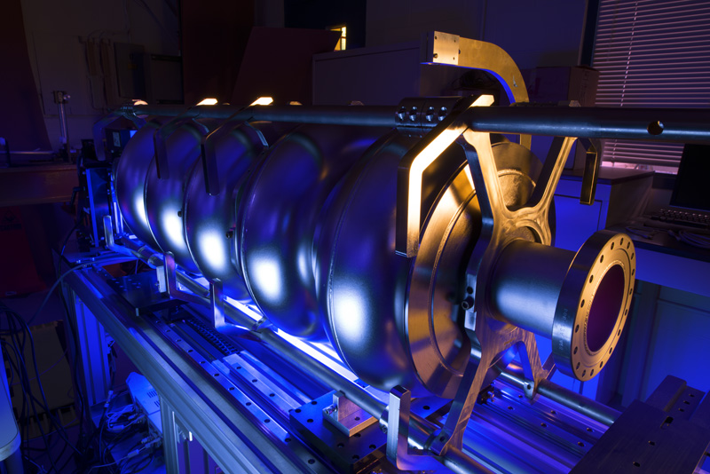
21st Century Science Laboratory

Slide 5
What does it mean to be a 21st Century HEP Science Lab?
We as scientists have to figure this out together
There are many pieces to the problem:
What does the cutting edge of HEP science look like 20 years from now?
What capabilities does the lab need to acquire/grow/maintain/give up?
How to attract/promote/retain/incentivize/empower the world-class scientists and technical staff that Fermilab we will need to flourish?

Slide 6
What does it mean to be a 21st Century HEP Science Lab?
We as scientists have to figure this out together
There are many pieces to the problem:
What does the cutting edge of HEP science look like 20 years from now?
What capabilities does the lab need to acquire/grow/maintain/give up?
→ Topics for our second retreat
How to attract/promote/retain/incentivize/empower the world-class scientists and technical staff that Fermilab we will need to flourish?
→ Topics for today

Slide 7
Some background for today’s discussions
The scientist survey
Scientist research fractions
Scientist internal and external recognition
Balance between postdocs and other kinds of scientist positions
Some lab diversity data and thoughts about meeting etiquette

Slide 8
The Scientist Survey
Yeah yeah we know the scientist survey was not very scientific – next time we will do better
But even this Version 0.1 has produced interesting results
I encourage you to work through SAC to figure out what Version 1.0 should look like

Slide 9
Statistics on scientists as of 10/1/16 from FCSA

Slide 10
Statistics on scientists as of 10/1/16 from FCSA

Slide 11
Survey responses statistics c.f. total on FCSA list

Slide 12
Survey responses statistics c.f. total on FCSA list

Slide 13
Scientist research fractions
This is part of a bigger discussion of what it means to be a lab scientist versus, e.g., a university professor
The labs are mission driven and this is a great strength
But scientists also need time think about data, new approaches, new technologies
How to achieve the right balance across the lab?
What is the role of collaborations with local area universities?

Slide 14
Scientist internal and external recognition
We have an awards committee focused our scientists becoming APS Fellows; we are doing pretty well at this, but what about other kinds of external awards?
How can we organize to get more Early Career Awards?
We have a few internal mechanisms for recognition:
  EPRA awards
  Tollestrup Award for postdocs
  Distinguished Scientist category
The committee that revamped the Distinguished Scientist category also recommended, based on your feedback, that the lab find additional mechanisms for internal recognition

Slide 15
Balance between postdocs and other scientist positions
Postdocs are a cheaper and more flexible scientific workforce
Oak Ridge e.g. has ~twice as many postdocs per scientist than FNAL
What is the right balance across the lab?
How does this mesh with our responsibility for postdoc career outcomes?

Slide 16
Diversity
This starts from asking the question about what does a 21st century lab look like?
We have some pretty good examples of what a 23rd century scientific organization should look like:

Slide 17
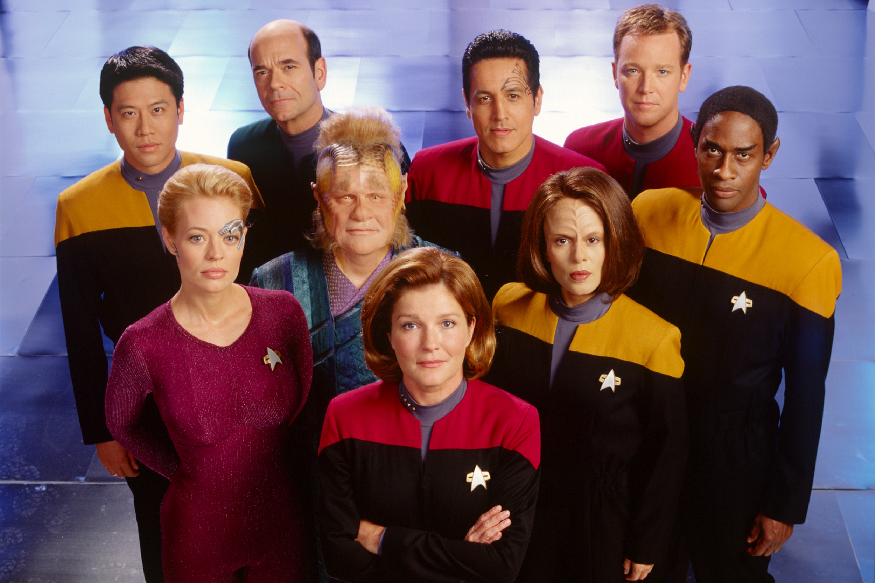
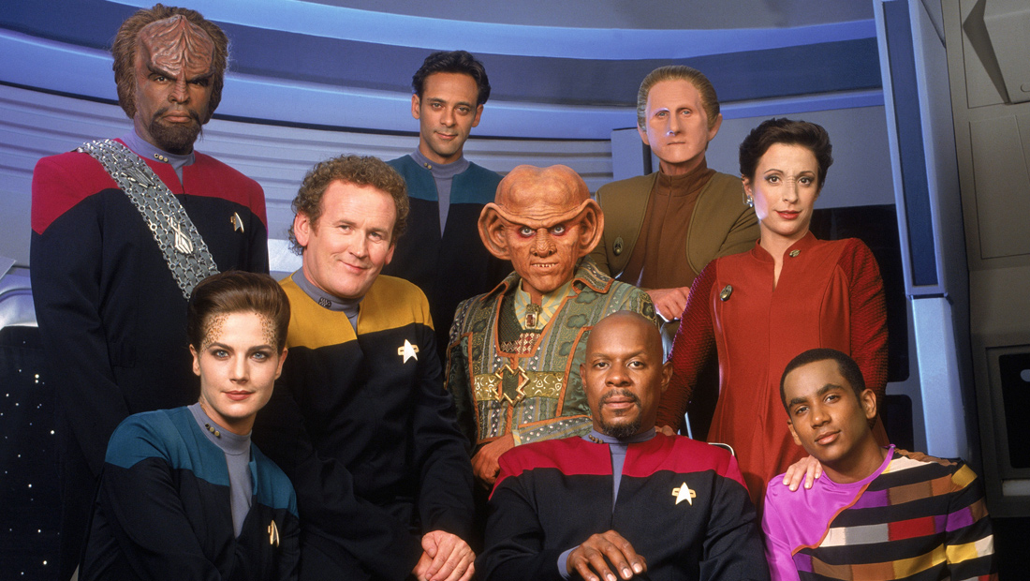
Diversity
This starts from asking the question about what does a 21st century lab look like?
We have some pretty good examples of what a 23rd century scientific organization should look like:

Slide 18
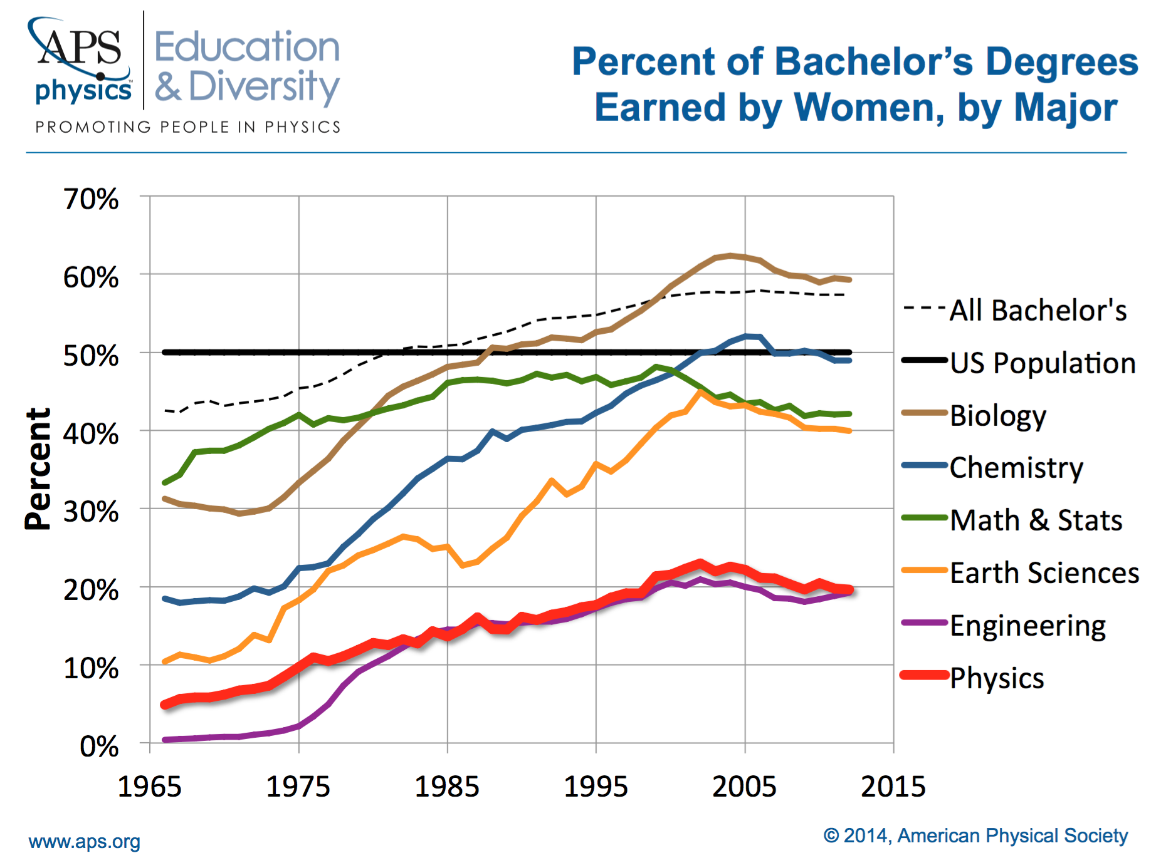
Diversity statistics: U.S. physics

Slide 19
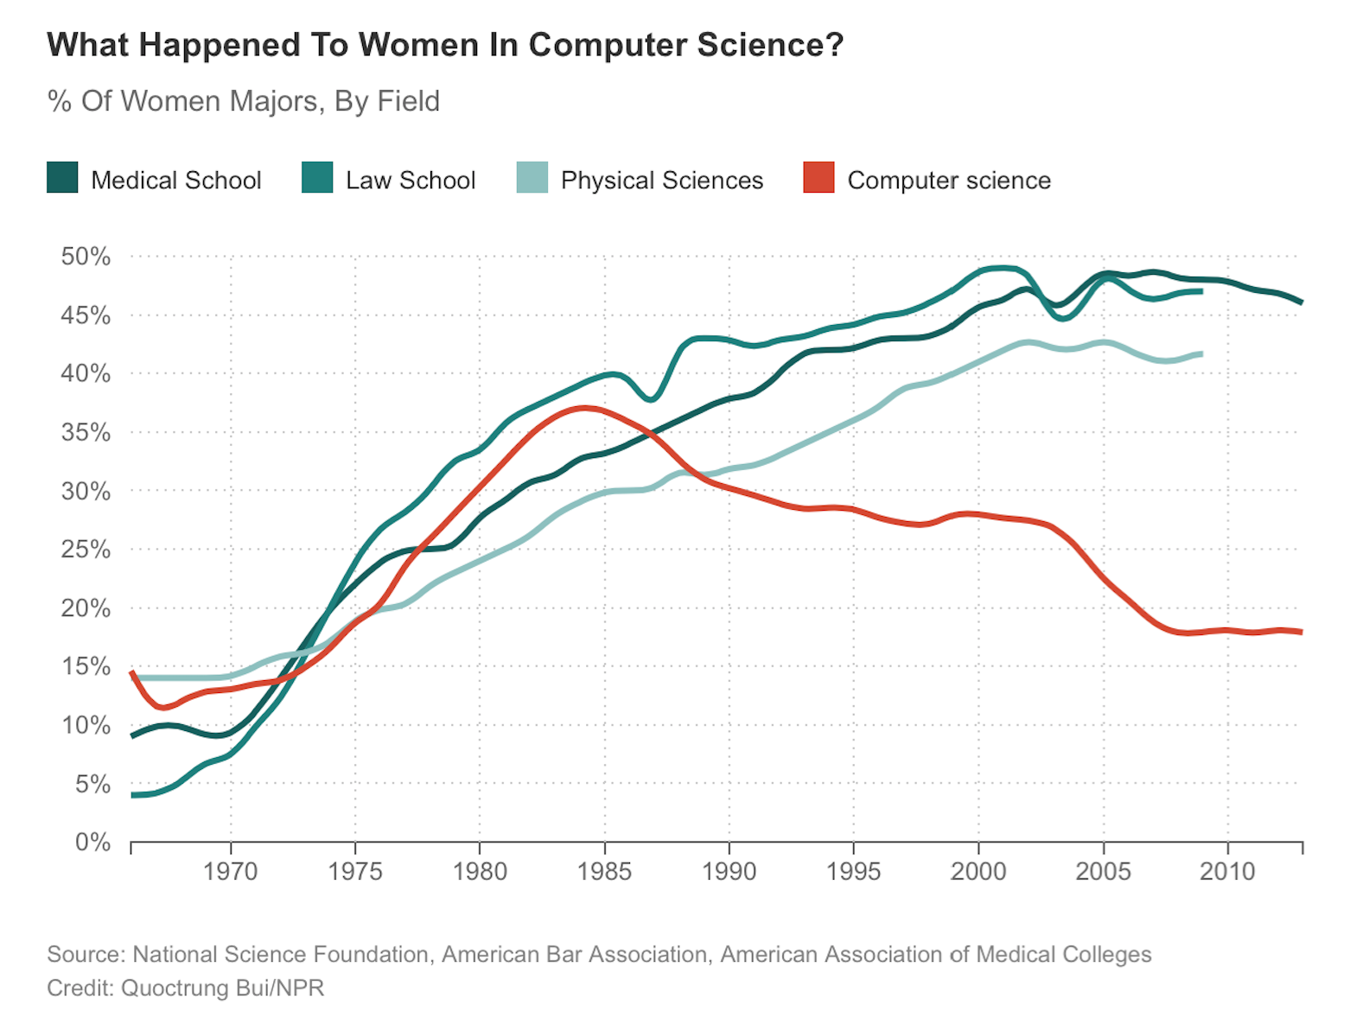
Diversity statistics

Slide 20
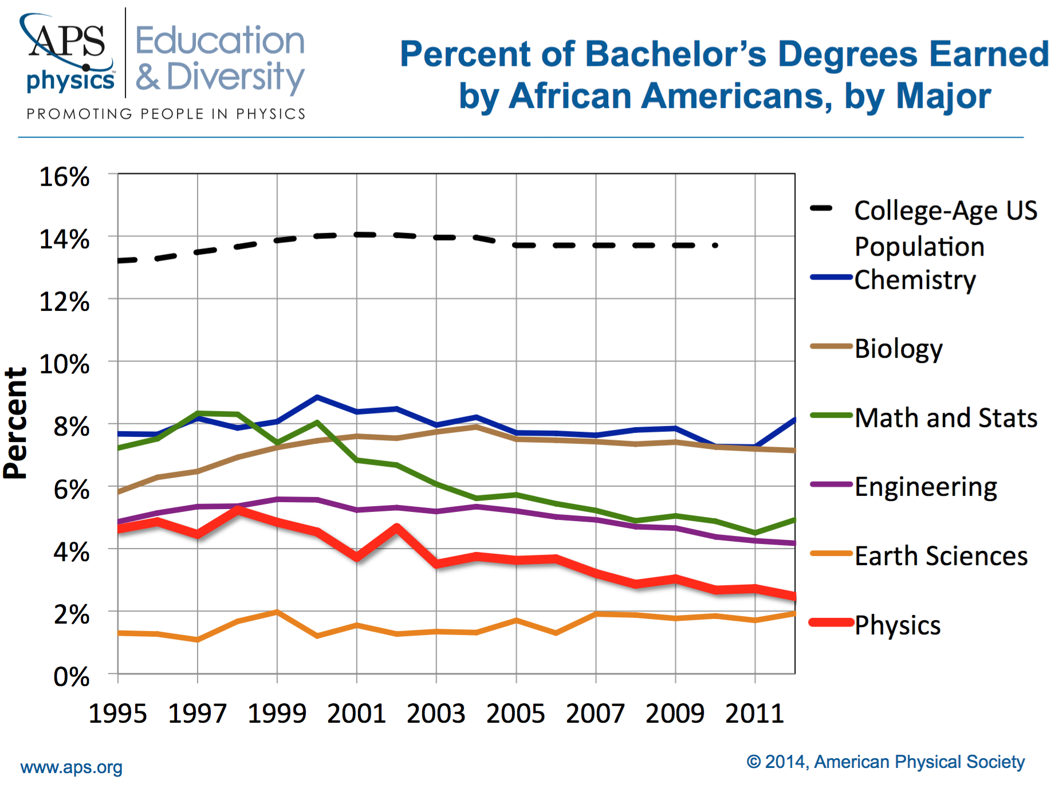
Diversity statistics: U.S. physics

Slide 21
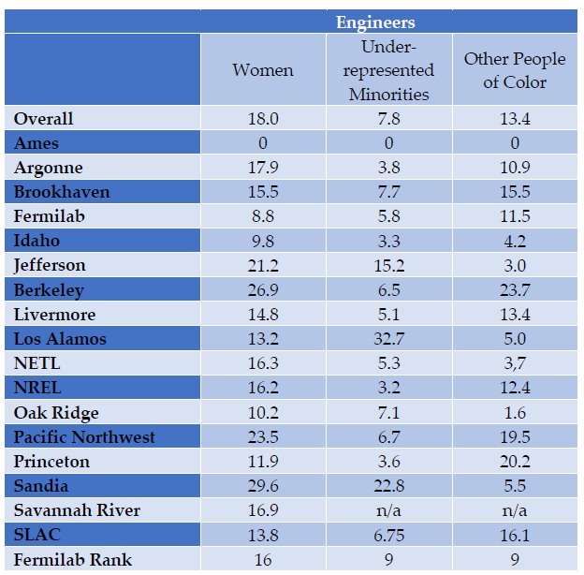
Diversity statistics: National labs

Slide 22
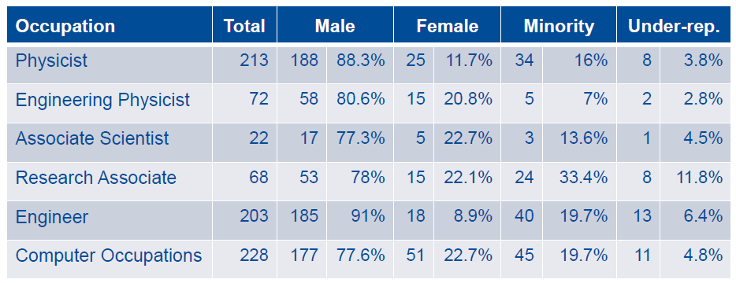
Diversity statistics: Fermilab
Lab as a whole (1820 employees):
23% women
8% Asian
10% under-represented minorities

Slide 23
Culture and atmosphere
Obviously we have a diversity hiring challenge
In addition, since our current lab workforce is not very diverse, we have a culture and atmosphere problem
This is in spite of the fact that (almost) all of us are well intentioned good enlightened people
Without making the atmosphere more inclusive we will never get to where we need to be

Slide 24
Culture and atmosphere
Precisely because this problem is less obvious to many people, and is rather fuzzy by nature, it requires all of us to be sensitive to it
We have a bunch of self-organized lab groups thinking about this:
  http://diversity.fnal.gov/lab-resource-groups/
The directorate thought meeting etiquette was a good concrete place to start, and we asked the Resource Groups to come up with a proposal. It will be part of a something wider: Fermilab Codes of Conduct
  As scientists, what ground rules for meeting etiquette would you like to have, and what would appeal to you in how we communicate them?
Nigel and I are enthusiastic about this, but request your help in making it work

Slide 25
