Slide 1
Reorganization to Health, Safety, and Environment
erhtjhtyhy
April 26, 2017
Betsy Dunn
Betsy Dunn
Director, Health, Safety, and Environment Division
Argonne National Laboratory

Slide 2
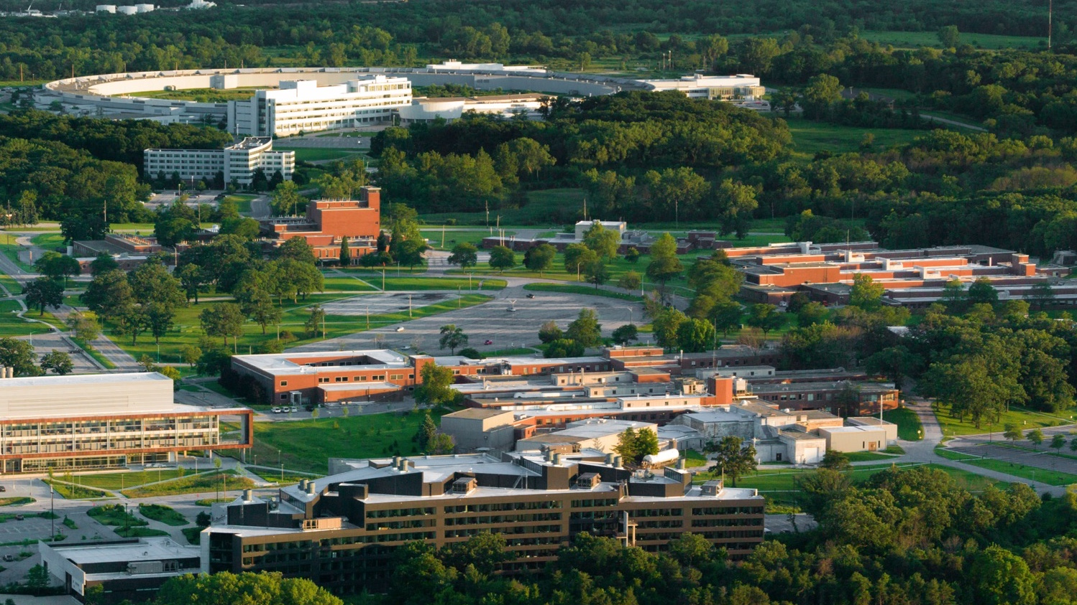
WHY?

Slide 3
SUCCESS =
delivering excellent results to our internal customers and sponsors

Slide 4
SUPPORT SERVICES AND RESEARCH PROGRAMS WORKING IN PARTNERSHIP
Deliver excellent service and anticipate customer needs
Drive discovery with increased operational effectiveness
Make important decisions in a timely way
Respond quickly to new opportunities

Slide 5
Uchicago safety review conclusions
Organization
Working to be more proactive and people-oriented
Changes to drive improvement
Key observations
Radiological awareness reporting is a best practice
Excellent collaboration in high-risk areas
Resource and succession planning challenges
Improvements in ESH recognized in past 5 years
Staff are committed
Five stories being told – need overarching strategy
Consider an investigation panel to span the Lab
Consider expanding job shadowing efforts
Notes:
In August, UChicago began to conduct a 3-part safety review –
Jim Tarpinian performed safety culture assessment
Martha Michels, Jim Floyd, Joe Kanabrocki (UC), and Jim Marcicek (UC) performed a study on alignment of ESH across the Lab
Martha Michels, Gail Mattson, Mary Logue, and John Sampson performed CAS review

Slide 6
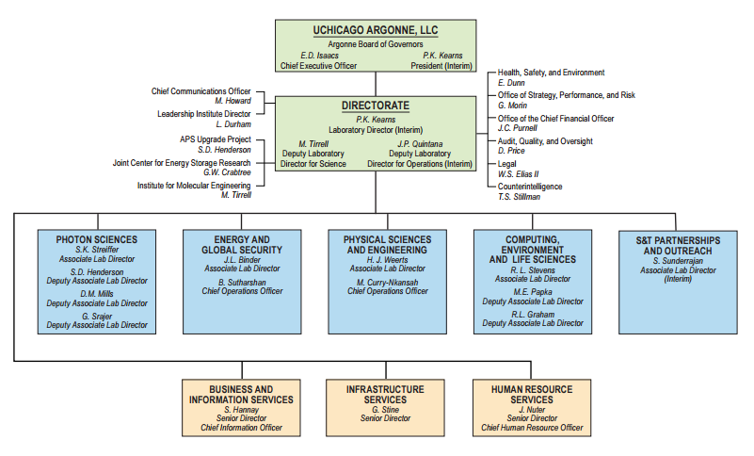
Our organization
Notes:
Communication improved in multiple directions:
HSE Director has direct line of sight to Lab Director (direct supervisor)
HSE core to deployed field support in divisions/directorates
Until now, work was division- or directorate-focused – desire to think and manage more globally

Slide 7
Health, safety, and environment
HSE
WHO
Health and Employee Wellness
Training and Safety Information
Worker Safety and Health
Environmental Protection
Radiological Protection
Deployed Services
LEADER
Elizabeth Dunn, Director
WHAT
Integrate all the Lab’s resources protecting our people and environment
Provide safety expertise and deliver services to keep employees healthy and safe
Notes:
HSE brings the Laboratory’s safety and health resources together into an integrated and service-focused team
HSE positions us to evolve into an organization where we can better drive line management to lead the planning and execution of its safety and health program
Communication flow is strengthened in multiple directions
Integrated team, including an investigation panel to span the Laboratory, positions us to more comprehensively and sustainably understand and address issues

Slide 8
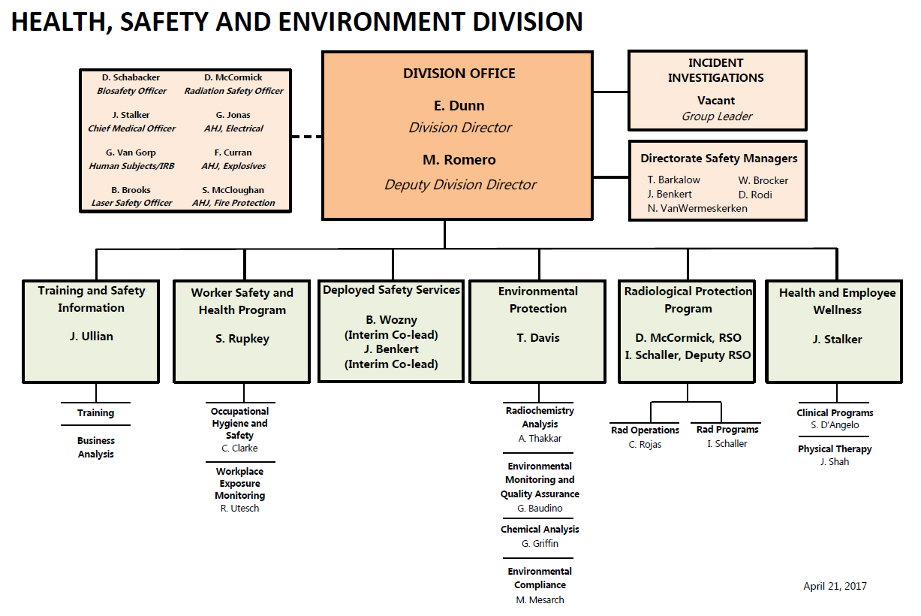
Notes:
Established Feb. 1, 2017
HSE reports to Lab Director
Central incident investigations team formed
Health & Employee Wellness joined the team
Environmental Compliance org formed under Env Protection – resources from 3 organizations came together
HSE Field Services – combines field deployed ESH coordinator staff from across divisions and directorates

Slide 9
deployed Services
Allows us the ability to leverage skills to best support Lab mission
Allows for consistent management of resources, aligned with institutional strategies and directorate priorities
Brings together safety personnel from across the Lab to share best practices, collaborate, and team
Enables “surge” support for new initiatives and programs, and facilitates succession planning
Provides for improved career development for staff, performance and salary management, and on-boarding
Notes:
We hope it will provide a greater sense of HSE community – moving away from the “us” versus “them”

Slide 10
Status of changes
Date | Action
February 1 | HSE established, directorate and 5 division safety staff joined HSE
February 6 | Health and Employee Wellness staff joined HSE
February 28 | Environmental Compliance established, FMS and PMA staff joined HSE
March 31 | Core Quality Assurance staff moved from HSE to BIS and AQO
May 1 | Remaining programmatic division safety staff join HSE
Key Hires:
Deputy Division Director (filled May 1)
Environmental Compliance Manager (filled April 24)
Incident Investigations Manager (posted)
Deployed Safety Services Manager (posted)

Slide 11
