Slide 1
BSA Operations Committee
Field Experience: Machine Shop Safety
Background
Following the 2011 tragic machine shop accident at Yale University, BNL’s Institutional Risk Management Committee (IRMC) recognized that operating machine tools without appropriate and required safety components is a significant risk to personnel safety.
At the time, just like other national labs, Brookhaven operated an extensive inventory consisting of 700 common and specialized pieces of equipment accumulated over many decades of operations. Although well-maintained, many of them lacked modern safety features.
IRMC recommended specific actions to correct the situation:
Remove equipment that is both non-compliant and non-mission critical from service immediately.
Allow non-employees to use equipment only if it is fully compliant or has undergone a risk assessment to determine alternative controls.
Require line organizations to bring all machines into compliance within a specified time frame.
Replace all machines that cannot be made compliant after assessing the cost impact and feasibility individually.
In 2015 the Policy Council started tracking the progress of the machine shop safety program through the key performance indicator (IKPI) process and by the end of CY2016 compliance reached 98%.
In 2016, the DOE Office of Enforcement issued a Notice of Violation to Argonne National Lab after a serious incident with an unguarded machine. The incident investigation and report highlighted the importance of machine shop safety. Furthermore, specific references in it validated the strict approach to compliance followed by Brookhaven National Laboratory.

Slide 2
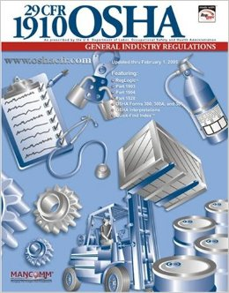
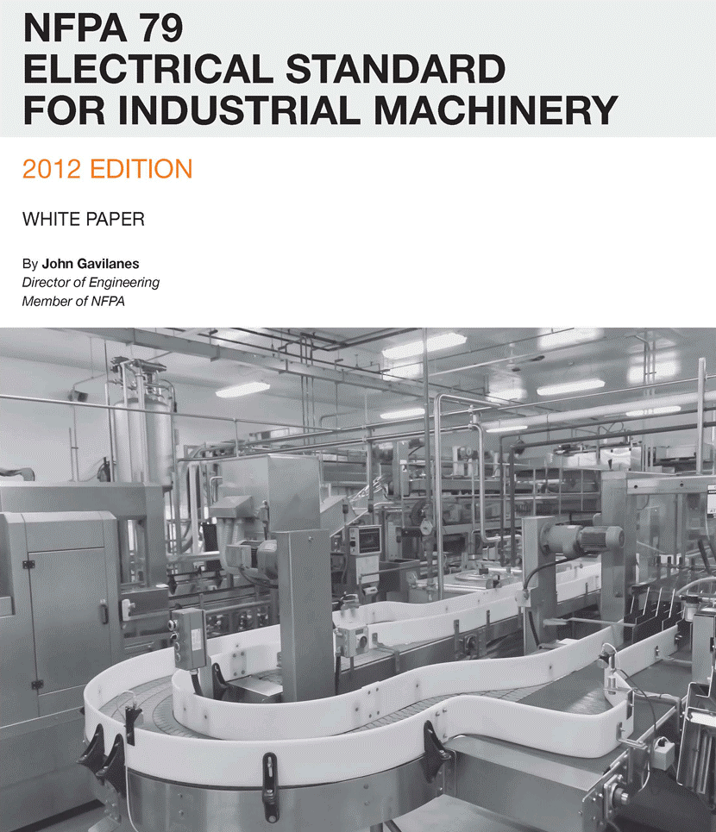
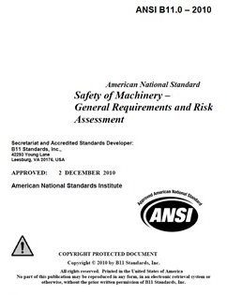
Regulatory Obligations at Brookhaven
OSHA’s General Industry Standard 1910 Subpart O became binding in 2006 when it was included by reference in 10 CFR 851.
Guarding Requirements:
OSHA 29 CFR 1910.212(a)(1)
DOE Safety & Health Rule 10 CFR 851.23(a)(3)
Anti-restart Requirements:
OSHA 29 CFR 1910.213(b)(3)
DOE Worker Safety and Health Rule 10 CFR 851.23(a)(3)
OSHA 5(a) General Duty Clause & 10 CFR 851.22(a) based on industry recognition of NFPA 79-2007 Para. 7.5.3 & ANSI B11
Emergency Stop Requirements:
OSHA 5(a) General Duty Clause or corollary 10 CFR 851.22(a) based on industry recognition of ANSI B11, NFPA 79-2007 and ANSI B11-TR6. Only NFPA-79 compliant e- stops are acceptable.

Slide 3
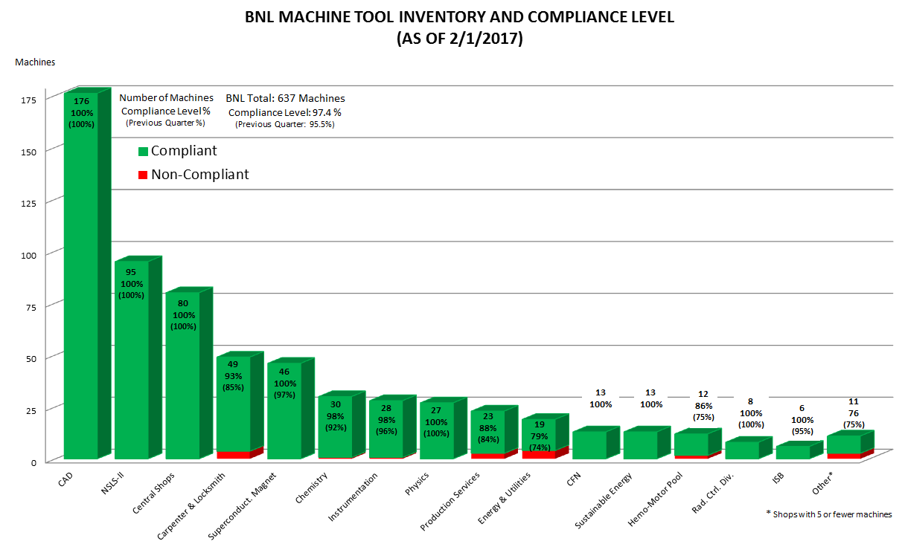
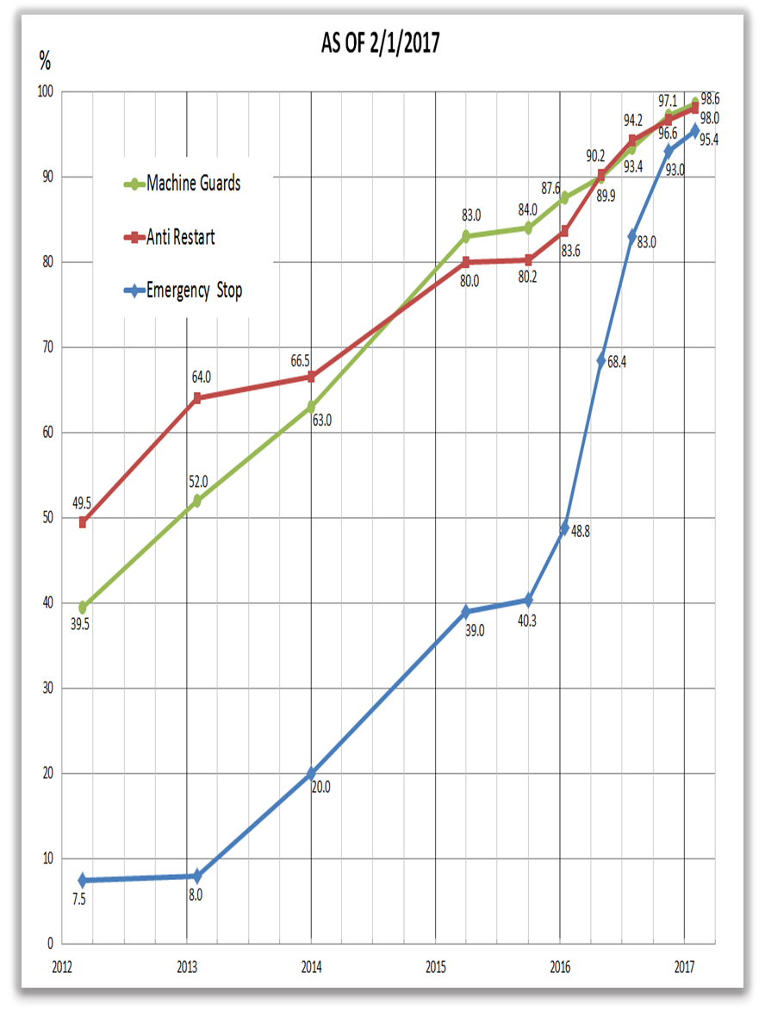
Brookhaven’s Inventory Compliance Snapshot
Machine Inventory Location and Status:
Compliance progress for each safety feature:

Slide 4
Machine Shop Safety Program Summary
Brookhaven operates 640 machine tools in over 50 shop areas of very different nature: heavy fabrication, small scientific support shops, trades shops…
A comprehensive upgrade project (2013-2016) has achieved a 98% compliance with current safety requirements.
A few machine upgrades remain (20 out of 640) and they are being tracked for completion.
Machine Risk Assessment (MRA) model based on ANSI B11-TR3 functions to document alternative controls when upgrades are not feasible.
ESHQ (Tier-I) inspections are used to identify and resolve remaining issues and to prevent reoccurrence of non-compliances.
SME inspects every single shop yearly at a minimum.
Status of machine compliance, shop inspections and supervisor training is tracked in real time through a web-based machine safety database application.
All new procurements of machines are reviewed and approved by SME and must be fully compliant before entering service.

