Slide 1
LOTO Practices Working Group and LOTO Newsletters

Slide 2
LPWG Structure
Log Out Tag Out Working Group (LPWG) formally established in October 2013 to:
Monitor implementation of revised LOTO Subject Area
Provide enhanced communication between workers, operating organizations and LOTO Subject Matter Expert (SME)
Develop tools for monitoring LOTO implementation
Group facilitated by LOTO SME
SHSD Management is engaged in the process
Cross-sectional team where members serve as points of contact for their organizations
Results of monitoring implementation are shared with authorized workers, management, and BHSO

Slide 3
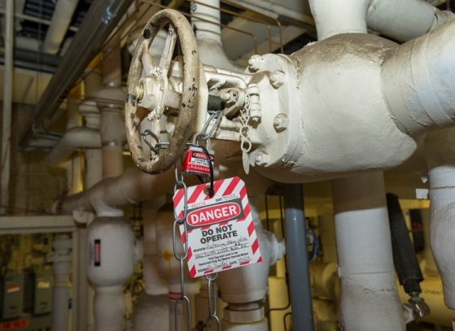
LPWG Meetings
Regular Business
Review of reports from LPWG members on meetings attended during that month
Review of ESH Surveillance Cards for LOTO
Determine if any of the above issues or observations require follow-up
Open discussion
Other business when required
Address questions from the field
Review proposed changes to LOTO Subject Area
Review of LOTO Newsletter
Develop LOTO communications

Slide 4
Tools developed by LPWG
Point of Work tools
Poster and lanyard
Helps with major decision points in the LOTO Process
When to LOTO
When to use simple or complex LOTO
How to determine type of training
Special conditions for contractors
Which lock and tag to use for LOTO
Work Orders
LOTO steps printable with work orders

Slide 5
Tools developed by LPWG
Observation tools
Observation checklist for use in the field
Webpage available lab-wide for collecting observation information
Database used for tracking and trending
Reports easily obtained for overall summary, individual reports and unsatisfactory findings

Slide 6
Tools developed by LPWG
Communication tool – Newsletter
Content Examples
Summary of LOTO observations
Noted items for improvement
Lessons Learned
Implementation Best Practices at BNL
LOTO Subject Area Updates
Worker Feedback
Q&A
Contact information of LPWG members
Newsletter was noted as a Best Practice during a recent external LOTO review

