Slide 1
Argonne WPC update
April 26, 2017
Betsy Dunn
Director, Health, Safety, and Environment Division
Argonne National Laboratory
www.anl.gov

Slide 2
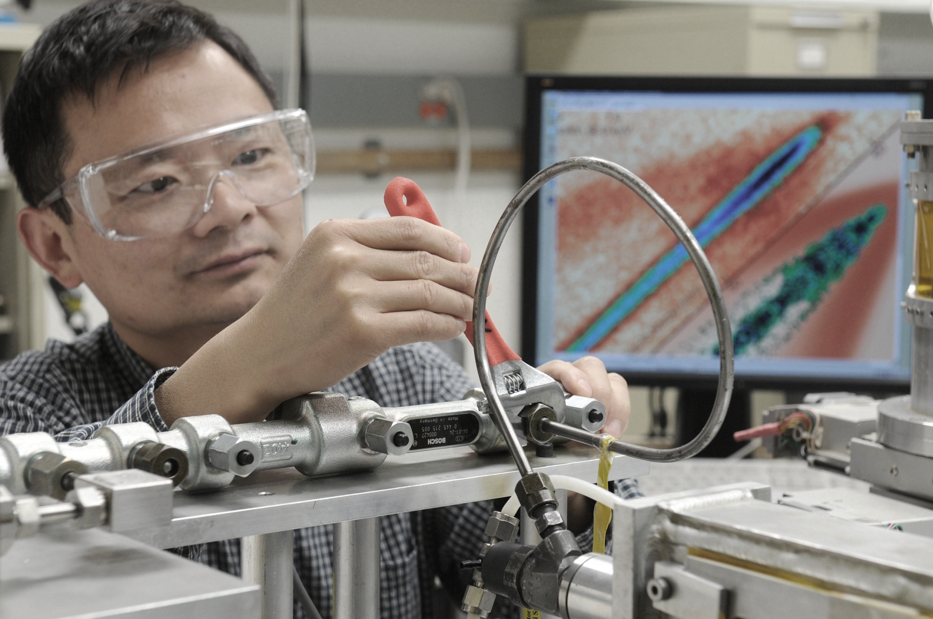
WPC Evolution
Driving continuous improvement in work planning and control
Pre-2008
WPC at the division-level. Reviews typ. include Lab-defined Experimental Safety Review
2008
MSD incidents:
March 3: Arsenic oxide release
March 11: Carbon monoxide exposure
2009
Lab-level process established:
LMS-PROC-64, Non-Experimental WPC
LMS-PROC-79, Experimental WPC
WPC electronic tool (ANL-886) goes live
2011
Lab-level process revised:
LMS-POL-16, WPC
LMS-PROC-200 Local WPC Implementing Procedures
WPC web-app release 1.9 goes into production
2012
WPC web-app release 2.0 goes into production
WAE web-app goes into production
2015
Electronic signature in WAE web-app
Lab Director formed a team to identify WPC improvements
Organizations developed local WPC implementing procedures
Notes:
In 2009/2010, Eric Isaacs, our former Lab Director, and now the University of Chicago VP for National Laboratories, chartered an issues analysis team with a goal of recommending changes and improvements to streamline Argonne WPC processes.
Our interim Laboratory Director, Paul Kearns, joined Argonne as Deputy Lab Director for Operations/COO in 2010. Paul was then, and continues to be, Argonne’s WPC Program Manager – recognizing that WPC impacts the entire Laboratory.
Paul was supported by Betsy Dunn through much of the evolution – she was Argonne’s WPC Project Manager, originally on the team appointed by Eric Isaacs and then asked to implement the recommendations of the team. Today, Betsy is our HSE Director.
Sue Baumann joined the team as our WPC Systems Engineer in 2013 – you’ll hear from Sue this afternoon as she helps you drill down into our process and tool. Today, she is typically a key point of contact for work planners across the site.

Slide 3
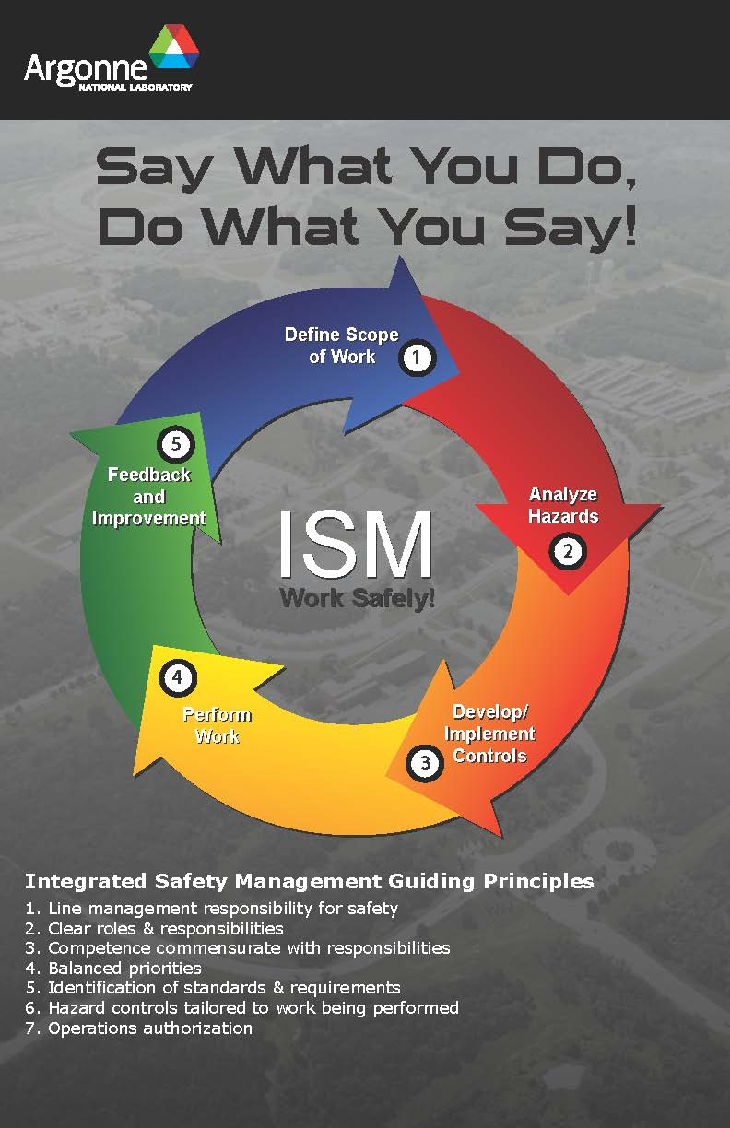
Current process
Lab-level WPC policy and procedure aligned with Integrated Safety Management
Formality of work control is dependent on rigor – considers complexity & consequence
Allows for work control using:
Skill-of-the-worker
Procedure
Task-specific
For example, a local WPC procedure may allow work to be performed using skill-of-the-worker when activity is low rigor, provided that workers are familiar with the hazards and the necessary controls
Issue: often, work control document is “task-specific”, yet is so broadly-defined that it actually results in “skill-of-the-worker”

Slide 4
feedback and improvement on our WPC Tool
Reports are cumbersome – too many pages, too much content
People developing work control documents are often not the workers
Documents are often broadly scoped, or too tightly defined
WPC tool “typically sufficient control set” choices are limited – difficult to anticipate all scenarios, yet keep the selections reasonable
People who infrequently develop work control documents express frustration – the system is not completely intuitive

