Slide 1
Environment, Safety and Health
Field Deployed Services Model (FDSM) at BNL
Gail Mattson
Associate Laboratory Director, ES&H
April 2017

Slide 2
Overview
Current Model and Challenges
Field Deployed Services Model Philosophy
Our Transition Process and Tools
Expected Challenges and Concerns
Back-up: Benchmarking Results
The goal is to establish a risk balanced, efficient ESH service model that supports and enhances operational requirements.

Slide 3
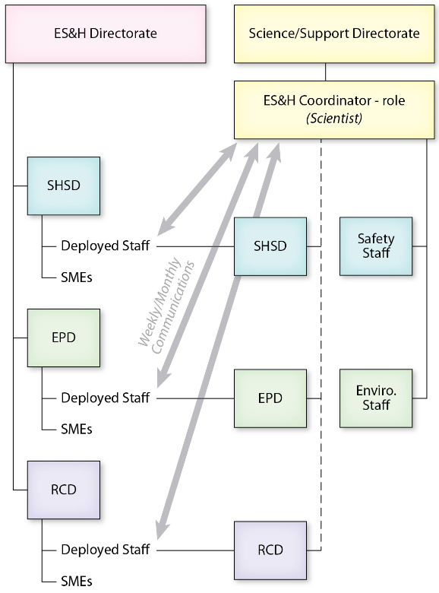
Current Model for ES&H Services

Slide 4
Challenges with Current Model
Inconsistent management of programs and resources are split between Line Management and ES&H Directorate
Difficult to manage deployed ES&H staff assignments in conjunction with line staff roles & responsibilities
Monthly and weekly communication between deployed staff managers and line management at times not effective, timely and/or in line with mission
ES&H Directorate does not have access to line staff for resource leveling
Limited professional development or succession planning provided for line safety and environmental staff

Slide 5
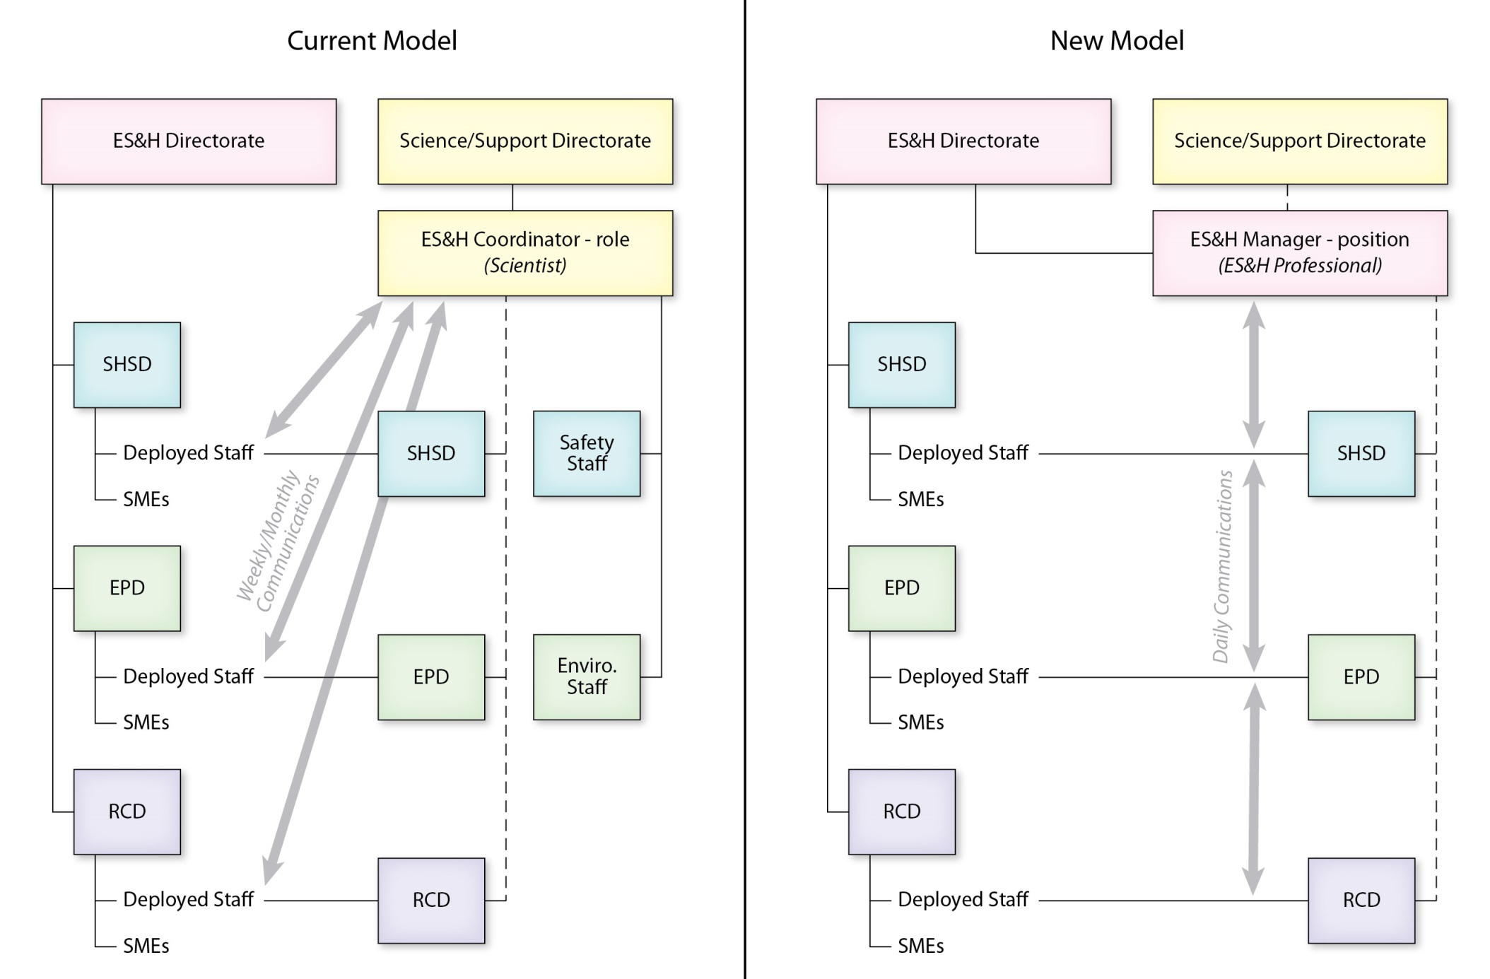
Field Deployed Service Model (FDSM)

Slide 6
Field Deployed Philosophy / Outcomes
Management and Oversight for Achievement of Institutional Strategic Outcomes
  Consistent management of mission support resources
  Resources are in alignment with institutional programs, strategies and directorate priorities (i.e., Budget and Staffing)
  Clear roles and responsibilities
Leverage the use of ES&H expertise / consistency to drive efficiencies and effectiveness
  Consistency across the laboratory in the training and development of ES&H staff
  Staffing all directorates with disciplined and credentialed ES&H professionals and technical staff
  Enhance institutional ES&H assurance processes / continuous improvement

Slide 7
Field Deployed Philosophy / Outcomes
Provides benefits for the staff
  Enhances career development, recruiting & succession planning
  Cross training to be well rounded, with broader perspectives
  Increased networking, teaming & mentoring opportunities
Establish the appropriate balance between ES&H requirements, operations and line management needs
  Service Level Agreements (SLAs) define and specify needs
Line Directorate management will continue to focus on safety as a top priority for safe conduct of science
  Deployed staff are located and work within assigned directorates
  Directorates will be responsible for their day-to-day direction
  ES&H Managers will work collaboratively with Directorate Operations and Chief Operating Officers

Slide 8
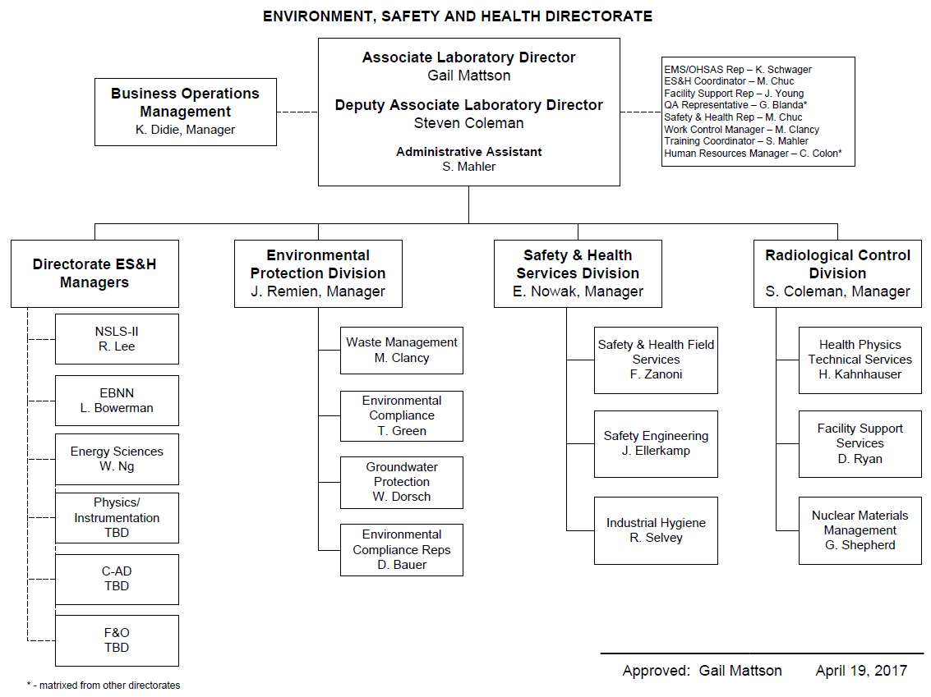

Slide 9
Expected Challenges / Concerns
Flat budgets & resources and increasing regulatory safety and health requirements
  No discretionary resources / floaters
Next generation of ES&H Professionals / Leaders?
  Challenged with mentoring, coaching / growing ES&H staff
  Typically fill needs with expensive, senior career professionals
ES&H matrixed staff support levels are determined by the number of FTEs line organizations are willing to fund in lieu of operational risks
Shuffling of responsibilities from line organizations to ES&H Directorate
Science Division Managers sense of loss resources

Slide 10
Back Up slides
ES&H FDSM Process

Slide 11
ES&H FDSM Process:
Clarify FDSM Expectations
  Identify & communicate benefits & expectations
Engage Key Stakeholders
  Identify risks, benefits and impacts to people, systems, etc.
Prepare & Execute Transition Plan
  Address the impact to each person/group
Implement Staff Change Process
  Phased implementation
Incorporate Monitoring Process
  Risks & resistance
  Success measures achieved
  Lessons Learned
Change Process Flowchart
Notes:
The process that is presented here as is based on the elements required for successful change management but has been modified to suit our unique situation and already reflects feedback from the first transition with Photon Science.
The process flowchart is a working document that has been developed with Sue Perino, who has been involved in two previous field deployment efforts with HR and F&O.
1st – we have held a number of meetings with the ALDs and other senior managers to identify benefits & expectations; and these will continue.
2nd – we engage the stakeholders at various levels to ….
3rd – we prepare and execute a transition plan
4th – only after the first 3 steps will we implement a staff change. We are committed to a phased implementation for the directorates only when we agree that we are ready to proceed. There is no specific timeline.
5th – we follow-up with a monitoring process.

Slide 12
ES&H FDSM Status:
NSLS-II Staff – Transitioned
  Staff transfer completed in FY16
  Conducted survey to identify issues
  Solicited staff for lessons learned
Communication with Stakeholders
  Captured concerns at Science Council and Policy Council
  Held focus groups with science and support directorates
  Have held series of meetings with Level I & II Managers to identify directorate-specific concerns and requirements
  Transition plans now being developed that also outline specific communication aspects and mitigation efforts
Planning for parallel and follow-on phases underway
  Developed Solutions Oriented Services Training
  Incorporating lessons learned
  Revising transitioned staff survey
Sample Survey

Slide 13
ES&H FDSM Forward Plan:
Phased Implementation Using Change Mgmt. Tools
  Accommodates different schedules
  Improves communication
  Allows for risk mitigations
  Provides lessons learned for each phase
Involve Impacted Staff
  One-on-one sessions with ESH ALD & Mgrs
  Risk identification and mitigation plans
  Conduct staff surveys
  Hold feedback sessions with all staff
  Objective source for information sharing (Change Mgr.)
Staff Change
Process Checklist
Notes:
So what is our plan going forward?
…………………….
And Sue will serve as our objective source for information sharing.
Please remember that “ The goal is to establish a risk balanced, efficient ESH service model that supports and enhances your operational requirements.”

Slide 14
Back up Slides
Benchmarking Information from PNNL, INL, ORNL and FermiLab

Slide 15
Benchmarking With PNNL and INL
Each Division has a Field Services Manager
  Negotiates with Line Operations Managers on Level of Effort / Purchased Service
  Responsible for performance appraisals, training for assigned support / position qualification
  Quarterly meetings with Operations Managers on performance of deployed support
Operations Manager reports to line DCOOs
  Direct and manage assigned field deployed resources
  Prioritize and assign directorate work activities
  Coordinates with Field Services Manager to address poor performance (including reassignment of resources)
Do not have service level agreements
  Line Organizations make a commitment during budget formulation

Slide 16
Benchmarking with PNNL
Staff matrixed to operations managers

Slide 17
Benchmarking With INL
Staff matrixed to operations managers

Slide 18
Benchmarking With Oak Ridge
Division Directors Manage Field Deployed Staff
  Division Directors negotiate with Directorate Operations Managers (DOMs) on level of effort/ purchased service
  Responsible for coordinating with DOMs with directing and managing field deployed resources
  Responsible for performance appraisals / training for assigned staff
Directorate Operations Managers
  Coordinate with Division Directors for ES&H staff support / purchased services
  Coordinates with Division Directors to address poor performance or request reassignment of resources
  Do not have assigned resources
  Ensures unencumbered Directorate Operations
  Does not have direct report responsibilities

Slide 19
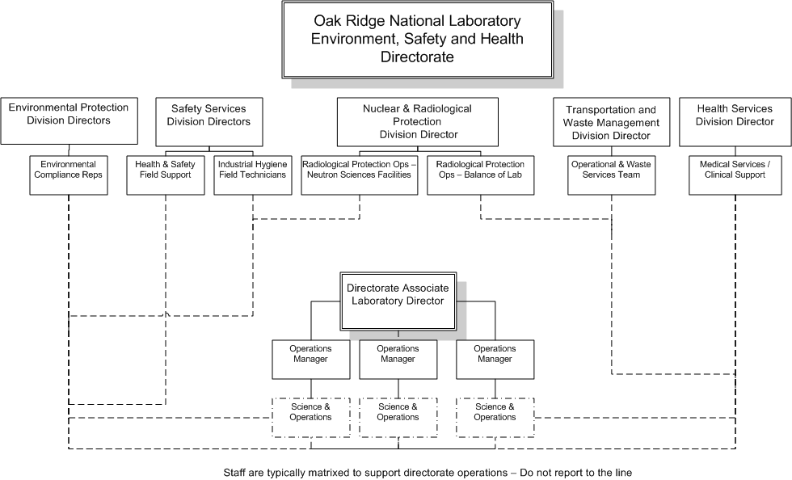
Benchmarking With Oak Ridge

Slide 20
Benchmarking with Fermi Lab
July 2015 Transitioned from Field Managed to Centralized ESH&Q
Division Safety Officers (DSOs)
  Directly report to Division Managers (Line Organizations)
  Matrixed to the ESH&Q Chief Safety Officer
  Serves as the Primary point of contact for assigned Line Organizations
  Coordinate and collaborate with Program Managers for ESH&Q support
  Do not have direct reports (except Accelerator Division)
  Performance reviews completed by Division Managers with input from the Chief Safety Officer
Do not have service level agreements

Slide 21
Fermi Lab Model

Slide 22
Comparing / Contrasting Results
Key Implementation Differences
For INL and PNNL mid-level / line operations manager for the organization prioritize, direct and assign field deployed resources
For ORNL ES&H Matrixed staff directed by internal ES&H Division Directors with strong coordination between DOMs and ES&H Division Directors
For Fermi Division Safety Officers matrixed to the ESH&Q
Differences also in the make-up of organizational structures (i.e., Occupational medicine, safeguards and security, quality management & performance management, training, risk / compliance)

