Slide 1
NETL Organization
Where in the World is ES&H?

Slide 2
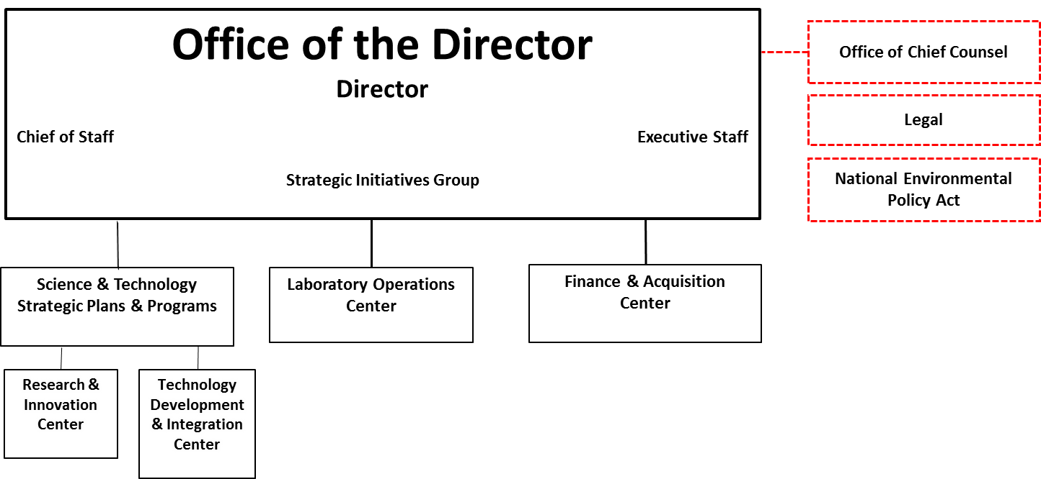
Organization
Overall

Slide 3
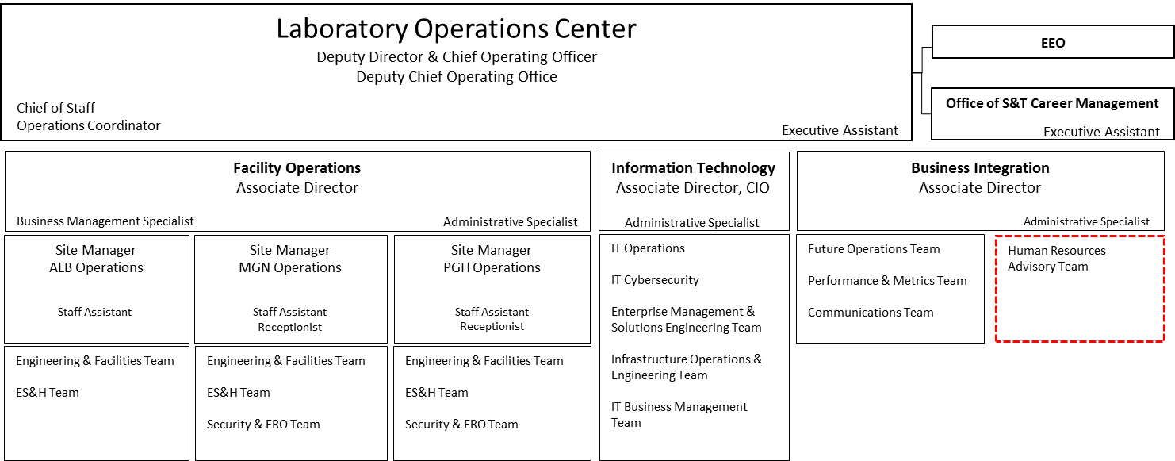
Organization
Laboratory Operations Center / Facility Operations

