Slide 1
Welcome to Fermilab
T.I. Meyer, Chief Operating Officer | Fermilab
Meeting of the National Lab ESH Directors (are you uNLEaSHD?)
25 April 2017

Slide 2
We interrupt this broadcast…
…there is no new news about the news
In spite of everything, Earth will keep going around the Sun
DOE will continue; the labs will continue.
And $4.xB is still “a whole lotta money”

Slide 3
Why are WE here?
Value proposition for American taxpayers
Investment in scientific research yields
…discoveries
…inspiration and training for the next generation
…breakthroughs in technology that drive economic growth
These things don’t happen by themselves and they won’t happen in corporate America
Fermilab is a national laboratory to conduct research and deliver value in these three areas…focusing on the science of particle physics

Slide 4
Why are YOU here?
Divine inspiration
“Martha, Martha,” the Lord answered, “you are worried and upset about many things, but few things are needed—or indeed only one.” [Luke 10:41]
Our shared intention: Have people leave work each day happier, healthier, and (more w)holesome than they came
The safest (silly) workplace is the one that does no work…
Each lab must make progress and we must do it safely
Together, we are stronger

Slide 5
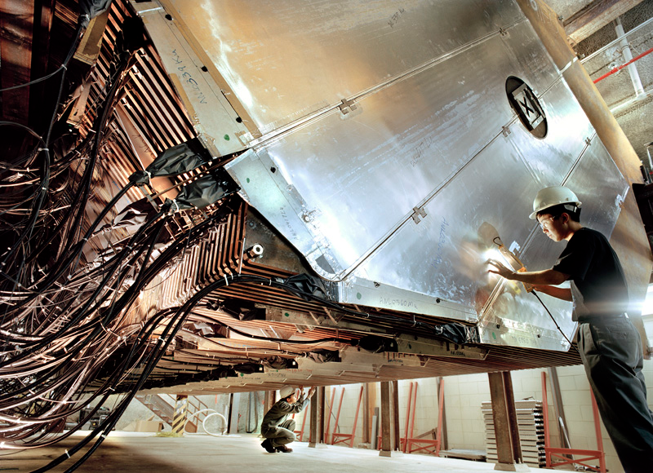
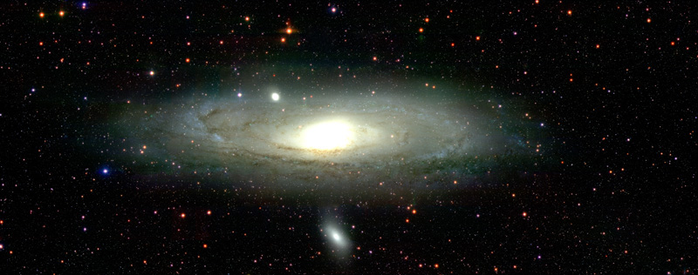
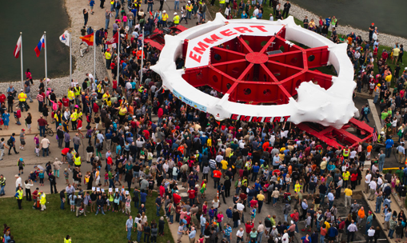
What is Fermilab?
Fermilab is America’s particle physics and accelerator laboratory.
Our vision is to engage the mysteries of matter, energy, space and time for the benefit of all
We do science that matters
One of the few remaining “single-purpose” laboratories
We are 50% of the DOE/HEP budget
$400M/yr, 1850 staff, 10 sq mi site
Presently part of the “evolutionary contract model” pilot

Slide 6
Evolution of Accelerator Tools
Ernest Lawrence and South Dakota
superconducting magnets…Tevatron
2km/13cm ~ 16,000 2TeV/80keV = 25,000,000

Slide 7
Where are the frontiers?
Particle physics…
Unknown unknowns: Dark matter, Dark energy
Known unknowns: Higgs, and Neutrinos!

Slide 8
Exciting science! Three scientific goals:
Origin of matter Discover what happened after the big bang: Are neutrinos the reason the universe is made of matter?
Black hole formation Use neutrinos to look into the cosmos and watch the formation of neutron stars and black holes in real time
Unification of forces Move closer to realizing Einstein’s dream of a unified theory of matter and energy

Slide 9
Project Overview: LBNF and DUNE
LBNF: DOE project with support from non-DOE partners. Provides facility infrastructure at two locations to support the experiment:
Near Site: Fermilab, Batavia, IL – facilities to create neutrino beam
Far Site: Sanford Underground Research Facility, Lead, SD – facilities to support neutrino detectors (DUNE)
DUNE: Deep Underground Neutrino Experiment
Near and Far Site detectors: U.S. as partner in international project
This project requires cowboys, monks, & librarians…biggest SC thang ever

Slide 10
What do we struggle with?
An organization 50 years old that has been “too” successful…
…and isolated, insular, insulated, and…self-assured
Thousands of eager, untrained “newbies” each year
Ten square miles of “anything can happen”
Organizational structure and organizational change
Fresh eyes, career development, professional peer support
Maintaining the culture of “healthy, respectful” questioning
Who ordered that?!
Proton beams that make neutrinos also make tritium
Internalizing other people’s experiences
DOE/AU didn’t believe “Everyone learns from each other’s mistakes, so we will contribute more errors than anyone for the good of the whole”

Slide 11
Outlook
We take all particles seriously…
…and we take safety seriously
In fact, part of what makes DOE the DOE is…
The willingness to do nearly impossible research and innovation in ways that are even safer than conventional work
That’s where you come in…leaders in this effort
…and if you see something, please say something!

Slide 12
Welcome to the Frontier!

