Slide 1
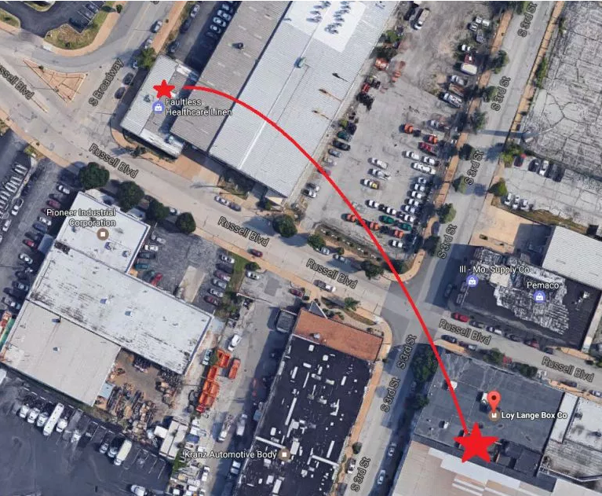
hot water storage tank explosion
St. Louis, MO on April 3, 2017
3) Tank lands on the roof of another building. Two fatalities from debris.
2) 1.5-ton tank lunched at 120 MPH 425’ up through the roof, then flies 515’
1) Hot water storage tank explodes at Loy-Lange Box Co. One fatality.
Notes:
In systems where there are large amounts of high temperature condensate return, a system referred to as a "semi-closed" receiver (SCR) system is used. Two receivers are used with this type of system. High pressure, high temperature condensate and the generator trap returns are returned to the pressurized SCR tank to minimize the loss of this valuable heat. The Steam Generator gets its feedwater directly from this tank. Raw makeup water and low temperature condensate are fed to a second atmospheric "makeup" tank (a "hotwell") , then transferred via a high pressure transfer pump to the SCR tank. (https://www.claytonindustries.com/clayton_p7_feedwater_treatment.html)
Image: https://www.google.com/search?q=boiler+explosion+st+louis+mo&source=lnms&tbm=isch&sa=X&ved=0ahUKEwjh1pKgu4vTAhXJLmMKHdOsDuIQ_AUICSgE&biw=1477&bih=796#imgrc=At2JddpCi0HbqM:&spf=191
DOL, OSHA investigations launched
2 in critical condition
The city of St. Louis does not inspect boilers but instead requires that every company with a boiler have a licensed engineer on duty whenever a boiler is in operation.
No causes known yet, will follow-up

Slide 2
Pressure Safety program overview
Prepared for the
ESH DIRECTORS MEETING
at Fermilab
erhtjhtyhy
Dejan ristic
Program Manager
April 25, 2017

Slide 3
drivers
Background
One of 10 WSH functional areas in 10 CFR 851:
Encompasses pressure systems (both fired and unfired) used in cryogenic, pneumatic, hydraulic, and vacuum applications, including associated hardware.
Contractors (e.g. Argonne) “shall establish safety policies and procedures to ensure that pressure systems are designed, fabricated, tested, inspected, maintained, repaired, and operated by trained and qualified personnel.”
Integrated with ISM core functions, guiding principles
Following hierarchy of controls
Adopted State of Illinois inspection requirements.
Notes:
https://energy.gov/sites/prod/files/hss/Enforcement%20and%20Oversight/Enforcement/docs/cfr/rule_enforcement.pdf
§ 851.24 Functional areas.
(a) Contractors must have a structured
approach to their worker safety and
health program which at a minimum,
include provisions for the following
applicable functional areas in their
worker safety and health program:
construction safety; fire protection;
firearms safety; explosives safety;
pressure safety; electrical safety;
industrial hygiene; occupational
medicine; biological safety; and motor
vehicle safety.

Slide 4
Accomplishments to date
3 pressure-specific procedures:
General pressure safety; Cryogenic liquids; Compressed gases.
2 online forms:
System evaluation; Dewar inspection.
Pressure Systems Safety Manual
Organized around seven areas.
Compilation of 240+ world-wide accidents.
Suggested/recommended in-house instructor-led training.
Conduct monthly pressure technology safety committee meetings.
Walk-downs regularly performed.
Work control documents review/approval.
Notes:
https://energy.gov/sites/prod/files/hss/Enforcement%20and%20Oversight/Enforcement/docs/cfr/rule_enforcement.pdf
§ 851.24 Functional areas.
(a) Contractors must have a structured
approach to their worker safety and
health program which at a minimum,
include provisions for the following
applicable functional areas in their
worker safety and health program:
construction safety; fire protection;
firearms safety; explosives safety;
pressure safety; electrical safety;
industrial hygiene; occupational
medicine; biological safety; and motor
vehicle safety.

Slide 5
Path Forward
General safety procedure requires an assessment of lab-wide vessels in use:
Implementation Plan developed;
New contract hire;
Greater use of central data repository.
Higher participation in training by postdocs.
Contribute to reestablished DOE/Energy Facility Contractor’s Group subgroup.
Notes:
https://energy.gov/sites/prod/files/hss/Enforcement%20and%20Oversight/Enforcement/docs/cfr/rule_enforcement.pdf
§ 851.24 Functional areas.
(a) Contractors must have a structured
approach to their worker safety and
health program which at a minimum,
include provisions for the following
applicable functional areas in their
worker safety and health program:
construction safety; fire protection;
firearms safety; explosives safety;
pressure safety; electrical safety;
industrial hygiene; occupational
medicine; biological safety; and motor
vehicle safety.

Slide 6
Convictions are more dangerous
enemies of truth than lies.
F. Nietzsche (1844-1900)
Thank You!
dristic@anl.gov
o 630.252.5075
c 414.708.2051

