Slide 1
Oak Ridge National Laboratory
R&D Pressure System Safety
John E. Powell
Environment, Safety, and Health Director
UT-Battelle, LLC.
April 25, 2017

Slide 2
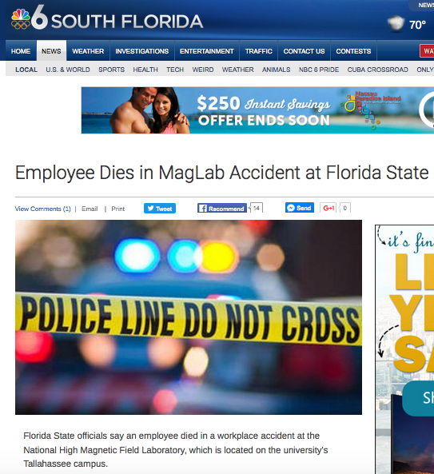
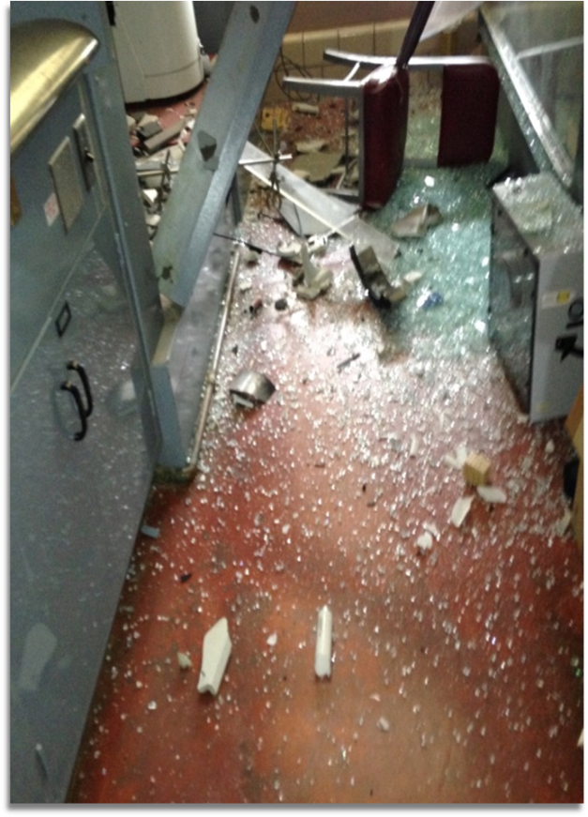
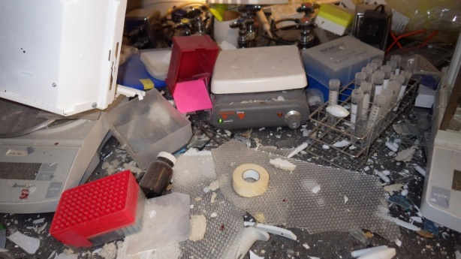
Recent safety events in research pressure systems caused us to perform an Independent Oversight assessment:
National High Magnetic Field Laboratory (MagLab) at FSU: Fatality
University of Hawaii: Serious injury
Ames Laboratory: Ball mill explosion, significant damage, no injuries
Fermi National Accelerator Laboratory: Injury
Lawrence Berkeley National Laboratory: Autoclave explosion, significant damage, no injuries
Battelle Hazardous Material Research Center (HMRC): Decontamination vessel explosion, significant damage, no injuries.
The assessment team included SMEs from INL, LLNL, and, PNNL as well as members from ORNL and DOE ORNL Site Office.
Notes:
MagLab: Unexpected pressure in a cooling water system resulted in a fatality during maintenance.
University of Hawaii: A low pressure tank exploded causing serious injury
Ames: An unexpected chemical reaction occurred in a ball mill resulting in an explosion that caused significant damage. Thankfully no one was in the lab at the time so there were no injuries.
Fermi: A high pressure fitting failed causing an injury to a worker.
Lawrence Berkeley: An explosion in an autoclave caused significant damage to a hood and equipment. Fortunately, no one was in the lab at the time of the incident so there were no injuries.
HMRC: A custom-made decontamination vessel exploded while being heated in a muffle furnace. Fortunately, no one was in the lab at the time of the incident so there were no injuries

Slide 3
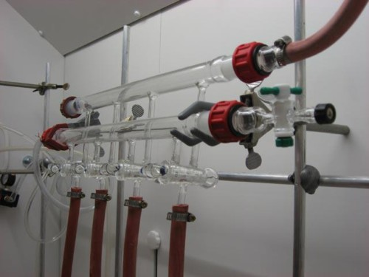
The assessment team confirmed that we have pressure safety concerns related to R & D activities:
Findings:
Finding - Lack of a clear flow-down of pressure safety requirements into SBMS and associated work practices, in particular those associated with non-code pressure systems
Finding- Improper identification & hazard analysis of pressure systems
Finding- Worst-case scenarios are not consistently incorporated into hazard analysis and control (e.g. glass components)
Finding- Lack of clear policy on application of Pressure Reducing Devices
  Gas cylinder regulators may not be used as PRDs
  PRD testing & maintenance requirements
  Responsibility for sizing & selection of PRDs
Finding-5 - There is no formal training on pressure system requirements for personnel involved in design, fabrication, assembly, or operation
Opportunities for Improvement:
OFI- Staff do not consistently understand how the requirements of the SBMS Pressure Systems Subject Area apply to their pressure systems.
OFI- The RSS questions & thresholds for pressure systems do not align with pressure system requirements
OFI- There is lack of clarity on who is viewed to be responsible for pressure system design and review...
Response focused on two areas:
Compensatory measures to assess/mitigate short term risks
Develop & execute a Corrective Action Plan

Slide 4
Contributing causes & planned actions
RSS pressure system threshold questions
Pressure system applicability matrix appears to exempt cylinder based systems
Pressure system roles & responsibilities not well defined/understood
Frequent changes to Engineering Management System leadership & related SMEs have contributed to weaknesses
  Revise RSS questions to clarify when Pressure System Safety subject area is invoked
  Revise matrix to clarify how requirements apply to compressed gas cylinder based systems
  Develop & deliver pressure system safety training module for R&D Pressure System Owners and H&S Professionals
  Implement a documented assurance step for the Verification of Pre-Startup Activities for new R&D Pressure Systems
  Create new Engineering Management Division (EMD) within ES&H Directorate
  Provide stewardship by deploying and monitoring Engineering Management System requirements from ES&H / EMD
Parallel to performing causal analysis and the development of the corrective
action plan, targeted assessment of (~500) R&D Pressure Systems took place.
No immanent hazards found, but results mirrored assessment conclusions

Slide 5
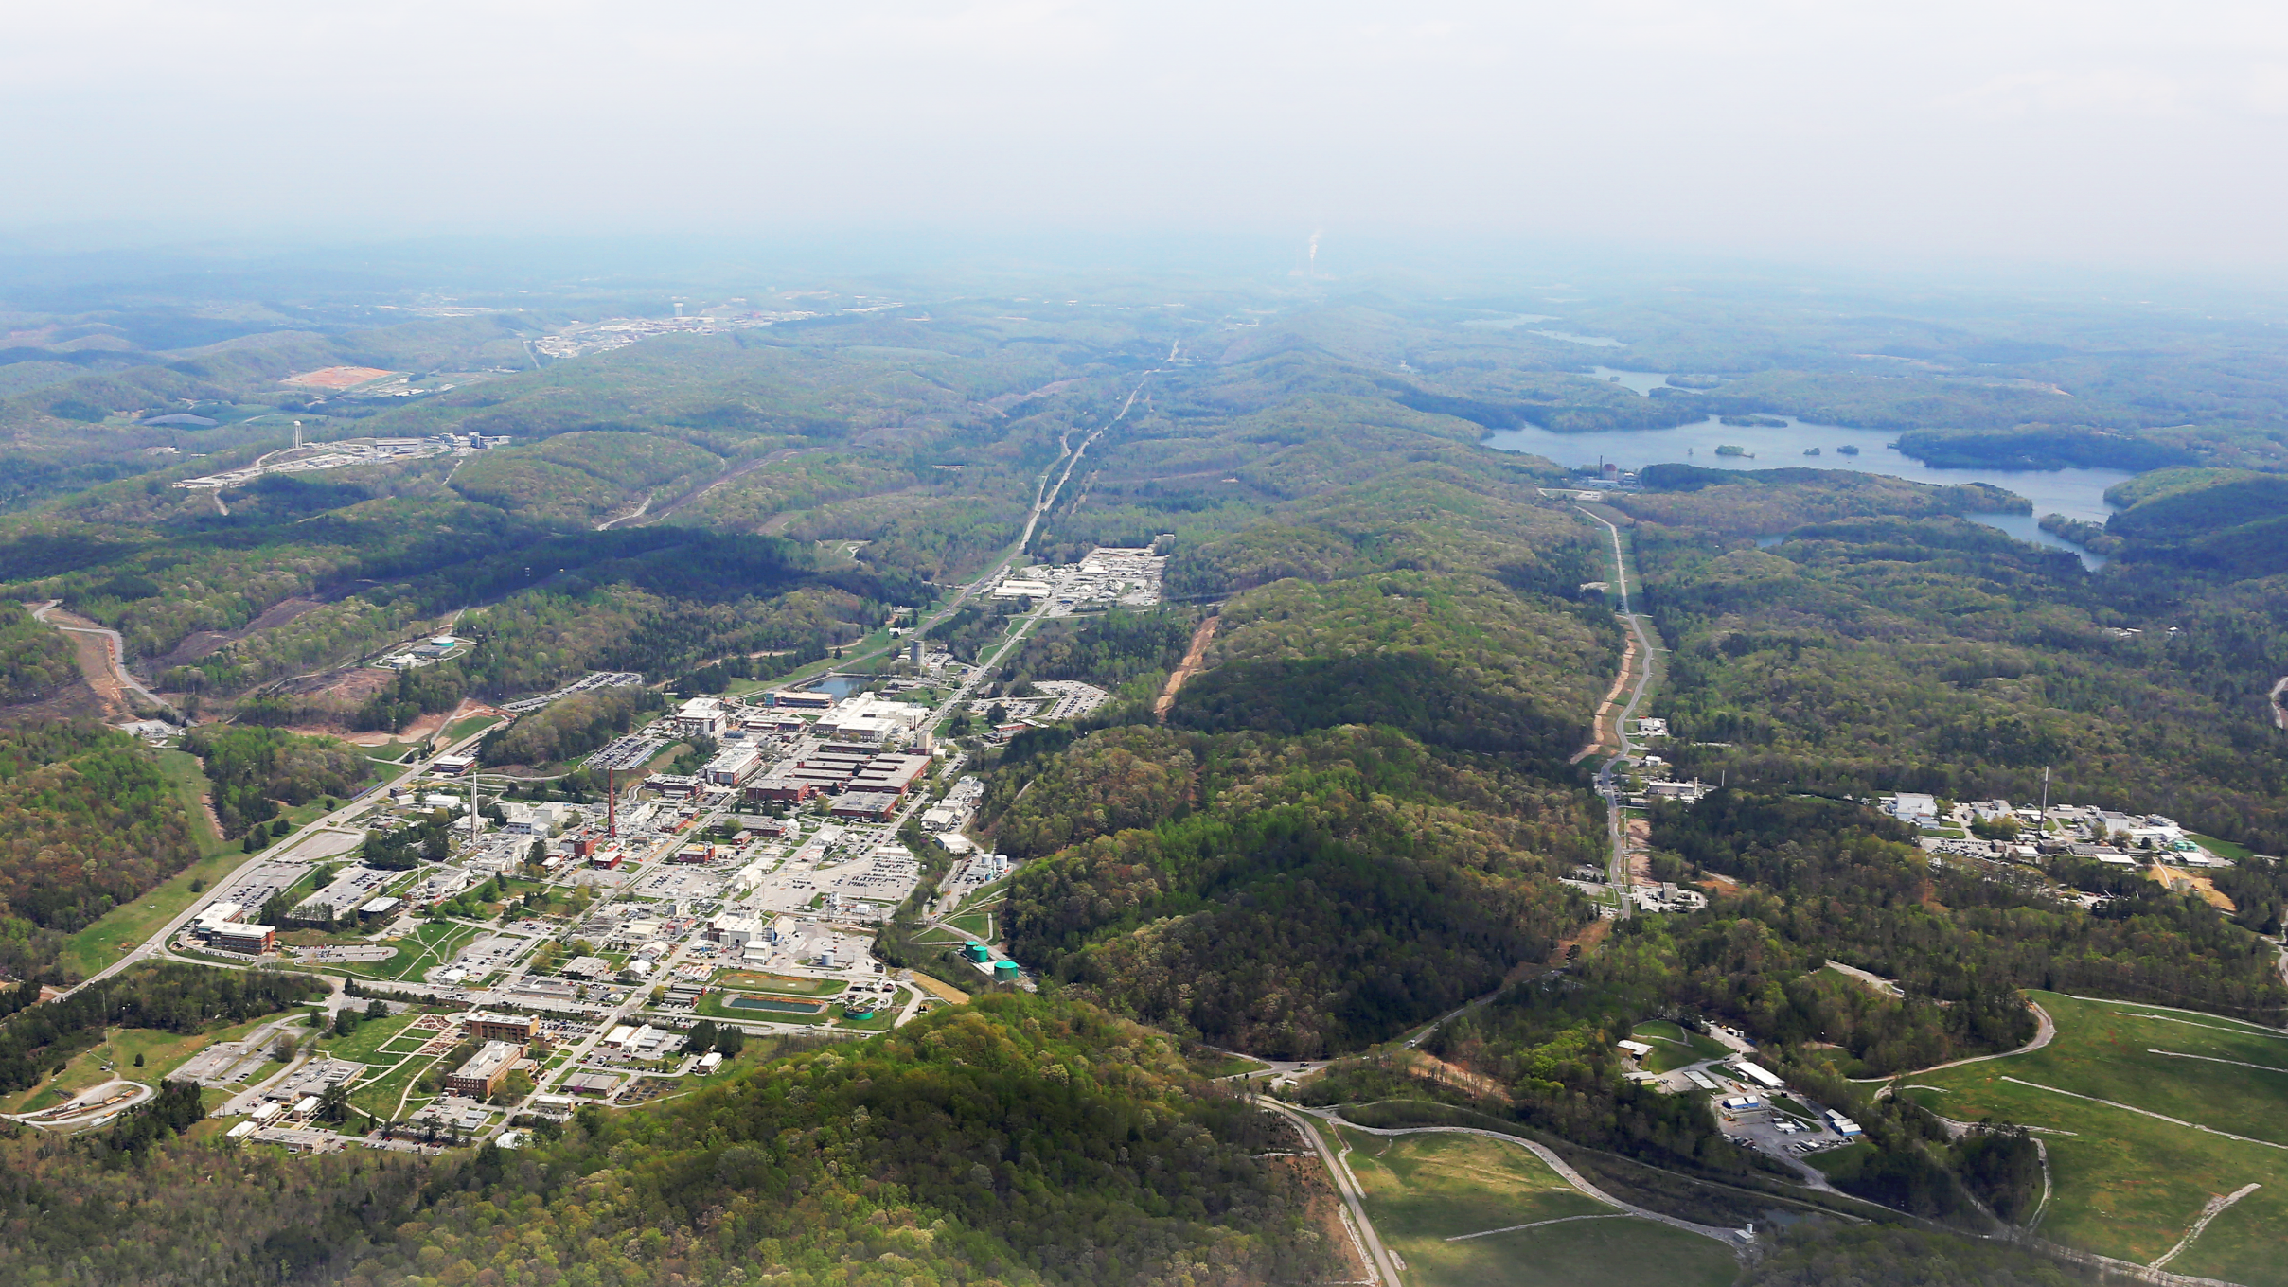
Discussion

