Slide 1
OIC Report LBNL Response
April 25, 2017
Jack Salazar

Slide 2
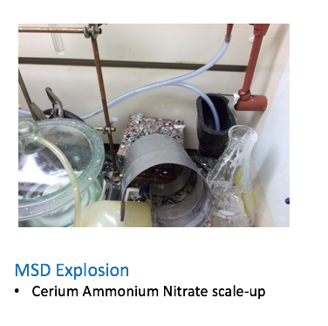
Lab Safety
LBNL context

Slide 3
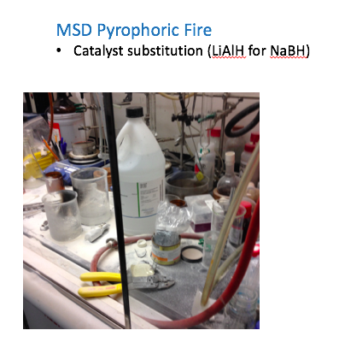
Lab Safety
LBNL context

Slide 4
Lab Safety
LBNL context

Slide 5
So….lots of corrective action activity on going
Lab Safety Improvement Plan
Incident specific corrective actions
Disconnect between WPC reviews/authorizations and ISM at the bench
Management of scope/change
Qualification and training (students)
Broader, institutional actions*
Proactive senior management – understanding and involvement
Activity Lead responsibilities and authority
Policy/requirements and implementation (NFPA 45 -storage, vent.)
Lab survey process (EHS Division and line)
Shared space safety management
* - OIC report was helpful

Slide 6
Some Particular Areas
Authentic Line Mgt. Engagement
Regular discussions at Area level with Deputy Lab Director
Pairing senior research scientists with Division Directors on their walk-arounds
Updating and communicating expectations to ALDs and DDs

Slide 7
Some Particular Areas
Researcher Qualification and Training
Focused support to Activity Leads
Training, communication from DDs, etc.
Sharing best practices (“Communities of Practice”)
Pyrophorics, Schlenk lines, Student training, etc.
Updating the WPC Tool
Enhanced hazard/control summaries
Improved visibility for Activity Leads

Slide 8
Questions?

