Slide 1
Work Planning & Control Today and in the Future (for experimental work in PNNL laboratories)

Slide 2
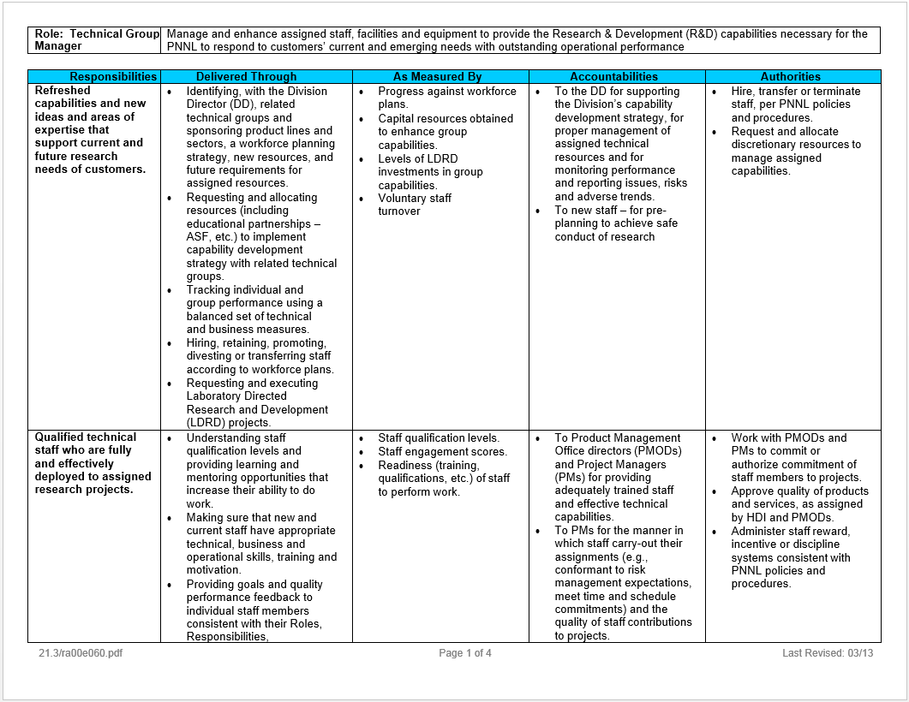
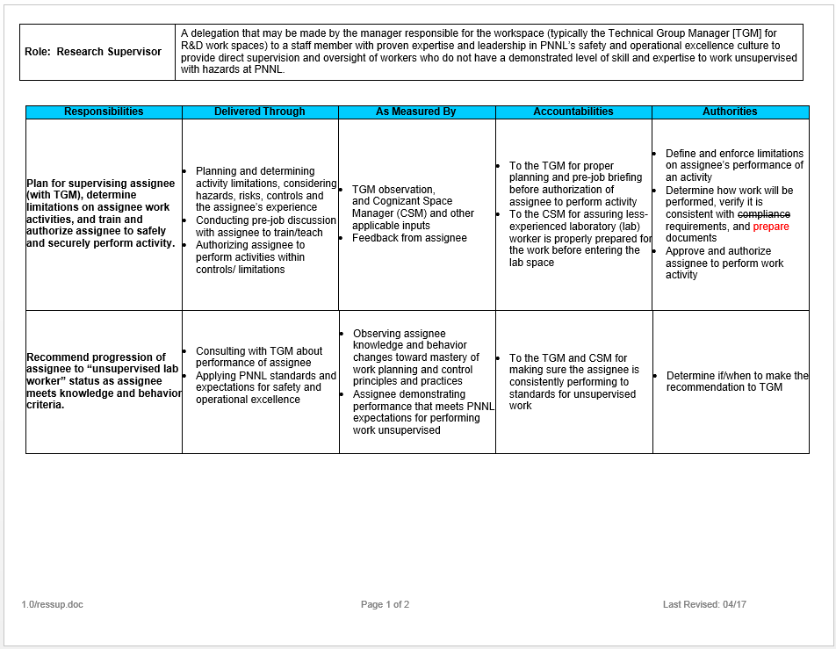
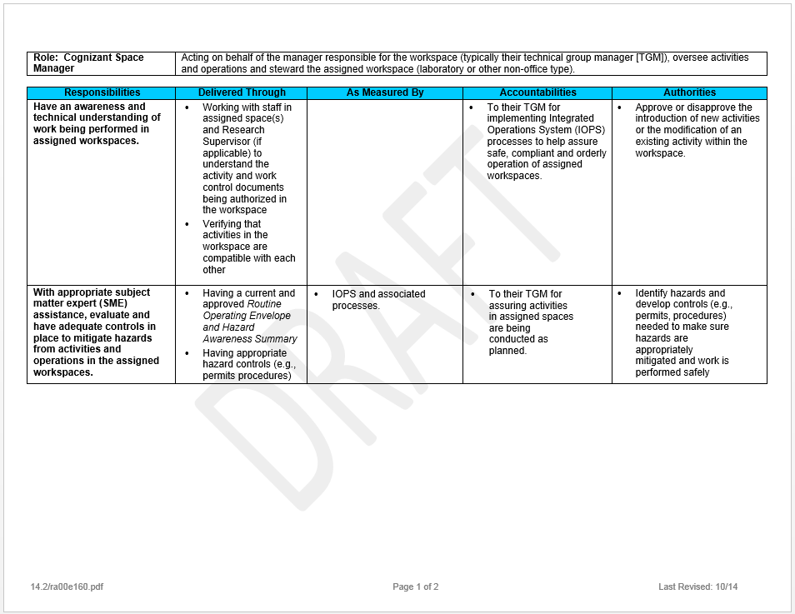
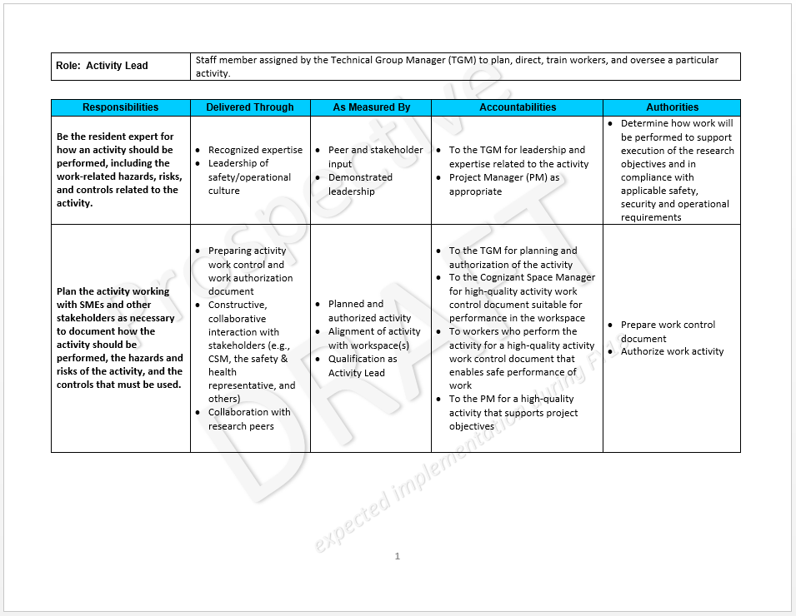
R2A2 for Key WP&C Roles
Safe, secure and compliant
workplaces and work activities
TGM
provide direct supervision and oversight of workers who do not have a demonstrated level of skill and expertise
Research
Supervisor
CSM
oversee activities and operations and steward the assigned workspace
Activity
Lead
plan, direct, verify qualifications, and oversee a particular Activity
Notes:
<click 1> “Line management responsibility for safety” (ISMS Guiding Principle #1) means that the role of the Technical Group Manager (TGM) is responsible for “safe, secure, and compliant workplaces and work activities,” as documented in their R2A2 (role, responsibilities, accountabilities, and authorities).
TGMs leverage their most experienced and capable staff to execute key aspects of their responsibilities. <click 2>
The Cognizant Space Manager (CSM) is a well-established role at PNNL that assures the safe and compliant configuration of workspaces and hazards, access control, hazard communication, training, coordination of activities, and oversight (feedback and improvement) for operations in the workspace. <click3>
The Research Supervisor formalizes a role with responsibility for training and coaching less-experienced workers (“Supervised Researcher”) in how to perform experimental work in PNNL laboratories. <click 4>
A new role, the Activity Lead is the “resident expert” in how to perform experimental activities. They plan how the activity is to be performed (including defining the scope of work, identifying and analyzing the hazards, and tailoring controls to mitigate the risk of the activity), verify that workers assigned to perform the activity are competent, and approving the activity and the workers who will perform it.
All three of these roles, acting on behalf of the TGM, must work together to make sure workers, the activities they perform, and the workspaces where the activities are performed result in safe and compliant operations.

Slide 3
Work Planning & Control Systems Today and Tomorrow
Today _{Space-based}
Future _{Space AND Activity}
HAS
Inconsistent from workspace to workspace and org to org
Often doesn’t describe boundaries
No hazards or controls specified
Excellent WP&C_{(ISMS)}
Worker
ROE
Hazards
ARA
Hazards
Less-than adequate
Activity-level WP&C
Controls
Workspace
CSM
Infrequently used
May reference permit, but reference to controls is not required
Workspace
CSM
Activity
Activity Lead
IOPS User
Permits
Hazards (in workspace)
User Access
Activities
Description (and bounding conditions)
Hazards (of Activity)
Controls
User Authorization
Access
“passive”
Active w/hazard(s)
Hazard-specific
Hazards
Controls
Assigned to user
There is not a clear understanding of work authorization and controls for particular activities
Workspace Summary
Not always clear what is being done (the activity)
Multiple permits may be needed for a given activity
Work Authorization
Assessments
Notes:
Let’s compare and contrast how we use our systems to perform experimental activity work planning and control (WP&C) today with how we will do it in the future.
TODAY
Today, IOPS is based on the workspace model, administered by the cognizant space manager (CSM) – a delegate of the workspace owner (typically a TGM). <click 1>
CSMs work with users of the workspace to identify the hazards that are/will-be used in their workspace. <click 2>
The CSM grants access to IOPS Users, and determines if they will be “active” with hazards. <click 3>
Hazards may require permits (e.g., CPP for HCL-3 chemicals). Permits are “hazard-specific,” and contain hazard controls and a work authorization for specific users. Permits don’t always make it clear what work activities are authorized (if they are written too broadly), and multiple permits may be required for a given activity (e.g., work with HCL-3 chemicals in a pressure system). Another problem with permits is that they only apply to a single workspace (even if the same activity is performed in multiple workspaces). <click 4>
Each workspace should have a routine operating envelope (ROE). However, the way ROEs are used varies from workspace to workspace, and it isn’t always clear what is in scope and what is not. <click 5>
For work that is out-of-scope of the ROE, the activity review and approval (ARA) can describe the scope of the work and provide work authorization. However, ARAs are infrequently used and controls for the activity are not necessarily specified (unless a permit is referenced). <click 6>
The hazards identified for the workspace and the ROE are combined to produce the hazard awareness summary for the workspace, which must be posted near the main entrance and is required reading for anyone with unescorted access to the workspace. <click 7>
Because we have a variety of tools to describe “activities,” and we don’t always use them well or consistently, we sometimes don’t have clear activity-level work authorization. <click 8>
This existing process provides considerable value in terms of identifying hazards associated with a workspace and ownership/oversight of the workspace by the CSM. However, it does not assure that the scope of work activities is clearly defined and it does not adequately enable hazard assessment and tailored controls, essential elements of integrated safety management (ISM), which is good business practice and a contract requirement. <click 9>
FUTURE
FY17 PEMP Notable Outcome 5.1 is designed to improve how PNNL performs activity-level work planning and control for experimental work in laboratories, using the “Activity Manager” approach from LBNL that is recognized by DOE as a best practice for ISM. <click 10>
We intend to keep the considerable value we get from the workspace model with a CSM in-charge. We intend to follow the Berkeley example by adding a requirement to clearly define the scope of each “Activity” that needs work planning and control, under the cognizance of an “Activity Lead” who is a delegate of management and an expert in the performance of the activity. Activities can be associated with one or more workspaces. <click 11>
The Activity defines the hazards associated with the work, which are aligned with a standard set of controls that mitigate the risk of working with the hazards. It also identifies the workers who are authorized to perform the work activity. <click 12>
The Activity is associated with the workspace(s) (with approval from the CSM), and the alignment of hazards and worker access is verified. The hazards, users, and activities are incorporated in the HAS. <click 13>
The Activity describes the scope of work, identifies the hazards, provides tailored controls, delivers expectations for the performance of work to users, and becomes a clear authorization for the activity. <click 14>
This shift from IOPS to a new Activity Manager (tailored to PNNL’s needs) will provide excellence in activity-level work planning and control (á la the integrated safety management system), building on our current valuable approach to workspace management. <click 15>
ASSESSMENTS
Assessment will continue to be enabled, much as they are today.

Slide 4
Managers’ view of Work Planning & Control Today and Tomorrow
Today
Future
Manager
Approve Activity
Activity Lead
Staff (and non-staff)
Who planned the work?
(we currently just call them “author”)
Who can perform the work?
(we sometimes assign general permits
to occupants for information
when we don’t intend them to do the work)
Activity
Can activity be performed
in workspace?
(how) Can Supervised Researcher
perform activity?
Approve worker
to perform activity
CSM
Authorize Activity in Workspace
Research
Supervisor
CSM
Staff (and non-staff)
Identify Supervised Researcher and
Assign Research Supervisor (Temporary role)
Approve worker
access to workspace
Supervised
Researchers
Laboratory
Permits
Laboratory
Can Supervised Researcher have access
to workspace?
Different managers may be responsible for the space, a given worker, or a permit
Notes:
TODAY
<click 1>
From the Manager’s point of view, today they have a number (sometimes a large number) of staff (and non-staff) assigned to them. <click 2>
Staff have access to laboratories (granted by the CSM), which is visible to the manager in IOPS. <click 3>
Managers of staff who author permits are asked to approve permits (which are associated with particular laboratory workspaces). <click 4>
With a little work, managers can see which staff are assigned (by CSMs) to work under specific permits. <click 5>
Unfortunately, the current approach to managing workspaces, staff, and “activities” (in the form of permits) means that different managers may be responsible for each of those entities and no one manager may have a complete view of them. This leaves room for difficult questions related to implementation of Integrated Safety Management, for example:
Who planned the work? Today the person responsible for the permit is called “author.” They have the support of S&H Reps, the CSM, and their immediate manager (who may or may not know a lot about the work).
Also, who can perform the work? We sometimes have very general permits assigned to everyone in the lab, or we have permits for higher risk activities that are assigned to everyone in the lab for information, even though few are truly authorized to perform the work.
We need to strengthen the work planning, hazard analysis, and tailored controls aspects of our WP&C system. <click 6>
FUTURE
<click 7>
Managers will continue to be responsible for staff. (This will be enhanced by having all non-staff assigned to a TGM.) <click 8>
Managers will also continue to assign CSMs to manage laboratory workspaces. <click 9>
CSMs approve unescorted access to their workspace. <click 10>
Less-experienced staff are assigned to a Research Supervisor to indoctrinate the less-experienced staff into PNNL’s culture and expectations for performance. <click 11>
Finally, the most experienced staff may be assigned as Activity Leads, who will define how particular activities are to be performed and will provide oversight of those activities. Activity Leads determine which workers may perform the activity. <click 12>
Approval of the activity by the Activity Lead (who is a delegate of the TGM) results in much stronger work planning (including hazard identification and analysis, and implementation of tailored controls) as well as assuring that workers are competent to perform an activity. <click 13>
Activity Leads must work with CSM(s) to authorize the activity in a given workspace (both the Activity Lead and the CSM must approve). <click 14>
If a Supervised Researcher needs access to a workspace, the Research Supervisor must work with the CSM to gain their approval… <click 15>
…and if the Research Supervisor wants the Supervised Researcher to perform some or all aspects of an activity, they must work with the Activity Lead to define supervision requirements and limitations.
This will enable implementation of the various aspects of the line manager’s responsibility for safety by competent staff, and provide better oversight of key elements of work planning and control.

