Slide 1
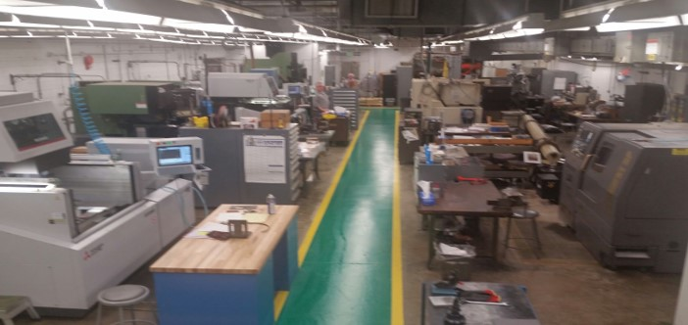
Machine Tool & Equipment Program improvements
erhtjhtyhy
April 25, 2017
Betsy Dunn
Betsy Dunn
Director, Health, Safety, and Environment Division
Argonne National Laboratory

Slide 2
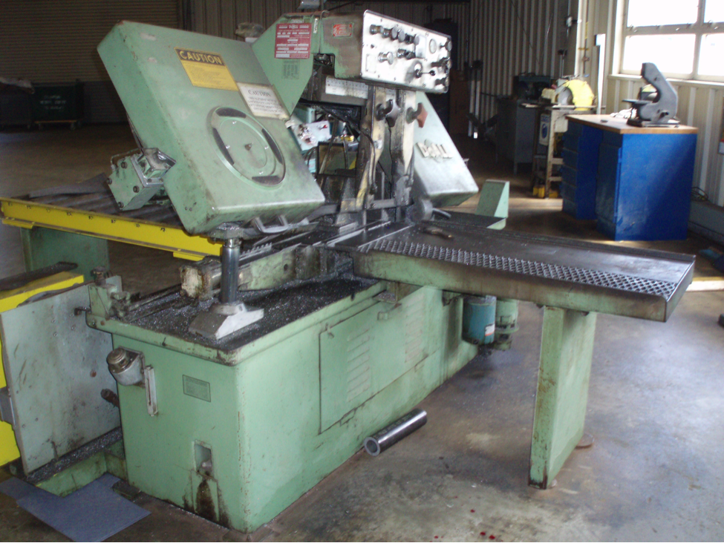
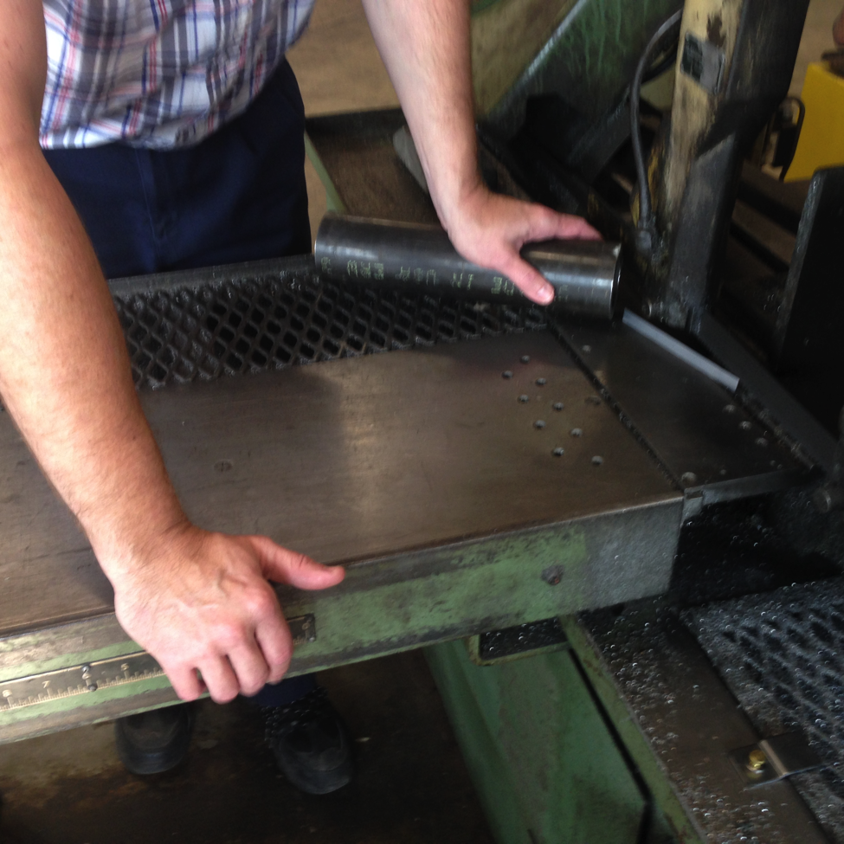
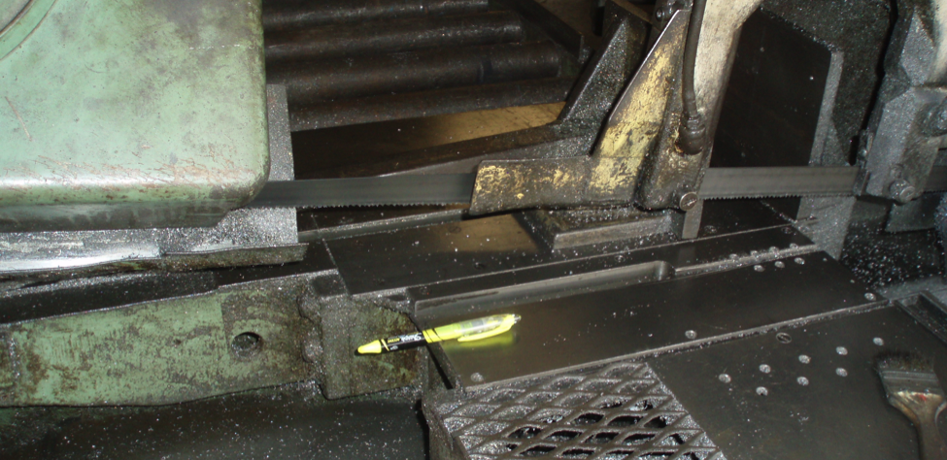
Machine Shop Incident
August 13, 2015
911 call was initiated by a Shops co-worker, initially thought to be an amputation, later determined to be a severe laceration.
Horizontal band saw involved in the incident.
Re-enactment of hand positioning of the injured machinist just prior to the incident. Vertical guide arm was located further to right, exposing length of unguarded saw blade. Ruler for reference only.
Unused portion of the blade that was unguarded where the employee’s finger contacted the blade.

Slide 3
Response to the Incident
Immediately following the incident, the Director of Facilities Management and Services put Central Shops in a safety stand-down
Extent of condition review performed in Central Shops, within 3 business days
Director’s Safety Council directed a sitewide extent of condition within 1 week
Lab Director sent out a personal message to Laboratory employees
Investigation Team to perform a formal investigation and causal analysis was chartered within 1 week
Laboratory formed a Corrective Action Review Board
Notes:
Stand down lasted 3 weeks.
EOC of saws in CS 3 business days of the incident.
EOC was expanded beyond CS because of the number of noncompliant guarding of saws. EOC was then expanded to all machine tools.
All tools that were not properly guarded or secured were tagged out of service or the cords were cut.
By December, all machine tools deficiencies were corrected or the items were excessed.
The Lab Director sent an All Employees Memo “Be Safe focus on the task at hand.” 27 Aug 2015 – to reiterate the importance of safety, staying on task, and pausing, if necessary, to consider the best and safest ways to perform.

Slide 4
Need for sustained improvement
Previous corrective actions did not result in permanent institutional corrections
In Central Shops, acceptance of hazards in the presence of skilled workers, plus other perceived obstacles, normalized deviation from safety standards
In other areas, a lack of clearly defined expectations, combined with less than adequate training and qualifications led to inadequate machine tool program/use
Overall, there was a lack of coordinated response to assessment findings
Feedback and improvement processes were less than adequate
Reporting was not always considered a priority, and was not always viewed as value added
Notes:
Inadequate corrections in the area of
Procedures
Inspections
Operational use of machine tools
Normalizing deviation - an acceptance of unguarded hazards because of high skill levels, past practices, perceived time pressures, cumbersome incomplete guards, all combined to create a complacency with regards to complete guarding.
Assessment findings – 2007 Multiple guarding issues
2010
2013 suggested program improvements regarding responsibilities not undertaken
NTS Validation of the Pistorius saw event indicated that inspections were not being inputted into IMTS
Feedback and improvement – failed to learn from the multiple incidents and inspection/assessment findings to create sustainable, long lasting corrections.
Lack of coordinated response and LTA feedback was due to the inadequacy of our management processes
COO and DCOO are briefed on all assessment findings – many times issues are elevated to the program level during these briefings
Issues Management Process Improvement
Reporting - Lack of formalized reporting, i.e., Inspections, machine tool deficiencies, led to a lack of visibility into the issue. Inspections and assessments were often done but not always input into the tracking system.
We have a ways to go in development of a strong reporting culture

Slide 5
Corrective action review board
CARBs are used to manage significant issues and are made up of senior leaders from across the Laboratory
Establishment of CARBs is formalized by procedure, teams are assembled by the COO
Process is intended to:
  Confirm solutions will adequately address causal factors
  Confirm solutions are sustainable and meet intended outcomes
  Confirm solutions are broadly applicable across the Laboratory when needed
  Provide timely delivery of actions and deliverables
Argonne formalized the CARB process in 2013
Notes:
CARB’s proceduralized in 2013 and used in:
Nuclear safety (Building 205 hazard categorization)
Radiological protection (Common causes)
Safety incidents review (Common causes)
Security incident
This incident

Slide 6
Closing the gaps

Slide 7
Understanding the issues
Assist visits
Brookhaven’s machine expert toured Central Shops to evaluate guarding, and share risk-based approach to devices for
  Anti-restart
  Emergency stop
Fermilab’s machine equipment expert toured Central Shops to share input
University of Chicago’s EHS director and VP of Research Safety provided oversight to corrective action plan
Argonne subject matter experts, Central Shops foreman and supervisor, division machine custodians, and responsible individuals participated in activities to gain understanding and partner in the development of solutions

Slide 8
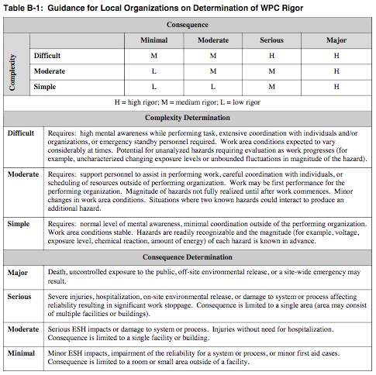
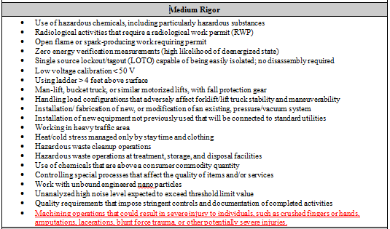
Adding clarity to Lab’s WPC Procedure
Machine operation was added to Table B-2: Rigor Level Examples in WPC
Notes:
To correct our issues, we started with at the core and began to work our way out –
First – we added clarity to our Work planning and control procedure

Slide 9
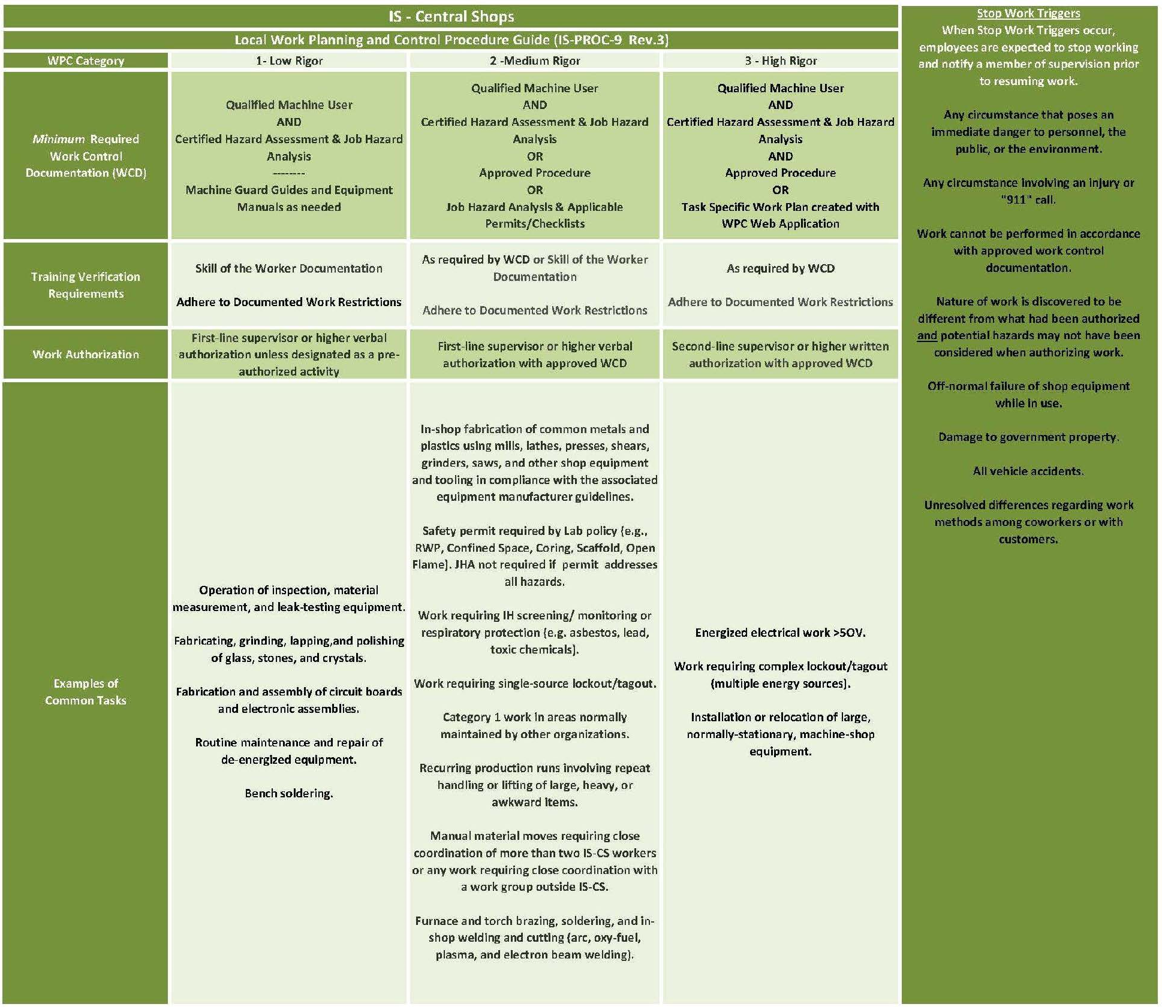
Applying the Right level of Rigor in central shops WPC process
Central Shops revised its WPC worker aid to align with the Lab-level rigor
Notes:
Central Shops then corrected its local WPC procedures –
--Machine use involving “in-shop fabrication using mills, lathes, presses, shears, saws, etc.” was corrected to Medium Rigor
--Minimum required work control for Medium Rigor includes a Qualified Machine User AND our new Hazard, Control, and Risk Identification Worksheet

Slide 10
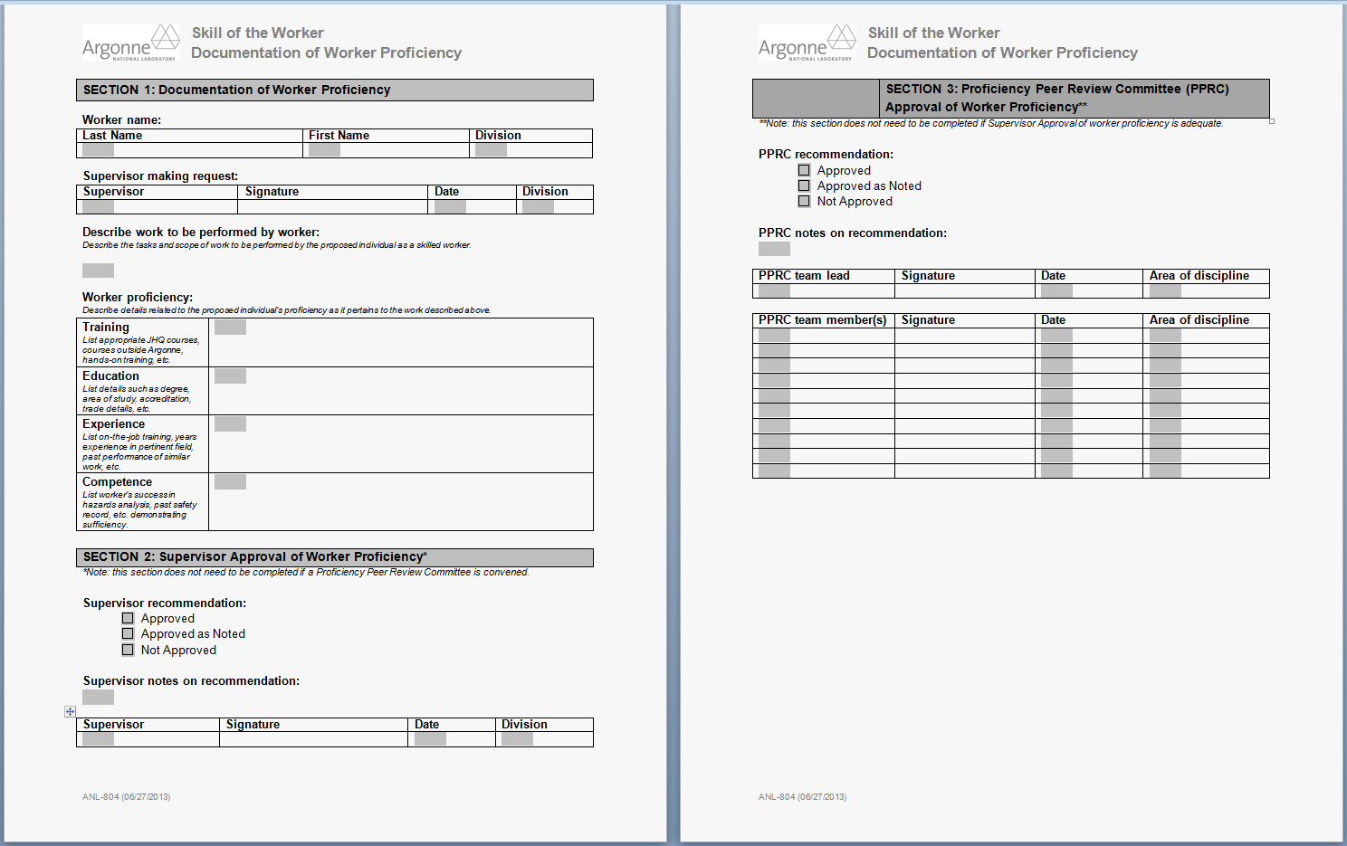
Qualification of machine users
Proficiency Peer Review Committee
  Argonne’s subject matter expert
  Two machine tool operators with a combined 70 years of experience
Qualifier qualifications are reviewed by the Committee to ensure the evaluator has the appropriate proficiency to assess machine operators
Notes:
As mentioned earlier, it became clear early on that our qualification process wasn’t what it needed to be.
--LMS-PROC-78 had included three steps to qualify as a user, but it was much too loosely defined
--It also was completely silent on the competency of the people performing the qualifications –
First: qualify the qualifier
Proficiency can include any combination of training, education, experience, and demonstrated competence

Slide 11
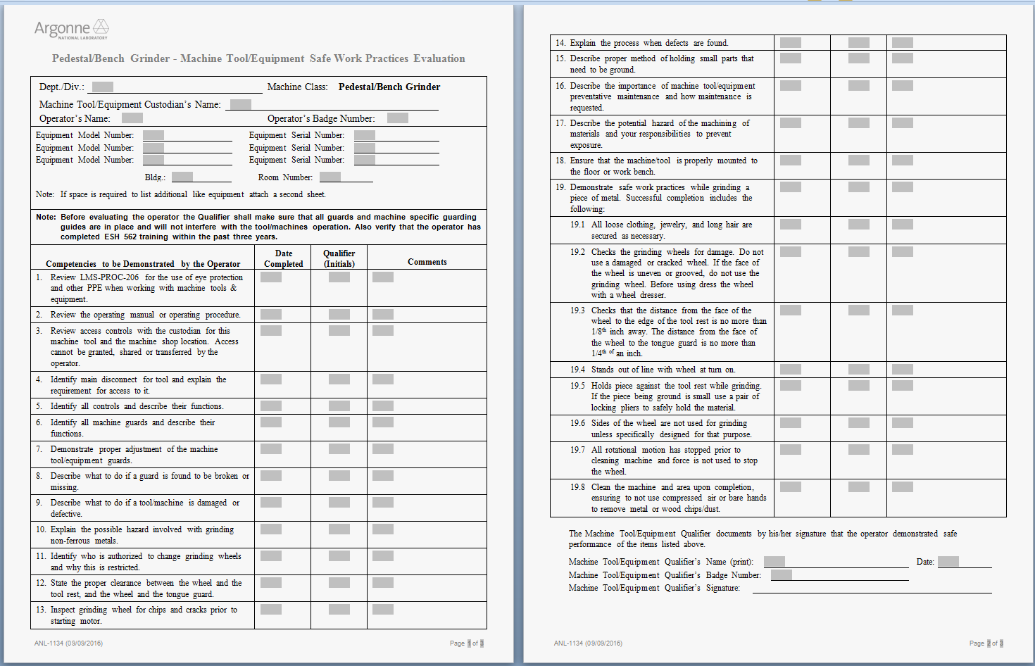
Qualification of machine users
Safe work practice evaluations developed for all machine types
Evaluations are a critical component of user qualification
Evaluations confirm that a user adequately demonstrates safety checks prior to machine use
Central Shops has an exception to this process
Notes:
Second: qualify the users
Safe Work Practice Evaluations
Evaluations include items broadly applicable and those specific to tool types – such as this one shown for a Pedestal/Bench Grinder –
--user must check the grinding wheel for damage – such as a wheel that is uneven or grooved.
--user must check that the distance from the face of the wheel to the edge of the tool rest is no more than an 1/8”
Evaluations confirm that the user safely operates equipment,

Slide 12
Procurement and Asset management
Purchases of new equipment are approved by Argonne’s POC, confirming that tools and equipment
  Meet applicable OSHA and ANSI requirements
  Meet applicable NFPA 79 requirements for anti-restart protection
  Have NFPA 79-compliant emergency stops when required by protocols
  Have an appropriate and qualified machine custodian designated
Argonne’s POC
  Inspects machine tools and equipment on arrival
  Ensures the machine is added to Argonne’s asset tracking system (FMax) with appropriate maintenance and inspection schedules
  Prepares a tool-specific pre-operation guide placard
Notes:
Previously, our machine point of contact was not involved in the procurement or asset management of the machines – it was left up to the line organization.
Today, all purchases of new equipment are hard-coded to require review and approval by our POC to confirm it:
On arrival, our POC is now also one of the first people to inspect the machine:

Slide 13
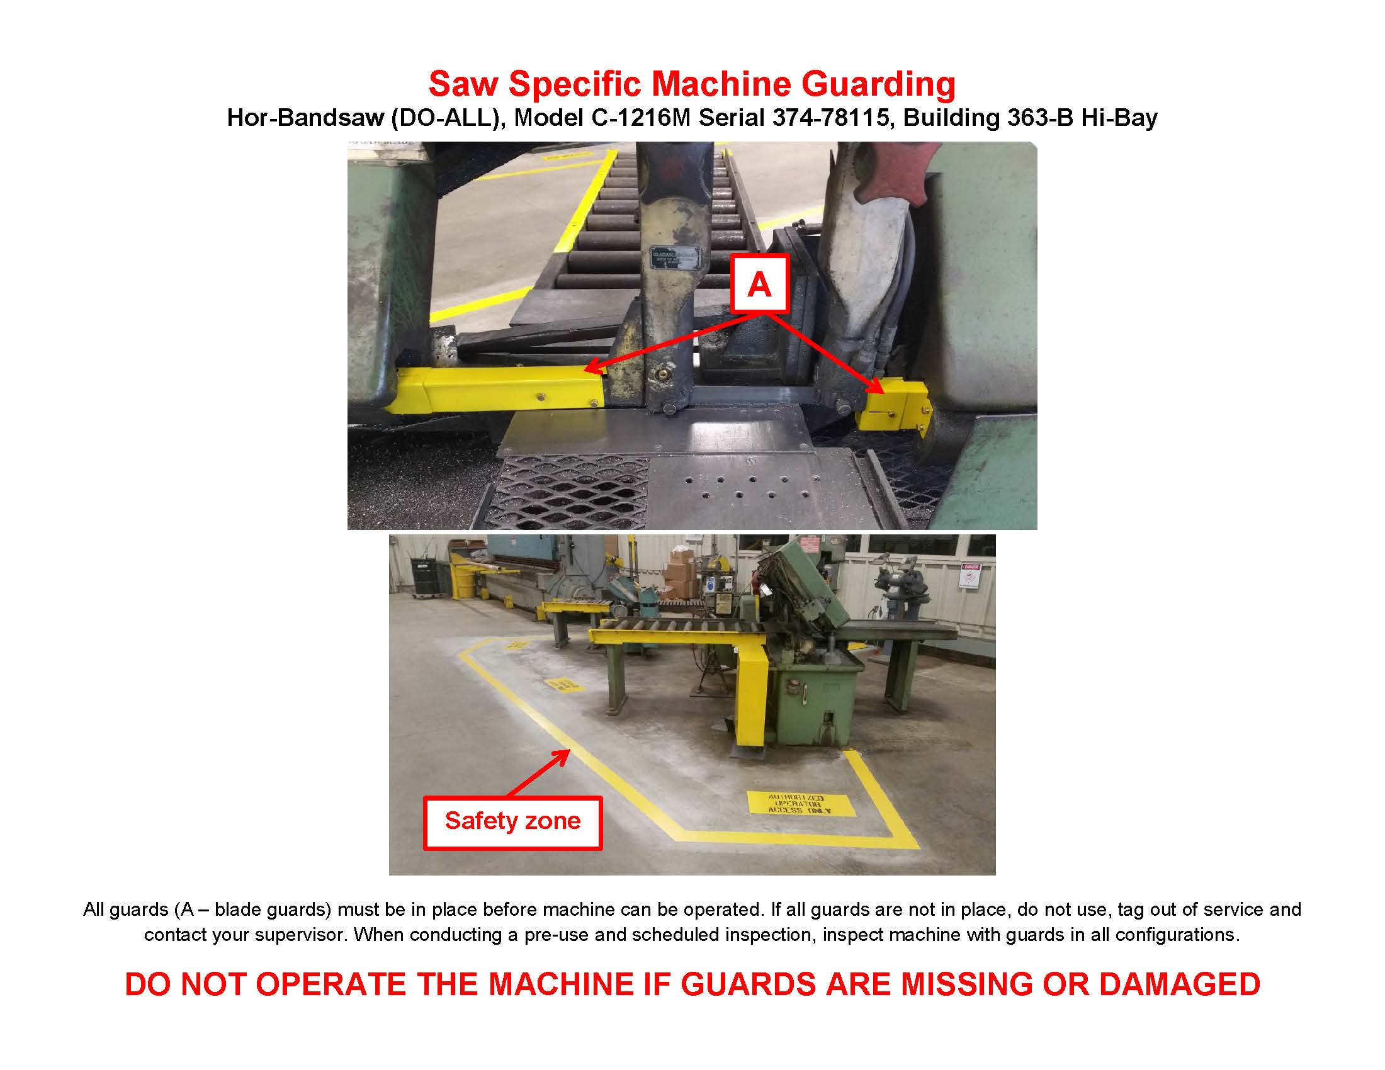
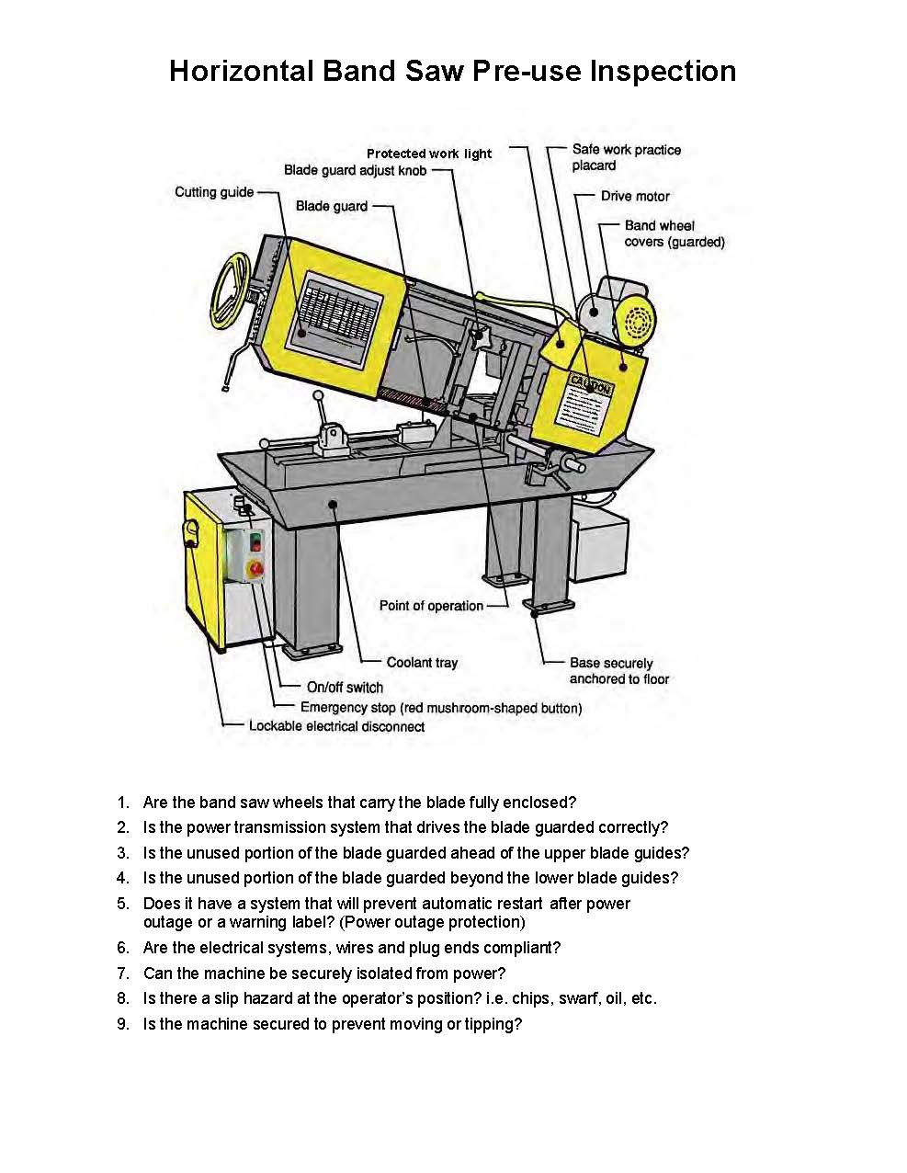
Pre-operation guides
Pre-operation guides are posted at or near each machine
Notes:
The development of these is a responsibility of our POC and it is done on arrival since he’s tied into the procurement process now.
--This procurement process allows him to also evaluate the pre-use inspections that are included on side 2 of the Guides to ensure they are appropriate.
These Guides are a critical part of our program.
--We rely on machine users to identify issues prior to use.
--The Guides also help people like me, supervisors, or those less familiar with OSHA and ANSI guarding requirements – to readily identify safeguarding issues.

Slide 14
Equipment Inspection & maintenance
Annual inspections are assigned to division “shop” owners via FMax
Inspections confirm that:
  An operator manual (or equivalent) is readily accessible
  A pre-operation guide is present, accurate, and posted
  A current log of qualified operators is accurate and posted
  All machine guards are present and functioning
Preventive maintenance is scheduled and completed
Corrective maintenance is tracked via FMax
Notes:
Previously each Argonne line organization managed its own inventory
Issues identified were sometimes, but not always, being entered into IMTS
We formalized the process and required that Argonne’s entire inventory going to the Asset Tracking System (FMax)

Slide 15
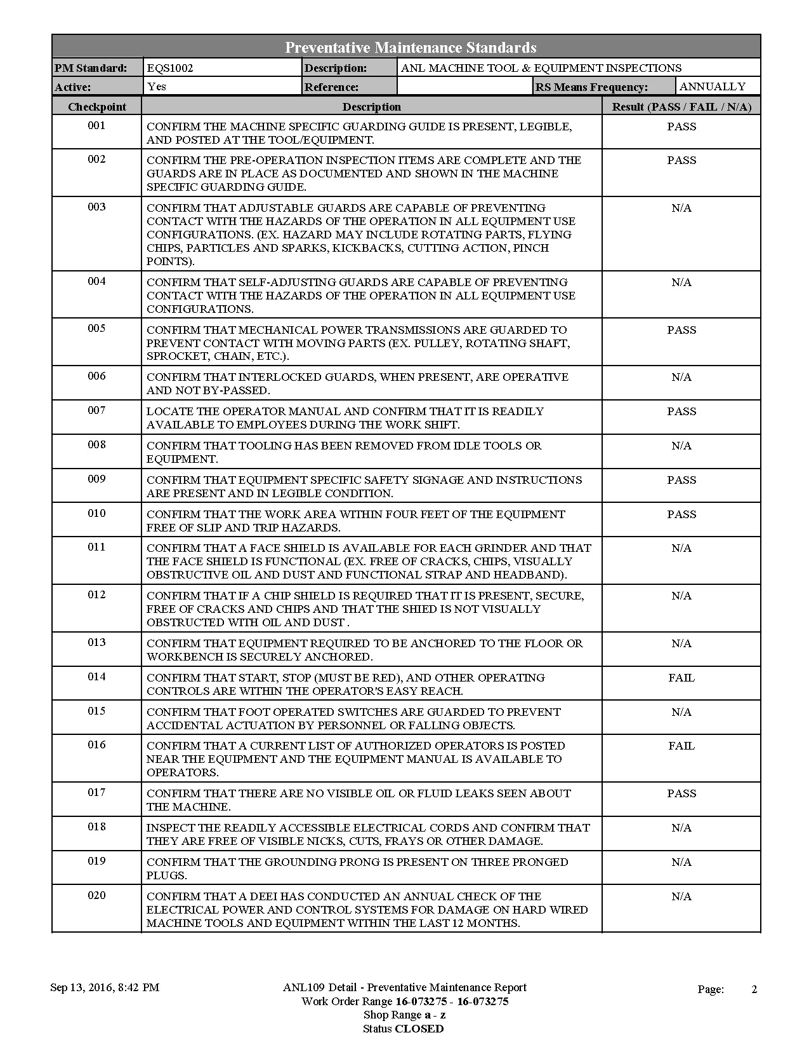
Equipment inspection & Maintenance
FMax auto-generates scheduled work orders, including annual inspection checklists
Work orders are “open” until action is completed
Maintenance or inspection may result in follow-on corrective work orders
Deficiencies that cannot be immediately corrected are prevented from being operated using a positive method until back in compliance per the checklist
Notes:
This is an example of the annual inspection checklist that is generated by FMax.
It requires the custodian to confirm each checkpoint with a Pass/Fail/

Slide 16
Hazard, Control, & Risk Identification
We continue to work towards improving the machine tool and equipment hazard, control, and risk identification process
Central Shops, working with HSE subject matter experts, developed a worksheet to gather hazard and control analysis details
Industrial hygienists assessed potential exposures and gathered data based on scoped work
Results from the work in Central Shops will inform decisions on improvements needed in the Laboratory’s exposure assessment process
Notes:
--Machine custodian develops worksheet with machine operator input.
--Worksheets are required to be kept in the Shop
Pre-Operation Guides identify machine guards – but the worksheets go into other hazards and associated controls
We expect them to be a key component in on the job training of machine users
The worksheets also provide an entry point for collecting data for workplace exposure assessment planning.

Slide 17
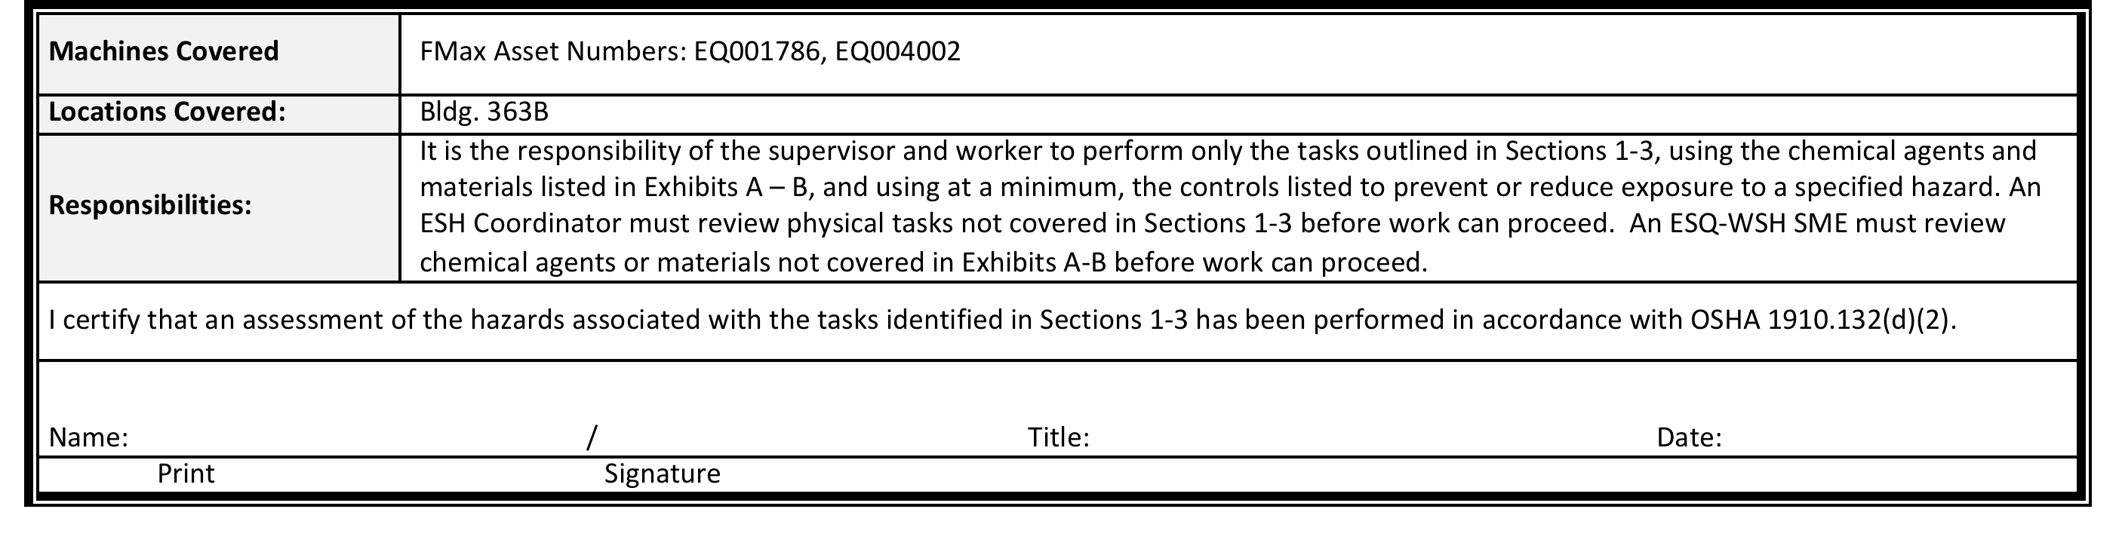
Hazard, control & Risk Identification
Central Shops

Slide 18
Training Improvements
Argonne’s ESH 562 web-based training (WBT) was revised to incorporate
  Worker-provided input
  Program and process changes
  New videos to enhance and better demonstrate concepts
  Best practices learned from benchmarking and assist visits
Three-year retraining interval added – previously no retraining interval
Employees were required to take revised training within 90-days of re-issue
Very positive feedback from machine users regarding course revision
Also, a new ESH 566 course, Machine Tool & Equipment Responsible Individual, Custodian, and Qualifier, was created for machine custodians and supervisors
Notes:
ESH 562 training – taken by all machine users and custodians
--Overhauled to incorporate our program changes – such as improved qualification requirements, use of Pre-Operation Guides, procurement, and asset management.
We also have OJT and the evaluation.
Safe Work Practice Evaluations are intended to demonstrate safe operation of a machine
Allows us to:
--Confirm objectives of WBT are understood.
--Confirm the pre-operation guides are used properly.
--Confirm the pre-use inspections are performed adequately.

Slide 19
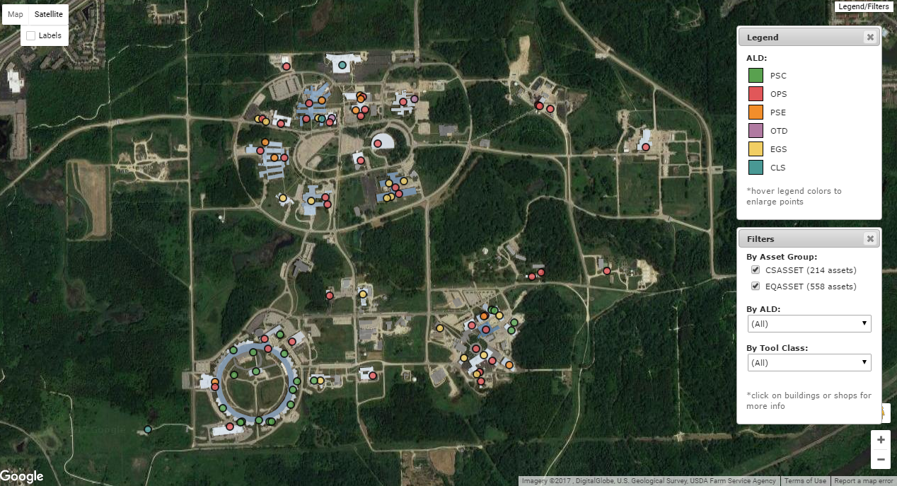
Continued work to reduce the machine tool/equipment footprint

Slide 20
Questions

