Slide 1
Electrical Safety Discussion Topic
Proximity Indicators
John Powell
Environment, Safety, and Health Director, UT-Battelle
April 25, 2017

Slide 2
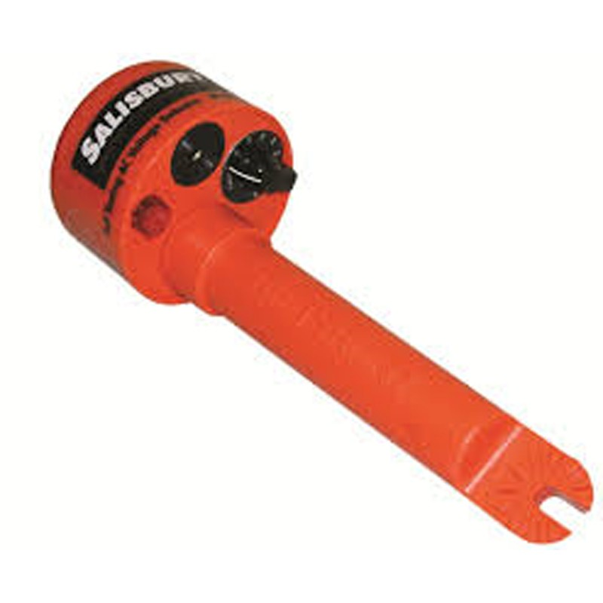
Discussion Topic: Proximity Testers: Friend or Foe?
Pros:
Inexpensive
Easy to use
Small enough to fit in worker’s shirt pocket
Cons:
Some say they are “inherently unreliable”
May not work if operator is isolated from ground
May not work if they get wet
Will not work if dead battery
Difficult to limit use (if use is allowed at all)

