Slide 1
Electrical Safety Lock Out Tag Out
Recent Experience - Oak Ridge National Laboratory
Legacy Conditions
John Powell
Environment, Safety, and Health Director, UT-Battelle
April 25, 2017

Slide 2
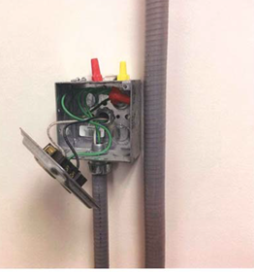
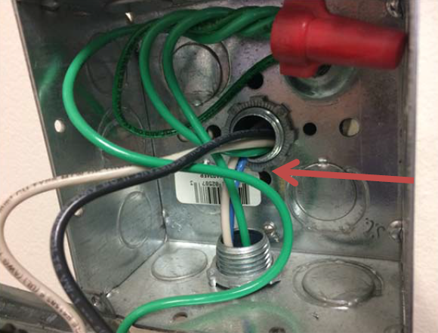
November, 2016: Electrician cuts energized line while performing scheduled work to relocate a printer.
Single source LOTO performed at Panel B, Circuit 22
Zero energy check at duplex receptacle (planned location)
Decision made to perform disconnect in printer cabinet
Did not repeat zero energy check at printer cabinet
Blue wire cut, spark observed
Blue wire found to be fed from
Panel B, Circuit 24
Lessons Learned:
Inadequate Zero Energy Check
at work location
Panel schedule confusing

Slide 3
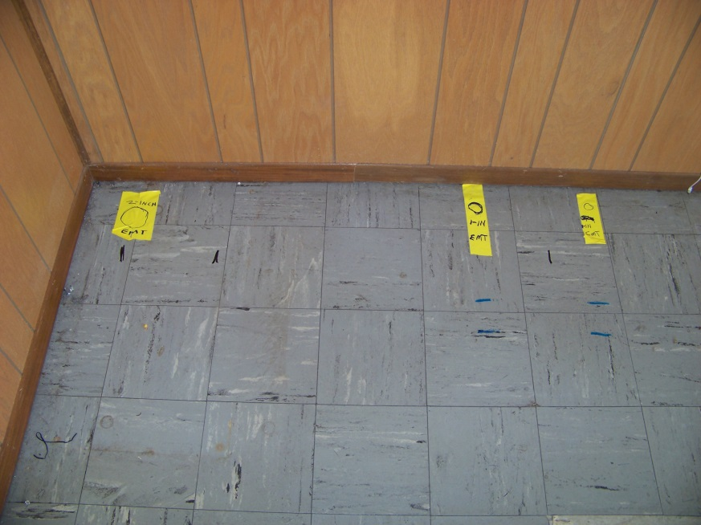
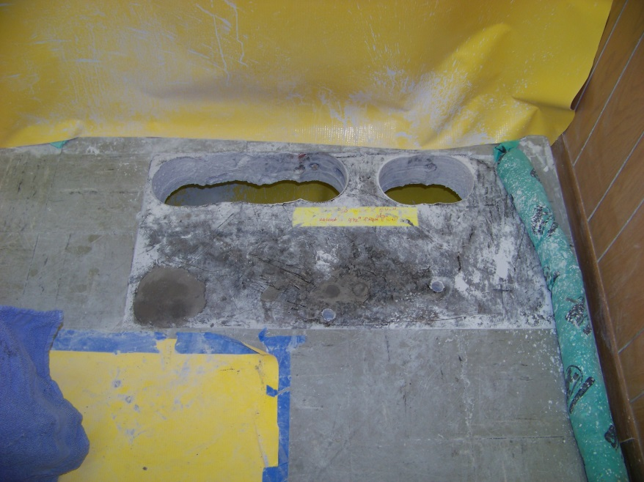
January, 2017: Communications cables cut while performing floor penetrations in concrete floor
Work involved installation of new SCRAM panel in nuclear facility
Floor penetrations required in 4 ½ inch thick reinforced concrete floor
Facility structural drawings indicate presence only of subsurface rebar
Scan performed to locate subsurface rebar, which were marked on tile floor
Floor tile determined to be asbestos, and removed (also removing markings)
Oral instruction from Structural Engineer to only cut east/west running rebar
Floor penetrations cut communications conduit, which were undetected
Lessons Learned:
Facility drawings not current
Improper work sequencing, inadequate
work direction
Inadequate subsurface investigation
Inadequate work direction

Slide 4
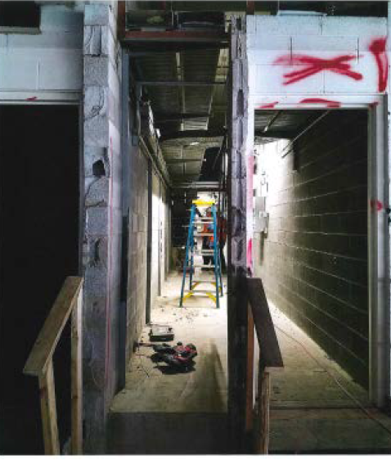
February, 2017: Abandoned energized wire cut during facility remodel
Work involved removal of cable trey & cables as part of a major facility remodel
In preparation for remodel, facility had been disconnected (air gap) from switchyard
East end of cables in trey air gapped – zero energy check performed by subcontractor laborer
Removal involved cutting of cables from corridor – no zero energy check performed on this end of trey
During work to cut cables, a spark was observed on one wire
Live electrical wire found abandoned in trey (i.e. did not terminate at east end) – fed from basement feed.
Lessons Learned:
Facility drawings not current
Legacy hazard existed, but not identified
Inadequate Zero Energy Check

Slide 5
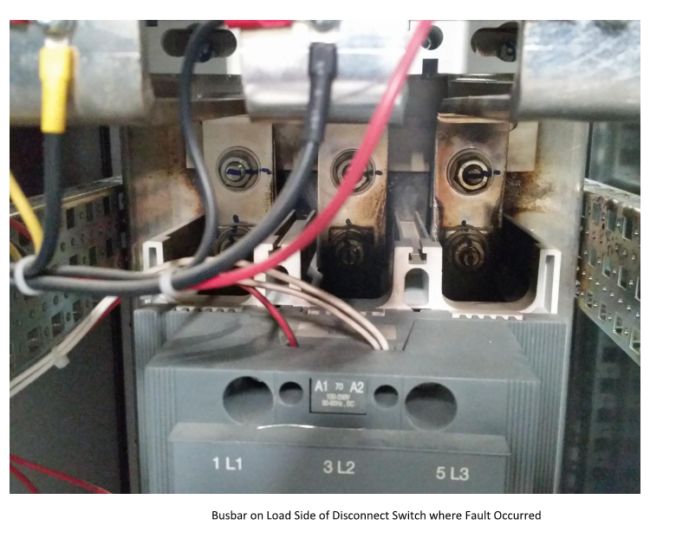
March, 2017: Initial commissioning of new electrical equipment resulted in arc. Response to this condition resulted in LOTO of adjacent cabinets in closed condition
Large scale renovation of computer center. Several new Variable Frequency Drives (VFDs) installed.
LOTO of electrical & mechanical systems during equipment installation (several months)
LOTO removed to commission the VFDs with vendor.
When VFD #1 energized, a fault occurred (arc within cabinet)
Chaotic environment immediately afterward. Electrician requested to LOTO VFD # 2 & 3 (diagnosis of problem)
LOTO of VFD 2 & 3 performed in closed (energized) position. No zero energy check performed.
Subcontractor electrician noted the error
Lessons Learned:
Chaotic work environment contributed to worker error
Failure to perform Zero Energy Check

Slide 6
Electrical incidents are on the increase at many DOE Facilities
ORNL has had 7 electrical/electrical-like events in past 4 months
EFCOG reports DOE sites had 8 ORPS-reportable electrical events during the two week time period of March 23 – April 6, 2017 (triple the normal rate of occurrences). Common contributing factors:
Open enclosures containing energized electrical conductors
Inadequate work planning or communication of LOTO activities
Incorrect execution of LOTO activities
Several sites have done, or are doing common cause analysis of events
Other common causes:
Subcontractor interface
Proper execution of Zero Energy Checks at actual work location, every time

