Slide 1

Negative Trends in Lock out – Tag out
Precursors to a “Bad Day” Event
2017 NLDC ES&H Working Group Meeting
Eric G. Damberg
Worker Safety & Health Division Manager
April 2017

Slide 2
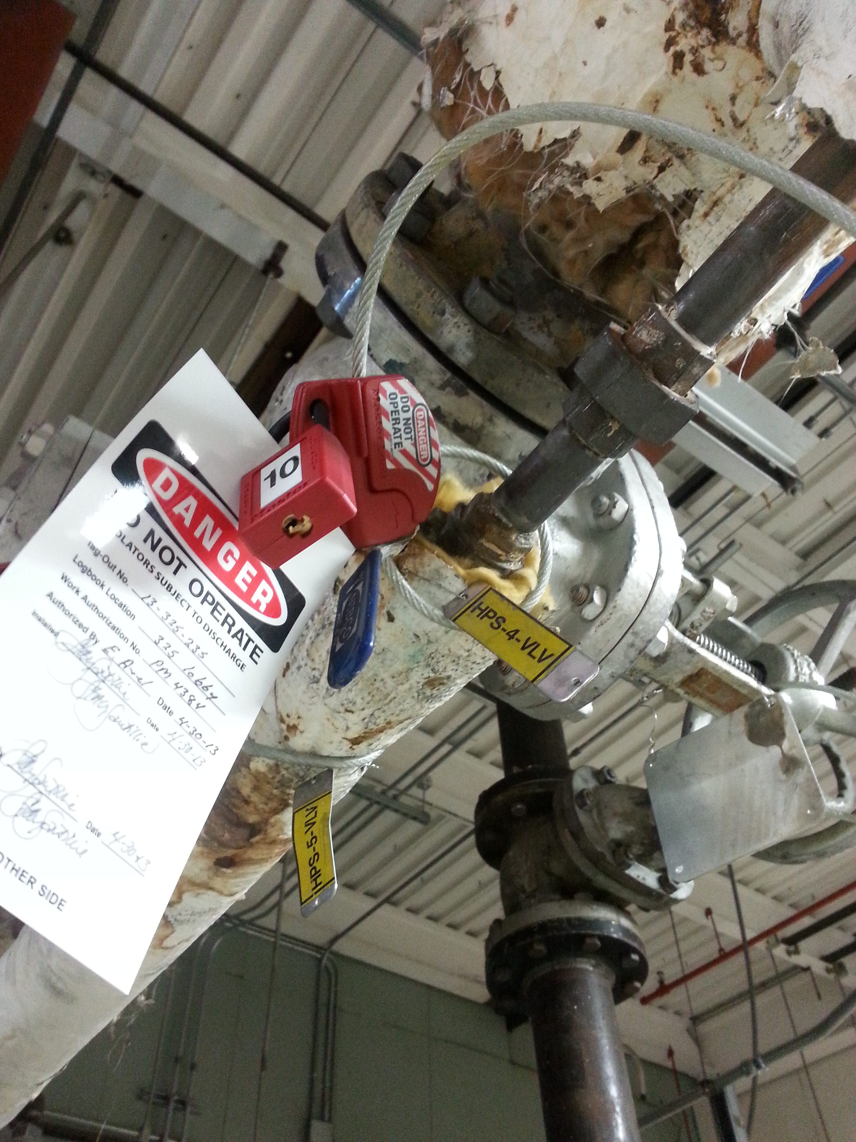
Hazardous Energy Control
(aka Lock out – Tag out)
Since May 2016 PNNL has reported 8 occurrences where staff failed to correctly implement LOTO
  Four (4) occurrences in R&D (Pressure & Mechanical Hazards)
  Four (4) occurrences in F&O (Electrical, Pressure, Ventilation)
  We MUST improve our performance in this area
  to prevent a “bad day” event at PNNL
PNNL Program is Compliant – Staff behavior is the greatest barer to improve performance

Slide 3
Lock Out Tag Out Common Causes
Bob McCallum facilitated a review of 10 LOTO events from Jan 2014 through December 2016 – the following common causes were identified:
Personnel made incorrect assumptions regarding the specific LOTO requirement that governed the work.
Personnel knowledgeable and experienced in LOTO incorrectly executed a LOTO work evolution. (e.g. inattention to detail)
Organizational practices related to operational discipline (e.g. second check, self-check, questioning attitude) did not identify and correct LOTO execution errors in a timely manner prior to performing work.
Additional Actions are underway to change the culture and behaviors
necessary to improve operational discipline and LOTO execution

Slide 4
Additional Actions to Change Staff behavior
Management Engagement / Assurance:
  Establish guidance and tools to improve quality of management observations with respect to Hazardous Energy Control
  Develop a method of analyzing reportable events to identify trends associated with Operational Discipline and Hazardous Recognition
  Develop method to verify that non-LOTO trained staff members, are not conducting work that requires hazardous energy control
Training
  Develop and deliver LOTO practical training for Authorized Workers that communicates expectations for operational discipline
  Raise Awareness for non-LOTO trained Staff:
    Further guidance to staff to identify when LOTO is needed
    Emphasize the importance of Hazard Recognition, LOTO Controls and when / why controls are required to be implemented
  Evaluate need for unique Controlling Organization training for staff who prepare written instructions for LOTO.

