Slide 1
Maintenance Error Results in Bypassing Enclosure Electrical Lock Out Tag Out
John Anderson Jr.
ESH Directors Meeting 2017
24 April 2017

Slide 2
Outline
Accelerator Complex
MI-65 LOTO Incident
  Incident End Results
  Sequence of Events
  Single Line Electrical Diagram
  Incident Analysis
Lessons Learned
Backup Slides
  Human Performance Improvement (HPI) Error Precursors
  Causal Factors
  Recommendations
  Contact Information

Slide 3
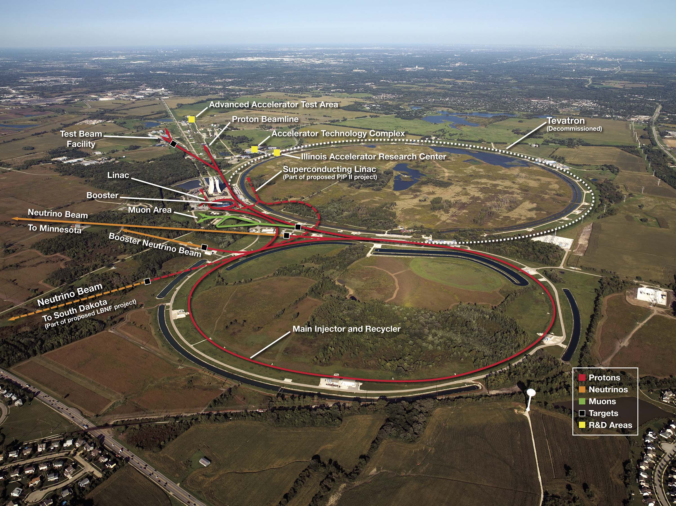
Accelerator Complex
MI-65 Service Building

Slide 4
MI-65 Lock Out Tag Out Incident
Start with the end first
  No personnel were injured
  No equipment was damaged
  Defense In Depth Electrical Safety Barriers
    Beamline enclosure electrical safety was reduced to one barrier
      Enclosure electrical safety system
  Essentially a “Free” event that we can learn from

Slide 5
MI-65 Lock Out Tag Out Incident
Sequence of events
  Accelerator complex was finishing a multi-month maintenance shutdown and returning to operations
  On 29 September 2015 at approximately 1:00 PM, an electronic technician was preparing power supplies in the MI-65 Service Building for NuMI beamline startup
  As the front panel power switches were being turned on, the technician noticed the input power meters on the power supplies move from 0 VAC to reading 480 VAC
  Power should not have been available as the upstream switchboard was believed to still be under Lock Out Tag Out (LOTO)
  The technician confirmed with his supervisor and
  Main Control Room that the beamline was still locked out

Slide 6
MI-65 Lock Out Tag Out Incident
  The technician turned the power supply power switches off
  The supervisor locked out the load side circuit breakers in the upstream panel board
  Operations Department Head and
  Division Safety Officer were notified
  Initial investigation revealed that the 13.8 kV motorized disconnect switch used to feed a 13.8 kV to 480 VAC transformer was in the energized position
  Records from accelerator operations indicate that the 13.8 kV disconnect switch was Locked and Tagged off at approximately 1:30 AM on Saturday July 4, 2015. Roughly three months earlier

Slide 7
MI-65 Lock Out Tag Out Incident
  Facility Engineering high voltage electricians were contacted to open the four bay switch that feeds 13.8 kV to the motorized disconnect switch
  The Division Safety Officer Locked Out the four bay switch restoring the LOTO for the enclosure
Electrical Safety Barriers
  Beamline enclosure electrical safety interlocks were disabled
    The only barrier that kept the power supplies from being able to be energized and delivering power to the enclosure magnetic elements

Slide 8
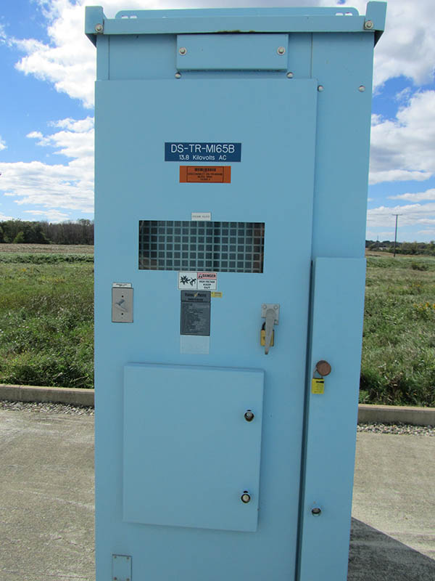
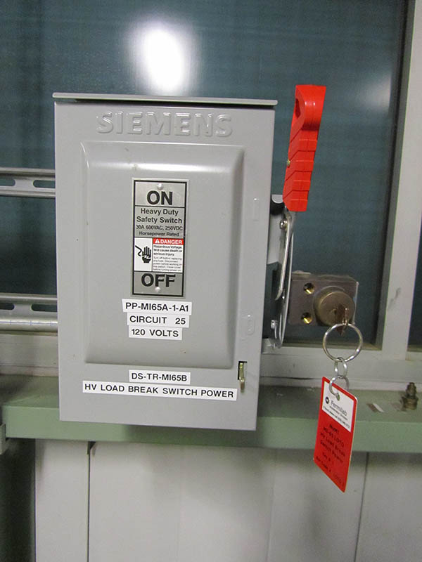
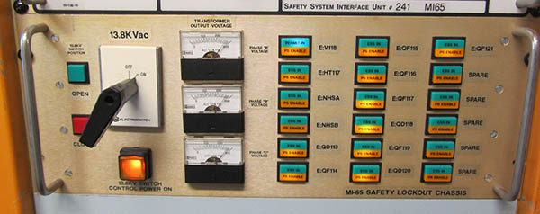
Electrical Diagram

Slide 9
Incident Analysis
Reviewed the MI-65 written LOTO procedure
  NuMI beamline is unique in the way it is locked out
  To improve electrical safety to workers, a 13.8 kV motorized disconnect was installed to disable power to the enclosure
  Allowed for remote switch operation
    Moved employees outside of the Arc Flash zone during disconnect switch operation
  Identified that if procedure is executed in the wrong order, it is possible to lock the switch in the on position
    Would also require missing two separate verification steps
Reviewed LOTO procedure with the operator that performed the lockout on July 4th
  Operator was confident she performed the lockout correctly

Slide 10
Incident Analysis
Reviewed Facilities Engineering maintenance records
  Maintenance was performed on the switch on July 22, 2015
  Maintenance procedures indicate the switch chain drive is to be lubricated and the switch cycled
  The electrician who performed the maintenance stated he used the manual drive to cycle the switch
    First time many of us learned there was a manual drive for the switch
Two most likely causes for this event were either
  Improperly performed LOTO procedure
  A change in the position of the motorized switch during maintenance

Slide 11
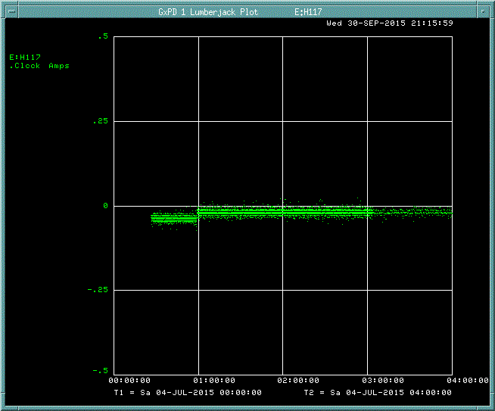
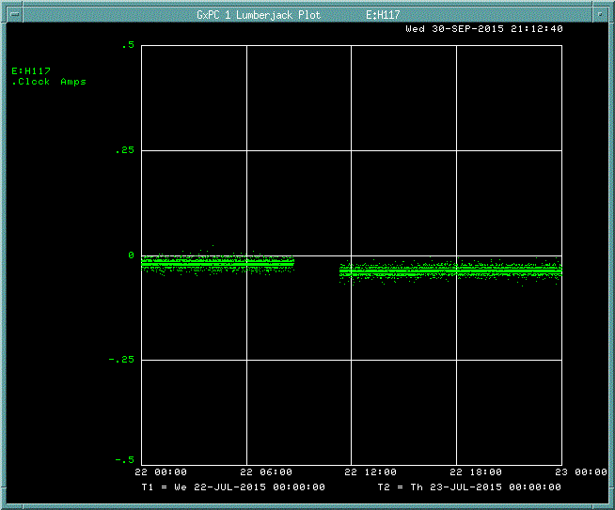
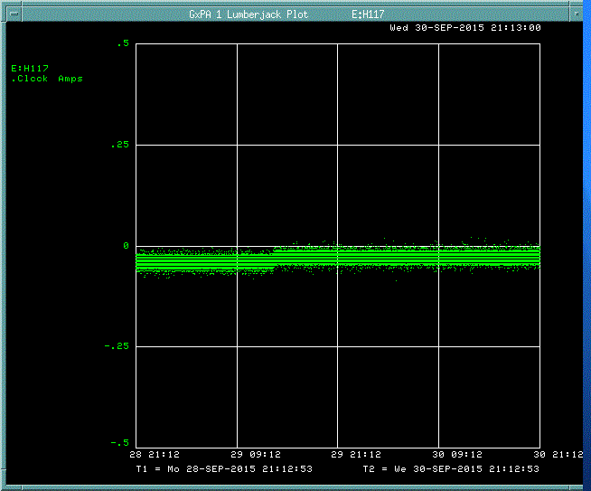
Incident Analysis
Search through accelerator data logs identified a small milliampere-level offset in one of the power supplies when the ac input voltage was available
July 4th
LOTO
July 22nd
Maintenance
September 29th
Discovery

Slide 12
Root Cause
Lockout device not applied to the motorized disconnect
  Rather the lockout device was applied to the power to the motorized drive
  Manual drive was able to be accessed during maintenance

Slide 13
Lessons Learned
Well-intentioned relocation of motorized switch controls created situation which application of LOTO was not readily apparent
The written LOTO procedure failed to notify maintenance personnel that the switch was used as a beam line energy isolating device
The lack of a lock and tag at the disconnect switch does not conform to the LOTO requirements in
OSHA 1910.147(a)(3)(i)

Slide 14
Causal Factors
A3: Human Performance Less Than Adequate (LTA)
  None
    The work as executed by the Accelerator Operator and Facility Engineering Section Electrician was in full compliance with the instructions they were provided
    As an organization, we set the employees up to fail!
A4 Management Problem
  A4B5C04: Risks / consequences associated with change not adequately reviewed / assessed.
    The change in 2007 from the transfer switch to the motorized switch did not identify the loss of the LOTO point on the energy isolation device as a risk
    Original construction transfer switch was never used for LOTO

Slide 15
Groups Involved in NuMI LOTO
Accelerator Division External Beams Department
  Overall responsibility for the beamline, reviewed LOTO procedure
Accelerator Division Electrical Engineering Support Department
  Specified disconnect switch, built switch controls, developed draft LOTO procedure, was not a reviewer of the final LOTO procedure
Accelerator Division ES&H Department
  Editor of LOTO procedure, reviewer of LOTO procedure
Accelerator Division Operations Department
  Performs the LOTO activities, reviewer of LOTO procedure
Facilities Engineering Services Section
  Performs maintenance on the disconnect switch, not a reviewer of the LOTO procedure

Slide 16
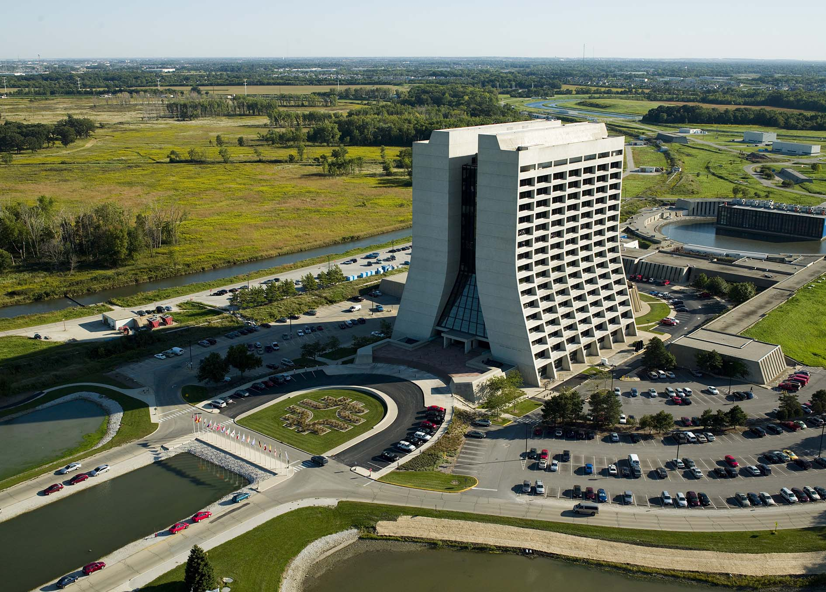
Questions

Slide 17
Backup Slides

Slide 18
HPI Error Precursors
Unfamiliarity with task / first time
  Development of a written LOTO procedure for remotely operated high voltage equipment had not been previously done
Interpretation requirements
  The use of the motorized switch as an energy isolating device was not communicated to the Facility Engineering Section
  The maintenance procedure did not address returning the switch to the position in which is found at the start maintenance
Confusing procedure / vague guidance
  The need for the motorized switch to potentially remain in the open (off) position after servicing because of its use as an energy isolating device was not part of its maintenance procedure

Slide 19
HPI Error Precursors
Confusing displays / controls
  The motorized switch was not marked as an energy isolating device by either permanent labeling or a tagout device
Lack of alternative indication
  The written LOTO procedure did not account for maintenance of the motorized switch that could bypass the energy isolation for the power supplies and beamline components
  The development or review of the procedure did not involve the Facilities Engineering Section that would perform the maintenance of the motorized switch

Slide 20
HPI Error Precursors
Habit patterns
  The maintenance procedure did not have a check point to identify the found position of the motorized switch
  The position of the switches shown on single-line electrical diagrams were used to determine in which position switches should be left
  Due to the impact of outages on most laboratory facilities, the switches serving facilities are normally placed in the closed (on) position so that the time spent in outages is minimized
Mindset (“tuned” to see)
  Preparation of the written LOTO procedure by Accelerator Division personnel did not account for maintenance work performed by the Facilities Engineering Section

Slide 21
Causal Factors
A1: Design / Engineering Problem
  A1B1C03: Design input not correct
    The LOTO procedure development did not take into account OSHA 1910.147(a)(3)(i) “… affixing appropriate lockout devices or tagout devices to energy isolating devices …”
    The LOTO procedure development did not consider the capability to operate the switch manually
    The LOTO procedure development did not include representation from the group (Facilities Engineering Section) that would perform maintenance on the motorized switch

Slide 22
Causal Factors
  A1B2C01: Design output scope LTA
    The LOTO procedure design did not take into account maintenance, that if performed incorrectly on the disconnect switch, could bypass the beamline LOTO
    The LOTO procedure writer failed to recognize that the switch could be operated manually
A2: Equipment / Material Problem
  A2B4C07: Marking / labeling LTA
    Motorized switch was not labeled or controlled as a beamline LOTO point as required in OSHA 1910.147(a)(3)(i)

Slide 23
Causal Factors
A3: Human Performance Less Than Adequate (LTA)
  None
    The work as executed by the Accelerator Operator and Facility Engineering Section Electrician was in full compliance with the instructions they were provided
    As an organization, we set the employees up to fail!
A4 Management Problem
  A4B5C04: Risks / consequences associated with change not adequately reviewed / assessed.
    The change in 2007 from the transfer switch to the motorized switch did not identify the loss of the LOTO point on the energy isolation device as a risk
    Original construction transfer switch was never used for LOTO

Slide 24
Causal Factors
A5 Communications Less Than Adequate (LTA)
  A5B1C03: Checklist LTA
    The maintenance procedure did not have a check point to identify the as found position of the switch
    Or a check point to verify the disconnect switch was returned to the as found position
  A5B2C07: Facts wrong / requirements not correct
    The maintenance procedure did not identify the motorized switch as an energy isolation device for beamline LOTO
  A5B2C08: Incomplete / situation not covered
    Maintenance procedure stated to cycle the disconnect switch, however it did not address returning the disconnect switch to the original position

Slide 25
Recommendations
Revise the written LOTO procedure for the MI-65 beamline power supplies to conform with OSHA 1910.147(a)(3)(i)
Revise Fermilab policies and training materials to instruct Knowledgeable Employees to include representatives from all laboratory groups that will operate and maintain LOTO energy isolating devices in the development and review of written LOTO procedures

Slide 26
Recommendations
Revise Fermilab policies and training materials to identify remotely operated electrical switches that are likely to be used as LOTO energy isolating devices are places where particular attention must be given to incorporating LOTO provisions in design, specification, and construction

Slide 27
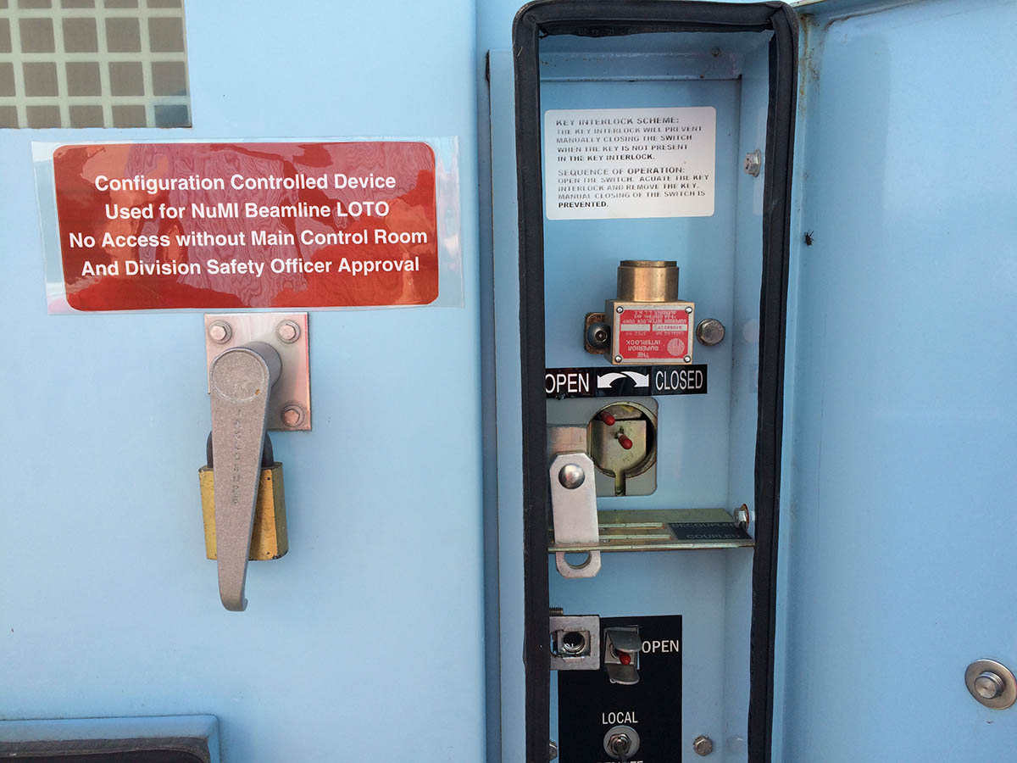
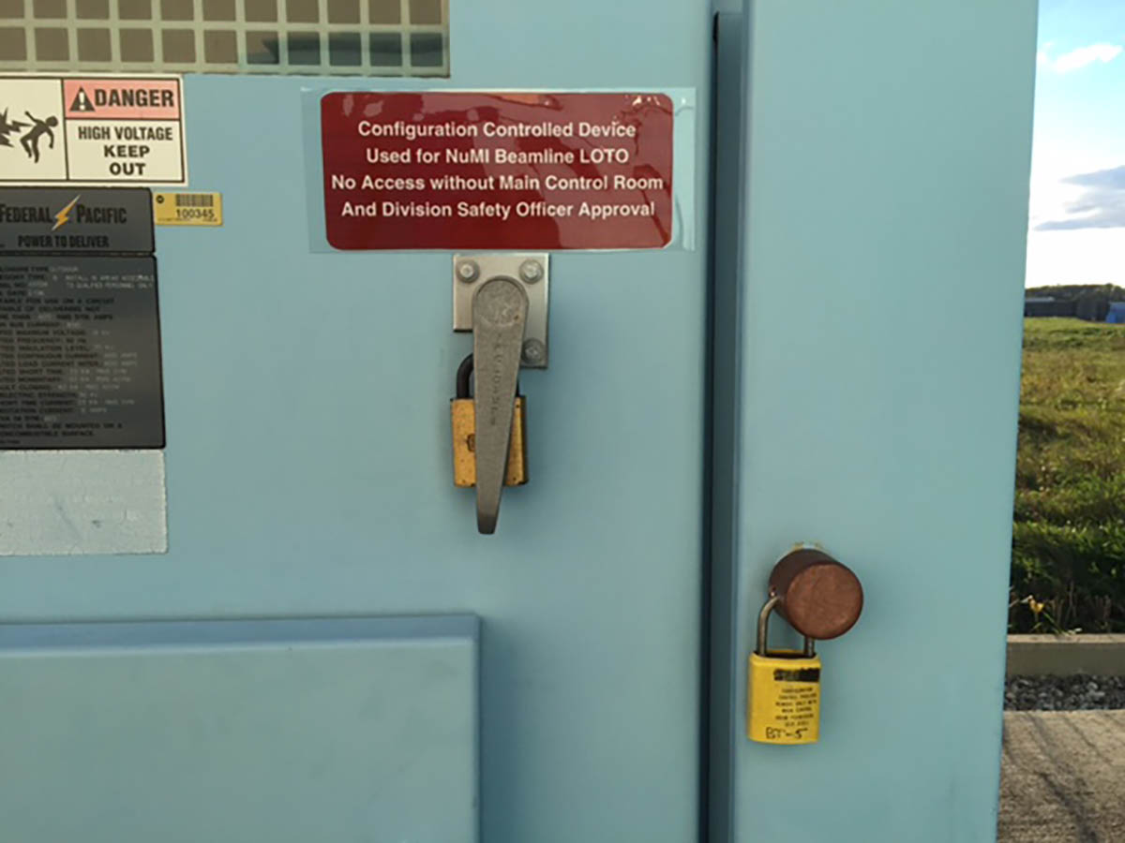
Switch Labeling and Lock Out

Slide 28
Contact Information
John E. Anderson Jr.
Associate Head, Office of the Chief Safety Officer
Environment, Safety, Health, and Quality Section
Fermi National Accelerator Laboratory
P.O. Box 500 MS 371
Batavia, IL 60510 USA
630 840 4973 office
www.fnal.gov
jea@fnal.gov

