Slide 1

Hazardous Energy Control Determination Process
Jason Sweesy
ESH Directors Meeting 2017
April 25, 2017
Notes:
Photo Title Slide Design #12 with PLATINUM Background
To best incorporate the contents of this title slide into your presentation(s), be sure to use the Select All command (Ctrl+A) before choosing to Copy (Ctrl+C) the content and then Pasting (Ctrl+V) it onto the title slide location within your new or existing PowerPoint file.

Slide 2

Objectives
Provide an overview of standards that apply to hazardous energy control.
Review the process used at PNNL to complete hazardous energy control determinations
Share examples of hazardous energy control determinations completed

Slide 3
Definitions
Service and/or maintenance - Workplace activities such as constructing, installing, setting up, adjusting, inspecting, modifying, and maintaining and/or servicing machines or equipment.
Normal production operations - The utilization of a machine or equipment to perform its intended production function.
Minor servicing - The activity must take place during, and is inherent to, normal production operations and is routine, repetitive and integral to normal operations.

Slide 4

Standards
29 CFR 1910.147(a)(2), The control of hazardous energy (lockout/tagout)
  (i) Applies to the control of energy during servicing and/or maintenance of machines and equipment
  (ii) Normal production operations are not covered by this standard. Servicing and/or maintenance which takes place during normal production operations is covered by this standard only if an employee:
    (A) is required to remove or bypass a guard or other safety device
    (B) is required to place any part of his or her body into an area on a machine or piece of equipment where work is actually performed upon the material being processed or where an associated danger zone exists during a machine operating cycle

Slide 5
Standards
29 CFR 1910.147(a)(2), The control of hazardous energy (lockout/tagout)
  Exception: Minor tool changes and adjustments, and other minor servicing activities, which take place during normal production operations, are not covered by this standard if they are routine, repetitive, and integral to the use of the equipment for production, provided that the work is performed using alternative measures which provide effective protection.

Slide 6
The Minor Service Exception
Exception may apply when servicing and/or maintenance occurs during normal production operations and LOTO is NOT required.
LOTO
Normal Operations
maintenance
requiring
machine shutdown
maintenance with minor risk not covered by 29 CFR 1910.147
Production without risk to worker

Slide 7
The Minor Service Exception
Minor tool changes and adjustments and other minor servicing activities, which take place during normal production operations….
Part 1

Slide 8
The Minor Service Exception
. . .[these minor servicing activities] are not covered by this standard if they are routine, repetitive and integral to the use of the equipment for production . . .
Part 2

Slide 9
The Minor Service Exception
3 Essential Words to the Minor Service Exception
Routine - The activity must be performed as part of a regular and prescribed course of procedure and be performed in accordance with established practices.
Repetitive - The activity must be repeated regularly as part of the production process or cycle.
Integral - The activity must be inherent to the production process.

Slide 10
The Minor Service Exception
. . .[minor activities that are routine, repetitive and integral are not covered by the standard], provided that the work is performed using alternative measures which provide effective protection.
Part 3

Slide 11

Alternative Measures
No details are provided in the OSHA Lockout/Tagout Standard
ANSI/ASSE Z244.1, Control of Hazardous Energy Lockout/Tagout and Alternative Methods
  “OSHA recognizes the value of national consensus standards, and in many respects, the ANSI Z-244.1-2003 standard offers useful guidance for employers and employees attempting to control hazardous energy. However, OSHA has not determined that, in all cases, compliance with specific provisions of the ANSI Z244.1-2003 standard and its annexes would constitute compliance with relevant OSHA requirements.”

Slide 12
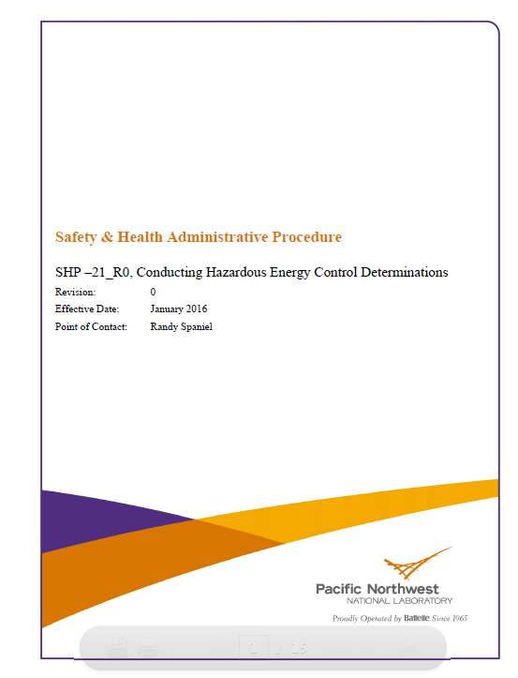
Hazardous Energy Control Determinations
PNNL Procedure
  SHP-21, Conducting Hazardous Energy Control Determinations
Purpose
  Evaluate and classify work activities as normal production operations, service and/or maintenance, or minor servicing.
  Qualitatively assess and evaluate the risk
  Prescribe the method of controlling unexpected release of hazardous energy.

Slide 13
Process
Evaluate work activity/work location
Discuss work activity with performing staff member
Review work control documents (e.g. Job Planning Package, Standing Operating Procedures, and Permits).
Exhibit 1 – Decision Matrix for Safeguarding Hazardous Energy

Slide 14
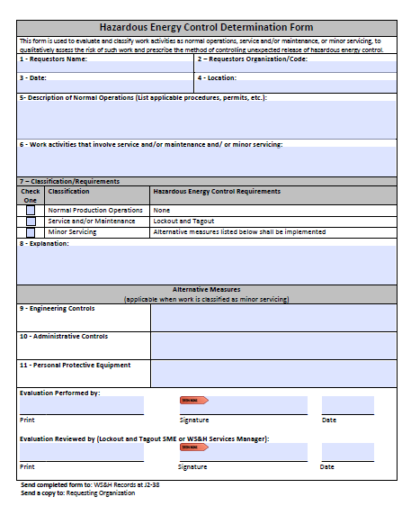
Process
Evaluate and classify work activities as normal production operations, service and/or maintenance, or minor servicing
  Normal Production Operations - Lockout and Tagout is not required
  Service and/or Maintenance - Lockout and Tagout required
  Minor Servicing - Document existing alternative measures and prescribe additional alternative measures
Prepare and approve Hazardous Energy Control Determination Form
Communicate Hazardous Energy Control Determination Results

Slide 15
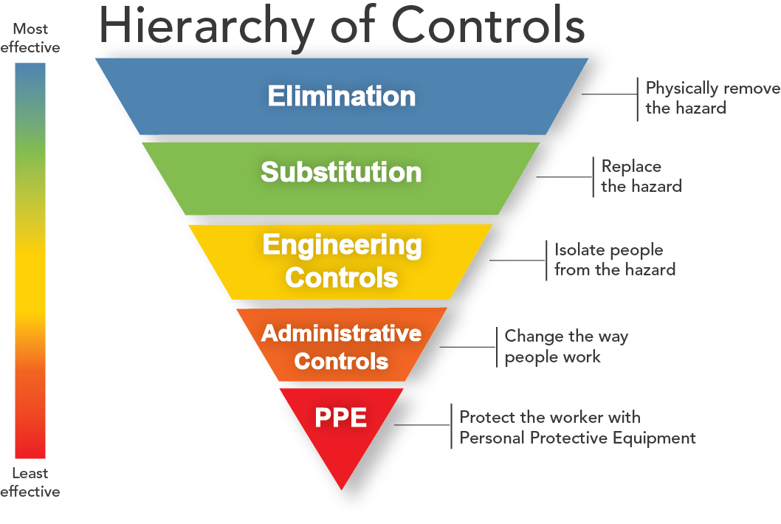
Hierarchy of Alternative Controls
Eliminate hazard through design;
Use engineered safeguards;
Use warning and alerting techniques;
Use administrative controls (such as safe work procedures, practices, and training); and
Use personal protective equipment

Slide 16
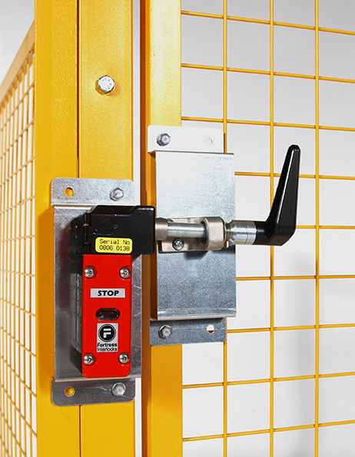
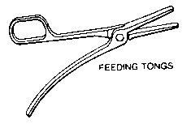
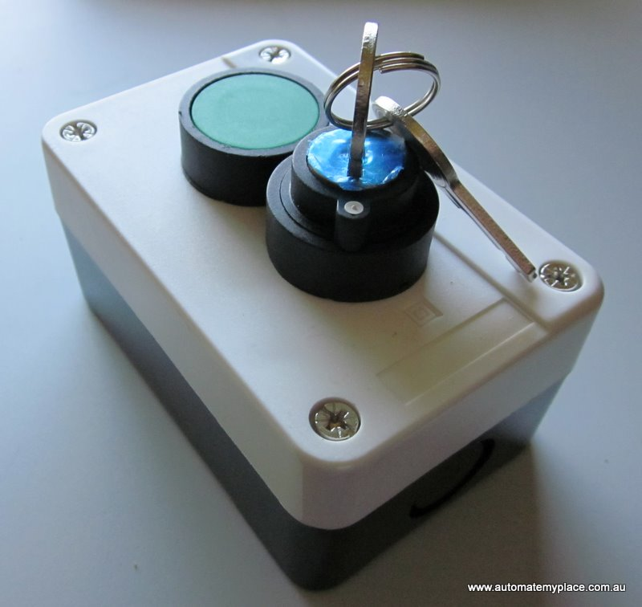
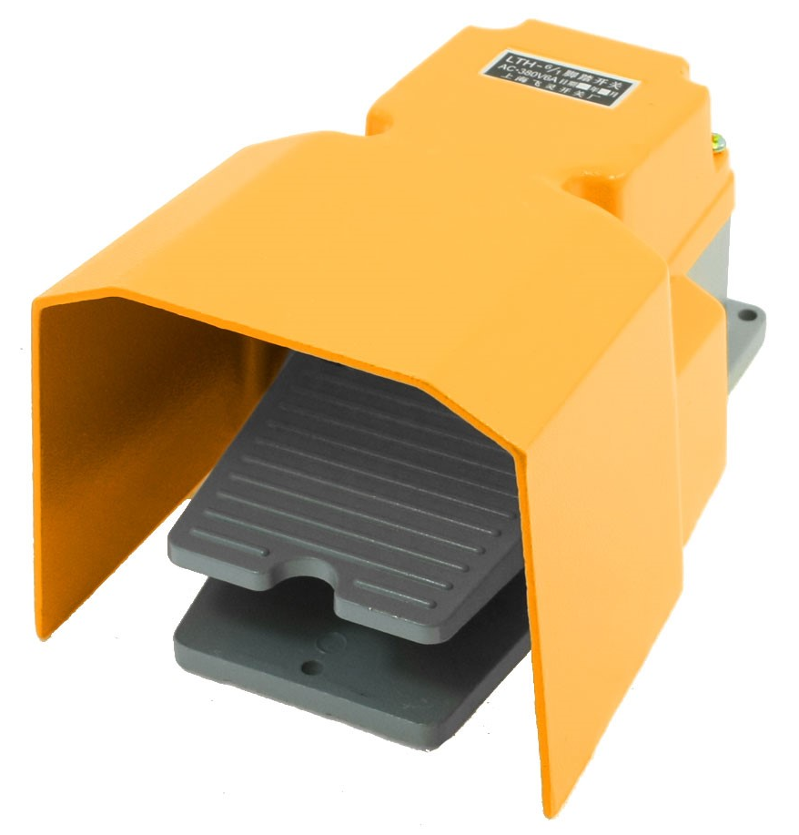

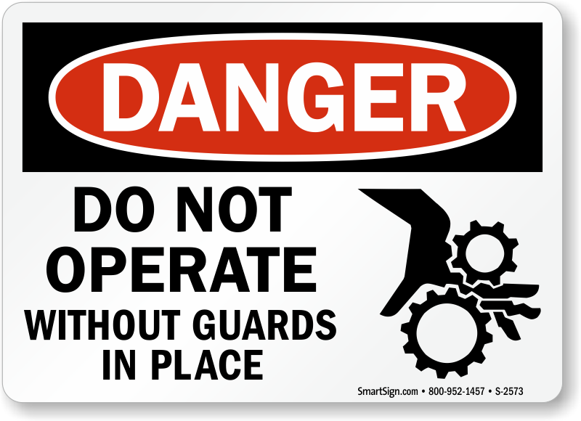
Examples of Alternative Measures
Specially designed tools
Remote devices
Interlocked barrier guards
Local disconnects, or control switches under the exclusive control of the employee performing the minor servicing.
Barricades
Warning signs and tags
Personal protective equipment

Slide 17
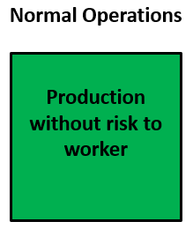
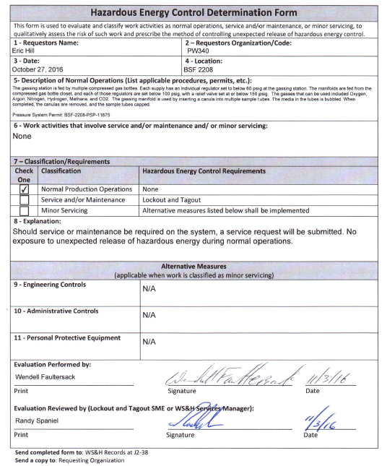
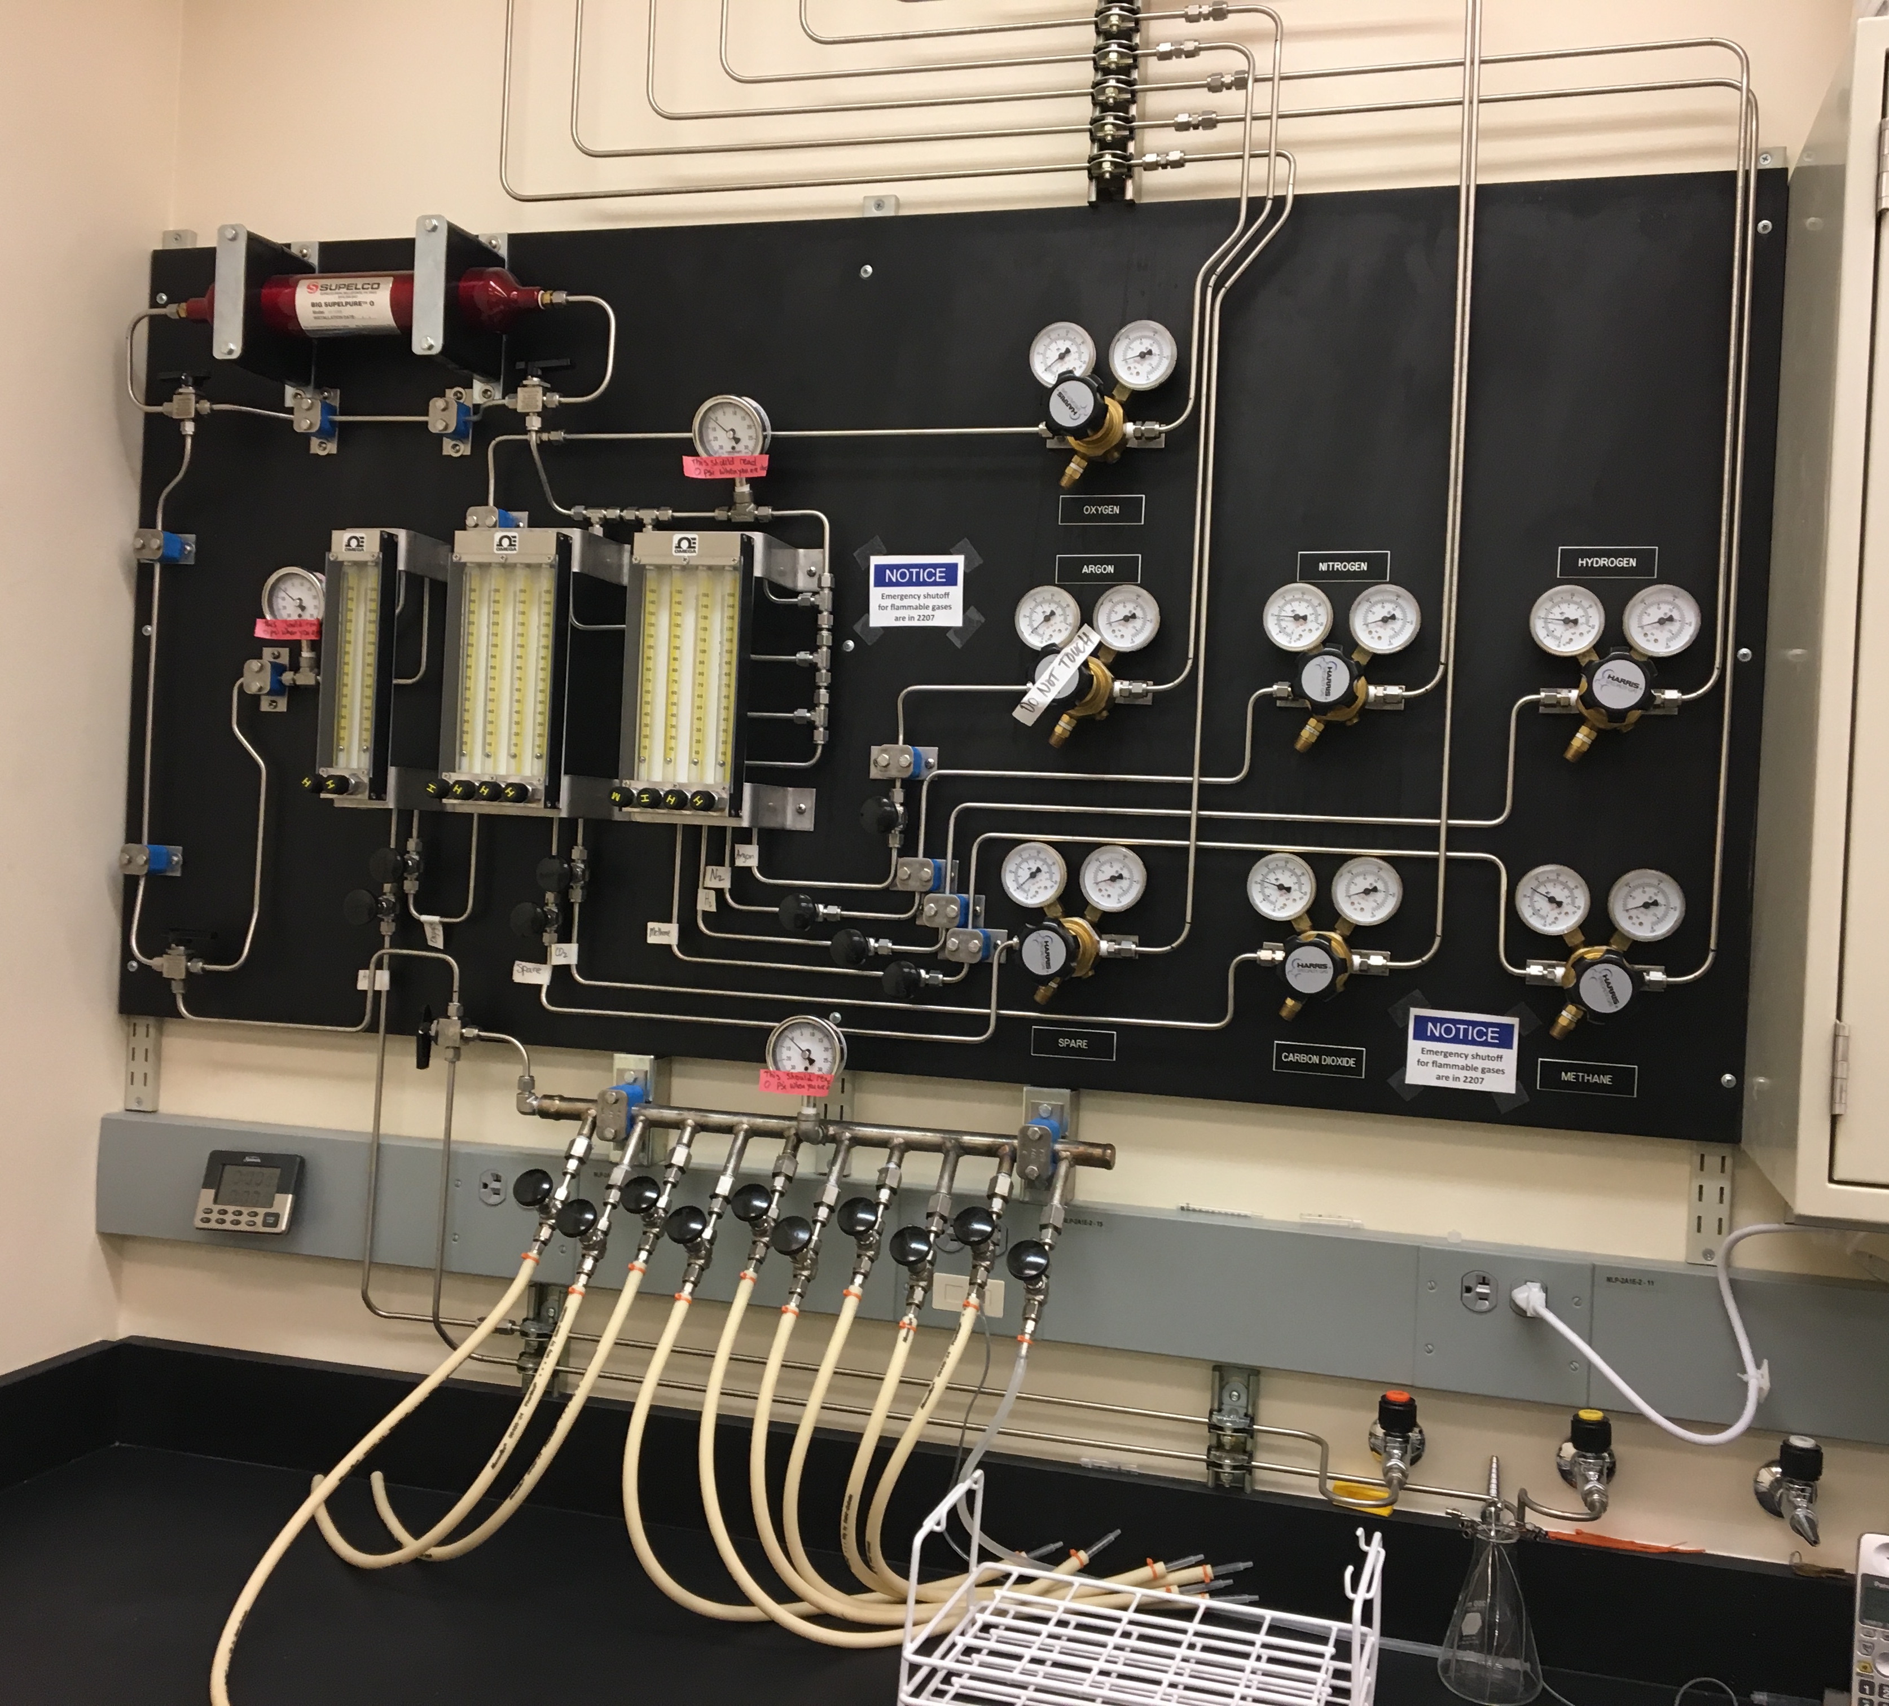
Determination Example
Normal Operations

Slide 18
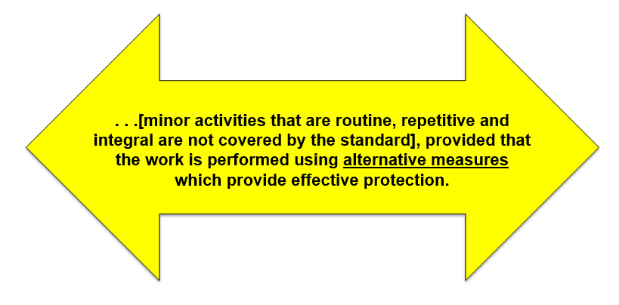
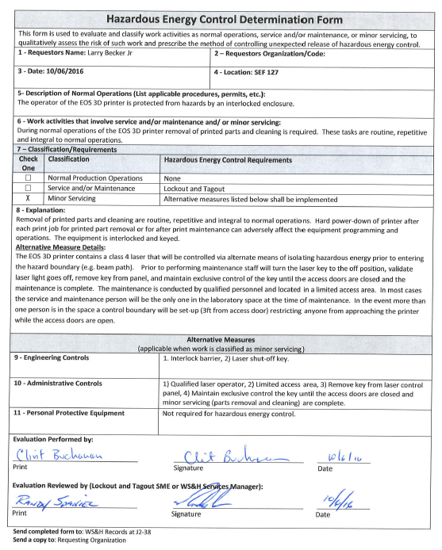
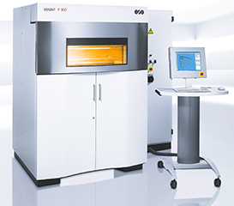
Determination Example
Minor Servicing – alternative measures implemented

Slide 19
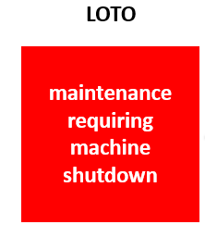
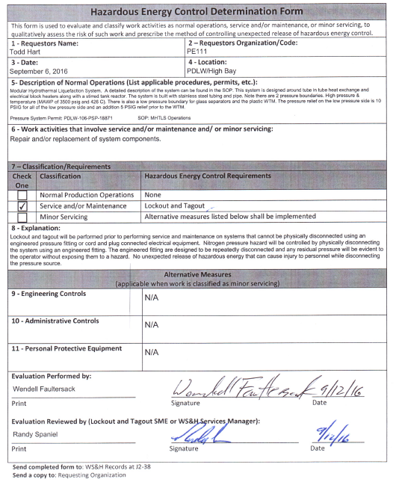
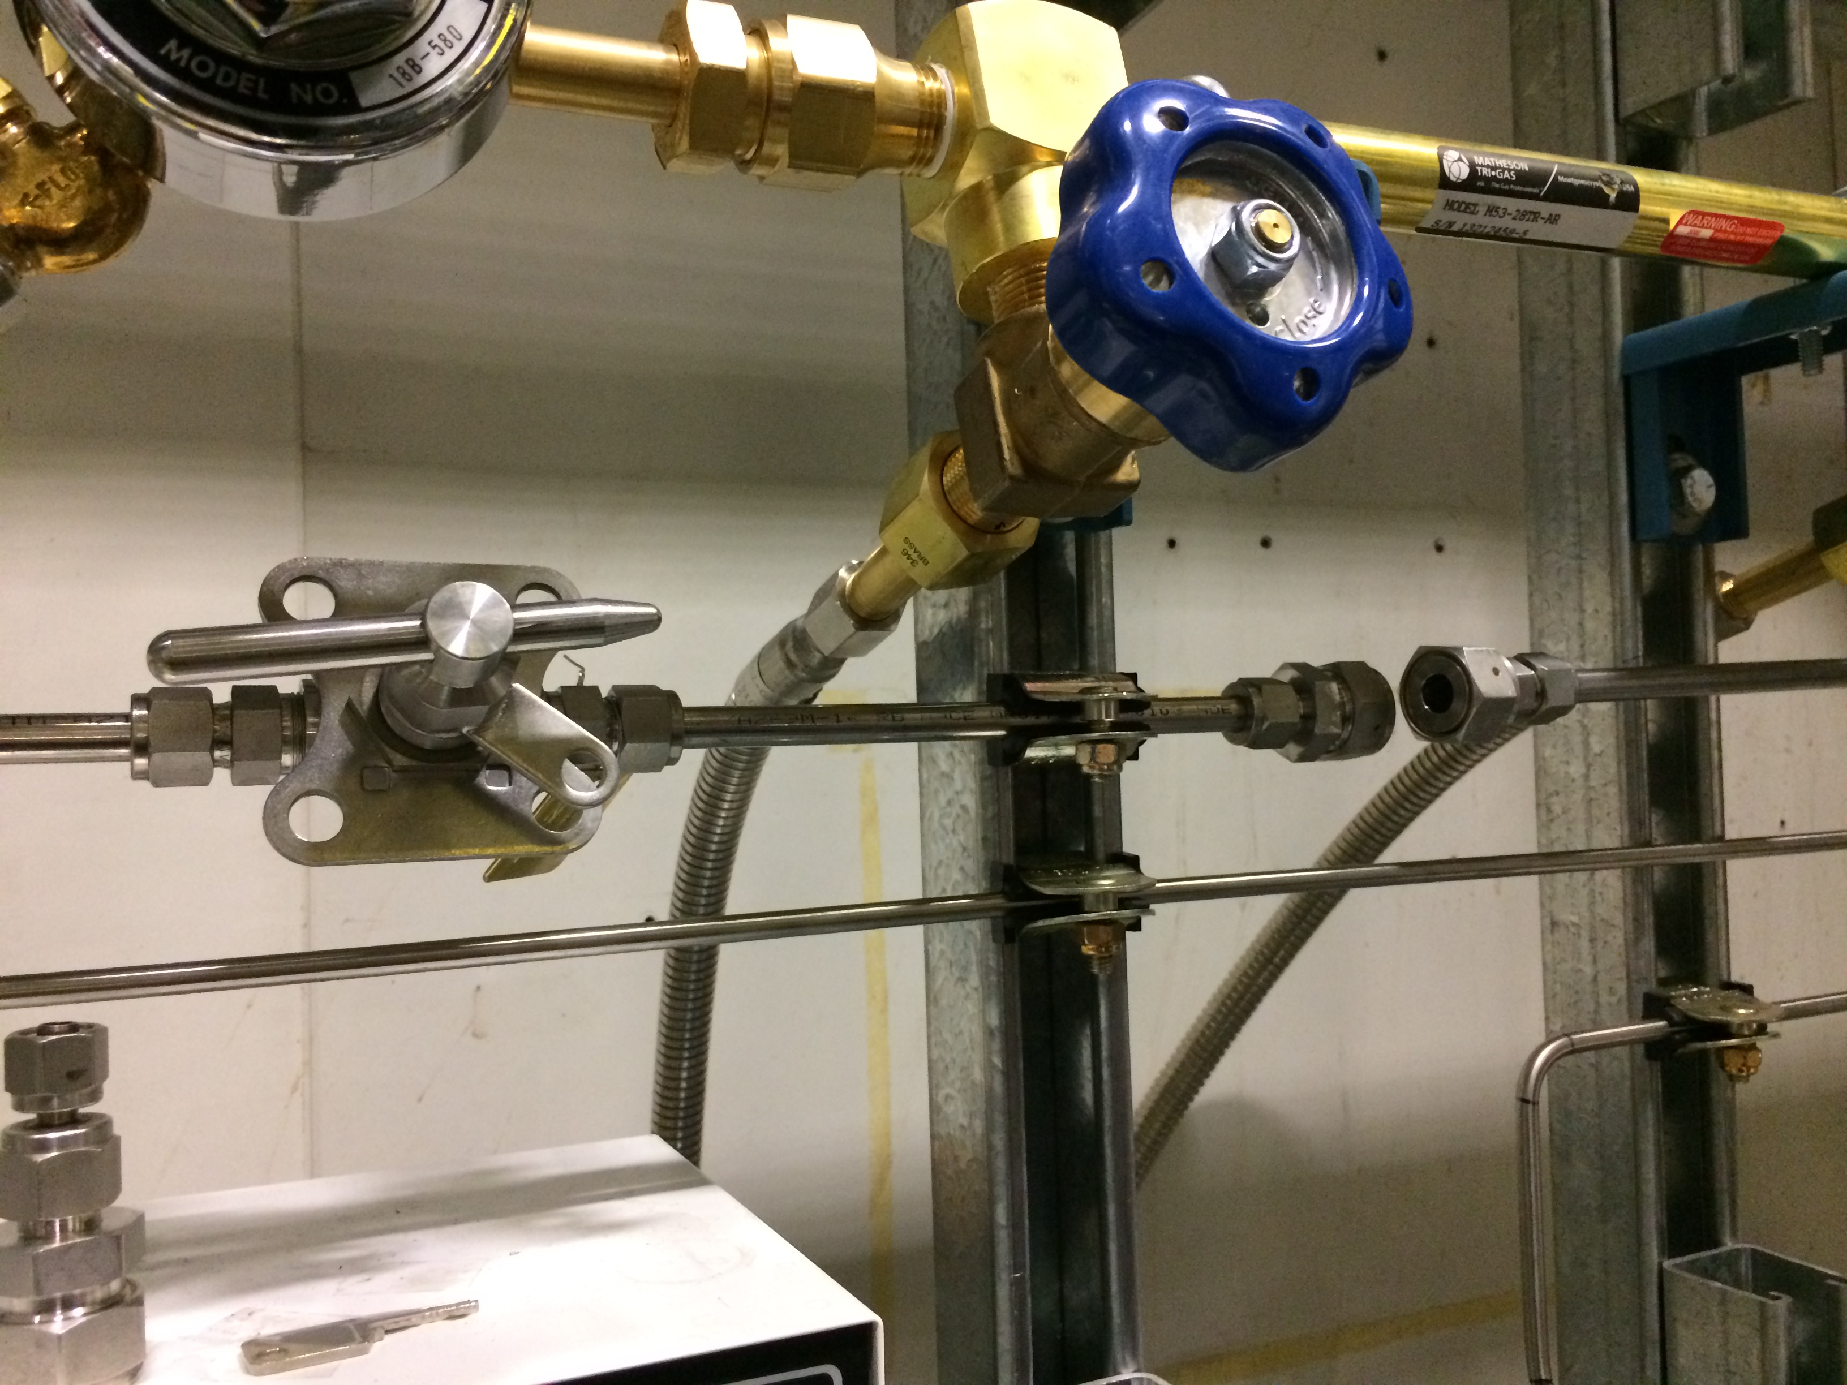
Determination Example
Service and/or Maintenance - lockout and tagout required

Slide 20
Questions

