Slide 1
Revolutionary Working Group Contract at SLAC
Attempting to document what makes sense
Brian Sherin, CSP & Carole Fried, CIH, CSP
NLDC ESH Directors Workshop | Fermi Lab
April 26-27, 2017

Slide 2
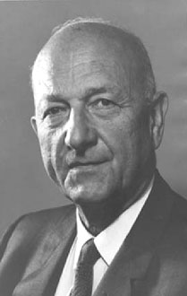

Original vision for the GOCO model
David Lilienthal’s vision:
  “enlist the capabilities and support of industries and universities’
  “eliminate bureaucratic supervision”
  Provide “freedom from various hampering restrictions…” and avoid “the government acting as entrepreneur”
  Take advantage of “operating economies”
Government Owned / Contractor Operated (GOCO)
Lilienthal saw the public and private sectors
working together as “co-trustees”
Notes:
1946 Lilienthal become first chair of AEC

Slide 3
In the original GOCO model
The Government “owned” the mission
National Security-Manhattan Project
Energy Security-Atoms for Peace
Expand fundamental knowledge-Human Genome,
And provided the funding,
And chose contractors who had the people, experiences and capabilities to deliver the outcomes

Slide 4








Over time, the Government has added more and more requirements
Contract Requirements
1970 1980 1990 2000 2010
  And many contractors have walked away
Notes:
Proctor and Gamble

Slide 5
What are we trying to solve with the RWG contract?
Simple answer:
  Move lab management contracts back towards the original GOCO model
Why?
  Industry and academia have better capabilities and experiences for running R&D organizations
  The private sector, when it operates under private sector rules, is dramatically more efficient and effective
  Contractors are much more accountable when they operate under commercial standards

Slide 6
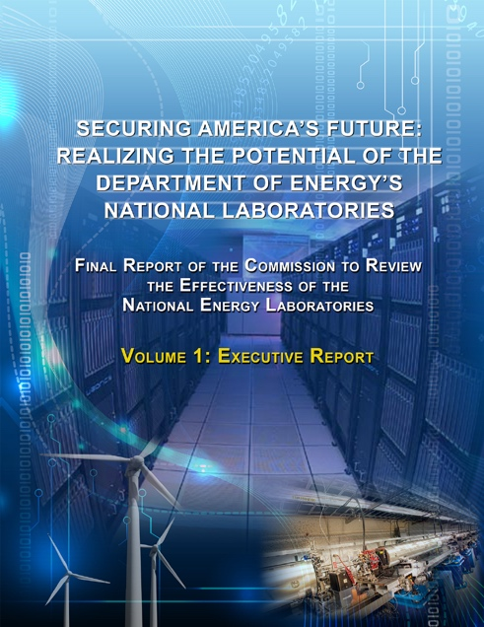
Origin of the RWG
Secretary Moniz’ charge to Stanford
  Requested “revolutionary” new contract ideas
  Gave a formal charter:
    Stay with his authority
    Exportable to other labs
  Principles-based discussion
CRENEL requested similar ideas
  Focused on effectiveness
  Stanford input had impact

Slide 7
CRENEL recommendations were shaped by our RWG input
CRENEL
DOE SSO & Stanford
Recognize Value
Rebuild Trust
Maintain Alignment and Quality
Maximize Impact
Manage effectiveness and efficiency
Ensure lasting change
Rebuild trust between DOE and its contractors
Restore authority, & accountability to line management and address DOE’s micro-management. Decision making authority and accountability returned to line management at the lowest practical level in the organization.
Organize the contract around performance expectations as articulated in the PEMP and Lab Plan. Make the contract a tool that both DOE and the contractor would use to drive performance.
Break the paradigm that more paper and more requirements are the solution, especially from WDC
Use consensus standards wherever and whenever appropriate

Slide 8
Rec 2. Rebuild Trust
DOE, Stanford and SLAC started with a trusting relationship
The RWG process deepened that trust
The old contract became the common “enemy”
“What is best for achieving our mission and goals?” was the guiding question

Slide 9

Rec 3. Maintain alignment
Return authority to line management
Give authority to lowest level of “line management”
Hold line management accountable
The RWG approach makes contractors much more accountable for the outcomes

Slide 10
Rec 5. Effectiveness and efficiency
“How does this requirement helps us achieve our mission and goals?” is the core question
Remove duplication, redundancy, conflicts, irrelevant requirements
Many, many anecdotes available
All add costs and increase risks
Use Stanford’s policies and practices where possible
Notably IT, Personnel, Business systems
But use DOE’s Orders when better
    Accelerator Order
    Project Management

Slide 11
Rec 6. Ensure lasting change
RWG’s ability to critically examine any new requirement creates a “firewall” that is designed to ensure lasting change
And avoid returning to the old ways
Moving the RWG contract model to other labs will allow us to meet this recommendation
Why we are here today

Slide 12
Why Stanford and SLAC for this Pilot?
SLAC was formed in 1962 – funded by AEC, built on Stanford land under a 50 year lease (now until 2043)
Stanford receives well over $1B/yr in federal funds (~40% for SLAC), so it already has mature systems
Stanford is highly engaged in SLAC performance
Both Site Office and Lab perform at a high level
Nature of research program – fundamental science, no classified work, no national security work
SLAC has never been a stand-alone enterprise (not a lab-in-a-box); always relied on many Stanford systems
ALL OF THESE FACTORS MADE SLAC A GOOD CANDIDATE FOR THIS PILOT

Slide 13
Guiding Principles
  Charged teams with identifying and solving problems such as:
    low-value added and high-cost requirements or approvals
    requirements inconsistent with other contractual or regulatory requirements
    duplicative, confusing, or difficult to find requirements
    “one-size-fits-all” requirements that are unduly burdensome/not a good fit for the laboratory
    following DOE policies even though contractor policy or industry standard is the best solution
  Key ingredients
  Leadership support from all parties
  Trust between parties and collaborative atmosphere
  Mutually agreed principles
  Actively engaged subject matter experts
  Support, tools, and structure for SMEs
  Strong rationales and documentation
  Core team collaboration in approval stages

Slide 14
Step 2: Establish Structure Around Principles
  Key operating rules:
    Stick to changes within the power of the Secretary to approve
    Propose what makes sense to enable better science – not about shifting risks or costs to the other side
    Increasing level of justification and approvals:
Sections
A-H
Directives
DEAR
FAR (Applicability Only)
Less Justification Required
More Justification Required

Slide 15
Realign Contract/Assign Teams
  H.0 Introduction & General Provisions
      (New provisions on goals, intention, partnering, precedence, contract maintenance)
  H.1 Mission Accomplishment (PEMP Sections 1 – 3)
  H.4 Management, Leadership & Stewardship (PEMP 4)
  H.5 ES&H and Environmental Protection (PEMP 5)
  H.6 Business Systems (PEMP 6)
  H.7 Project Management and Infrastructure (PEMP 7)
  H.8 Security, Cyber, Emergency Preparedness (PEMP 8)

Slide 16
Notable changes to ES&H/Security elements
 | Previous | Current
10 CFR 851 | Lack of clarity over referenced code versions | Modified H Clause- Authority given to SSO to approve through SLAC WSHP based on applicability and risk
 |  | No enforcement actions pertaining to changes in consensus standards will be taken against the Contractor before implementation is complete as stated in the agreed schedule.
External regulation | Previous H Clause | Modified authority to decide at local site office.
Haz Mat Transportation | DOE O 460.1C | Eliminated; implied compliance with DOT regs (49 CFR)
Stop Work | FAR 52.242-15 + numerous repetitions in DEAR/851 | FAR, 851 and H Clause (1 sentence)
Aviation Mgmt | 440.2-C (wasn’t yet in contract) | Use of Stanford UAS policy (FAA-based)
Radiation Protection | DEAR 952.223-75 Preservation of individual occupational radiation exposure records | Deleted. Redundant with CFRs
 | DOE O 435.1 Radioactive Waste | Deleted Order. Kept Manual 435.1-1
Notes:
Have to keep updating as changes are made/comments are received.

Slide 17
Notable changes to ES&H/Security elements
 | Previous | Current
Nanomaterials | Policy 456.1 | Deleted. SCP for O. 456.1 only
Emergency Management | DOE O 151.1-C | Not in contract; SLAC developing comprehensive plan with NFPA 1600 as basis for emergency preparedness, management and business continuity
Unclassified Foreign Visits and Assignments | FACTS entry of all Sensitive Country nationals, plus entry of all information into PeopleSoft for badging | Capture info in PeopleSoft, quarterly report and upon request; no change to “T-3” nationals
Counterintelligence | Full order (475.1), with lack of clarity over applicability | Site Compliance Plan references Site Security Plan, and limits applicability in some areas
Notes:
Have to keep updating as changes are made/comments are received.

Slide 18
Justification Example – Site Compliance Plan

Slide 19
Comparison - Current RWG Contract
  Contract was signed by the Secretary on October 1, 2016, and is in the first year of a three-year pilot
New RWG M&O Contract
Eliminated 13 FAR and DEAR clauses (and counting)
H Clauses – some eliminated, many wrapped into new H Clauses
Eliminated 10 Directives (and counting)
Site Compliance Plans tailoring almost all remaining (30ish) Directives
Over 25% shorter than old M&O contract
Contract Maintenance
  Current - Almost 50 new or revised provisions to review and comment on each year (FAR/DEAR Clauses, Acquisition Letters or Directives) in either Fed Register or Rev Com; many end up in our Contract
Defined and Deliberate process for adoption of new or revised Clauses or Directives. Through this process, already have decided NOT to include 1 Directive (re: aircraft order) and 1 H clause (multi-factor authentication)

Slide 20
Documentation Moving Forward
  Contract maintenance analyses and process flow charts
Notes:
Have to keep updating as changes are made/comments are received.

Slide 21
Looking Ahead
Revolutionary “experiment” expected to last three years, and may be continued if successful
Independent body (TBD) will be in charge of monitoring experiment
Management encouraged to look at additional areas that could benefit from SCPs or other collaboration with SSO
Some areas of new contract will require longer timeline to implement, while other changes already implemented
Starting to look at RWG Phase 2

Slide 22
Questions?

