Slide 1
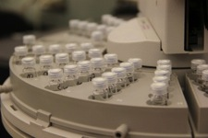
A Hard Look After a Near-Miss - Improvements to Readiness Review Procedure
Sean Whalen, Manager, ESH&A
April 25, 2017

Slide 2
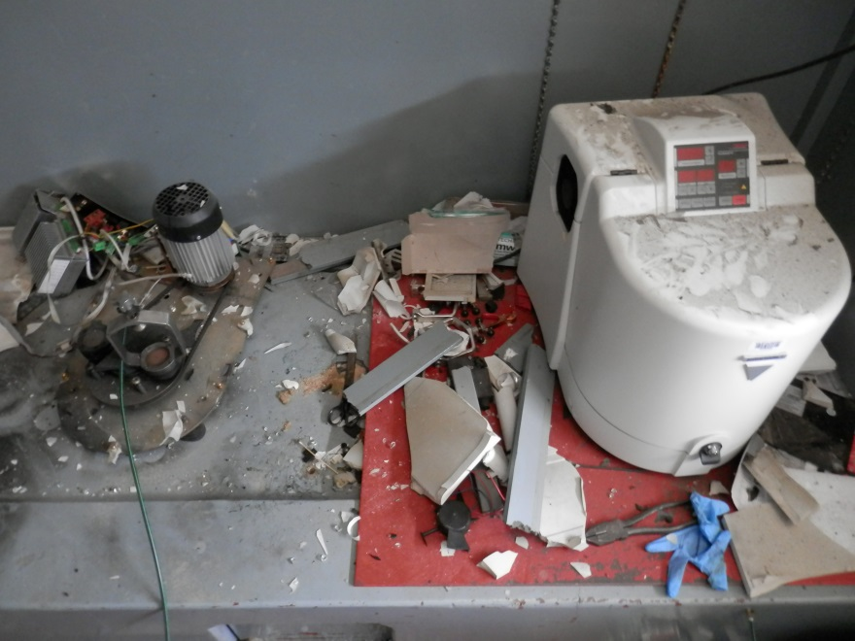
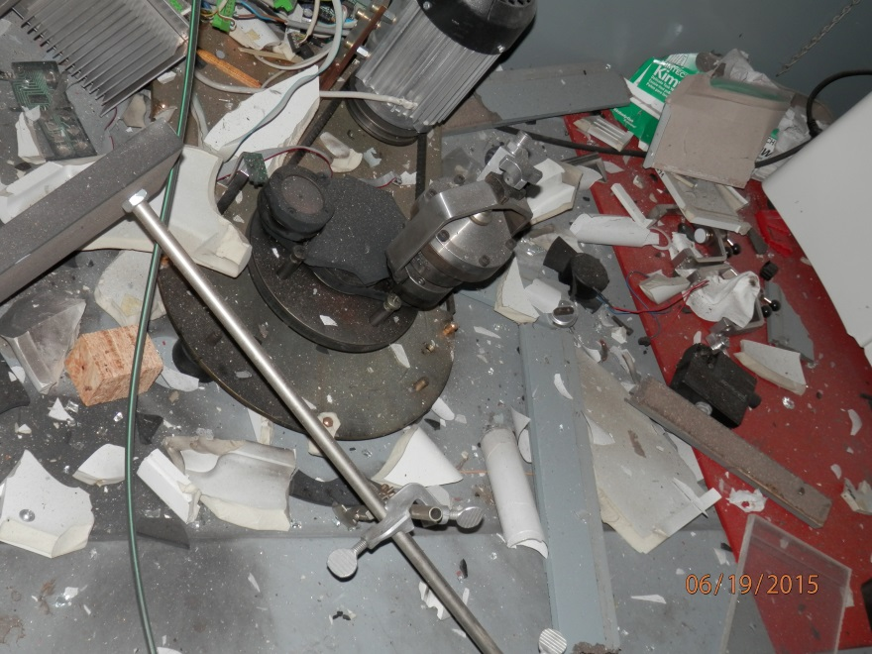
Incident Overview and Response
High-pressure ball mill vial ruptured
Near miss event: No one was in laboratory; no injuries.
Damage
Ball mill was destroyed
Hood was badly damaged
Glass and debris scattered through the lab and out into the hallway
No fire or significant smoke
No sprinkler actuation

Slide 3
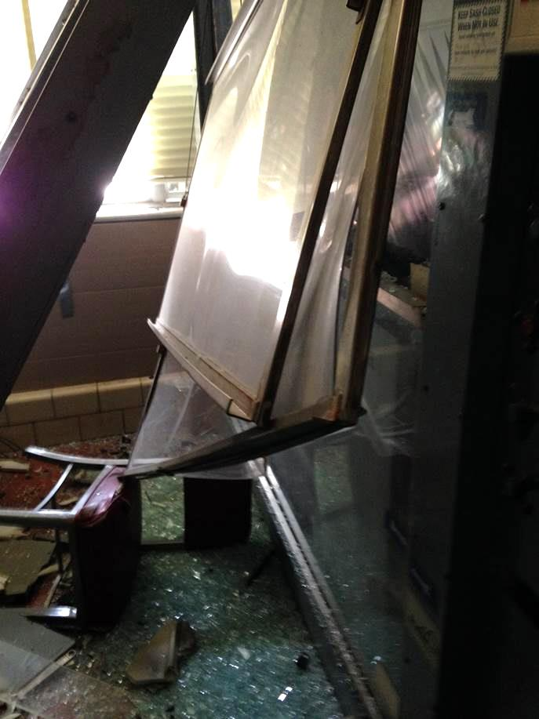

Slide 4
ISM/EMS: A visual representation
Notes:
Here is a visual model of the ISM/ESM process.
The first step is to define the scope of work. This includes what is being performed, when it will take place, who will be doing the work, and where they will be doing it.
Step number two is to analyze the hazards and environmental impacts of the work to be performed. Don’t just think of the hazards and impacts that are currently present, but include hazards that could arise in the future.
Step three is to develop hazard controls and implement them. Once we know the hazards and impacts of the work we can develop safety procedures and training to reduce them.
Step four is to work within the safety and environmental controls that are designed.
Step five is to evaluate and provide feedback for what has been implemented.
This process is most visible in our Readiness Review Process, which will be discussed in a few slides.

Slide 5
Readiness Review = WP&C
Pre Event
3 risk rankings (I-High, II-Moderate, III-Low)
5 year reauthorization (I year on High)
Task/Hazard/Control not specifically defined
Approved by SRC
Annual “review” but no verification

Slide 6
Readiness Review = WP&C
Post Event
Specific Task/Hazard/Control statements
Delivered training to all RR holders +
Improved risk rankings (I-High, II-Elevated, II-Moderate, II-Low, III-Lowest)
3 year reauthorization for II-Elevated, 5 for others (except High)
Approved by Division Director
Annual review with verification check

Slide 7
Other Nuggets
Risk evaluation is Qualitative
Required Group Leaders to attend RR meetings
Procedure is well known and accepted, even by some of our more recalcitrant scientists
Tremendous support from top management
Clunky - Need to move to a more user friendly interface

