Slide 1
48 Hour Summary
Donovan Tooke
Wednesday 09:00 Meeting
1 February 17

Slide 2
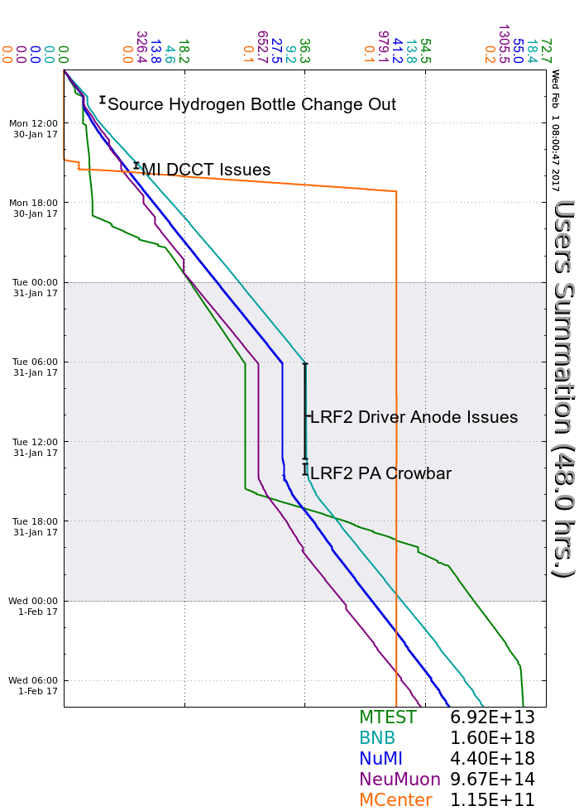
Monday
Changed Source Hydrogen Bottle
MI20 pond pump investigation
Replaced 60 HP pump (Tues)
400 MeV Chopper cabinet
Lost MI DCCT readback
No SY beam, QXR regulation
Tuesday
LRF2 Driver Issues
MI DCCT Readback issues
Lowered intensity (threshold)
Wednesday
Had a few LRF trips
Instrumentation Test of Muon Campus

Slide 3
Current Conditions
Beam to NuMI
632.4 kWatts
48.6 e12
Beam to BNB
4.14 e16 p/hr
Beam to SeaQuest
5.083 e11
Beam to MTest

