Slide 1
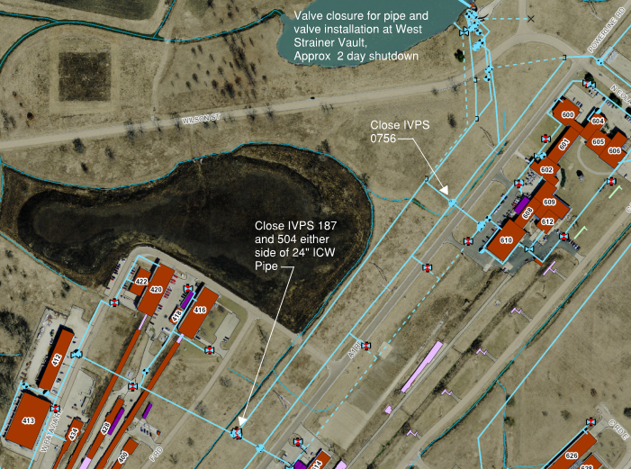
Tentative Meson Area ICW Supply Shutdown, Feb. 9-10

Slide 2
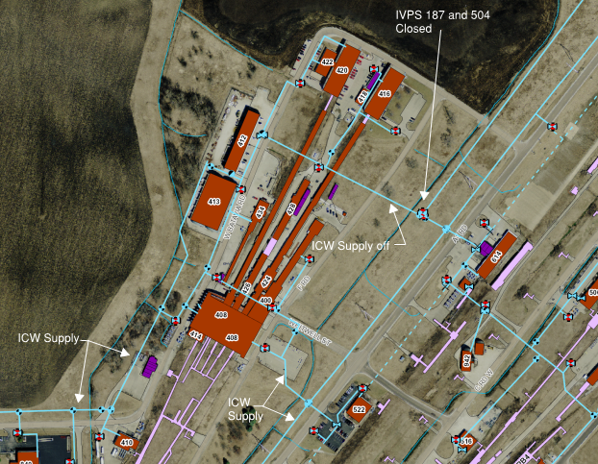
Tentative Meson Area ICW Supply Shutdown, Feb. 9-10

Slide 3
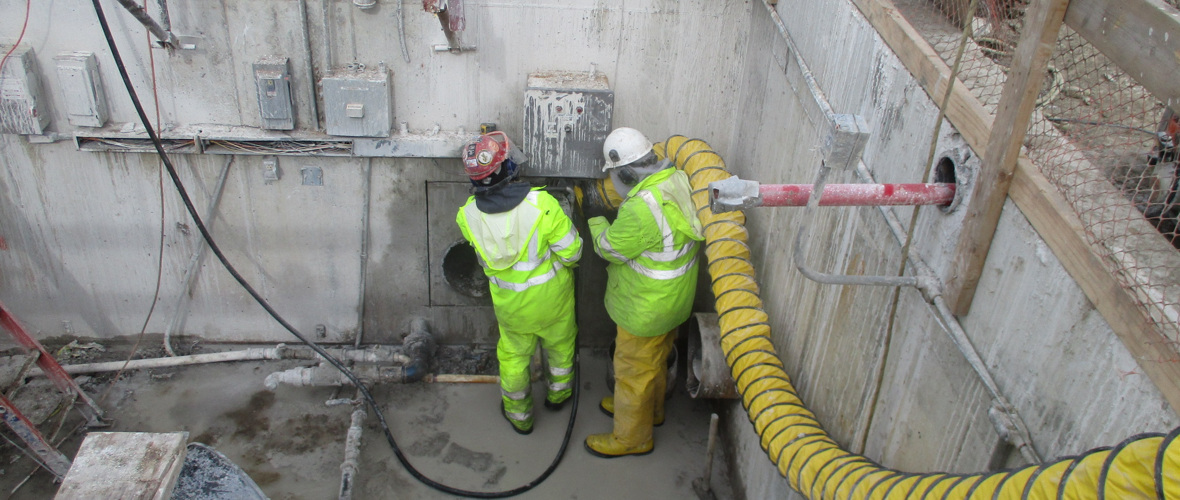
Casey’s Pond West Strainer Pit Discharge Piping Upsize
Saw Cutting Concrete to enlarge Discharge Piping

Slide 4
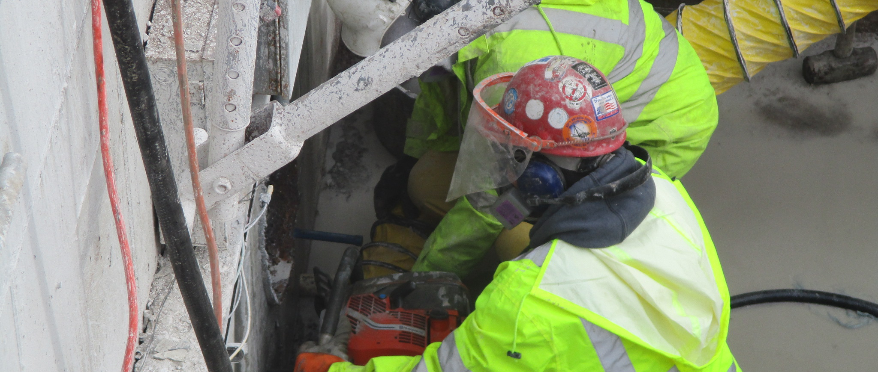
Casey’s Pond West Strainer Pit Discharge Piping Upsize

Slide 5
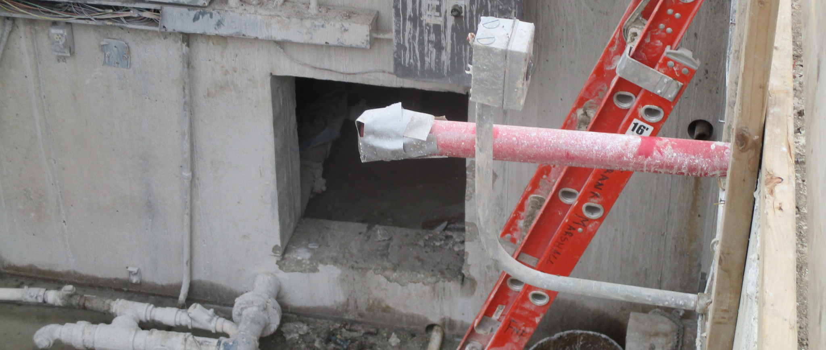
Casey’s Pond West Strainer Pit Discharge Piping Upsize

Slide 6
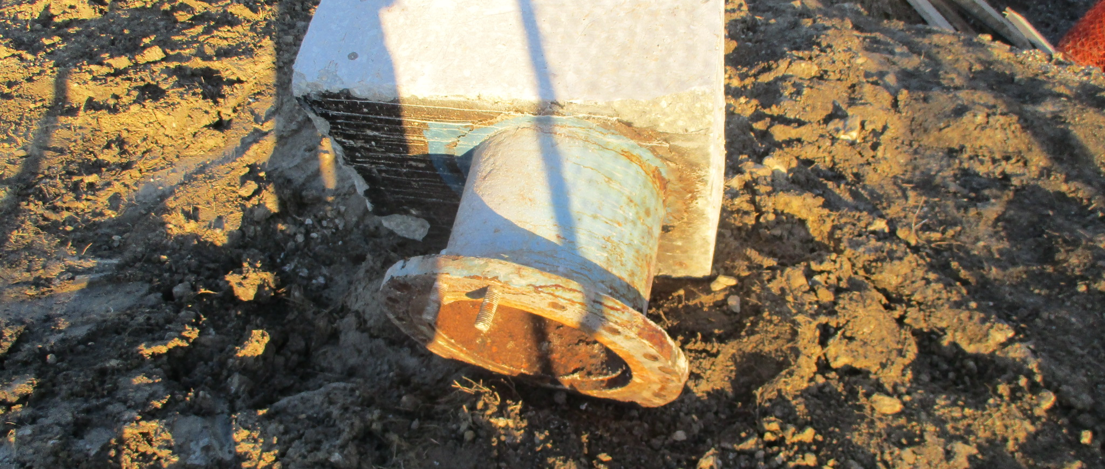
Casey’s Pond West Strainer Pit Discharge Piping Upsize

Slide 7
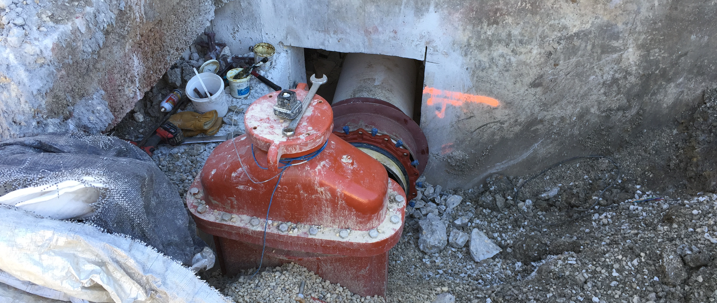
Casey’s Pond West Strainer Pit Discharge Piping Upsize

Slide 8
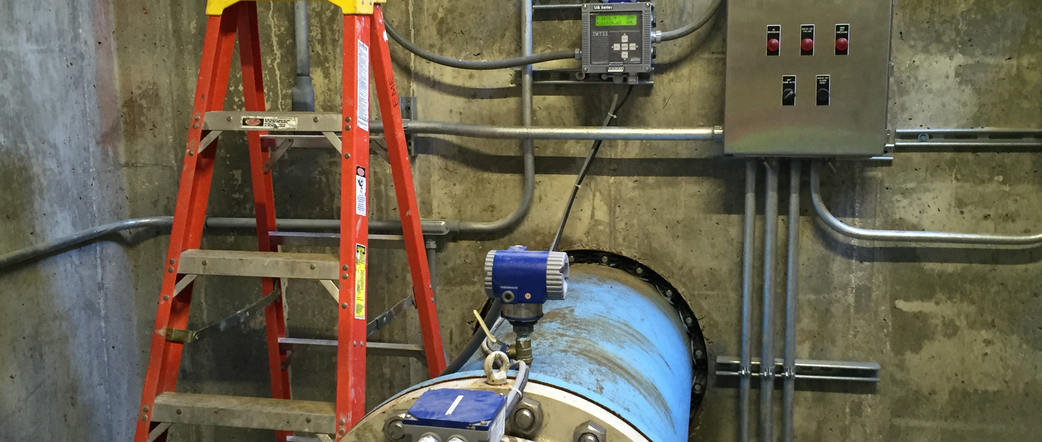
Casey’s Pond New East Strainer Pit Flowmeter

Slide 9
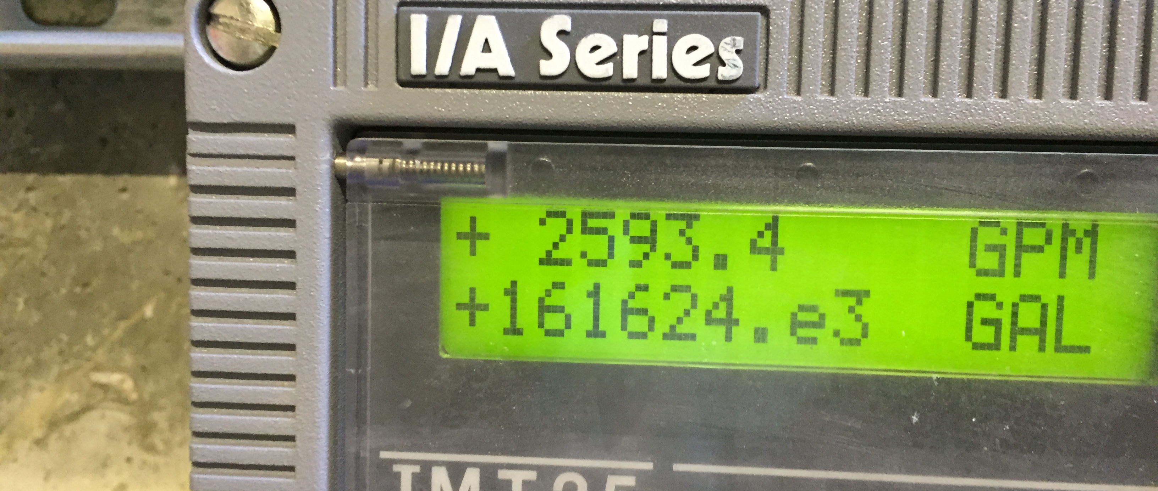
Casey’s Pond New East Strainer Pit Flowmeter

Slide 10
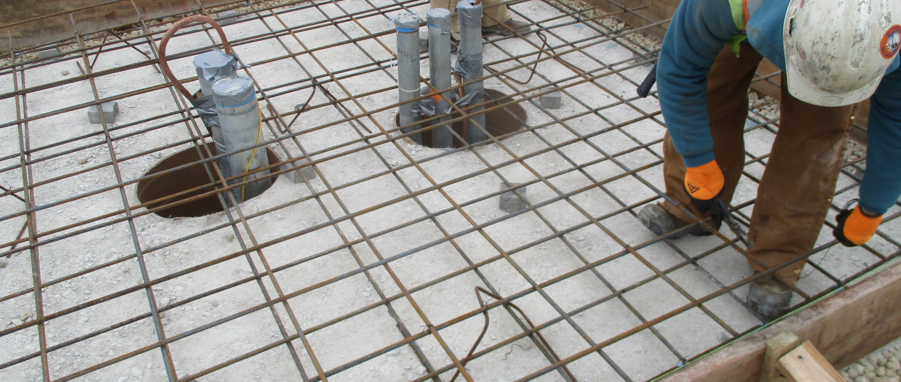
CMTF Pump Station Transformer

Slide 11
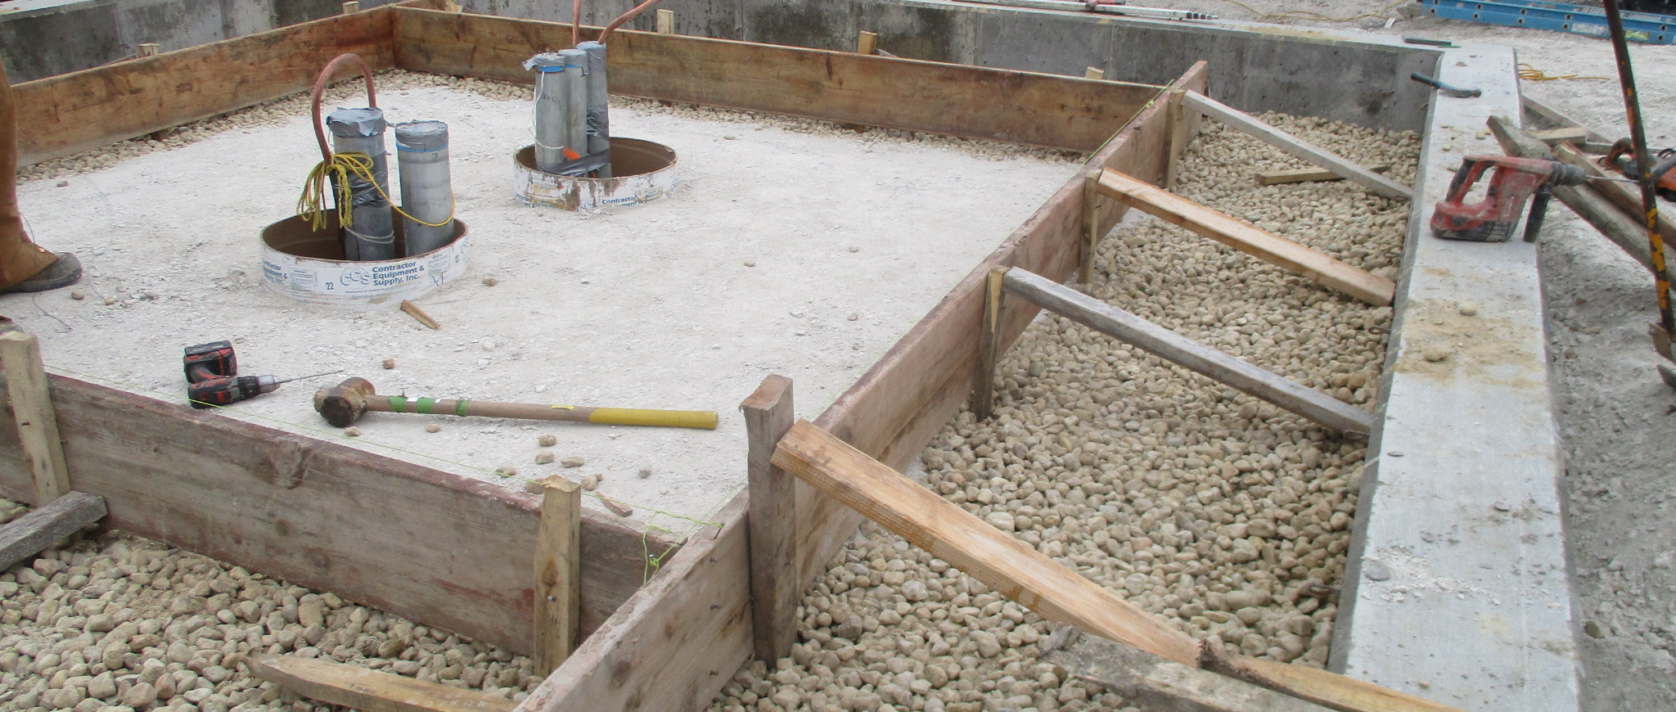
CMTF Pump Station Transformer

Slide 12
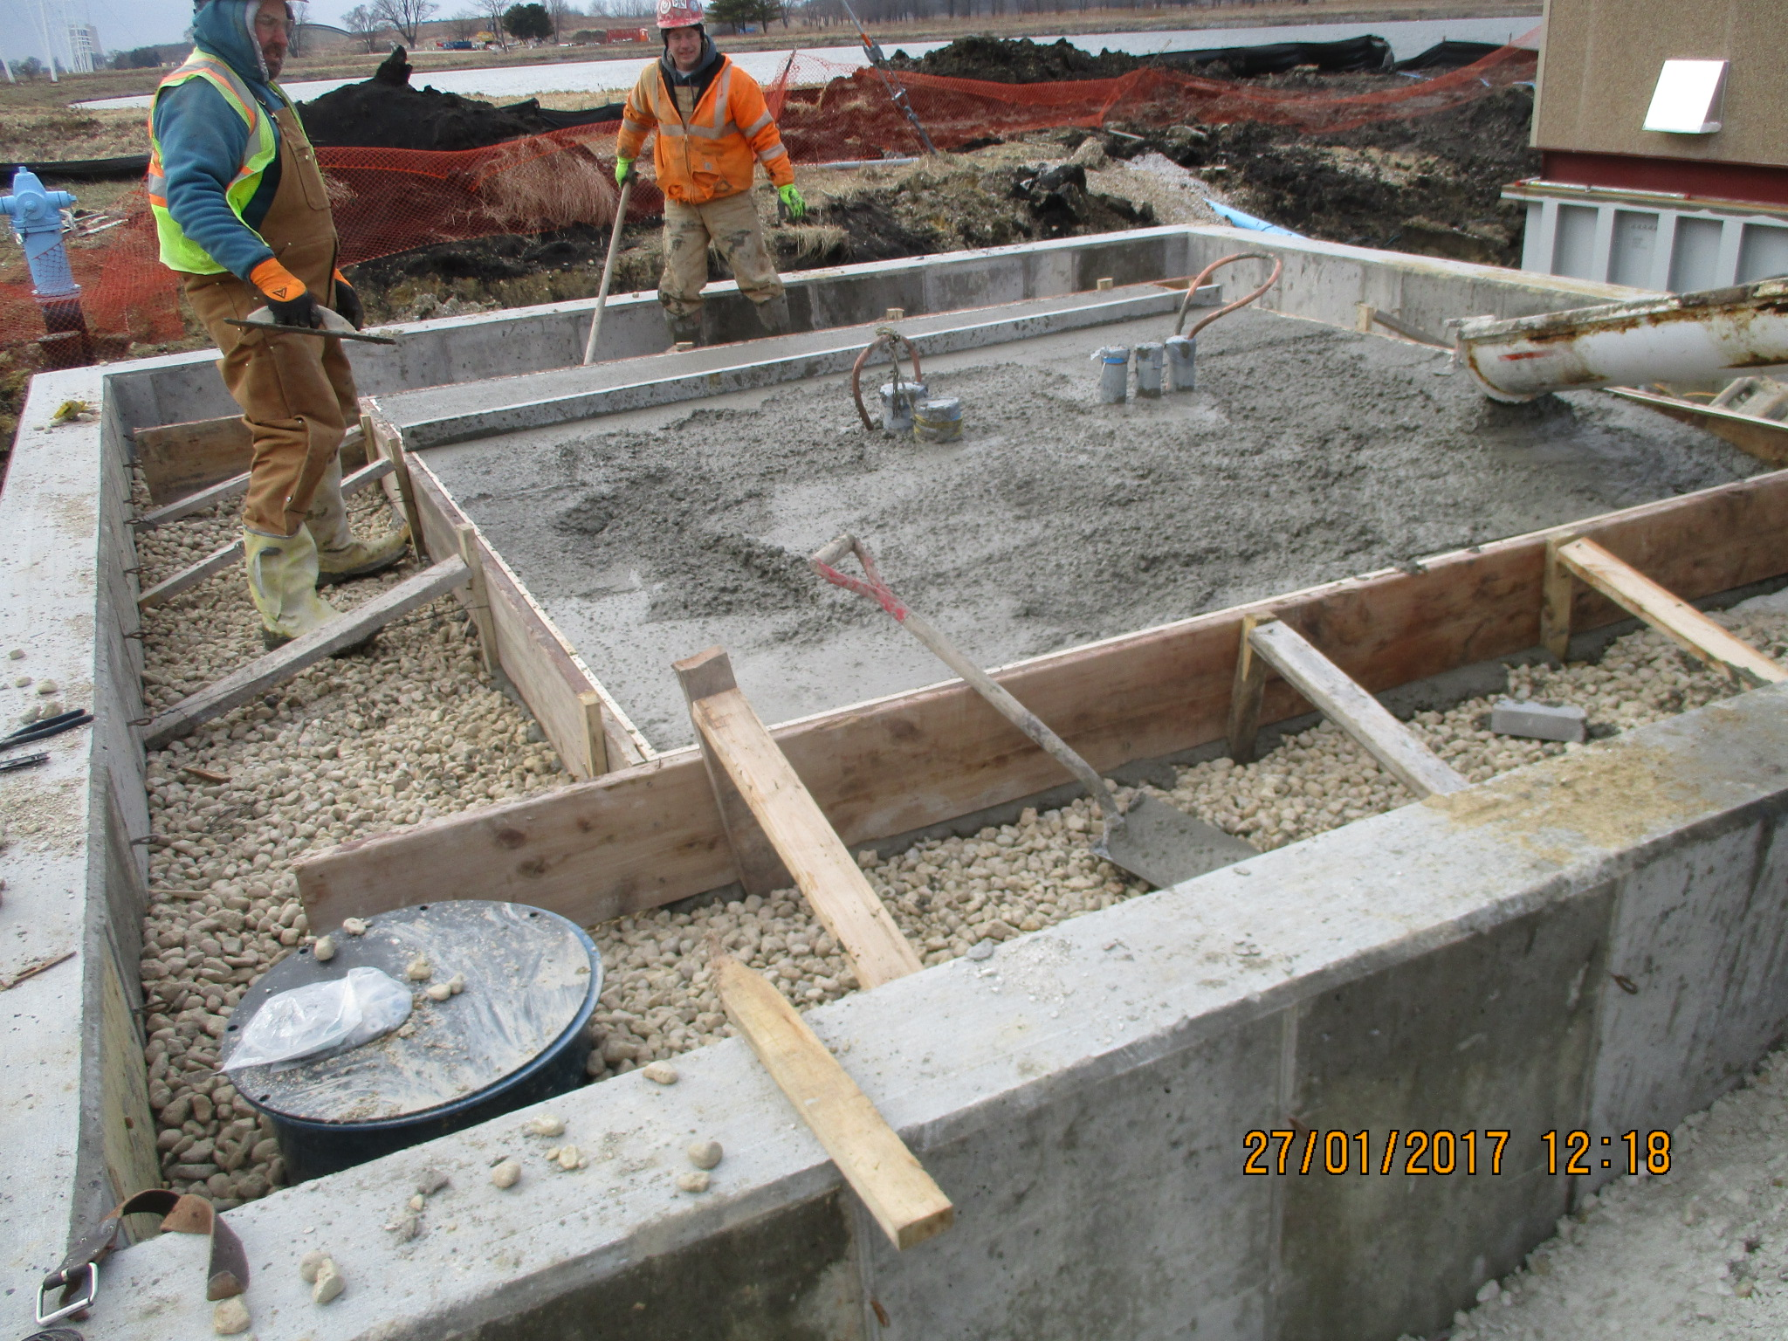
CMTF Pump Station Transformer

Slide 13
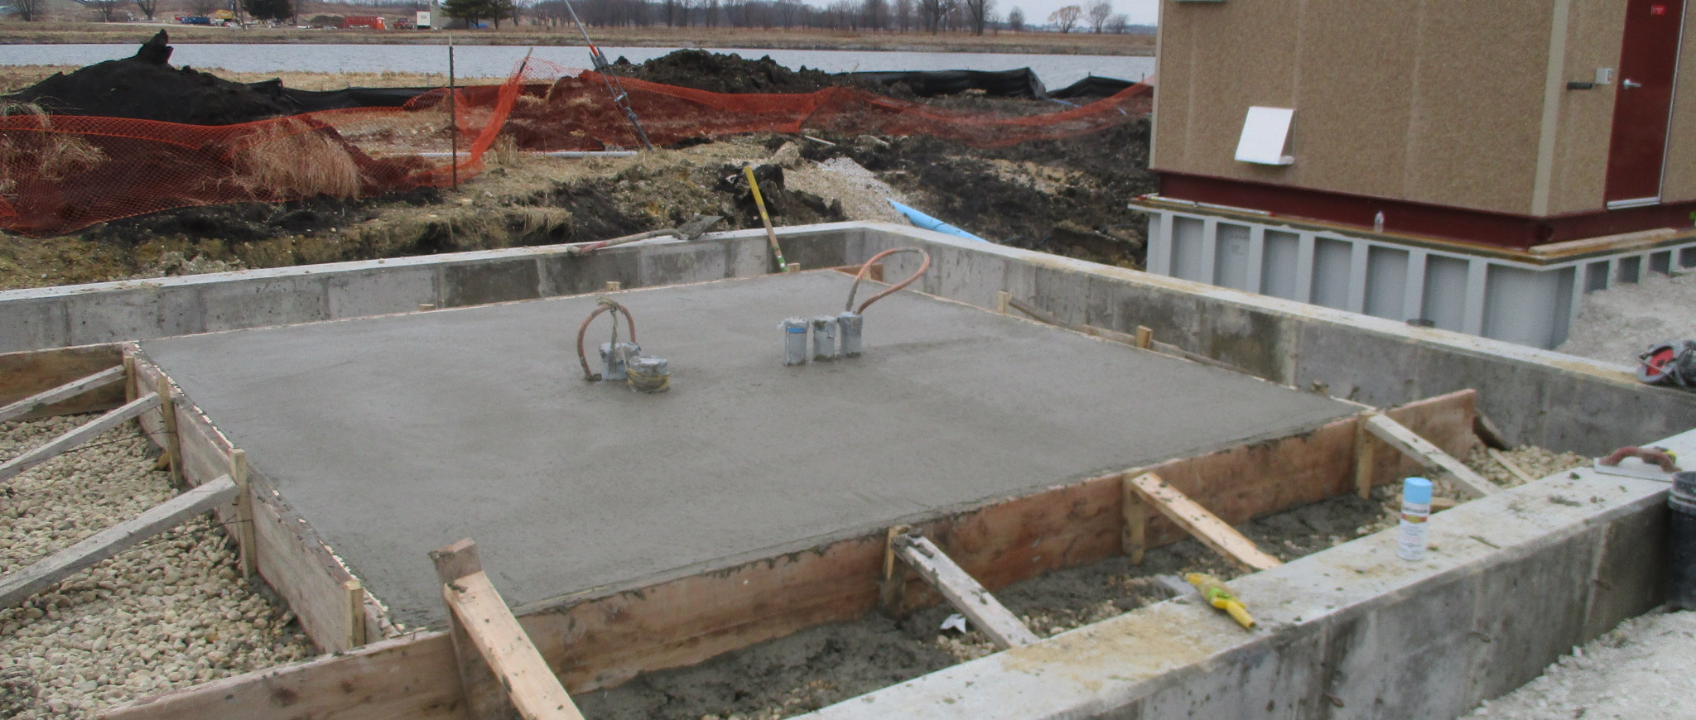
CMTF Pump Station Transformer

Slide 14
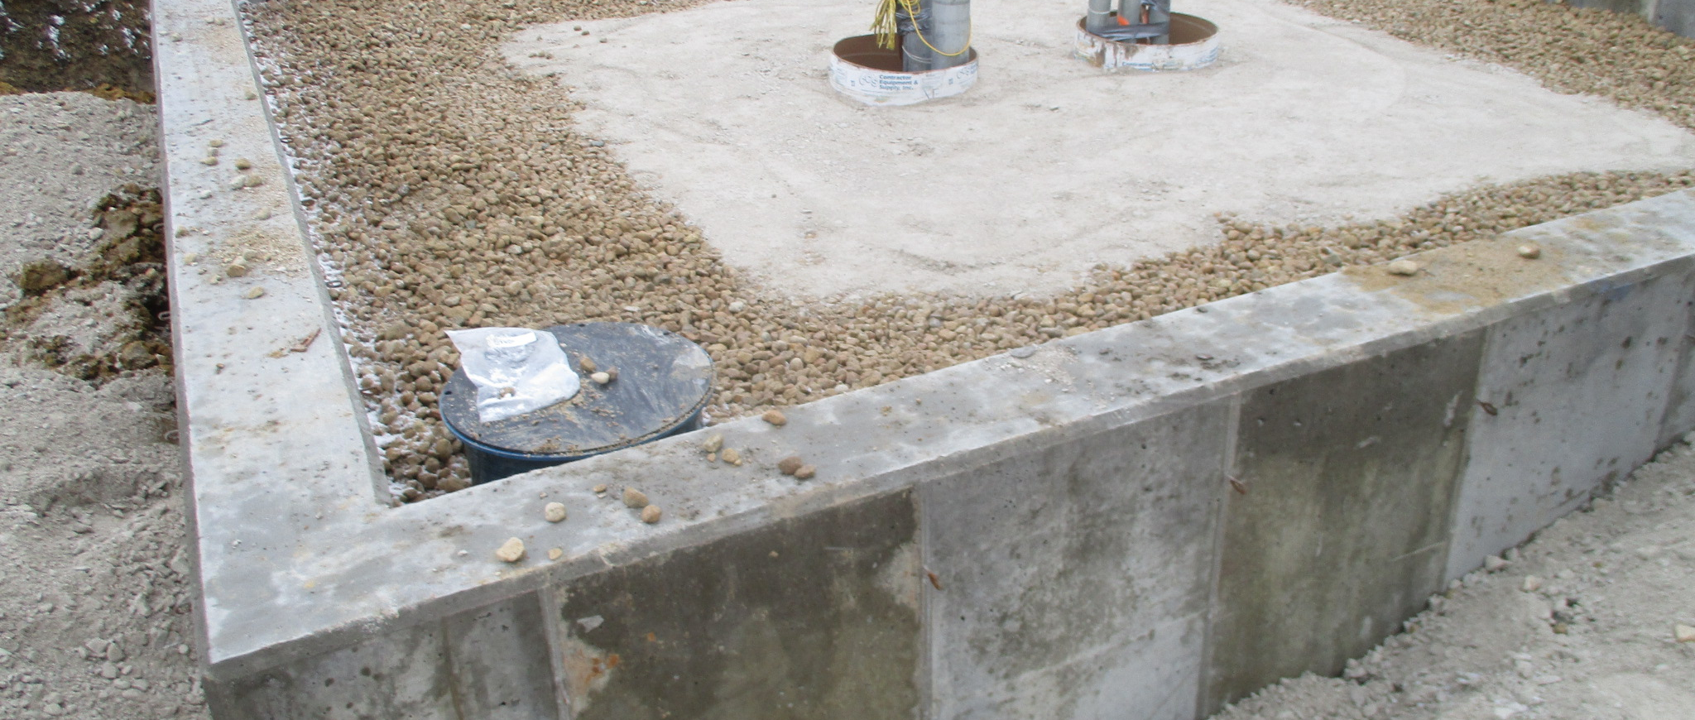
CMTF Pump Station Transformer

Slide 15
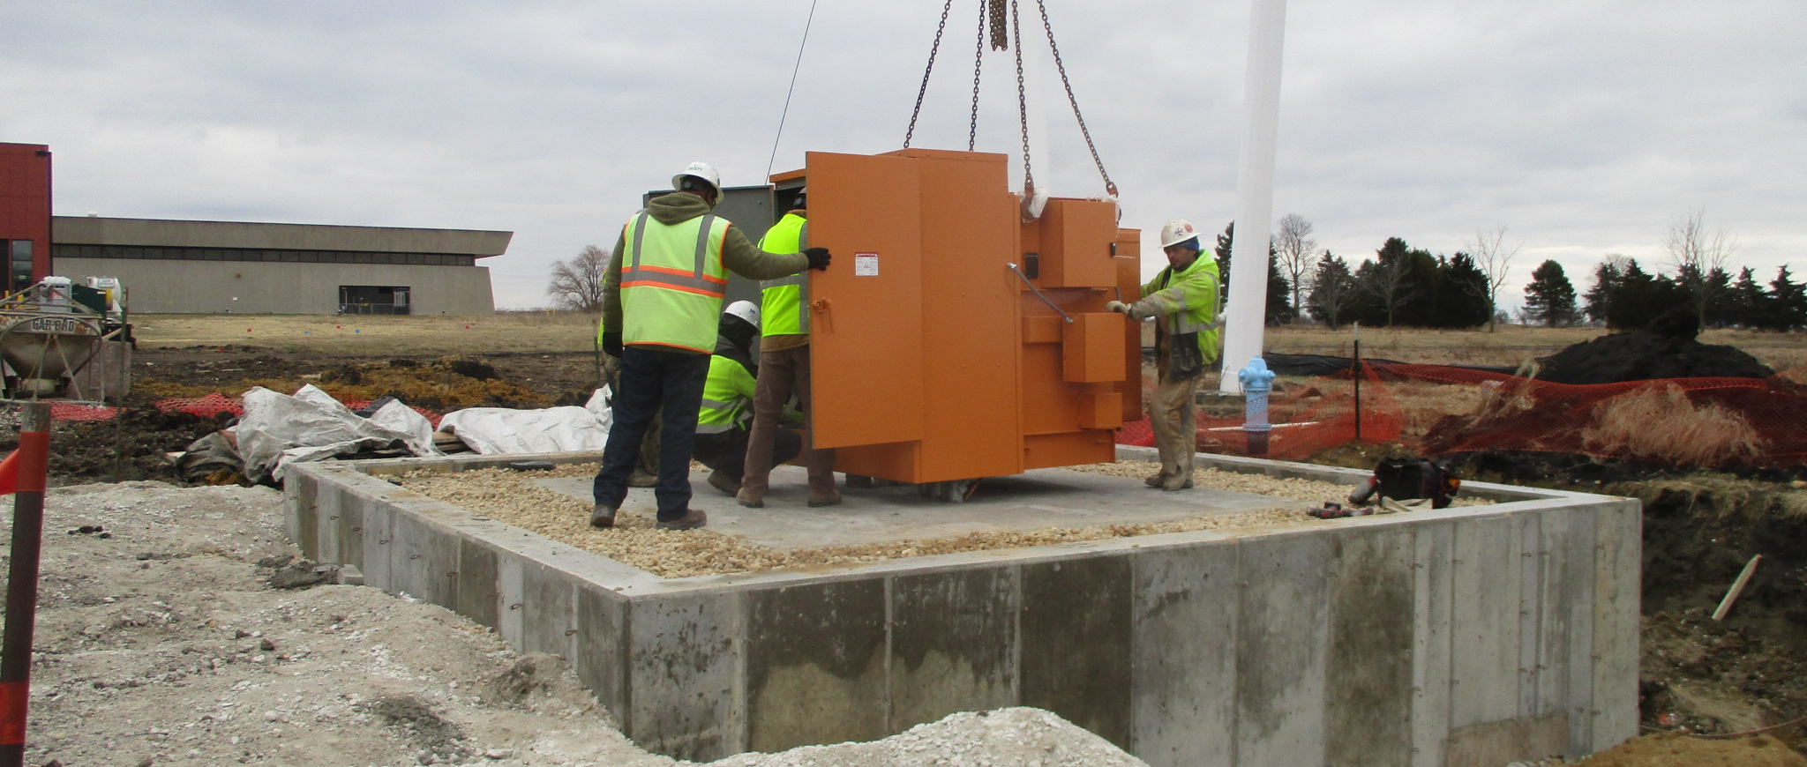
CMTF Pump Station Transformer

Slide 16
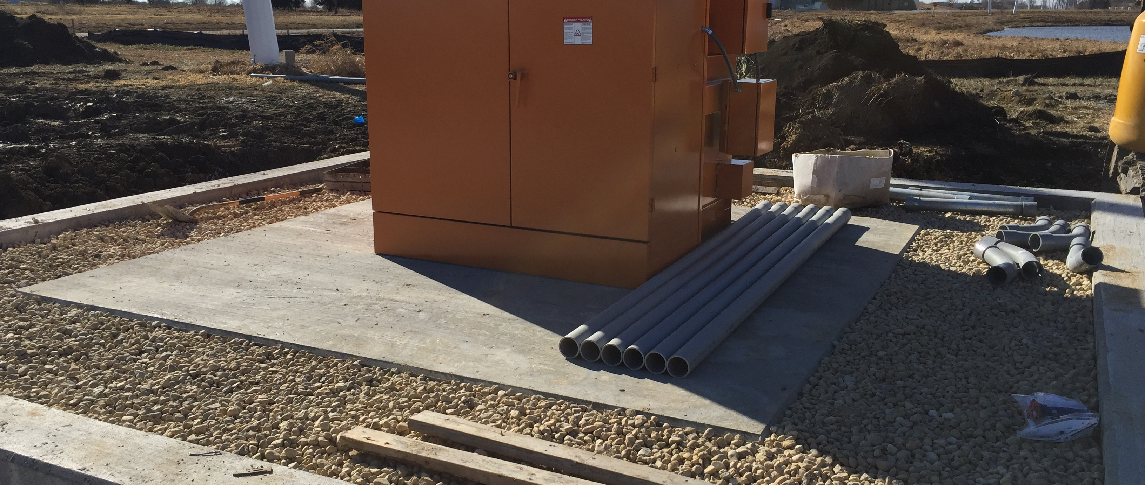
CMTF Pump Station Transformer

