Slide 1
09:00 Meeting
Summer Shutdown Planning
2/3/17
Cons Gattuso

Slide 2
Shutdown Planning Guidance
Start Date
  June 12th Monday(in the tunnel) A mere 93 working days
  Beam off
    June 10th at 0001 hrs. (Saturday)
    June 11th Configuration control/rad surveys/convert to shutdown Key sets
Duration
  ~16 weeks duration (defined by budget constraints )
    Turning on Week of October 2nd (Fixed)
      1-2 Week of Start up/ Commissioning
Start Time Date
May Still Change

Slide 3

Go fund me page
$1 raised of 1 Million
Help Fund our Summer Shutdown

Slide 4
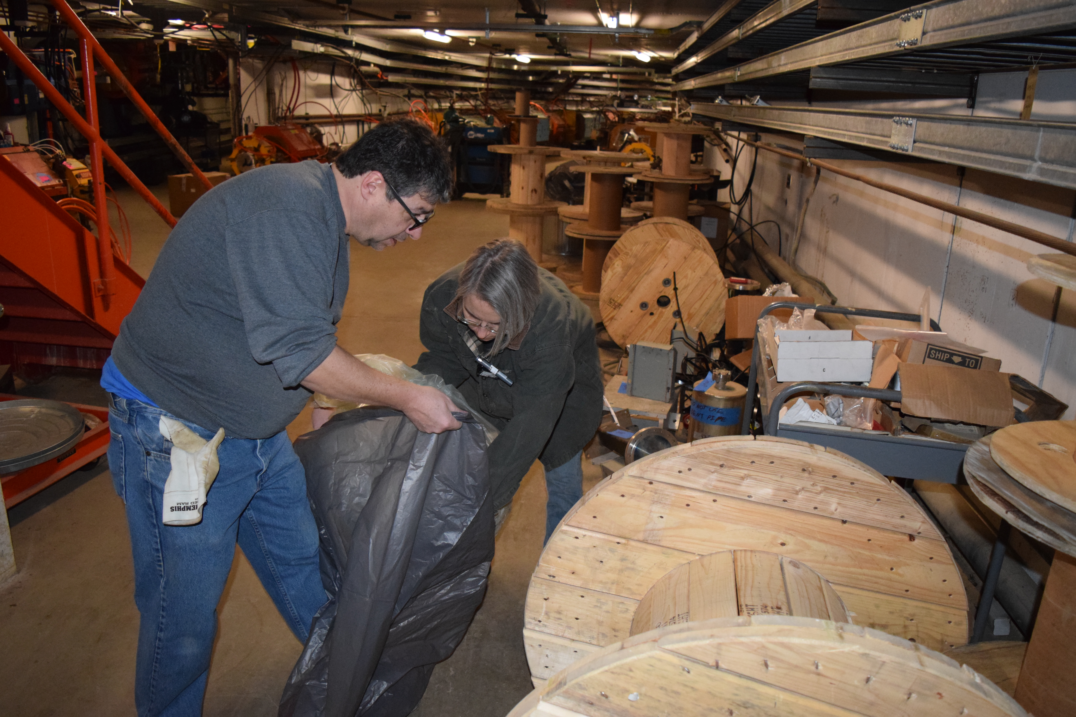
Help Keep down-on-their-Luck Scientist off the streets and tunnel

Slide 5
Accelerator Division Summer Shutdown
Shutdown Planning
  Major Job priority listing was defined such that they fit our ~16 week shutdown window based on this priority ranking. We planned around the ~16 week time window, not around getting as much done as possible
    PIP/ Muon Projects/TSPIP
    Upgrades
    Maintenance
  Shutdown Coordinators (Initial meeting with Machine Coordinators started on Jan 10, weekly meeting since)
    Each Machine/Department had a Shutdown Coordinator assigned
      They gather the work list for each machine and prioritized based on machine needs
    Bi-weekly meetings to discuss the work list items
      We merged the Machine schedules to the Global schedule
        Balancing out resources like:
          Alignment
          Electricians
          Welders
          Etc.
    We will be very strict as to what jobs were done
      No last minute surprise jobs that we’ll tried to squeeze in.
2/3/2017

Slide 6
Proton Source Shutdown Work list
RIL
Source maintenance
Einzel Lens maintenance
RFQ maintenance
General maintience
Linac
Marx modulator project
  Fabrication and Testing underway
    Planning to installed 2 modulator in 2017
      Duration ~6-7 Weeks for the removal of old and installation of new
LE tasks (performed by Linac techs)
  Modulator/driver maintenance
  Inductrol maintenance
  Water skid maintenance
HE tasks (performed by Linac techs)
  CS & PFN maintenance
  PFN cap bank maintenance
  QPS PM
  Water skid maintenance
  Heat exchanger maintenance
Booster
BRF21 and BR22 installation ~6-8 weeks
IPM Installation
  Controls Rack installation
  Tunnel component installation
General Maintenance
  Power supplies
  Cooling Systems
  Vacuum

Slide 7
Main Injector/Recycler
MI
  Replace MI RF station 6
    ~2-3 weeks
  Ion pump maintience
    ~1-2 Weeks
  8 Gev line
    Ion pump Maintenance
      ~1-2 weeks
    Vacuum leak check
      ~1-2 Weeks
    Multi wire replacement (2)
      ~1 Week
  General maintience for MI/RR
    ~2-3 weeks
      Tunnel and service building
  Vacuum flange repair at 614-1 location
    1-2 weeks
NuMI beamline
  Shielding wall ~2 weeks
RR
  Collimator installation ~4-5 weeks
    1 primary Collimator
    2 masks
    Correction element system
    Loss monitor system
    Vacuum modification
  TSP upgrade from 106-229
    10-11 weeks
  Aperture improvement at the RR 402 and 520 locations
    ~3 weeks at the 402
    ~1.5 weeks at the 520

Slide 8
External Beam line
P3 rough vacuum
  F3 House IP to Turbo Station upgrade (~2 weeks)
    Run 4" vacuum pipe from service buildings down stairwells to tunnel
    Install Roots blower stations in service buildings, one per house.
    Switch controls over to Tevatron CIA crates, rename parameters
    Remove and cap ion pumps.
  Cable mitigation in the Meson and Neutrino Muon areas: (~6-7 weeks)
F11-2 3Q120 replacement
  Magnet has a vacuum leak on the bellows near the magnet.
    ~1-2 weeks to replace
Separating the Booster 95 LCW system from Switchyard (~3-4 weeks)
  Switchyard would be its own separate stand alone system. Feed from the F-Sector old MR system.
BNB
  Relocation of the of the
  RAW water skid DI bottles.
  (1-2 weeks)

Slide 9
External Beam line (continued)
NuMI (~10-12 weeks)
  Target replacement
  General maintience
    Dehumidifiers
    Drain tile cleaning
    Ext.

Slide 10
Muon Campus Work
The installation work in Muon Campus does require a shutdown.
  In order to meet the project milestones we will need to continue to make progress using the same resources that are needed for the shutdown. This is a people resource issues that will need to be folded into our schedule.
  During the Summer shutdown installation activities
    M4 line installation
      Stand and magnet installation (5-7 weeks)
    Delivery ring 30 straight section
      Injection septa (1-2 weeks)
      Removal and reinstallation of ring for the M4 line installation
    Abort line
      Extraction septa (1-2 weeks)
    General Alignment ~2 weeks

Slide 11
ALARA Plans
Estimated Dose for the shutdown ~7-8,000 mRem
  ~2040 mRem
  ~500 mRem
  ~600 mRem
  ~1400 mRem
  ~1000 mRem
  ~1000 mRem
  ~ 500 mRem
Non ALARA task
  ~ .1mr/hr rate for ~30 techs
Booster
  BRF21and 22 installation
MI/RR
  RR520 Aperture improve.
  RR402 Aperture improve.
  TSP2IP upgrade
    106-229
  8GeV line ion pump replac.
NuMI
  Target change out
Prelim
Prelim
Prelim
Prelim
Prelim
Prelim
Prelim

Slide 12
What Remains To Be Planned
Power outages
  We should have a plan in place my Mid-End May
    Scope of the of this years power outage will be reduced
    Impact will be slightly greater given the inability to back feed some areas
General Maintience Schedule
  Following details still need to be worked out
    LCW
    Mechanical
    Kicker Systems
    Compressed Gasses
      Air
      Nitrogen
      Argon/C02
Shutdown Duration Drivers
  Linac Marx Modulator installation
  RR TSP to IP conversion
  Muon Campus Overlap with Switchyard crews

Slide 13
Pre shutdown activities
Alignment:
  Reference the following magnets/devices
    RR primary collimator
    RR masks (2)
    Multi wires (2)
    Booster RF cavities (2)
  AS found the following magnets:
    MI Quad 504
    MI Dipole at 614-2
    RR Gradient 616A and B
    RR Quads at 402A and B
    RR520 Lambertson
The have a short time to prepare for this shutdown
so every access period that we have we will need to
take advantage of.
This list will grow as scope of the work is
better defined.

