Slide 1
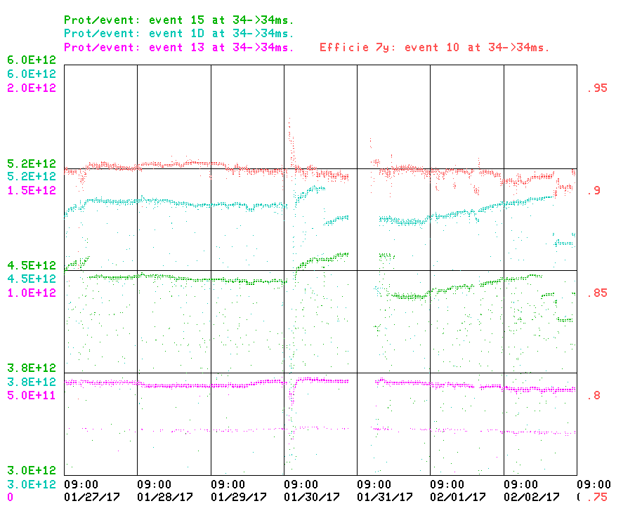
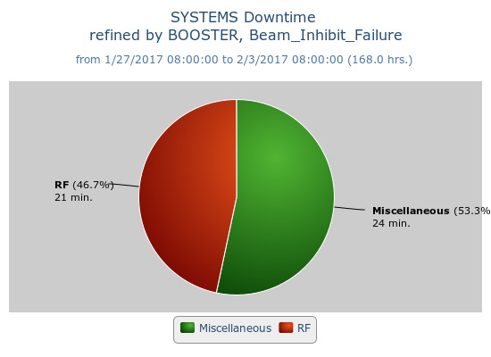
Booster Operations, 1/27/17 – 2/3/17
EFF 89.5%
$1D: 4.7E12
$15: 4.3E12
$13: 4.2E11
BRF2 trip this morning
Weekly Downtime: 45 min
Studies:
Tuned frequency curve
beta function measurements
Future Studies:
Collimator study ~4hrs

