Slide 1
Main Injector/Recycler
Friday 9am meeting
M.J. Yang,
Main Injector dept.
Feb 03, 2017

Slide 2
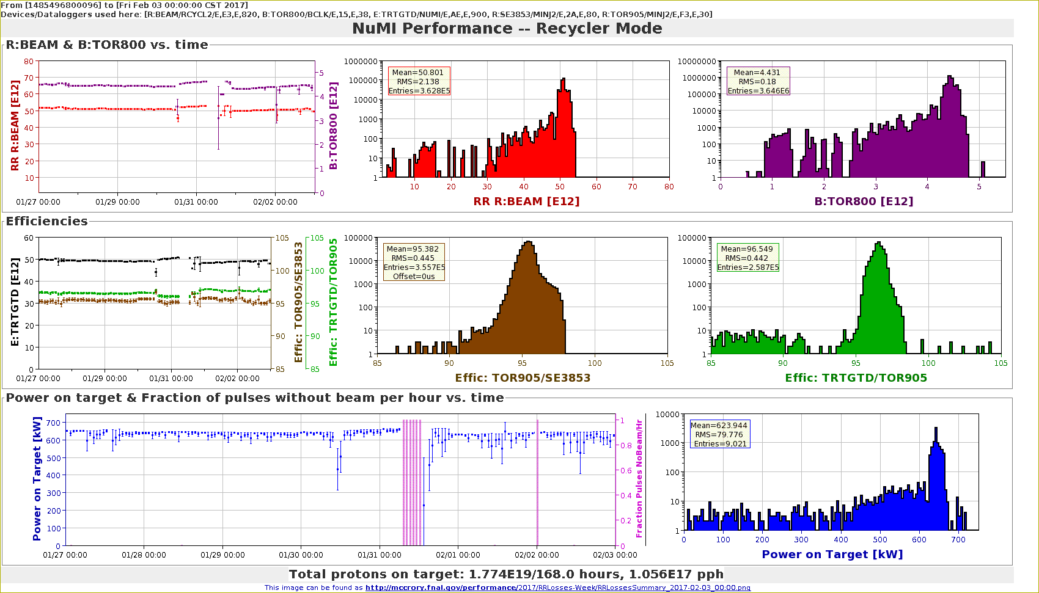
NuMI Performance RR

Slide 3
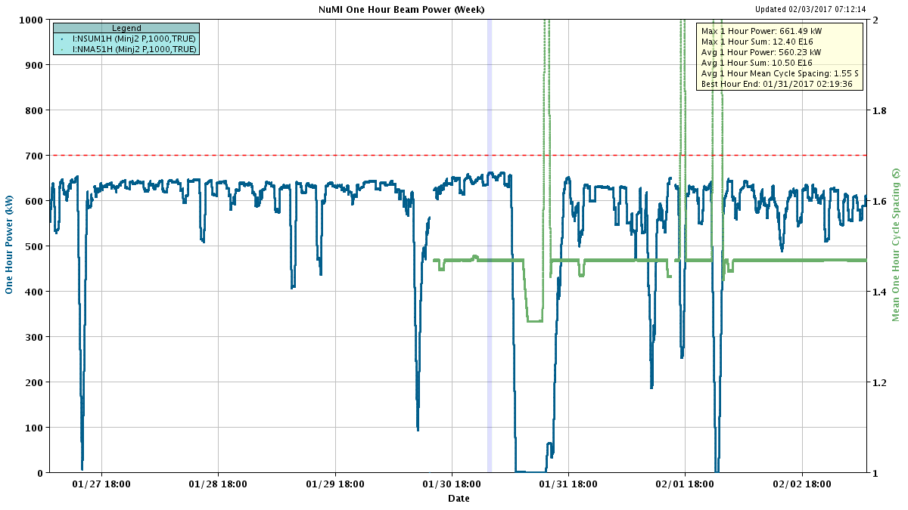
NuMI 1-hour beam power

Slide 4
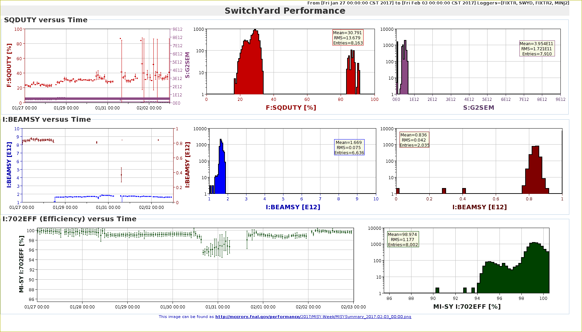
Switchyard Slow Spill performance

Slide 5
MI beam inhibit downtime

Slide 6
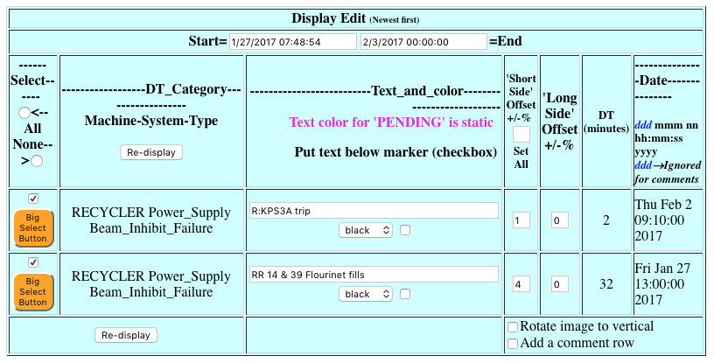
RR beam inhibit downtime

Slide 7
Issues
MI DCCT
Beam intensity is at the upper limit of design range.
Occasionally went unstable.
RR lower level RF
RR damper glitch occurring with $E9 in time line.
Problem is traced to slow phase unwinding.
Gap clearing kicker timing
Being monitored.
Apply lattice matching
From MI8 line to RR.
Based on latest study results.

Slide 8
Studies
Gap clearing kicker study
Verify length of kicker waveforms.
RR loss
Injection phase
Chromaticity.
RR30 transfer line study
Beam profile measurement
Vary # of Booster turns.
Vary # of batches.

