Slide 1
48 Hour Summary
Donovan Tooke
Friday 09:00 Meeting
3 February 17

Slide 2
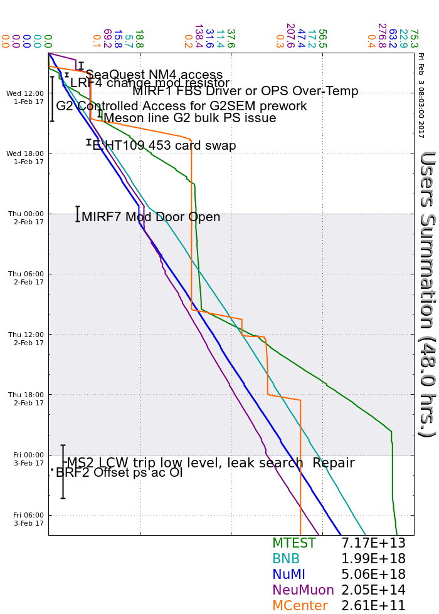
Wednesday
Muon Campus Instrumentation Test
Mini-Glitch: KRF7 & NS2LCW
LRF4 Modulator Resistor
G2SEM prepwork
Meson line G2 bulk PS issue
MIRF1 FBS issues
Replaced E:HT109 C453 card
MIRF7 mod door interlock resistor
Thursday
RR30 kicker/beam permit investigation
P1 – P3 line PS ramp over/undershoot
M02 pinhole leak on header
Friday
BRF2 FBS trip
AP50 power outage: 8am – 8pm
G2 SEM FOIL Calibration

Slide 3
Current Conditions
Beam to NuMI
630.7 kW
48.4 e12
Beam to BNB
3.84 e16 p/hr
Beam to SeaQuest
G2 SEM Foil Calibration
Beam to MTest

