Slide 1
Accelerator Division Status
Duane Newhart
Op Schedule Meeting
3 February 2017

Slide 2
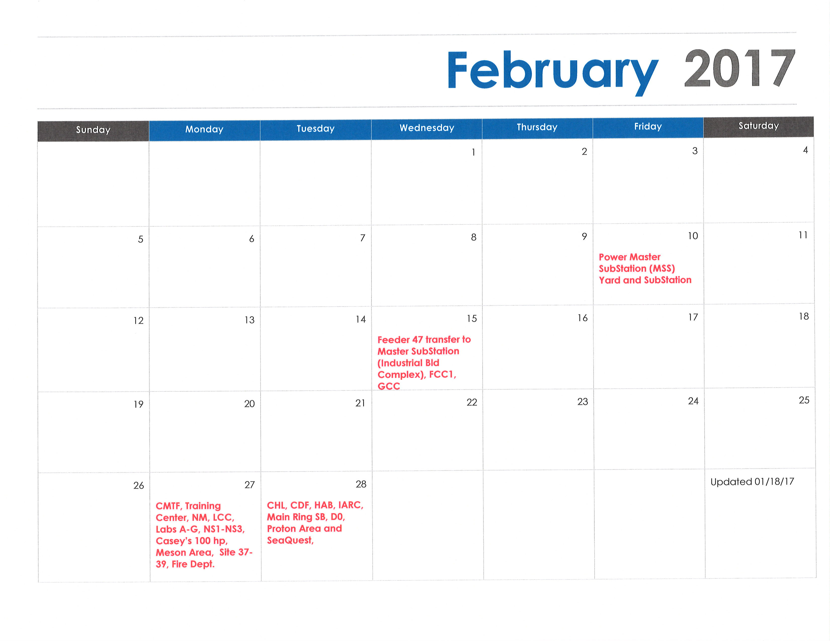
February 2017

Slide 3
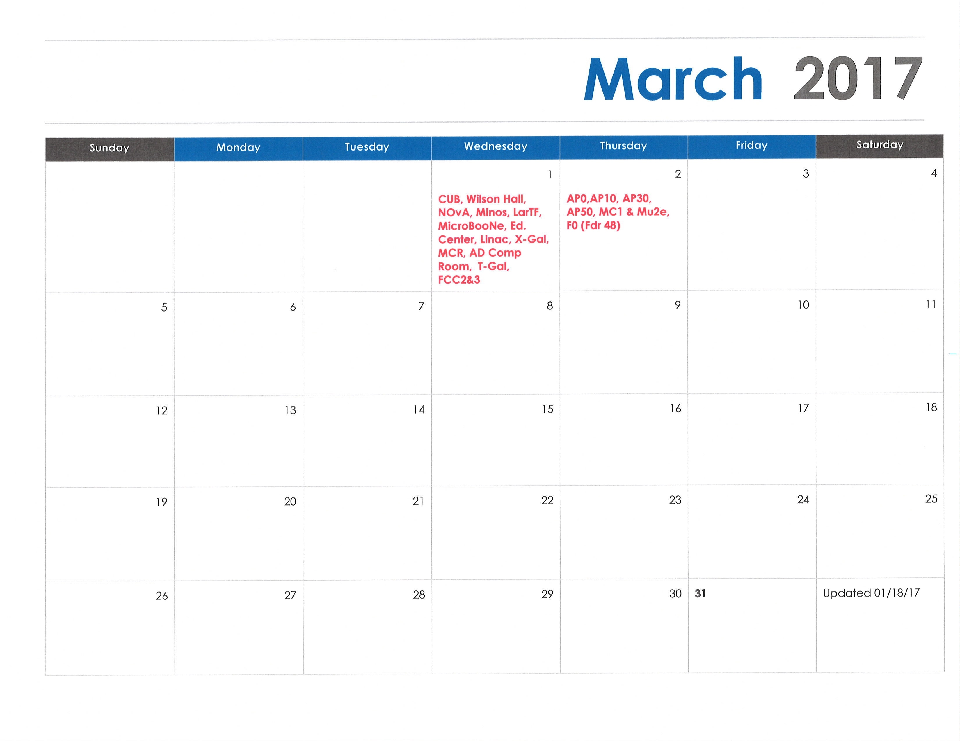
March 2017

Slide 4
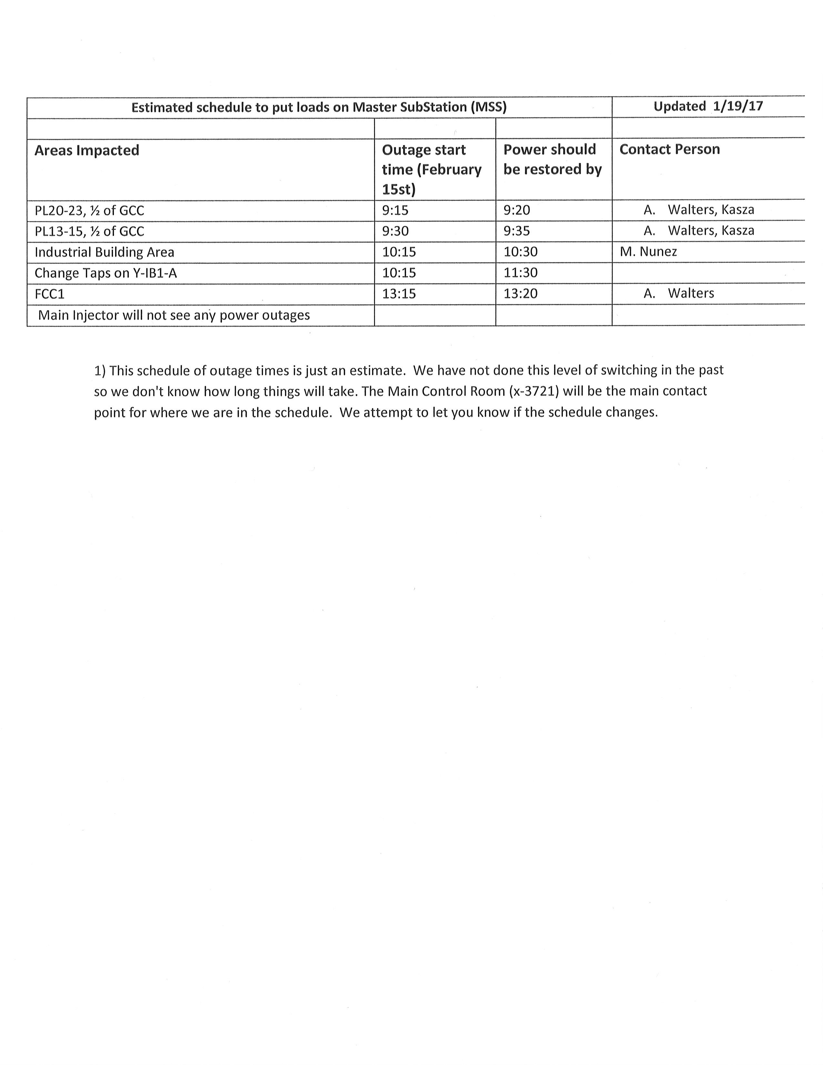
February 15th

Slide 5
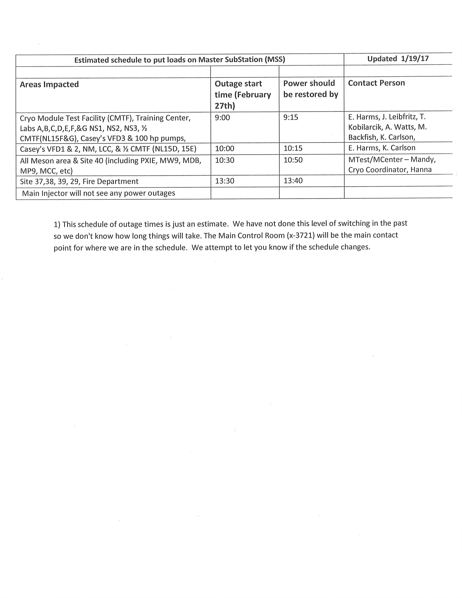
February 27th

Slide 6
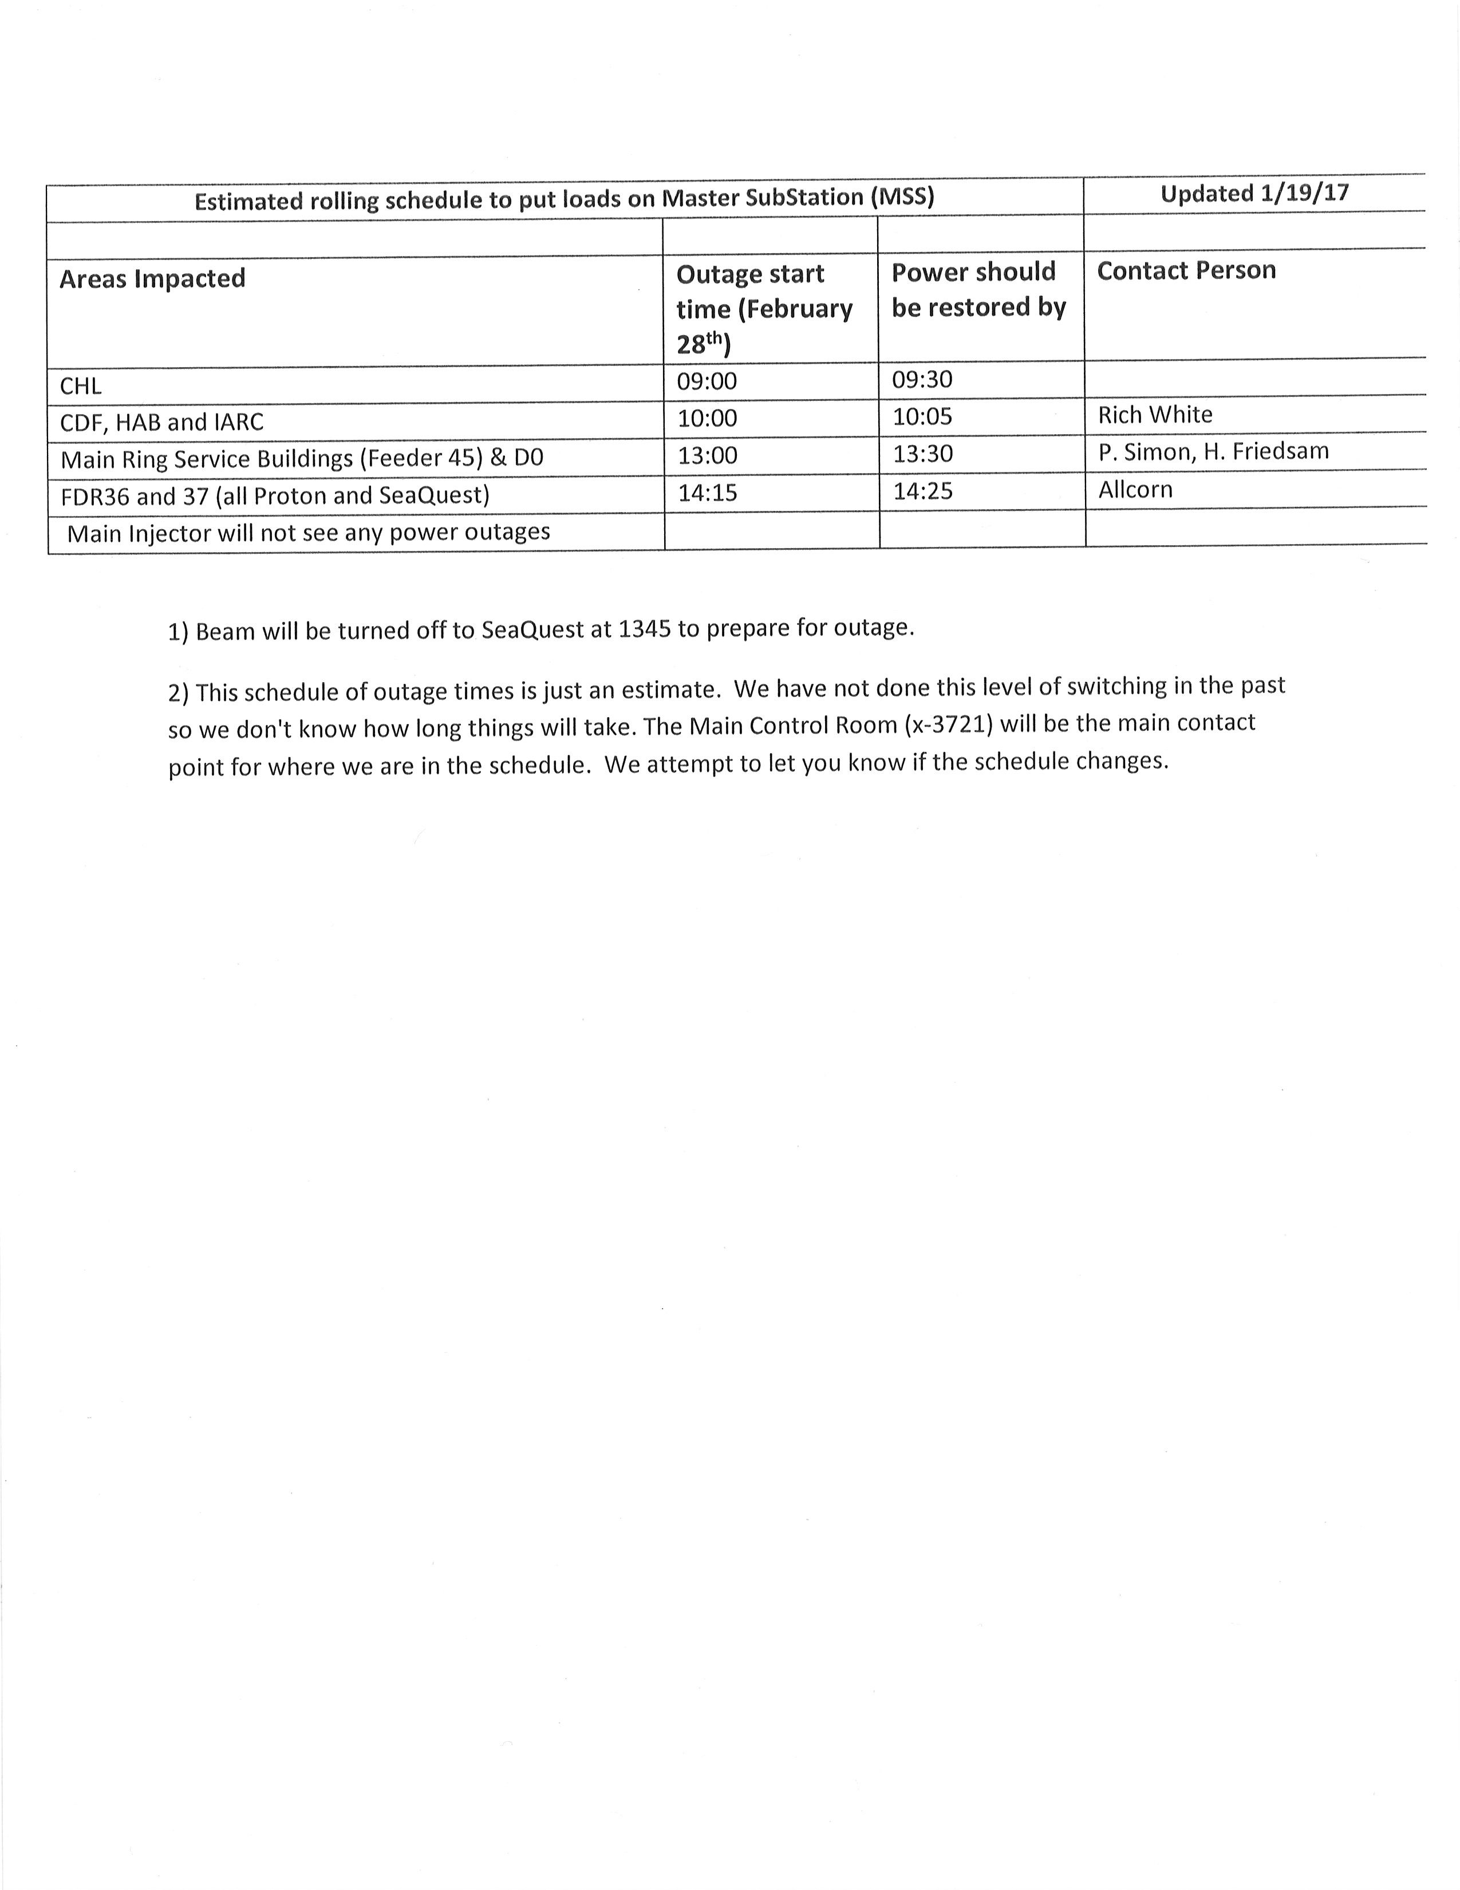
February 28th

Slide 7
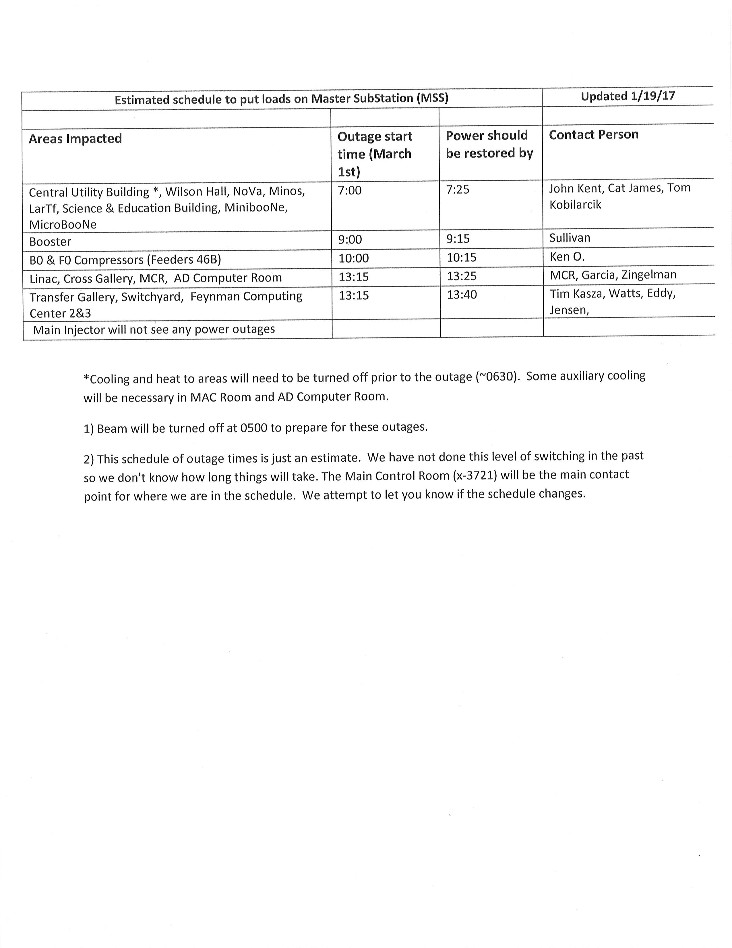
March 1st

Slide 8
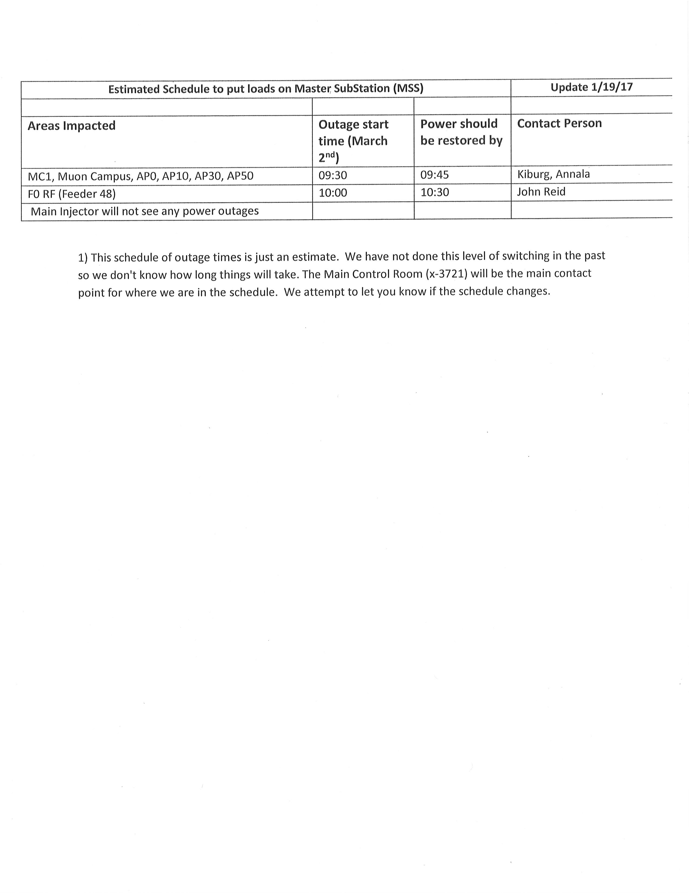
March 2nd

Slide 9
Schedules and Links
Schedule can be accessed from the Operations Department Home Page
  Schedules -> Operations Schedule
Direct link to schedule
  http://www-ad.fnal.gov/ops/schedule.html

Slide 10














Collaborations / Partnerships / Members [22pt Bold]

