Slide 1


Data Reduction
Xin Qian
BNL

Slide 2
Introduction
The “data reduction” is a common practice in the high-energy experiments
  The goal is to reduce the overhead in handling the data
This specific proposal regarding “TPC data reduction” was proposed by Brett in doc-db 2089 for protoDUNE data utilizing some developments that we have in MicroBooNE data analysis
  The end results is 2.5 PB → 6.5 TB data (wire data only). Raw data is saved anyway
  This can also be applied in Monte Carlo Simulation to reduce the disk usage
In this talk, I will briefly explain the idea and went through a few key developments needed to make it successful

Slide 3
Basic Steps
Input unpacking: with DAQ’s raw data access library
ADC mitigation: due to imperfect performance of P1 ADC
Noise filter: reduce excess noise if any
Signal Processing: waveform deconvolution + signal ROI
  150 x reduction of data by dropping noise waveforms
Rebinning: exploit oversampling following Nyquist theorem
  400 x reduction with Rebin-3
Output packing: save in raw-like format with ROOT compression

Slide 4
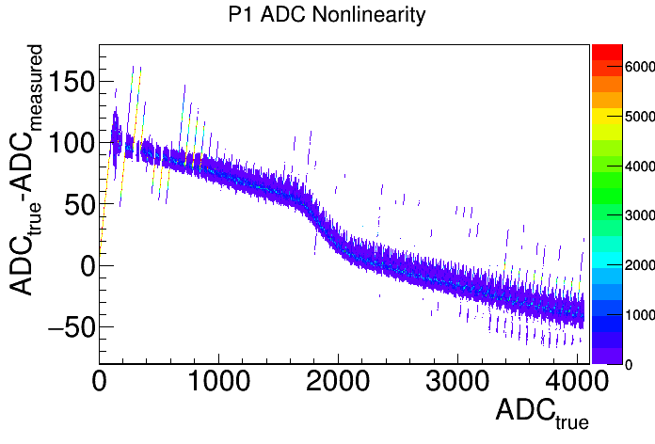
ADC mitigation
Current P1 ADC (to be used in protoDUNE) does not reach expected performance of an ideal 12-bit ADC
  Electronics team (Hucheng, Matt et al. ) has been working very hard to find an optimal running condition
  Performance of P1 ADC with external clock is much improved
Example with internal clock!
Stuck bits at 0
Overall Nonlinearity
Stuck bits at 63
Local oscillation/jump and double peak

Slide 5
About P1 ADC Correction
Electronics team has a comprehensive plan in terms of testing all ADC chips and select the best performed ones for protoDUNE-SP
  David Adams has been analyzing existing tested data to evaluate the performance and to work out useful metrics for this
Expected performance of P1 ADC
  Without any calibration, we expect a ~6-bit ADC performance
  With a linear correction, we expect a 7-9 bit ADC performance
  With a full nonlinearity correction, we expect a 9-10 bit ADC performance
    An ideal 10-bit ADC would lead to negligible impact on physics data analysis
  Also need to control the “stuck-bits” problem
David and I are working closely with the electronics testing team to ensure a successful ADC Calibration/Correction plan
  A dedicated presentation by David in the future

Slide 6
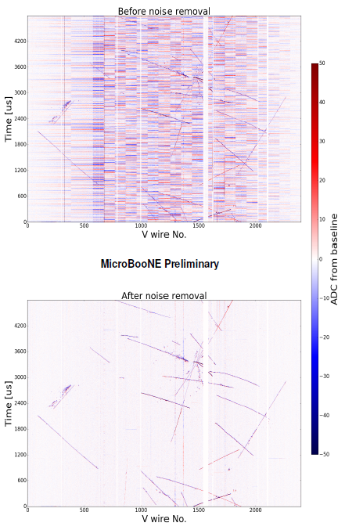
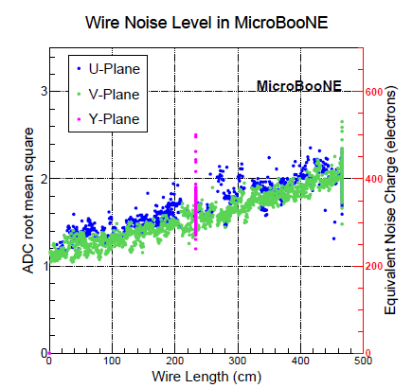
Excess Noise Filter
We have extensive experience in dealing with excess of noise in the context of MicroBooNE data analysis
  Public note:
    http://www-microboone.fnal.gov/publications/publicnotes/MICROBOONE-NOTE-1016-PUB.pdf
Given the experiences in MicroBooNE (same type of cold preamp), we gain valuable experience in ID excessing electronics noise
I personally do not expect much excess noise in protoDUNE, but we should always be prepared
David Adams also has extensive experience in dealing with excess of noise in 35-ton

Slide 7
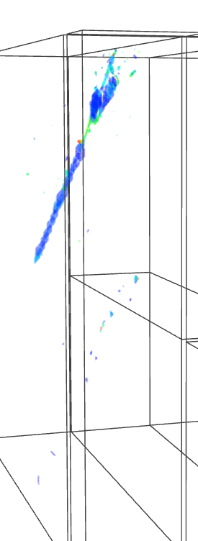
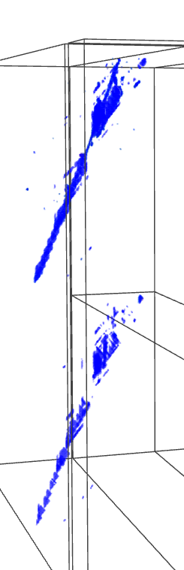
TPC Signal Processing
TPC signal processing: extract the ionization charge information from the induced current from all planes
In principle, each wire plane sees the same amount of ionization electrons. This can be used in removing ambiguities (one of the concept used in Wire-Cell 3D Imaging)
We have been working extensively on the TPC signal processing in the context of analyzing MicroBooNE data, public note:
  http://www-microboone.fnal.gov/publications/publicnotes/MICROBOONE-NOTE-1017-PUB.pdf
With Charge
Without Charge

Slide 8

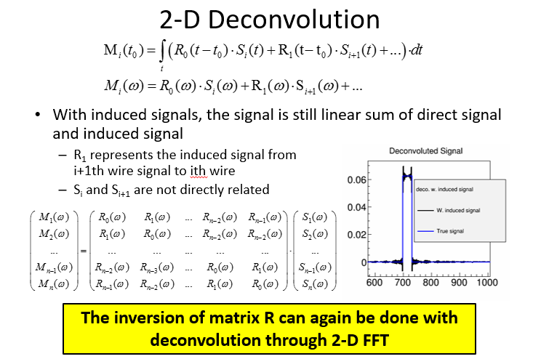
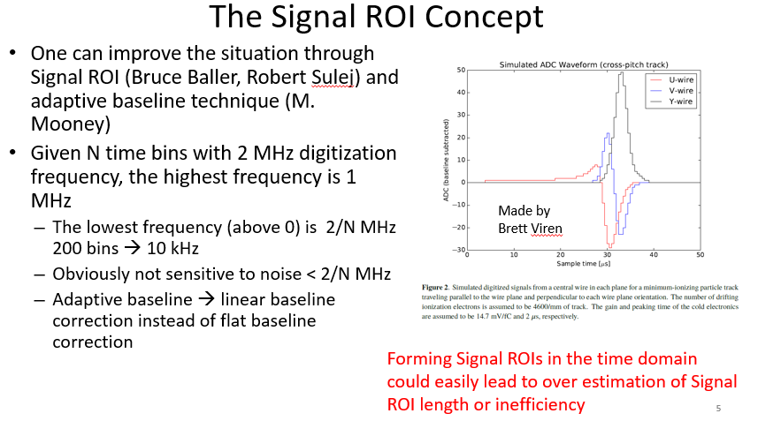
TPC Signal Processing
Some details are summarized in my talk in the past collaboration meeting
  https://indico.fnal.gov/getFile.py/access?contribId=32&sessionId=16&resId=0&materialId=slides&confId=10641

Slide 9
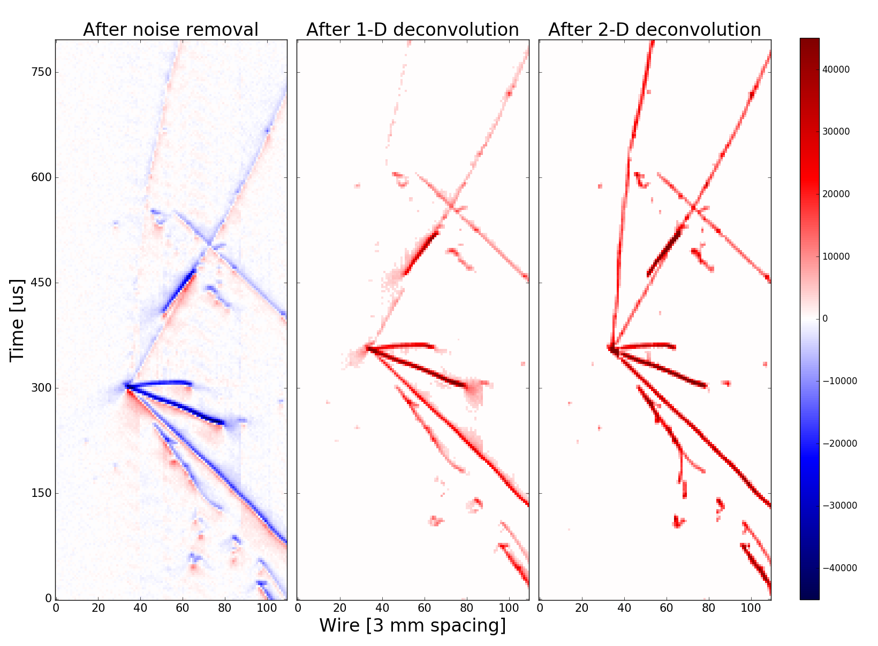
Performance
With TPC signal processing, we can easily/must ID the region containing real signals
Data reduction is achieved by only saving the region containing real signals
X 150 reduction in the MicroBooNE case

Slide 10
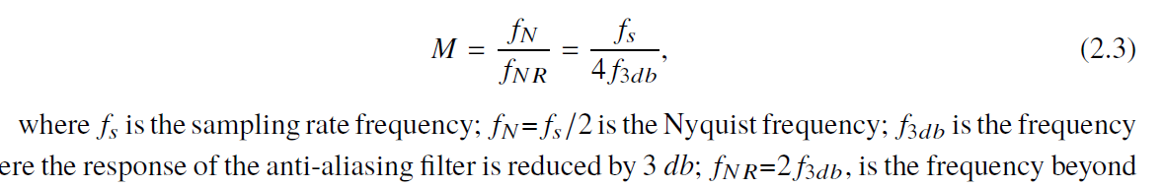
About Rebin and Digitization Frequncy
Theorem:
  If a function x(t) contains no frequencies higher than B Hz, it is completely determined by giving its ordinates at a series of points spaced 1/(2B) seconds apart
In practice, this is measured by oversampling
It is required “M >1”. In MicroBooNE at 1 us shaping time and 2 MHz digitization, we have M = 2 taking into account only the electronics response
  Higher value when taking into account field response

Slide 11
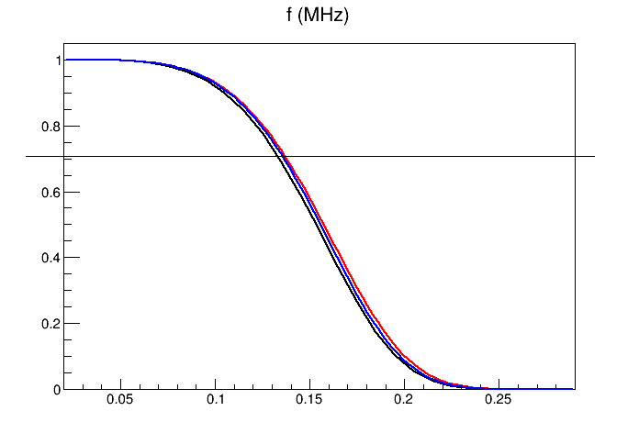
For Deconvoluted signal
During TPC signal processing, we apply deconvolution, which involved a software filter
With this software filter, we can calculate the “M” given 0.5 or 1 us binning.
  Goal is to get “M>1”
At 3db, the amplitude ratio is about 1.413
  So f_3db =0.137 MHz
  At 2 MHz, we have M = 3.65
  At 1 MHz, we have M ~ 1.82
  At 0.667 MHz, we have M ~ 1.22
Software filter applied in three planes in MicroBooNE
We do not lose information, even if we rebin the data into 1.5 us per bin

Slide 12
If we directly use the cut-off frequency, we have
Digitization | Rebin | Oversampling M Using 3db formula | Oversampling M Using cut-off frequency
2 MHz | 1 | 3.65 | 4
1 MHz | 2 | 1.82 | 2
0.667 | 3 | 1.22 | 1.33
0.5 MHz | 4 | 0.91 | 1
To be safe, I think 1.5 us rebin is good enough. 2 us rebin is probably OK, but it is better to leave some room in this
MicroBooNE is running at 273 V/cm → 0.1119 mm/us
DUNE is expected to run at 500 V/cm → 0.16 mm/us However, DUNE’s wire pitch is 5 mm instead of 3 mm (MicroBooNE)
We can estimate the time scale as 5./3.*0.1105/0.16 ~ 1.15, So using MicroBooNE software filter to estimate is reasonable, as the DUNE time scale is expected to be longer
In Rebin operation, the integral of the waveform is locally conserved. This is not true for resampling, so rebin is expected to contain more information regarding the waveform
We have successfully tested the Gaussian fit with the rebinning scheme: Nyquist is right ☺

Slide 13
To achieve good “Data Reduction”
We need
  Good electronics response and ADC calibration for ~15000 channels
    Likely not much to do regarding the electronics response (pole cancellation?)
    Need to do a very careful job regarding the ADC (stuck bits, nonlinearity, bench test vs. in-situ)
    Need to work closely with the electronics testing team
  Software Noise Filtering
    The hope is not to do much on this
    May still need to do this to achieve the best performance
  Workout the software and sort out the computing
    A future talk by Brett on this
  Very closely monitor the change in the data to keep up
    Monitor various noise issues
    Monitor electronics mis-configuration issues, different drift voltages?
    Need to work closely with the online monitor team, and be prepared for various changes in any configuration

Slide 14
How to proceed from here?
Demonstrate that we can achieve data reduction on the full protoDUNE TPC simulation
  Integration of full TPC simulation (Brett, David, and Chao)
  Integration of full TPC signal processing (Brett, David, and Xin)
Build up the robust ADC calibration/correction system
Work out the data unpacking …
Prepare for the noise filtering (already integrated with LArSoft in MicroBooNE)
Prepare to monitor changes in configurations/running condition during data taking
…

Slide 15
Summary
“Data reduction” is a common strategy for us to adopt in protoDUNE data/simulation → DUNE
We have various pieces (noise filtering, TPC signal processing, ADC calibration …) to achieve this
  A concrete plan to integrate the software
We need to work closely with
  Electronics testing team on the ADC calibration
  DAQ team on the data unpacking details
  Online monitoring team to track the changes in configuration/running condition and noise issues
  Prompt processing team to deal with potential changes
  …
We need your help/inputs to make this successful!

