Slide 1
HEPCloud: efficient resource provisioning in the Science Cloud
Panagiotis Spentzouris
Fermilab
16/03/17

Slide 2
HEP: success through decades of data-driven science
The Standard Model of Particle Physics
A great scientific achievement
Every particle physics experiment ever done fits with this model
But it is incomplete…
Why are there so many particles?
Why are their masses so different? Why is the universe mostly matter?
Is there a higher level theory providing natural explanation to these questions and unifying the different forces?

Slide 3
HEP Science Drivers
Utilize high-energy particle beam collisions to discover
the origin of mass, the nature of dark matter, extra dimensions.
Employ high-flux beams to explore
neutrino interactions, to answer questions about the origins of the universe, matter-antimatter asymmetry, force unification.
rare processes, to open a doorway to realms to ultra-high energies, close to the unification scale
Commission surveys utilizing massive instruments to understand the nature of the contents of the universe
ordinary matter, dark mater and dark energy.

Slide 4
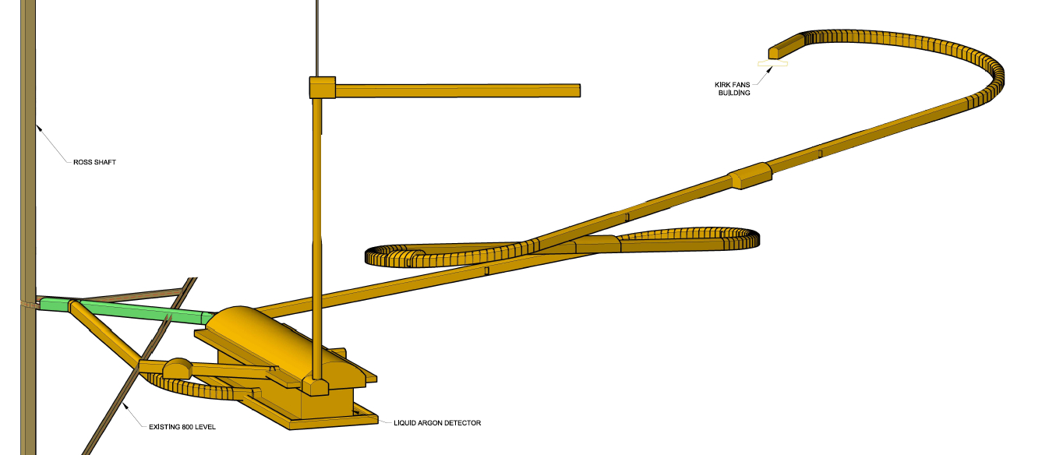
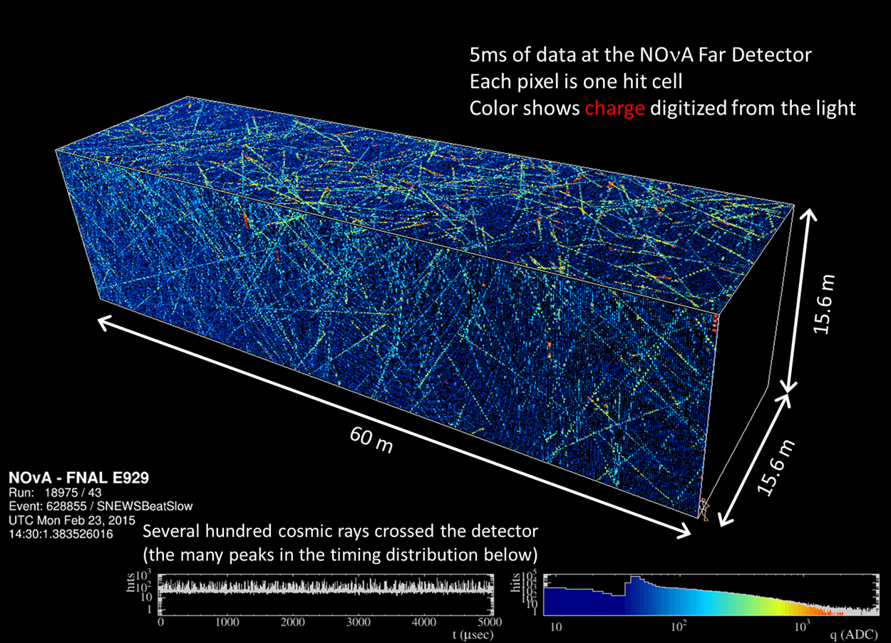
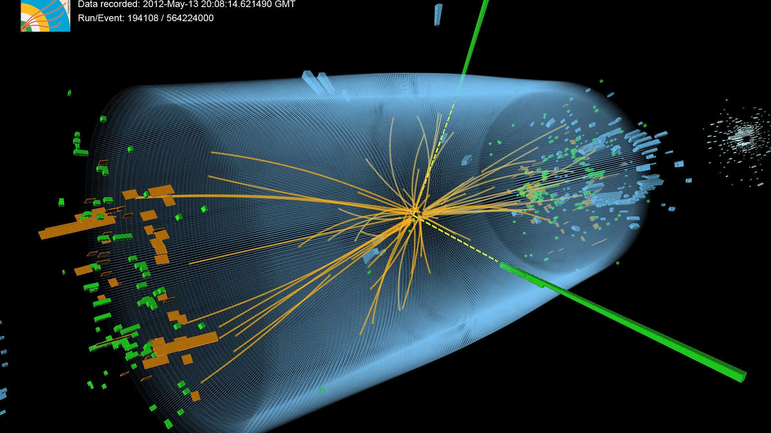
Massive Scientific Instruments generate Big Data
Fermilab experiments
Multiple passes of data analysis by large, distributed collaborations
Notes:
14 kilo ton liquid scintillator, 500 miles
800 miles 17 kilotons LAr, 5000 feet underground

Slide 6
Compact Muon Solenoid (CMS) at the LHC
Protons collide at the LHC ➡ 14 million times per second
100 Megapixel “camera” captures energy, position
1000 times per second
Measurements during a collision constitute an “event”
Huge number of events (6.3Ms live time in FY16), huge data sets to be analyzed by 1000’s of collaborators

Slide 7
Extreme Simulation Needs
Particle physics governed by quantum mechanics
Initial conditions not known precisely
Recorded particle collisions sample a large space of possibilities
Detector effects, event selection
We are using probabilistic techniques to sample this space in simulation
typical for CMS, simulated sample x10 of detector sample
Analysis of both simulated and detector events necessary to extract physics results

Slide 8
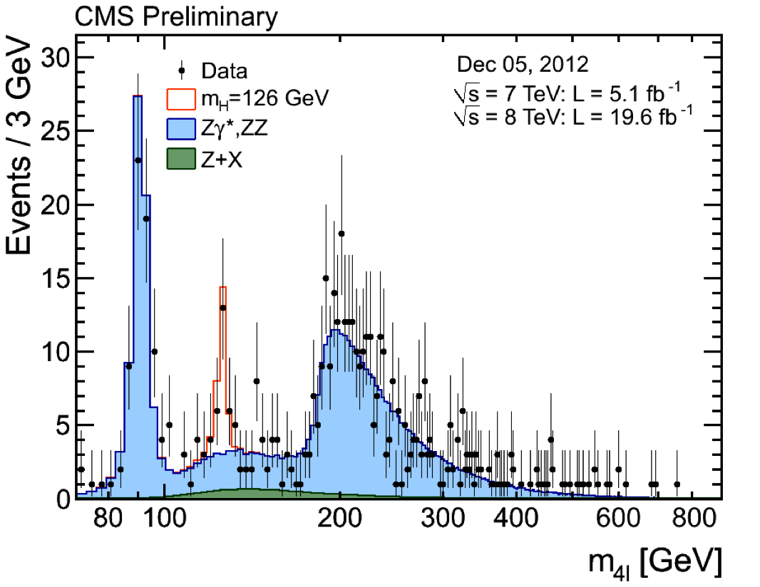
Example: Higgs discovery
Comparison with what we know (Simulations)
Analyze data, compare, and look for deviations ➜ Needle in the Haystack
Find additional ingredients that match the detector observation

Slide 9
The Big Data Frontier… from “Wired”

Slide 10
Processing the Data: global CMS (distributed) computing
70+ compute clusters (Open Science Grid and Worldwide LHC Computing Grid)
150,000 cores
~75 Petabyte Disk
~100 PB used tape space
Strong networks connecting the individual sites
Weekly transfer volume between all sites: 4-6 Petabyte
Total LHC Trans-Atlantic network capacity: 340 Gigabits per second

Slide 11
But this won’t be enough as the program evolves…
Better Accelerator and Detector performance ➡ increase discovery potential
But, computing will need to reach 10-100x current capacity

Slide 12
Furthermore, resource utilization not at steady state

Slide 13
A new approach necessary
Scale of required computing, combined with departure from Moore’s law, calls for a paradigm change in procuring and managing computing resources
Similar trends for HEP programs outside LHC
Utilization efficiency and cost-effectiveness is essential
Deploying resources when needed (elasticity)
high frequency provisioning instead of the traditional ”annual procurement cycle”
Enables “goal oriented” resource allocation
Requires expanding pool of potential resources beyond “owned, on the floor, program specific” resources and developing tools to effectively manage them

Slide 14
The HEPCloud concept
HEPCloud is envisioned as a portal to an ecosystem of diverse computing resources, commercial or academic, to:
provide “complete solutions” to users, with agreed-upon levels of service
route to local or remote resources based on policy, workflow requirements, cost, and efficiency of accessing various resources (compute, storage, networking)
manage user allocation of “owned” resources and supercomputing facilities, and credits to commercial clouds
provide cost effective and efficient “elastic” resource deployment, by utilizing sophisticated decision engine and middleware for automation.
Enabling high-frequency and goal oriented provisioning

Slide 15
HEPCloud pilot project
Pilot project to demonstrate feasibility, explore potential
Establish partnerships with industry and academic institutions
Develop architecture and components
Mature enough policies, cost model, monitoring and decision engine to
Demonstrate scaling and sustainability with commercial clouds
Initiate work with HPC facilities to understand constraints and requirements for further developing policies and tools necessary to enable access
Identify use cases that are feasible within the constraints of allocation, security and access policy of HPC facilities.

Slide 16
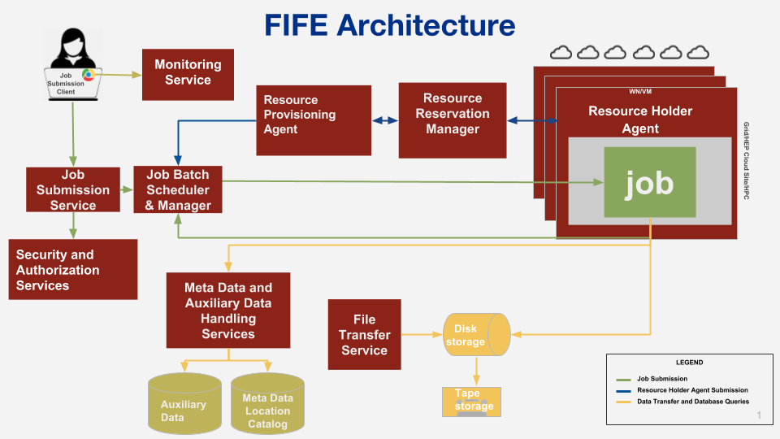
HEPCloud pilot project
Utilize Open Science Grid (OSG) stack for provisioning
Fermilab developed and co-developed tools for workflow management, data management (and their integration), monitoring
Partnerships:
ESnet
BNL (ATLAS, Facility)
ANL/CCE (edge services)
OSG (provisioning)
FNAL (CMS, muons,
neutrinos,
Facility)

Slide 17
HEPCloud architecture
Workflow (resource provisioning trigger)
Facility Interface
Authentication and Authorization
Monitoring takes input from all components
Monitoring
Decision Engine
Facility Pool
Provisioner
Cloud Resources
Cloud Resources
Cloud Resources
Local Resources
HPC Resources
Grid Resources

Slide 18
And for the CS types…

Slide 19
The Decision engine
High Frequency “trading” of resources
Assign “value” to resources
Owned, allocated, commercial credits
Data movement/storage, speed/availability
…
Aware of
policies, workflow
requirements, …
Enables automated
goal oriented
acquisition

Slide 20
HEPCloud pilot use cases: cloud
NoVA Processing
Processing the 2014/2015 dataset
16 4-day “campaigns” over one year
Demonstrates stability, availability, cost-effectiveness
Received Amazon Web Services (AWS) academic grant
CMS Monte Carlo Simulation
Generation (and detector simulation, digitization, reconstruction) of simulated events in time for Moriond16 conference
56000 compute cores, steady-state
Demonstrates scalability
Received AWS academic grant
CMS Monte Carlo Simulation
Generation (and detector simulation, digitization, reconstruction) of simulated events in time for Moriond17 conference
160000 compute cores during Supercomputing 2016 conference (~48 h)
Demonstrates scalability, capability
Received Google Cloud Platform grant
mu2e Processing
Simulating cosmic ray veto detector and beam particle backgrounds
3M integrated core-hours
Demonstrates rapid on-boarding
Received Google Cloud Platform grant

Slide 21
AWS CMS use case: simulation campaign for Moriond 2016
60k slots for ~2weeks, 25% of global CMS capacity, sustained

Slide 22
Google CMS use case
205 M physics events generated, yielding 81.8 TB of data, in 48 hrs, during SC2016

Slide 23
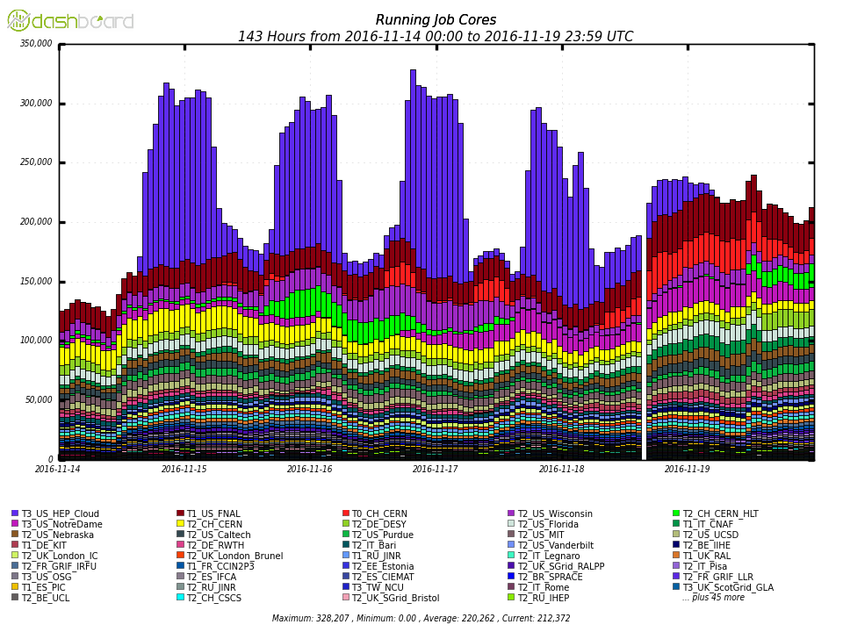
Doubling the size of global CMS capacity
Cores from Google

Slide 24
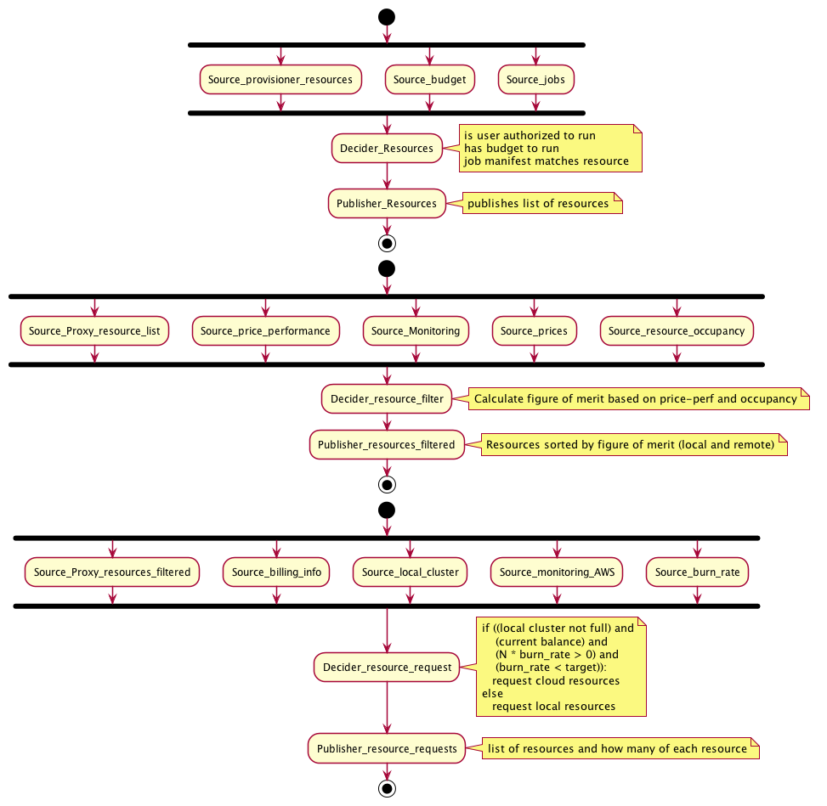
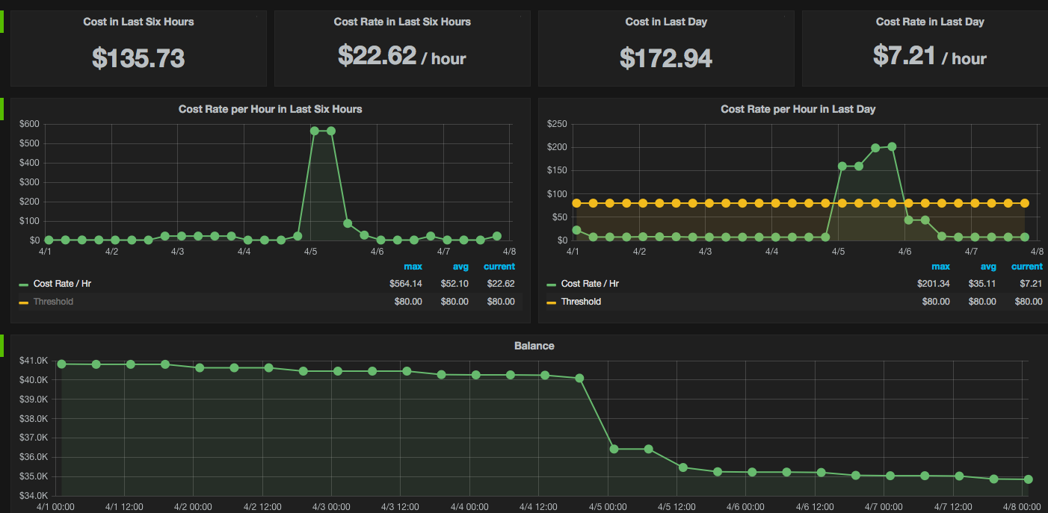
Decision Engine development
Prototype focus on Cost Model logic for commercial cloud access
Current focus: complete architecture, incorporate HPC and corresponding policy modules
Proto-prototype Decision Engine implementation

Slide 25
Decision Engine Architecture Summary

Slide 26
HEPCloud pilot project on HPC
Early steps: adapt HTC workflows to HPC facilities
Neutrino experiment production on Cori @ NERSC
Physics Generators on Mira @ ALCF: multi-parameter tuning of event generators using collider data
CMS production on Edison, Cori @ NERSC: provisioned resources and executed various Generator-Detector Simulation-Reconstruction workflows
Current status:
run corresponding workflows through the HEPCloud production team @ NERSC
Identify and implement necessary additional security controls and processes
Investigate “edge service” solutions, security policies and controls with ALCF

Slide 27
Starting production on NERSC
Use cases have been defined
Ramping up processing
Identifying/resolving issues with data movement efficiencies, performance, …

Slide 28
HEPCloud and HPC
An intresting possibility, for the exascale era, is to consider HEPCloud as a common layer for ”offering” exascale facility services to data-driven science domains
and, in the other direction, though HEPCloud services (e.g. storage/data management) integrate other resources (especiaally data centers) to the exascale facilities
The HEPCloud concepts are not HEP specific, other data driven sciences have similar needs (as we learned at the exascale crosscut review)
Common layer for accessing facility (authentication, policy, tools…); software deployment; workflow and data management integration;…
So, HEPCloud could evolve as a common layer across different science domains (DOECloud?) –and, possibly, serve as an attraction point for further developing cross-cut cloud strategy and infrastructure

Slide 29
Summary
Successful demonstration of concept with commercial cloud and NERSC use cases
Plan to transition aspects of HEPCloud to production end of 2018
Continuing R&D for Decision engine, policy development, integration and development of software infrastructure…
Partnerships with other domain sciences and ASCR welcome!
Next stage: focus on incorporating HPC resources
Build on work to provision cycles on Edison, Cori at NERSC
Extend HPC use cases to non-pleasingly parallel problems
Deep learning, …
Complete interfaces with commercial cloud providers
Done: Google Cloud Platform, Amazon Web Services; Next: Microsoft Azure, …
Long term: Explore possibility of partnerships in integrating concept to exascale facilities software infrastructure

Slide 30
Backups

Slide 31
HEPCloud and exascale
Big Data on exascale: more diverse, larger data sets; larger, distributed data set ensembles; many stages of analysis and several “passes” of data processing; need to get data in and out of the exascale facility
Different from the current LCF “Big Data” paradigm (data flow networks for analysis of large, structured data sets generated by massive simulations)
Assuming utilization of exascale for processing instrument (observational) data and simulated data for modeling response of instruments
Workflow and data management, tracking provenance, …; desirable to present exascale facilities to users using common interface, tools, access, means to effectively utilize allocations on different facilities based on load and status
Functionality essential even if LCFs remain focused on running massive simulations, since these will have to be coupled to observational data outside the LCF
The HEPCloud concept could provide this functionality

Slide 32
Research/Partnership Areas
Developing policies and interfaces for LCF
Data management
Debugging and Monitoring
Workflow end-to-end execution automation, including resource management
Workflow ensemble management
Automated workflow lifecycle
Failure Management
Integrating Advanced Networking to Decision Engine and Monitoring
Exploring in-situ analysis approaches, especially for filtering simulated data
Becomes desirable if exascale machines used extensively for simulation campaigns

Slide 33
Accessing NERSC and LCFs
FNAL security team (on behalf of HEPCloud) interacted with NERSC (through our liaison Lisa Gerhardt) and ALCF security team (contact Piotr Zbiegiel)
Analyzed access models for each facility and mapped to HEPCloud access model and controls
Mapping was successful for production teams, after modifications of HEPCloud controls (sensitive country)
We are operating at NERSC under the pilot project. If we move to operations, we could further advance by better integration of security teams (monitoring information, advancing common controls, …)
Haven’t closed the loop with ALCF. MFA requirement an additional change needed on our end for automated production workflow management (not an issue/reason for not proceeding )

Slide 34
