Slide 1
SeaQuest AEM updates 2/6/17
Arun Tadepalli
Rutgers University
(on behalf of the SeaQuest E906 collaboration)

Slide 2
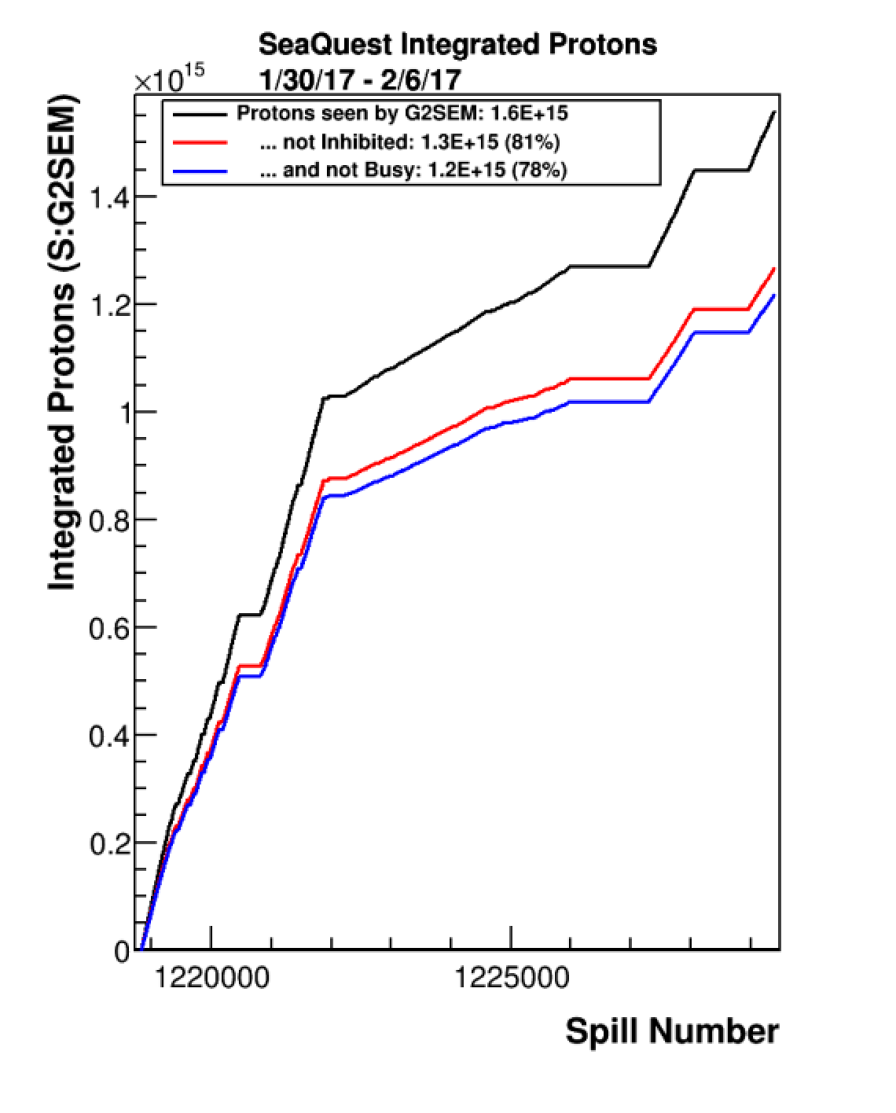
Protons On Target plot
Beam
Looking forward to new calibration constants in G2SEM
Taking data at a higher intensity

Slide 3
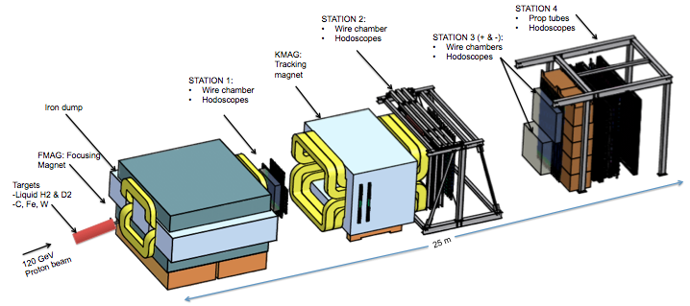
Target and DAQ status
Target
Currently taking good data with solid targets
D₂ will be delivered tomorrow or Wednesday
H₂ is at SeaQuest
Plan to cool down targets starting Wednesday
DAQ
MainDAQ – occasional minor VME ROC problems
ScalarDAQ – working
BeamDAQ – working
Verify trigger timing

Slide 4
Spectrometer status
Beam vacuum pipe - stable
Cerenkov counter – stable
Hodoscopes – stable
Chambers – stable
Prop tubes – low efficiency channels revived
Online monitoring – stable

Slide 5
Computing status
No jobs on the grid currently
Trying to complete R006
Reprocessing ~230 runs
Preparing for R007

