Slide 1
Accelerator Division Status
Duane Newhart
All Experimenters’ Meeting/Lab Status Meeting
6 February 2017

Slide 2
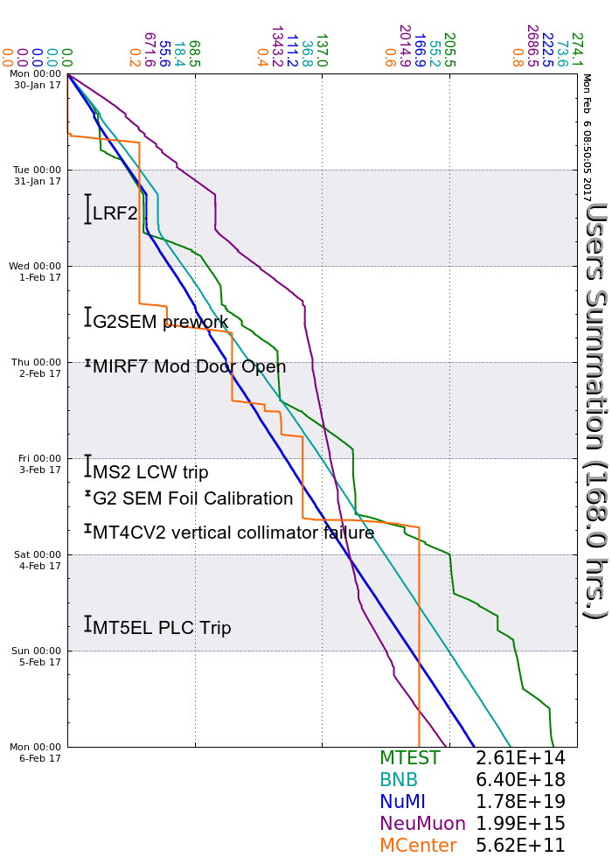
Accelerator Operations Summary
From: January 30, 2017 (0000 hours)
To: February 06, 2017 (0000 hours)
Calendar Week # 05
NuMI Weekly Integrated Intensity 1.79 E19 protons
Beam Hours To NuMI 151.7 hours
BNB Weekly Integrated Intensity 6.23 E18 protons
Beam Hours To BNB 155.2 hours
NMuon Weekly Integrated Intensity 1.99 E15 protons
Beam Hours To NMuon 131.3 hours
MTest Weekly Integrated Intensity 2.60 E14 protons
Beam Hours To MTest 121.9 hours
MCenter Weekly Integrated Intensity 5.50 E11 protons
Beam Hours To MCenter 11.2 hours

Slide 3
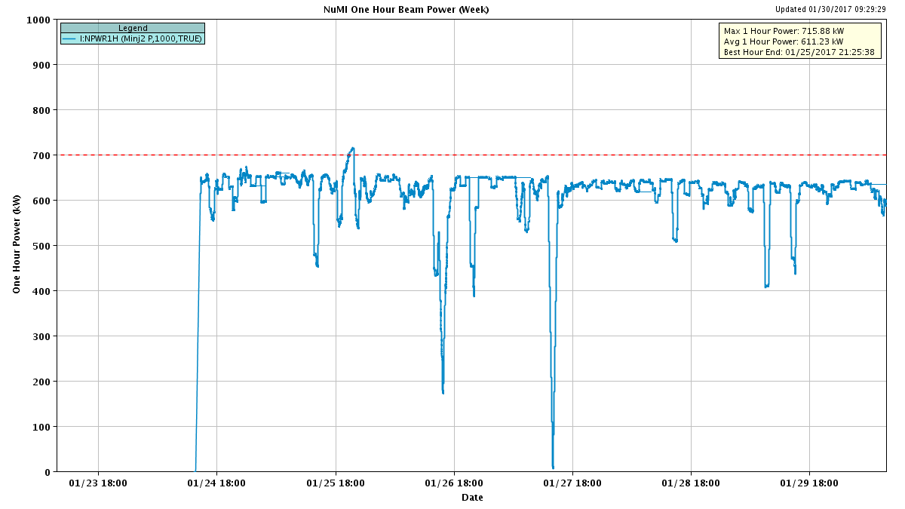
NuMI Beam Power
635.6kW NuMI with SY => 700 KW NuMI only
1 hour beam power record: 715.88 kW (1/25/17 20:25 to 21:25)

Slide 4
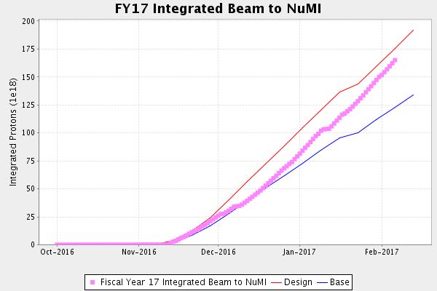
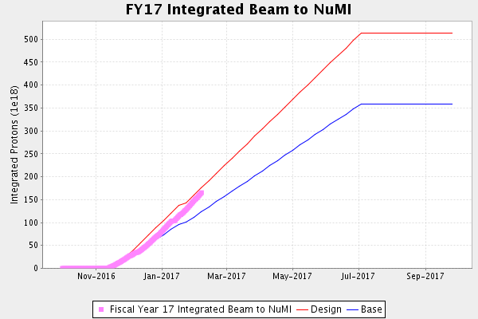
NuMI Operation

Slide 5
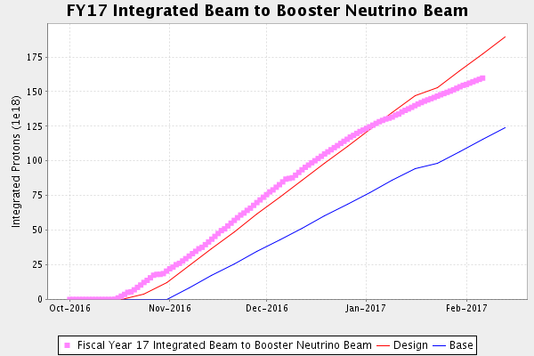
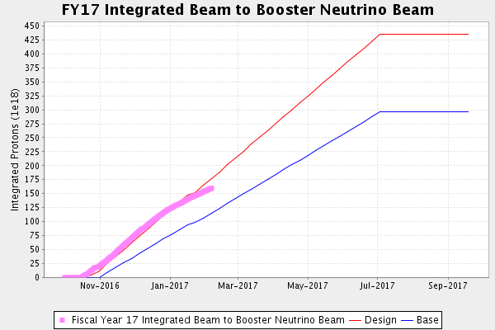
BNB Operation

Slide 6
Complex Status
LINAC
  Running well
  Testing Marx modulator on LRF5
    Testing suspended
  LRF2 anode supply failure
  KRF2 has a water leak
Booster
  Running well
  New shielding assessment
MI/RR
  Slipstacking 6+6
NuMI
  Running at ~630 kW with Switchyard
  Ran at ~700 kW without Switchyard
    New 1 hour beam power record
      715 kW (1/25/17)
Booster Neutrino Beamline (BNB)
  Running well
Switchyard
  MCenter, MTest, and SeaQuest
  G2SEM replacement
  Beam available
General
  Downtime Planned
    4 hours down tomorrow for KRF2
    Next full day downtime in late February or early March
    Coordinating downtime with MSS commissioning

Slide 7
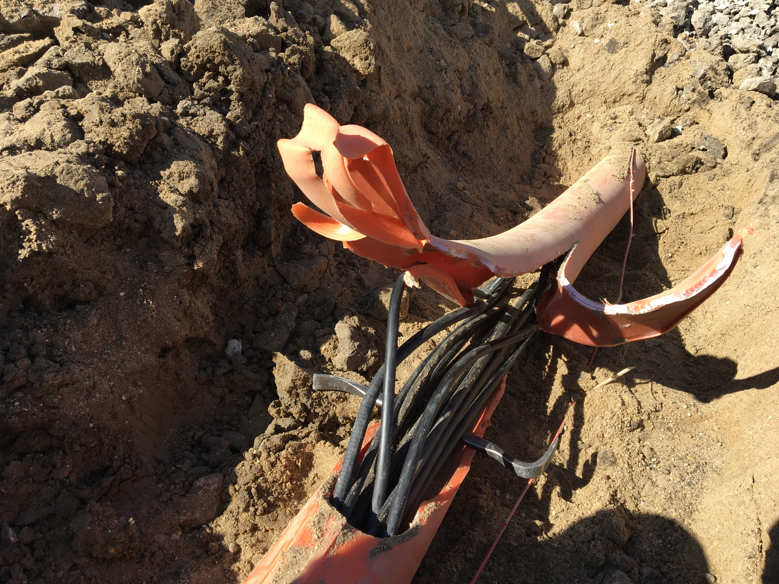
MI-12 Communication Duct
Summary
Emergency Repair Plan In Place
  Need 2 hour notification
  Vendor has cable
New Communications Duct Plan
  Communications duct installation
    New duct installed
  New fiber cable has been delivered
    Electricians notified
    Installation pending
  Hope to move to new cable in March
    Coordinate downtime with Master SubStation outages
Damaged on 10/24/16
Protected from further damage
Provides timing/date to Neutrino Experiments
Experiments running fine

Slide 8
PIP-II Injector Test & FAST Status
PIP-II Injector Test
  RFQ operation
    Emittance measurements with new scanner look good
    Shutdown to install 30 degree bend magnet in Low Energy Beam Transport (LEBT)
    Down for ~4-5 weeks
    Performed maintenance
  Plans for the week
    3rd week of shutdown
    Shutdown for magnet installation
FAST
  No gun operation
  Drive laser aligned in laser lab
  Shutdown for 300 MeV upgrade
    Toroids are ready for certificationStands installed and aligned
  Magnet supports being added
  Magnets installation underway
    4 quads and 2 large dipoles so far
  All corrector magnet stands are now installed
  Cable pulls have begun
    all TPM cables are pulled, HV ion pump cables being
  4 transverse profile monitors are UHV certified, 2 in certification, 1 failed leak check.

Slide 9
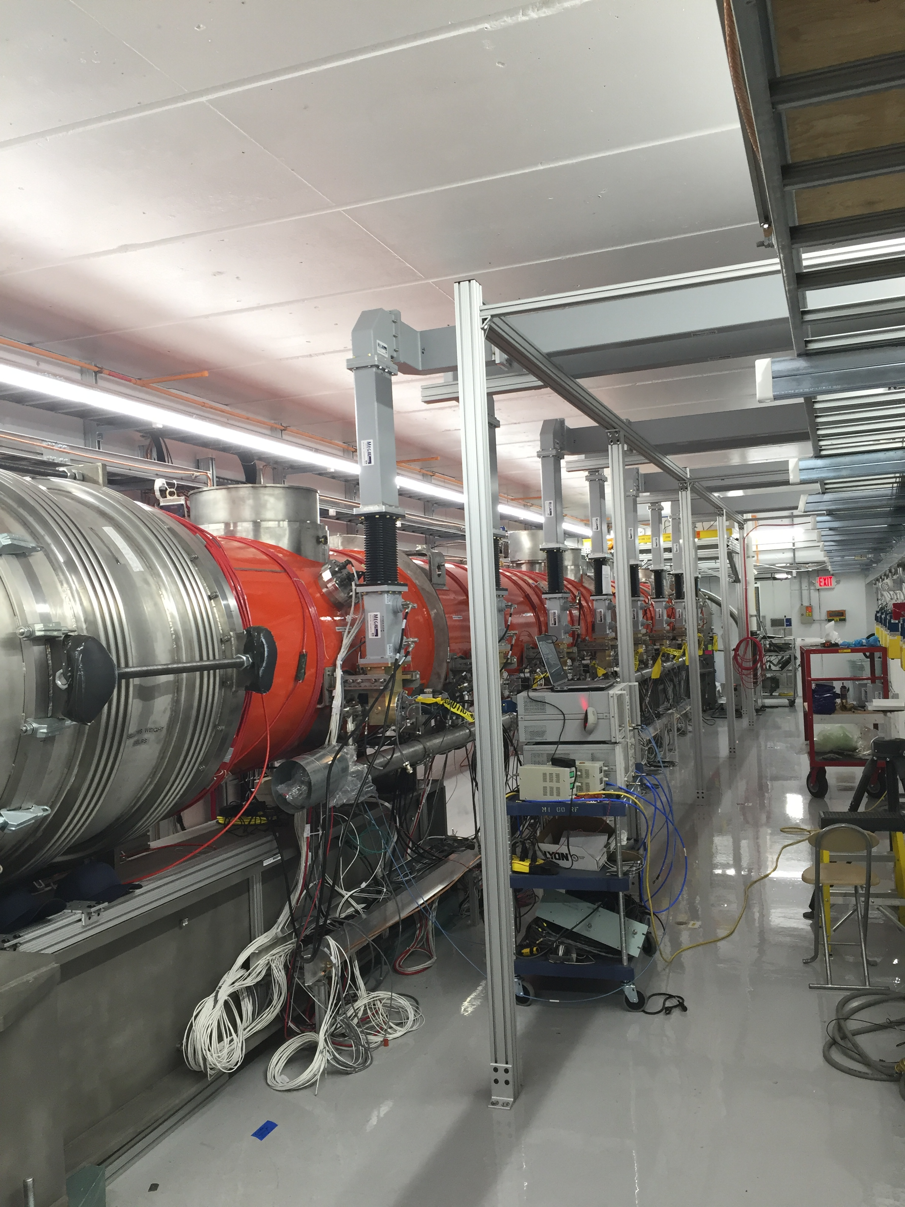
CMTS1 Status
LCLSII Prototype Cryo Module
  Cryo
    Operation at 2K restored
  Accomplishments
    LLRF: spent two days testing joint systems.
    Opertated (>128MV specification)
      With internal magnet coils for 6 hours
    Gathering lots of microphonics data
  Plan for the week
    swapping out the remaining two cryo valve stems, following the positive results from the previous one.
      reduced the thermo-acoustic oscillations in the cryomodule
    Microphonics as needed
    Turn off February 17th for ICW work

Slide 10
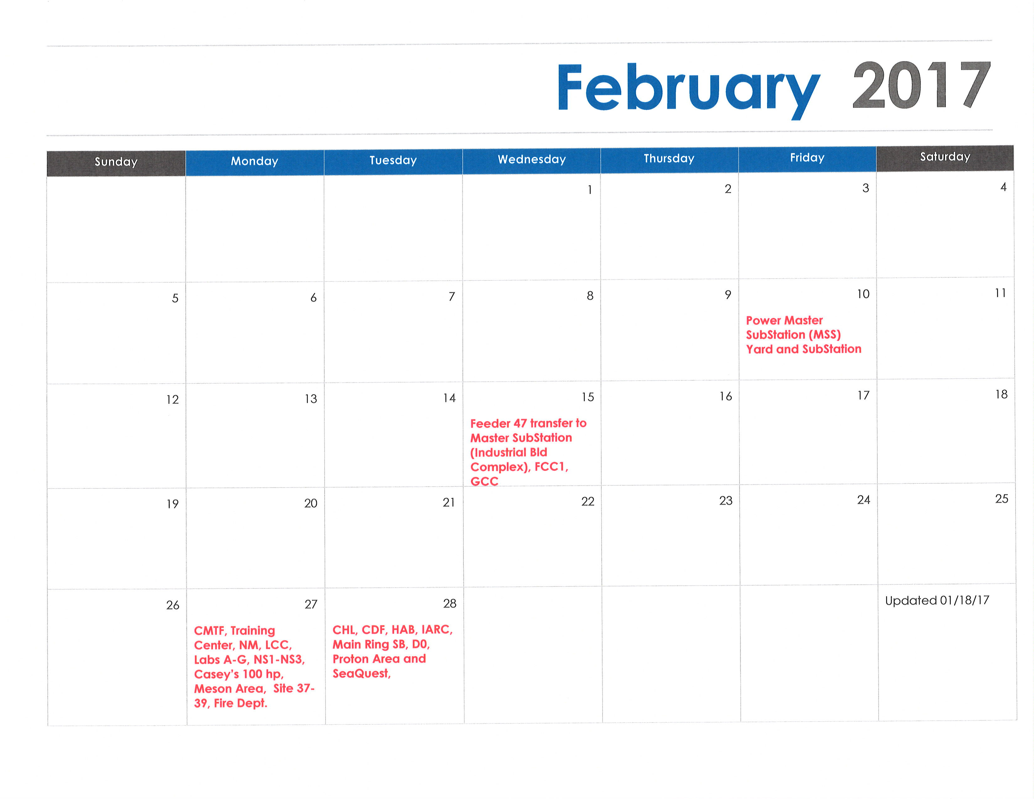
February 2017

Slide 11
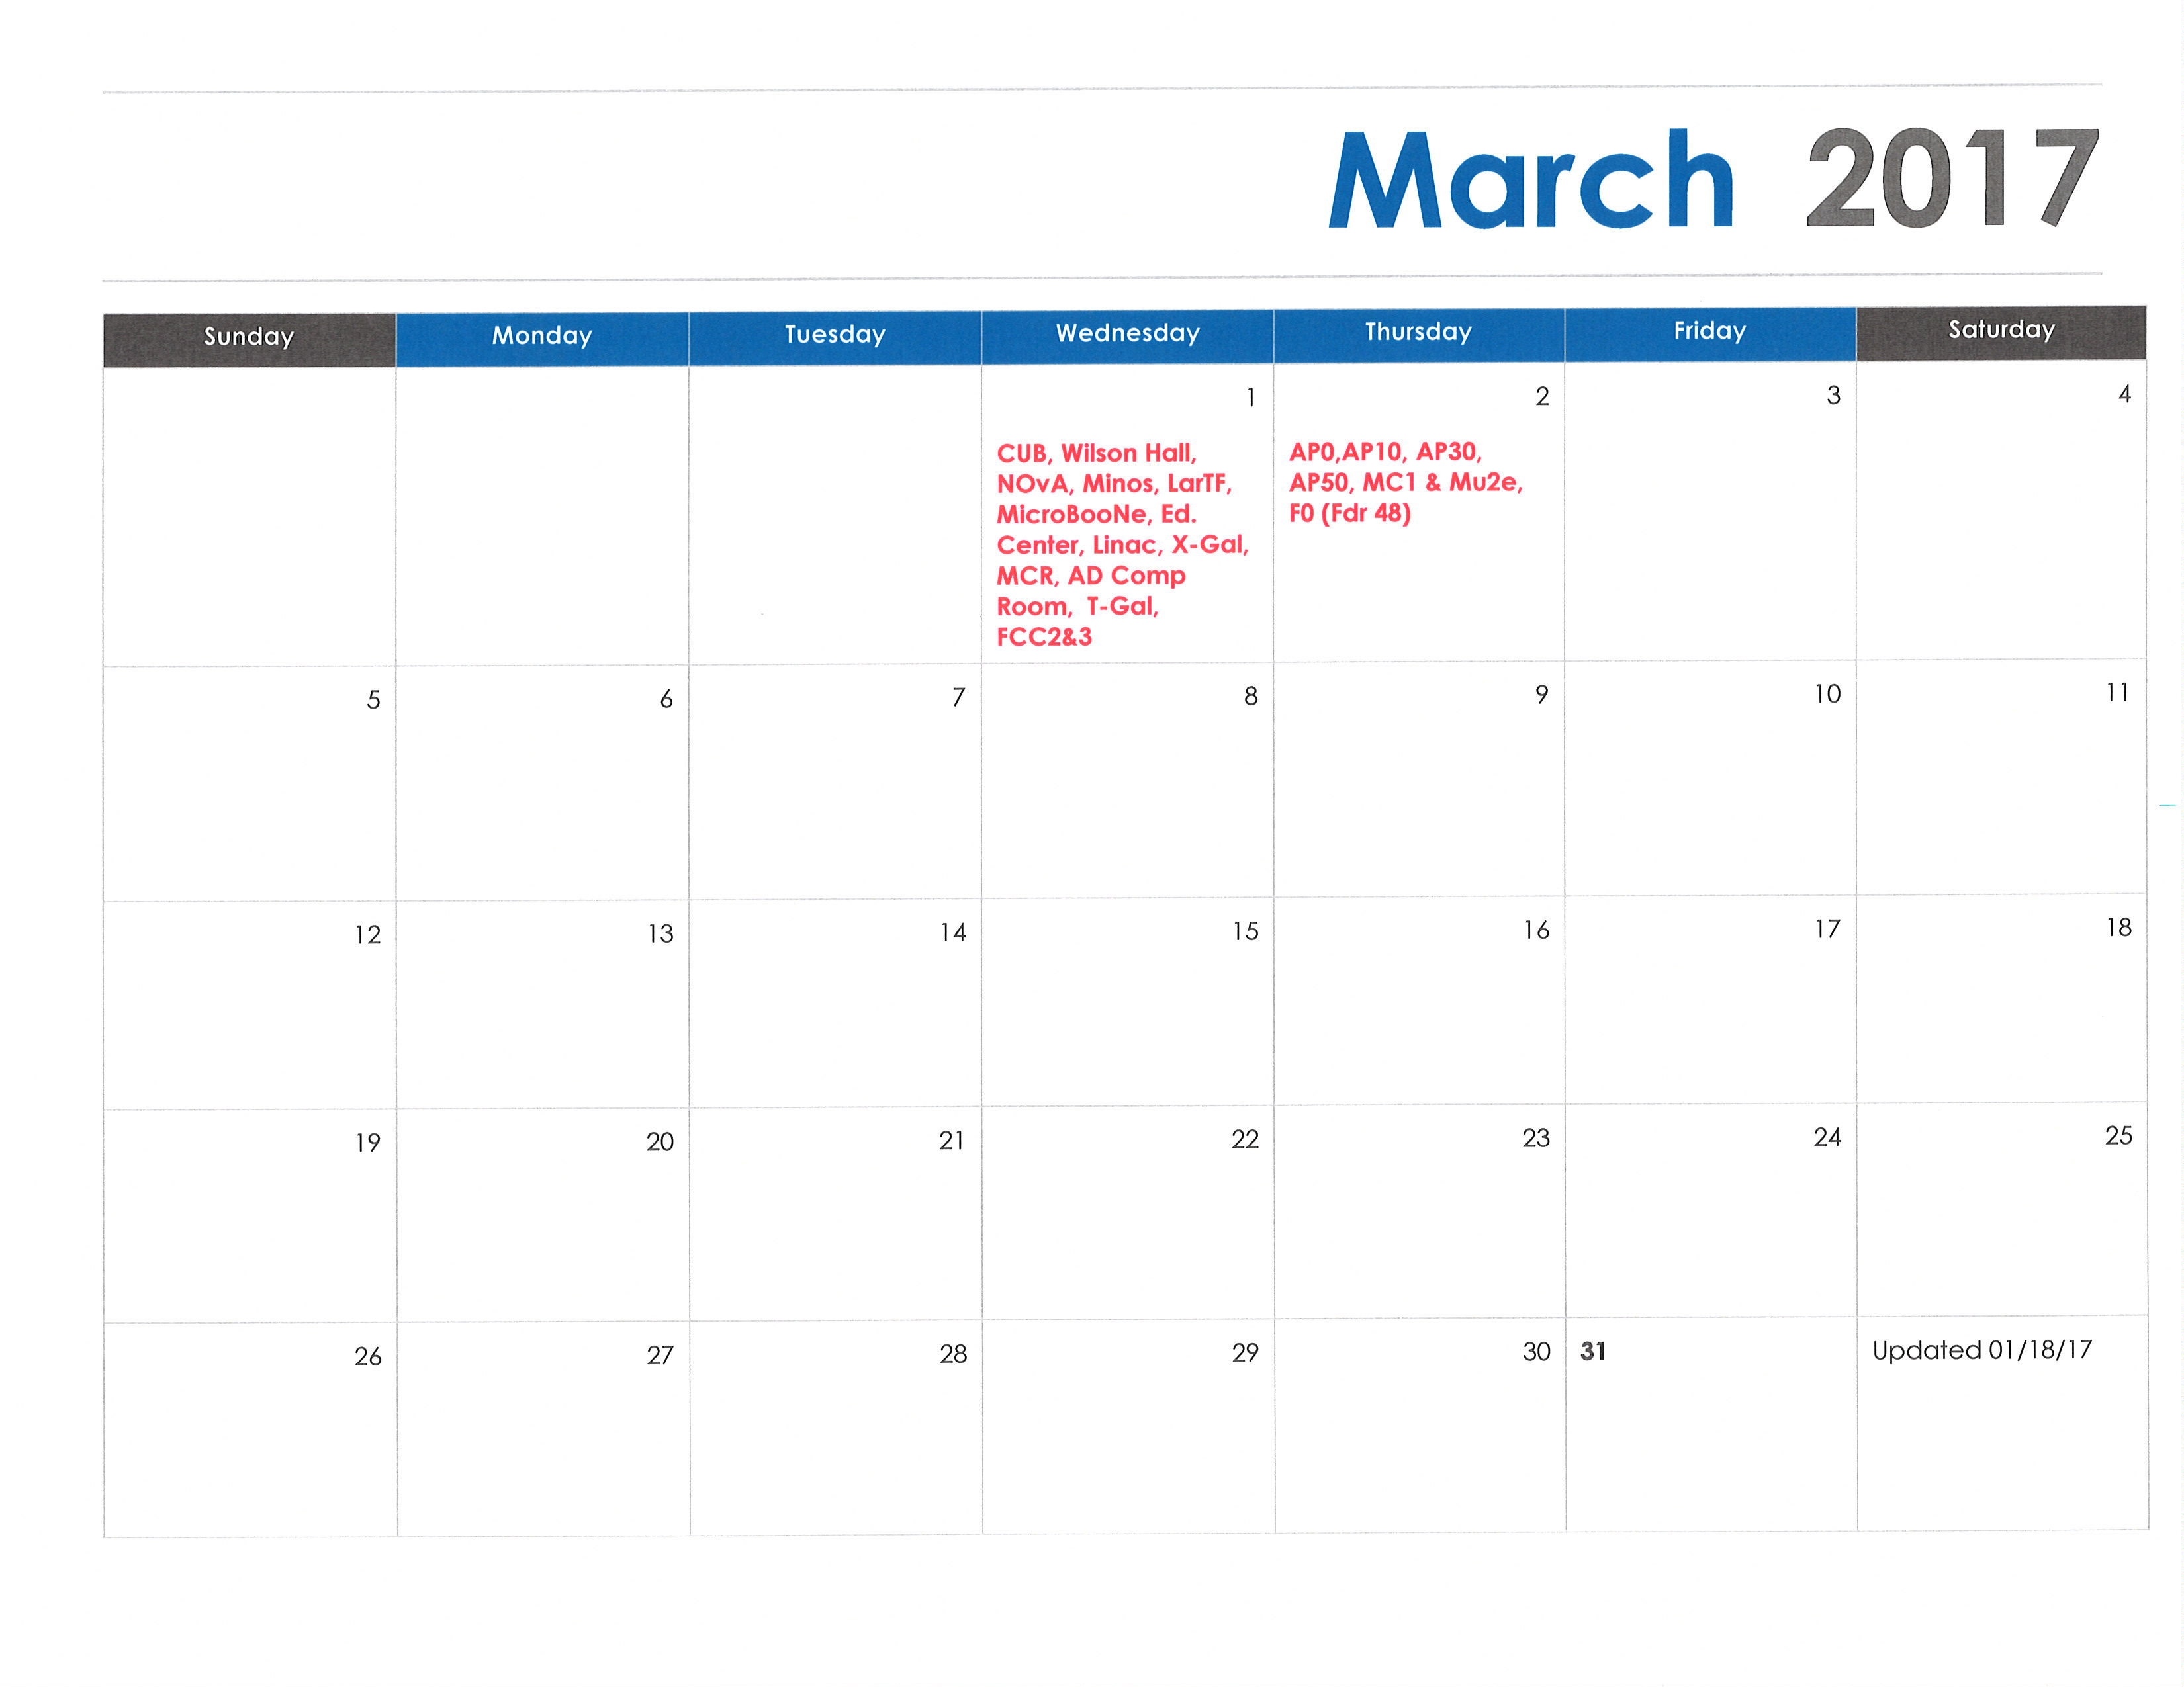
March 2017

Slide 12
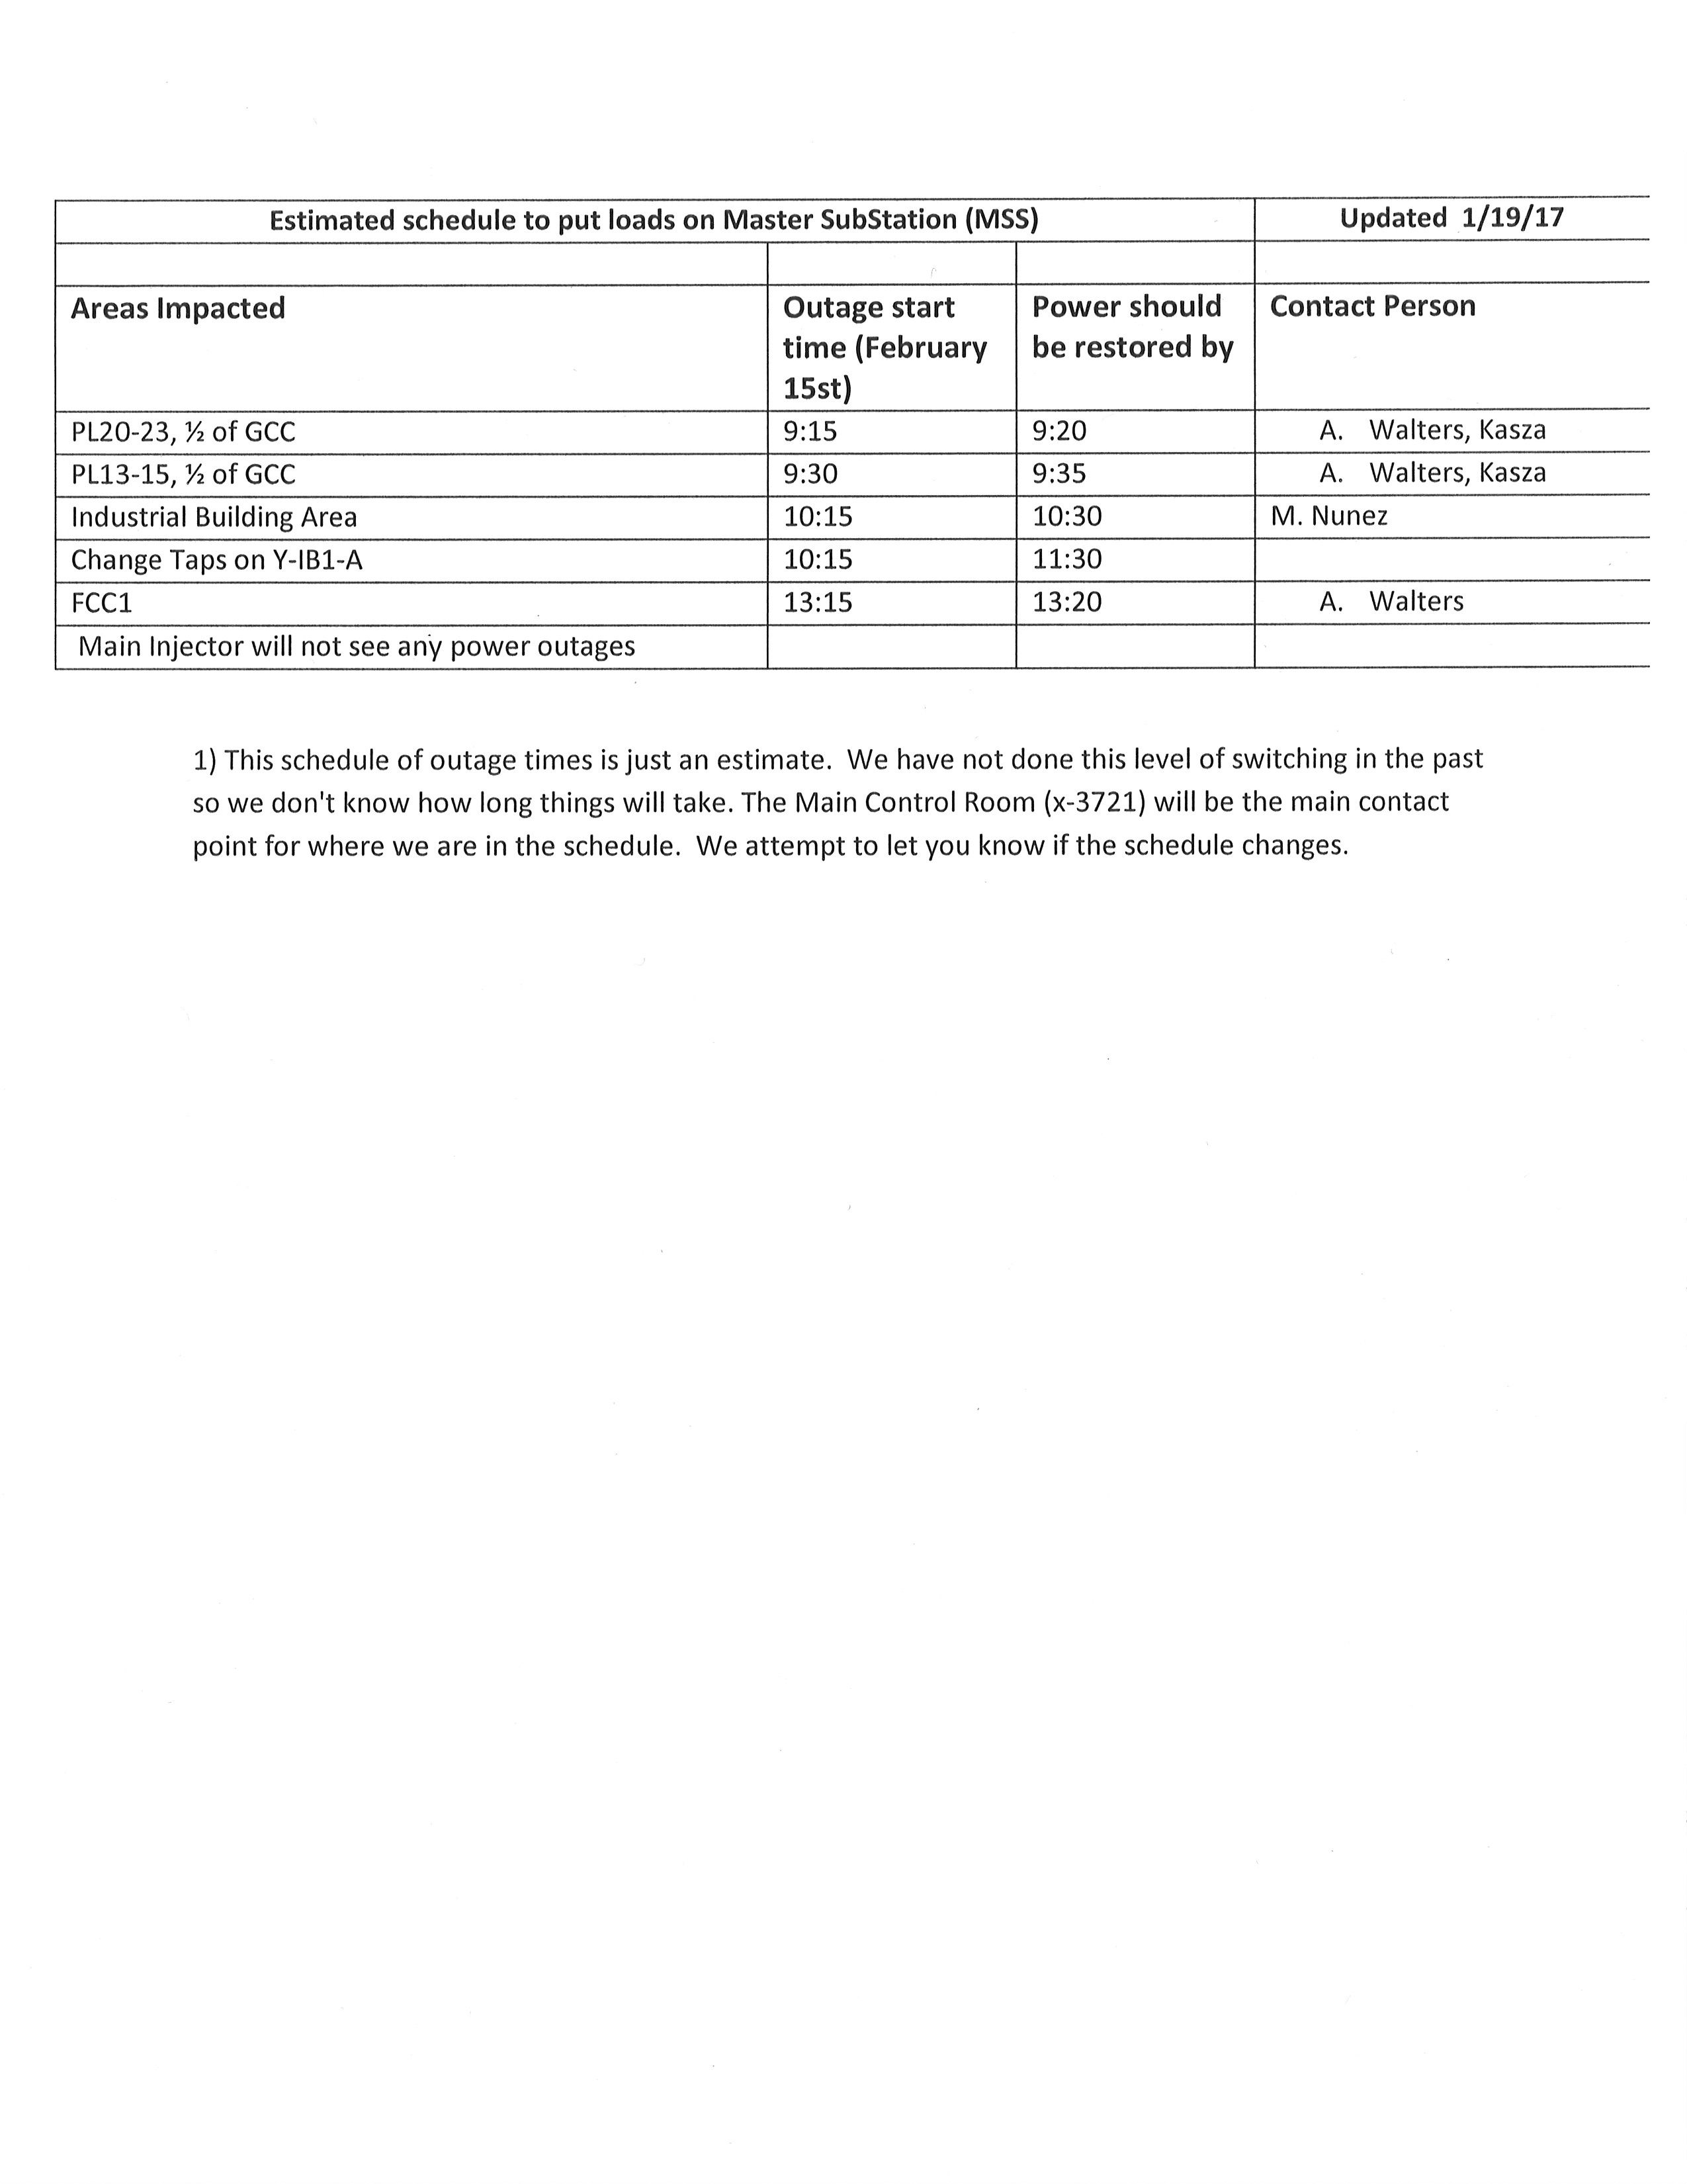
February 15th

Slide 13
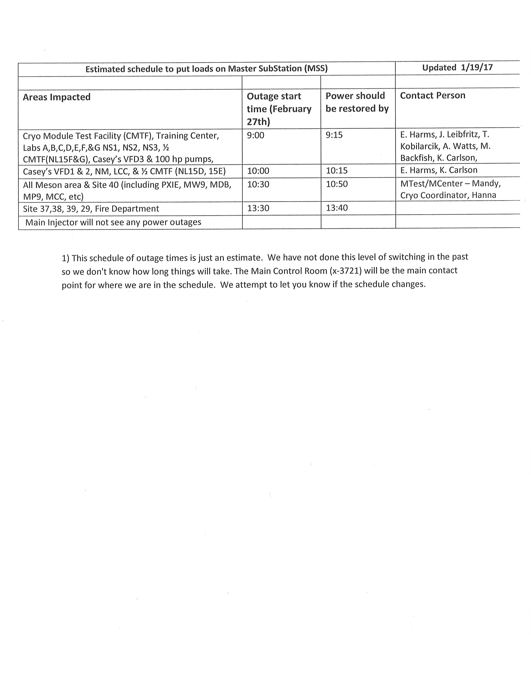
February 27th

Slide 14
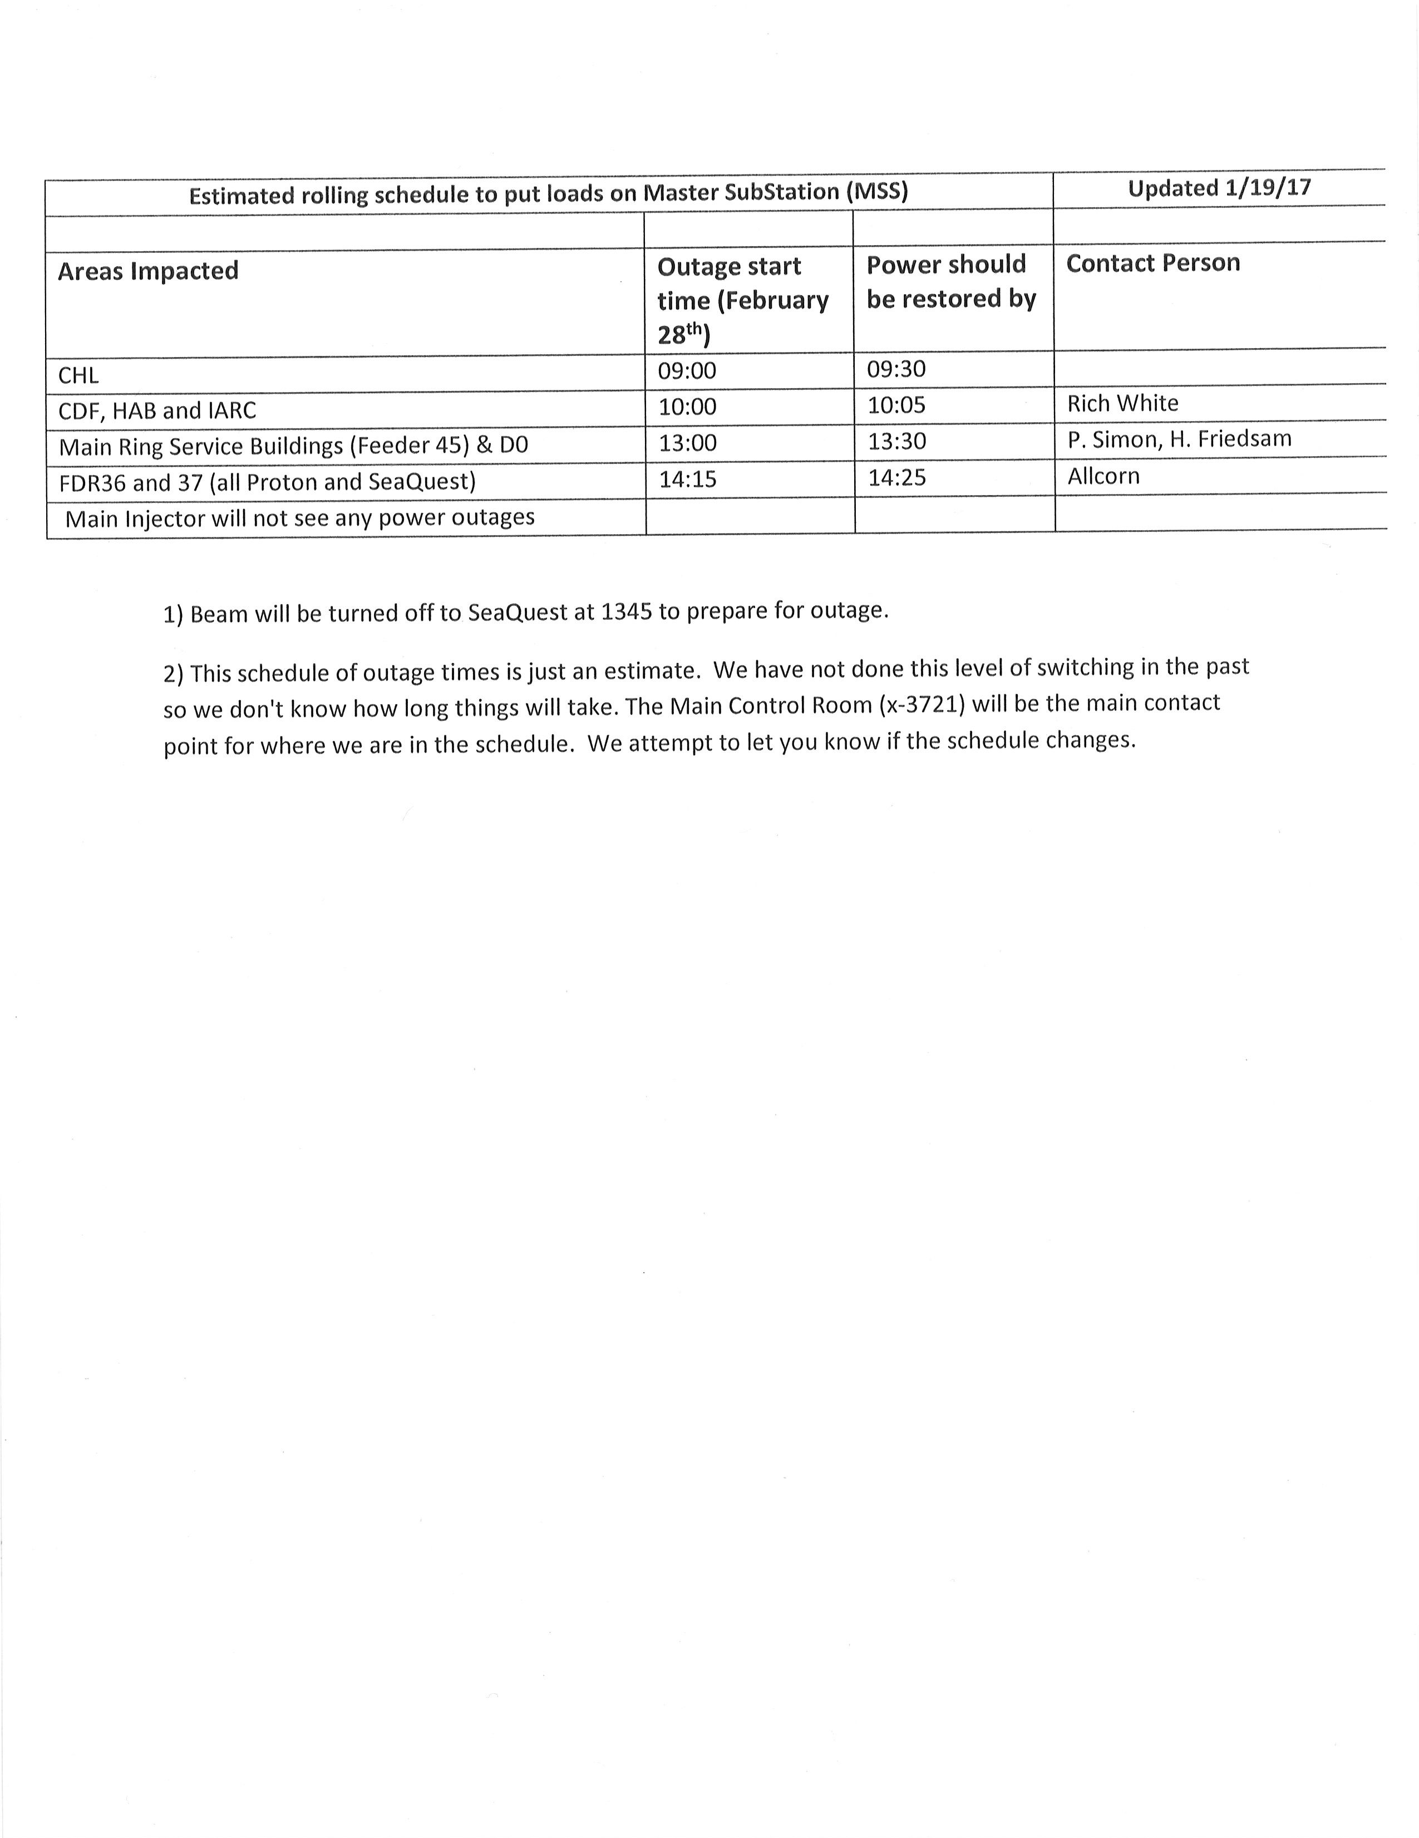
February 28th

Slide 15
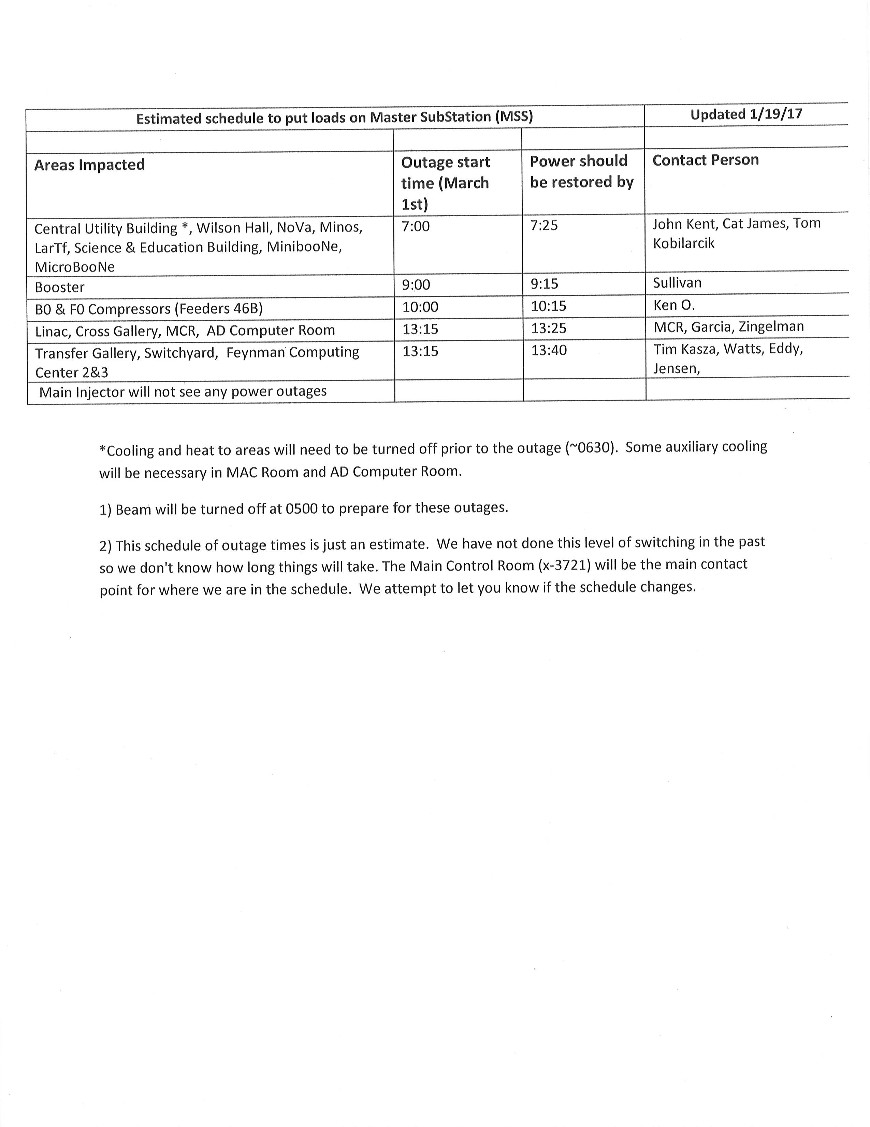
March 1st

Slide 16
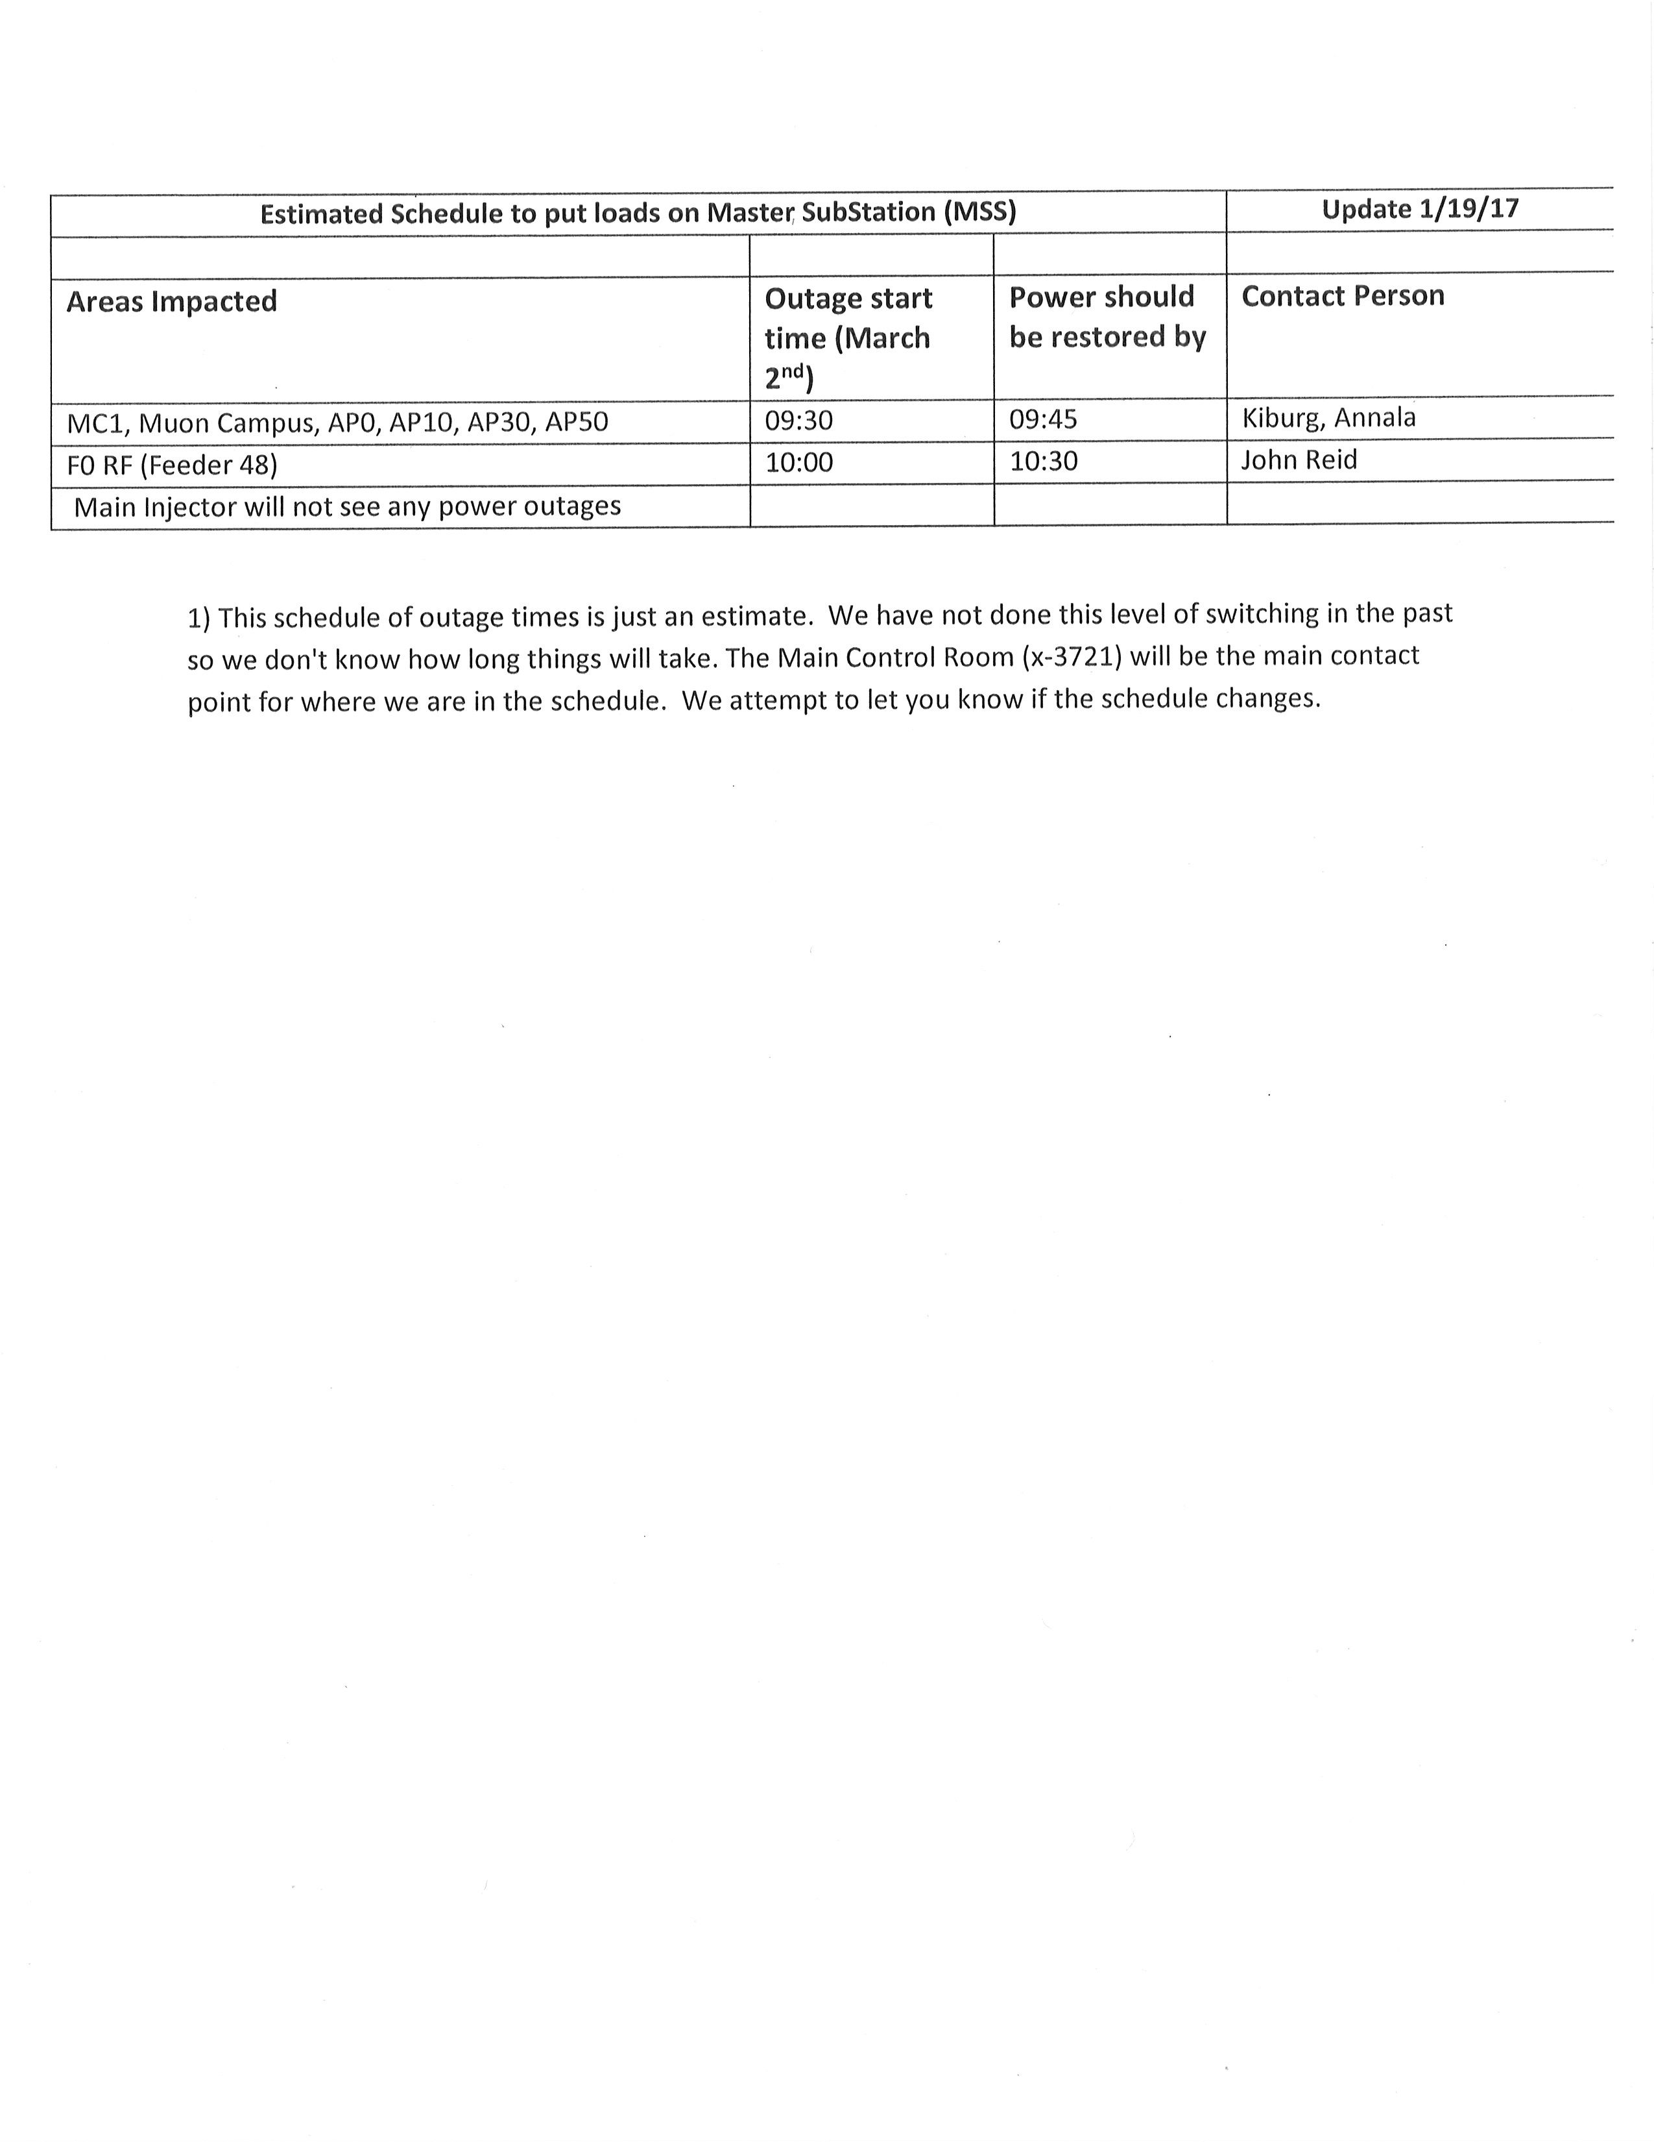
March 2nd

Slide 17
Schedules and Links
Schedule can be accessed from the Operations Department Home Page
  Schedules -> Operations Schedule
Direct link to schedule
  http://www-ad.fnal.gov/ops/schedule.html

Slide 18














Collaborations / Partnerships / Members [22pt Bold]

