Slide 1
Organizational Update
Arkadiy Klebaner, EAC member
The 3rd All Engineers Retreat
14 February 2017
Notes:
Some of us have heard about some organizational changes coming up, but did not know if it actually will happen

Slide 2
AD/Cryo is moving to Technical Division

Slide 3
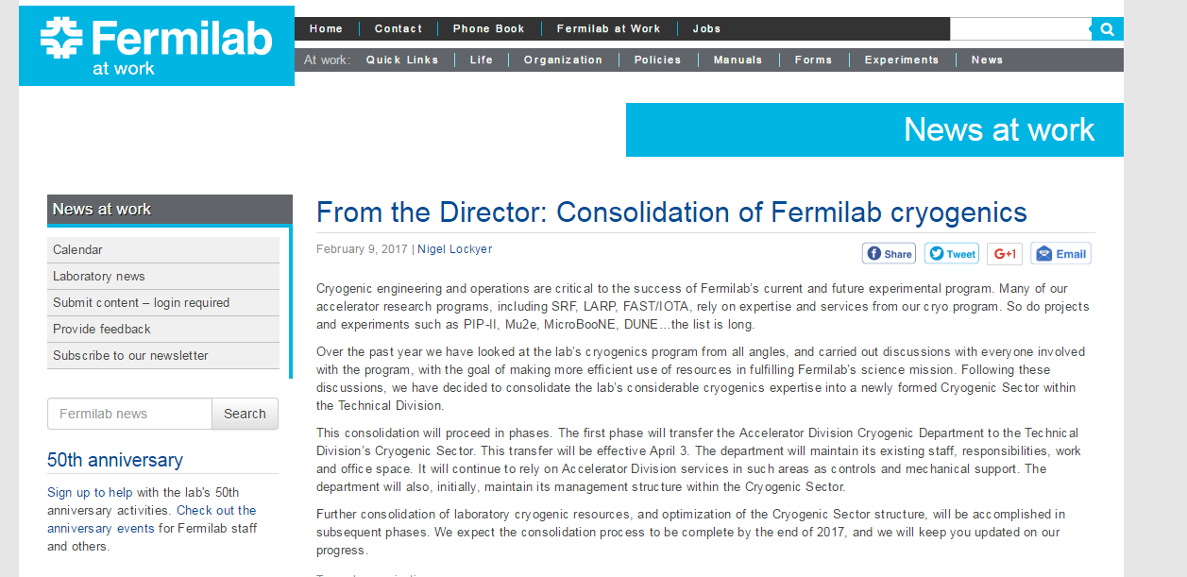
Fermilab At Work, February 9th, 2017

Slide 4
The Change
After extensive discussions and considerations of the Laboratory needs in the area of cryogenic engineering and operations of various cryogenic system, and taking into account more efficient use of resources in fulfilling the Laboratory goals, Fermilab senior management has decided to consolidate cryogenics expertise in Technical Division
The consolidation will proceed in phases
Phase I involves the transfer of the Accelerator Division Cryogenic Department to Technical Division, effective April 3rd, 2017
Further consolidation of the Fermilab cryogenic resources will be accomplished in subsequent phases

Slide 5
Why Change?
AD/Cryogenics Department mission has changed:
Tevatron is decommissioned
Expanded Work For Others effort ➔LCLS-II
New projects require cryogenic engineering support
PIP-II, Mu2e, FIP, Quantum Sensors and Computing, etc.
OHEP Fermilab 2016 Facilities Operations Review
“… There are significant cryogenic skills needed now and through the next five years…”
“… Fermilab would benefit from an analysis of critical expertise needed to pursue its strategic plan, and develop (and adhere to) a plan for continuity of expertise. This need has already been recognized in regards to cryogenic technology ...”
“ … Fermilab management may find opportunities to optimize the evolution of the organization by evaluating near- and longer-term operational and technical project requirements to determine whether efficiencies could be realized by rebalancing the distribution of work and/or functions between the Accelerator and Technical Divisions…”

Slide 6
FY2016 Notable Outcome
Goal 3.0
Objective 3.2
Provide Effective and Efficient Science and Technology Project/Program/Facilities Management
:
“The Laboratory will complete actions to respond to the program’s institutional review recommendations concerning cryogenic-engineering resources and planning by preparing a hiring plan, a lab-wide resource-management strategy, and a five-year outlook for cryogenic needs. These plans will be ready for evaluation at the FY 2016 S&T Review of Fermilab.”
Office of Integrated Planning and Performance Management (IPPM)
https://fermipoint.fnal.gov/organization/ocoo/ippm/SitePages/Home.aspx
Notes:
Each year, the Office of Science (SC) conducts an evaluation of the scientific, technological, managerial and operational performance of the contractors who manage and operate its national laboratories
Each Performance Goal is comprised of a small number of Objectives. Within each Objective, SC Science Programs and Site Offices can further identify a small number of Notable Outcomes that illustrate or amplify important features of the laboratory’s performance for the coming year.

Slide 7
What We Know
The department will maintain existing responsibilities, line management structure, staff, work and office space
We will continue to rely on the Accelerator Division services – controls, mechanical support, etc.
The department’s responsibilities will extend to other projects within the Technical Division

Slide 8
What We Don’t Know
The change is based on the assumptions for the current and future Laboratory projects. We don’t know if the assumptions are 100% correct – life will tell
We don’t really know if the current organizational structure is optimized for the Division needs. It is likely that adjustments will be made in the future
We don’t know details of the next phase yet – discussing with cryogenic groups around the Lab to understand what make sense
We Don’t Know What We Don’t Know - we will adjust as needed

Slide 9
Dodgers Story
While in Brooklyn, Dodgers won one (1) World Series Championship in nine (9) appearances
"Wait ’til next year!" was an unofficial Dodger slogan in Brooklyn
After moving to LA, Dodgers have won five (5) World Series championships in the same number of appearances
Brooklyn is doing well
Disclosure: I am not a Dodgers fan by any measures

Slide 10
Thank you!

