Slide 1
Accelerator Status Report
M. Monningh
2/08/2017

Slide 2
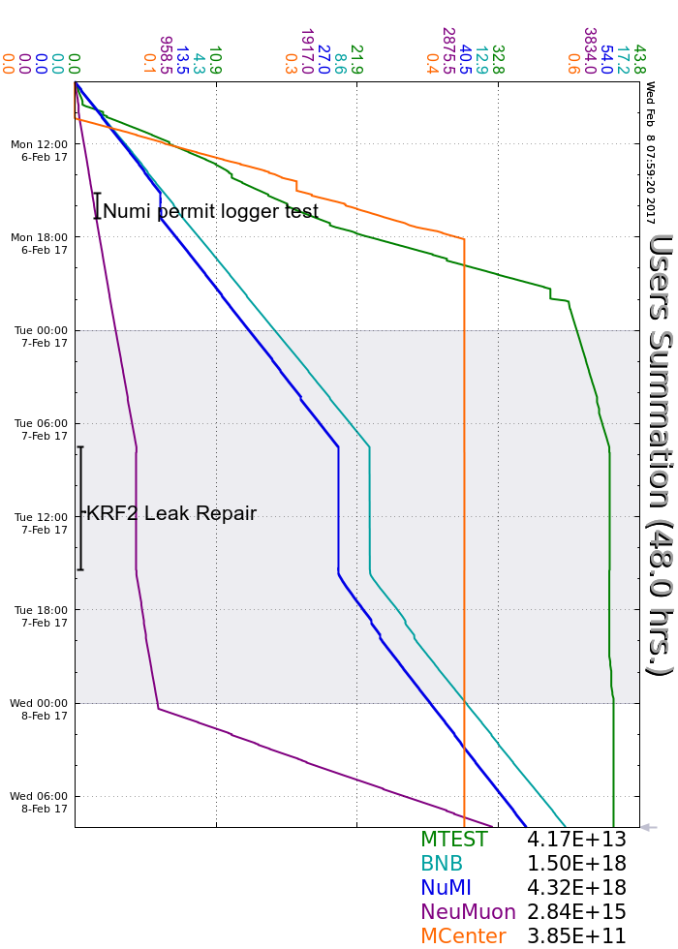
Monday
Diagnose NuMI permit/logger interaction
Tuesday
Access/repairs period
Monday~Wednesday accelerator summary

