Slide 1
Assumptions Document
Steve Holmes
PIP-II Friday Meeting
10-February 2017

Slide 2
Role of the Assumptions Document
The Assumptions Document provides the basis for developing the supporting documentation for CD-1
Goal is to establish consistent expectations among the DOE, the Lab, and the Project
Documents assumptions inherent in the cost estimate and RLS
Defines interfaces with existing facilities
Documents responsibilities assigned to the Project and to the Laboratory
Defines responsibilities of the DOE as they impact the cost estimate and RLS
The Assumptions Document will provide the basis for the Fermilab-PIP-II Project MOU that will be written in advance of CD-1 (as recommended by the DOE Review Committee)
Draft Assumptions Document exists is under review by the Directorate
We are asking the Director to approve this document
Current draft will be posted to docdb once Directorate review is complete
Document 144

Slide 3
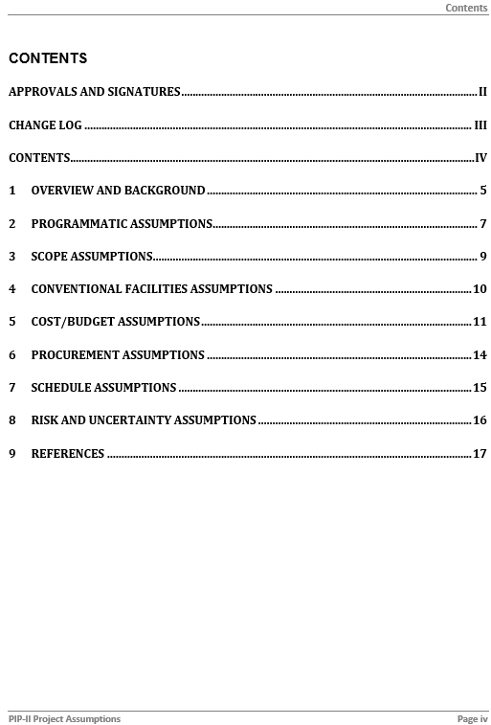
Table of Contents

Slide 4
Assumptions/Programmatic (highlights)
The performance requirements of PIP-II are documented in the PIP-II Functional Requirements Specification (FRS), which represents the application of the goals outlined in the MNS to the Fermilab accelerator complex.
PIP-II will be constructed on the Fermilab site and will utilize the upgraded Booster, Recycler Ring, and Main Injector for the generation of a long baseline neutrino beam.
The long baseline neutrino program will eventually require >2 MW of proton beam power at energies within the range 60-120 GeV. This will require eventual replacement of the existing 8-GeV Booster.
The Mu2e program will eventually require ~100 kW of beam power, a factor of ten beyond the initial goal of that program. This beam will have to be provided at duty factors approaching CW.
PIP-II will be situated to allow the delivery in the long term of 800-MeV protons to the Mu2e Hall on the Muon Campus and the eventual construction of a new accelerator to replace the 8-GeV Booster.

Slide 5
Assumptions/Programmatic (highlights)
India is strongly engaged with Fermilab in the R&D phase of PIP-II, and will make a significant in-kind contribution to the PIP-II construction phase… It is assumed that the deliverable dates…will be met.
The DOE/OHEP will provide budget authority in line with the anticipated funding profile as shown below in $M…It is anticipated that a revised profile will be available following the President’s FY18 Budget Request.
To the extent possible, the PIP-II Injector Test (PIP2IT)… will be relocated to form the front end of the PIP-II linac once the required conventional facilities are available.

Slide 6
Assumptions/Programmatic (highlights)
Operating funds will be available to support maintenance and operations of PIP2IT systems once commissioning of each system is completed.
Operating funds will be available to support maintenance and operations of the 800-MeV linac, Booster, Recycler, and Main Injector once Key Performance Parameters (KPPs) associated with each of these systems is achieved.
Operating funds (special process spares) will be available to support the fabrication of an initial complement of spare components.
Improvements to the Booster, Recycler, and Main Injector required to support continuous improvement in capabilities within the ongoing neutrino research program will be supported via operating funds. Any such improvements will be implemented in a manner consistent with the PIP-II configuration.
Installation and commissioning of new systems required for injection of 800-MeV protons into the Booster will be scheduled coincident with the interruption to accelerator operations in the Main Injector complex required for integration of the long baseline neutrino facility (LBNF). This interruption is currently scheduled over the period December 1, 2022 – November 1, 2024.
The NEPA process will be complete by June 2018, in advance of CD-2.

Slide 7
Assumptions/Scope (Highlights)
The scope of the PIP-II Project starts at the H- source and ends at the extraction kicker to the LBNF beamline in the Main Injector.
For all PIP-II systems the scope includes research & development, design, fabrication, inspection and acceptance, installation, and commissioning activities. Commissioning is assumed complete upon meeting the project KPPs.
The PIP-II project will fabricate an adequate complement of spare components to initiate operations. Spare components will be transferred to, and reimbursed from, the Fermilab special process spares account prior to CD-4.

Slide 8
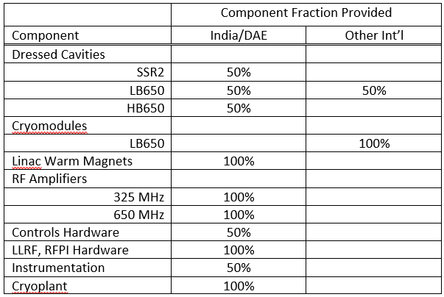
Assumptions/Scope (Highlights)
The scope assigned to…international partners for the construction phase will only be formalized following CD-2. However, planning for the construction phase currently assumes the following scope for in-kind contributions:
The enclosure for the superconducting linac will have sufficient length to accommodate four HB650 cryomodules beyond those nominally required for 800 MeV beam.

Slide 9
Assumptions/Conventional Facilities (Highlights)
1,400 gallons per minute of industrial cooling water (ICW) will be available for PIP-II process loads… The connection location from the existing sitewide ICW will be in the vicinity of AZero
ICW will be utilized for Fire Protection
The PIP-II ICW return discharge will be routed to the existing AZero cooling pond. It is assumed that the existing system to pump the ICW to the Casey’s Pond system is adequate for this flow
250 tons of chilled water will be available from the Central Utility Building (CUB) for use by PIP-II. The connection point for the chilled water will be in the vicinity of CUB
PIP-II will require six (6) 13.8 electrical feeders, fed from the Master Substation (MSS);
Existing feeder 46A, fed from the Kautz Road Substation, will be used for backup of critical PIP-II systems;
PIP-II will install new electrical breakers at MSS;

Slide 10
Assumptions/Conventional Facilities (Highlights)
Existing electrical ductbanks will be utilized for PIP-II feeders from MSS to manhole P-71
New PIP-II electrical ductbanks will be extended from the existing electrical system at manhole P-71
New electrical ductbanks will follow the latest safety isolation standards
A new utility corridor with natural gas, domestic water supply (DWS), sanitary sewer, data/comm and chilled water will be extended from the vicinity of CUB to the PIP-II project site
Maintenance of systems/buildings/structures will be transferred from the PIP-II project to Fermilab at the time of Beneficial Occupancy
Conventional facilities will be responsible for the mechanical equipment required for oxygen deficiency hazard (ODH) mitigation. The design, installation and commissioning of the control portion of the ODH system will be accomplished by the controls group.

Slide 11
Assumptions/Cost & Budget (Highlights)
The PIP-II Project involves multiple countries and funding agencies. International participation to the development and construction of the facility will be via in-kind contributions. The PIP-II Project will establish a costs in U.S. dollars while accounting appropriately for the in-kind contributions and any risk associated with their delivery. The accounting method described below is utilized to arrive at a “cost-to-DOE TPC”.
The cost estimate for PIP-II is developed at the lowest level of the WBS by identifying the direct costs associated with required services and materials, and effort of laboratory personnel, in the absence of in-kind contributions.
Components that are assumed as in-kind contributions from India/DAE or other international collaborators are flagged for removal from the cost-to-DOE TPC and RLS.
The cost-to-DOE TPC is then calculated by applying laboratory overhead, escalation, and contingency to all un-flagged systems and components. This is referred to as the DOE-funded portion of the Project.
If there were no in-kind contribution to PIP-II, the following technology choices would be modified:
650 MHz rf power would be provided by inductive output devices (IOT), klystrons, or phase-locked magnetrons.
The cryoplant would be appropriately sized for low duty factor operations, and configured to allow subsequent upgrade to CW operations.
The base estimate for the PIP-II Project direct cost will be maintained in FY2016 dollars .
All scientific labor applied to the DOE-funded portion of the Project in the form of either technical or managerial tasks, will be charged against the Project.
Earned value management will apply only to DOE-funded activities.
The PIP-II cost-to-DOE TPC includes all costs starting in mid-January, 2016, shortly after the receipt of CD-0.

Slide 12
Assumptions/Cost & Budget (Highlights)
Labor and M&S costs are estimated for each task and are documented in the BOEs. Labor hours are estimated as “touch labor”.
FTEs are calculated assuming 1 FTE=1768 hours/year of touch labor. A full year includes 2080 of paid time, with the difference allocated to vacation, sick leave, and breaks. These hours are accounted for in the fringe rate component of the laboratory SWF (salary, wages, and fringe) rates.
Labor rates for each type of labor resource are captured Cobra, the resource hours are captured in the Resource Loaded Schedule.
Fermilab ES&H support is off-project and is included in the overhead rate.
Contingency associated with in-kind contributions is identified and managed via the PIP-II Risk Management Plan. The contingency associated with the in-kind will be held by the DOE.

Slide 13
Assumptions/Cost & Budget (Highlights)
Labor, M&S procurement, and pass-through indirect rates are applied to the project as calculated on an annual basis by the Fermilab Budget Office…The Special Construction Line Item rate will be applied to all TEC-related expenditures. Current indirect rates are given below.
Labor overhead will not be charged on any effort reported against PIP-II Project task codes by staff within overhead sections at Fermilab.

Slide 14
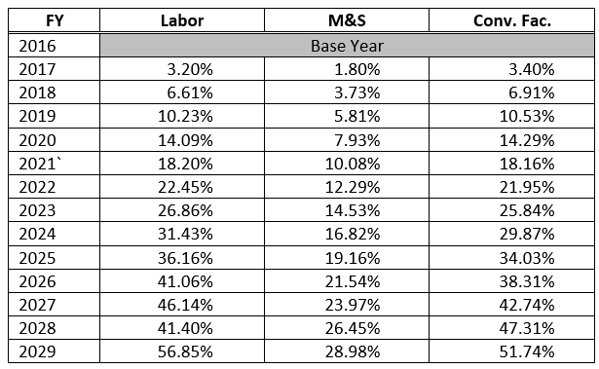
Assumptions/Cost & Budget (Highlights)
Escalation rates are determined by each DOE laboratory budget office, and are documented in the table below.

Slide 15
Assumptions/Cost & Budget (Highlights)
DOE funding for the project in a “normal” year without continuing resolutions can be expected to be received…as shown in the table below…the project will assume in its planning a smaller amount for each quarter.
Funding in support of project work scope assigned to other DOE laboratories will flow through Fermilab via Inter-entity Work Orders (IWO).

Slide 16
Assumptions/Procurements (Highlights)
Competitive, best-value proposals will be sought for all major procurements.
Work assigned to partner DOE labs will be procured through each lab’s procurement departments and in accordance to those policies.
All procurement contracts will be written in U.S. dollars.
Conventional Facilities construction will primarily be accomplished through a number of a competitively solicited, fixed priced construction packages…If appropriate and in the best interest of Fermilab, alternate delivery methods will be assessed and implemented. This will be done utilizing Acquisition Planning, and Fermilab’s Procurement Department standard policies, procedures and practices.
Procurement approval cycles through all levels of DOE are incorporated into schedule duration planning.
The Finance Office will assign a dedicated Procurement Manager to the PIP-II Project for the duration of the Project. The Procurement Manager will report his/her effort directly to the appropriate PIP-II Project task code and will not be subject to laboratory SWF overhead.

Slide 17
Assumptions/Schedule (Highlights)
The RLS will include all tasks required to complete the DOE funded scope of work and will be developed to meet all DOE and Laboratory reporting requirements.
Deliverables from India/DAE, or other international partners, will be represented and tracked via International Tier 3 and 4 (I3 & 4) milestones. All such milestones will correspond to the deliverable dates established in approved DOE-DAE joint documents with three months of float added.
If project work scope is assigned to other DOE laboratories, their work activities will be included in the Resource Loaded Schedule with institution-specific resources.
Long-lead procurements will be authorized via CD-3a coincident with establishment of the project baseline at CD-2. Long-lead procurements will include advanced purchases of Nb, initial superconducting cavity orders, and initiation of site preparation activities.
The intent is to manage the project via one critical path, through the development, design, fabrication, installation, and commissioning of the linac superconducting cryomodules. All other activities will have at least one month of float relative to the critical path.
Milestones for DOE-funded work are tiered…having schedule float from their early finish dates as follows:
Tier 2 – DOE Federal Project Director – 6 months
Tier 1 – DOE Program – 1 year
Tier 0 – DOE Acquisition Executive for Critical Decision – 2 years, 6 months (CD-4 only)
The accelerator shutdown required to connect the beam transfer line into the 8-GeV Booster will be coincident with the accelerator shutdown for LBNF connection into the Main Injector.
The project schedule will be based on the funding profile shown in section 2.
Schedule Risk Mitigations will be incorporated into the Resource Loaded Schedule.

Slide 18
Assumptions/Risk & Uncertainty (Highlights)
Assessment of cost and schedule risk impacts will be used to produce cost and schedule contingencies.
Risks associated with delivery of international in-kind contributions will be identified within the PIP-II Risk Registry, and incorporated into the project schedule contingency. However, the cost contingency will be held by the DOE.
The schedule contingency will be used to assess the adequacy of the schedule float on the DOE CD-4 milestone.
As risks are retired contingency released will be applied to Management Reserve.

