Slide 1
Accelerator Status Report
Wednesday – Friday accelerator status report 10 February 2017

Slide 2
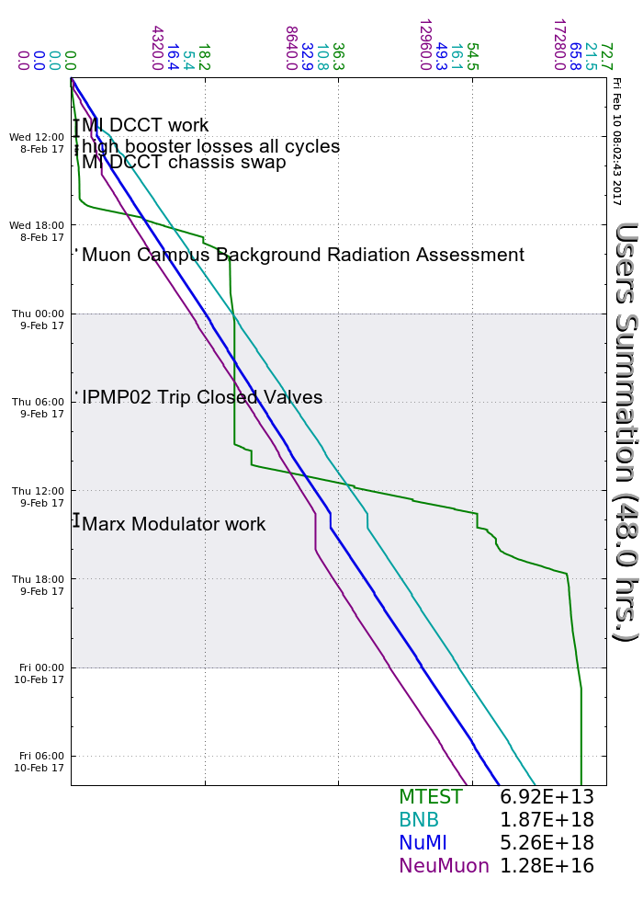
Wednesday
MI DCCT card swap and revert
LRF5 Marx work
Top off MI10 and MI30 flourinert
Quiet time for Muon Campus rad reading (5 mins)
Thursday
LRF5 Marx work
RR LLRF reboot
HP3US regulation improved, beamline retuned (work in progress)
Friday
BNB BPM E:HP868 becoming unreliable
Wednesday to Friday accelerator summary

