Slide 1
72 Hour Weekend Summary
Donovan Tooke
Monday 09:00 Meeting
February 13, 2017

Slide 2
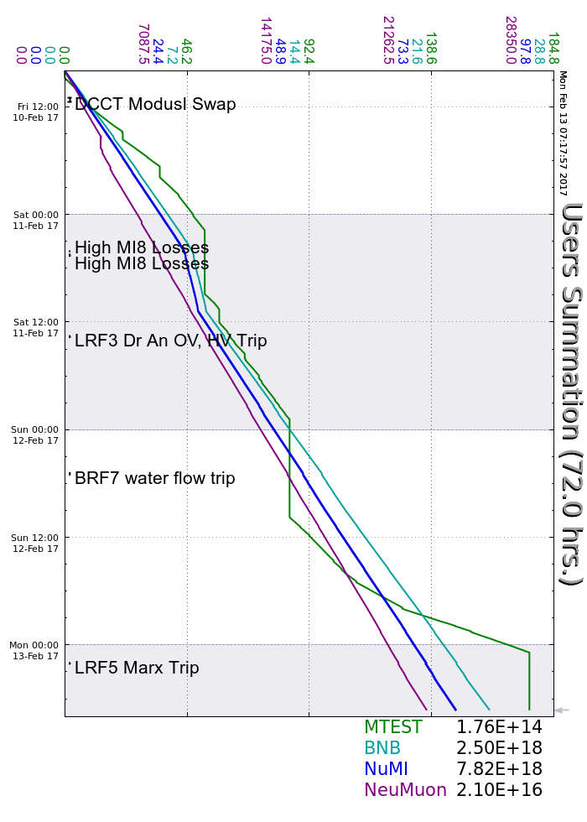
Friday
New MI DCCT electronics
Saturday
BRF10 died: need 1 hr mod swap
Changed C052 card for B:Q801S
E:V118 had 2 excessive 60Hz trips
A few LRF3 Driver Anode OV/HV
Sunday
Several LRF2 Drive Anode OV/HV
BRF7 FBS LCW flow
Reduced BNB intensity
A few LRF3 Driver Anode OV/HV
MI D2 Damper settings match 20/21
F:SQDUTY increased 3%
Monday
Several LRF2 Driver Anode OV/HV

Slide 3
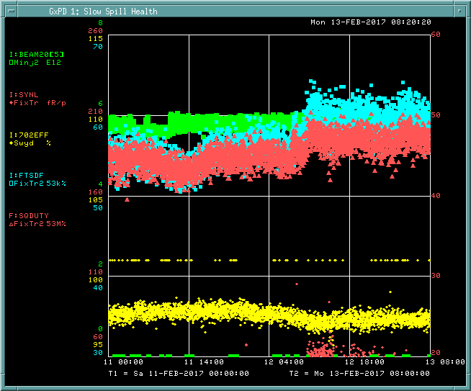

Slide 4
Current Conditions
Beam to NuMI
648 kWatts
49.5 E12
Beam to BNB
3.909E16 p/hr
2.5 Hz
Beam to SeaQuest
5.61 E12 ppp
Beam to MTest

