Slide 1
WA105/ProtoDUNE-DP
Charge Readout Plane Assembly and Transport Box
WA105 Technical board– 15th of February 2017
B. Aimard, N.Allemandou, M. Cailles, G. Deleglise, D. Duchesneau,
N. Geffroy, Y.Karyotakis, T. Yildizkaya

Slide 2
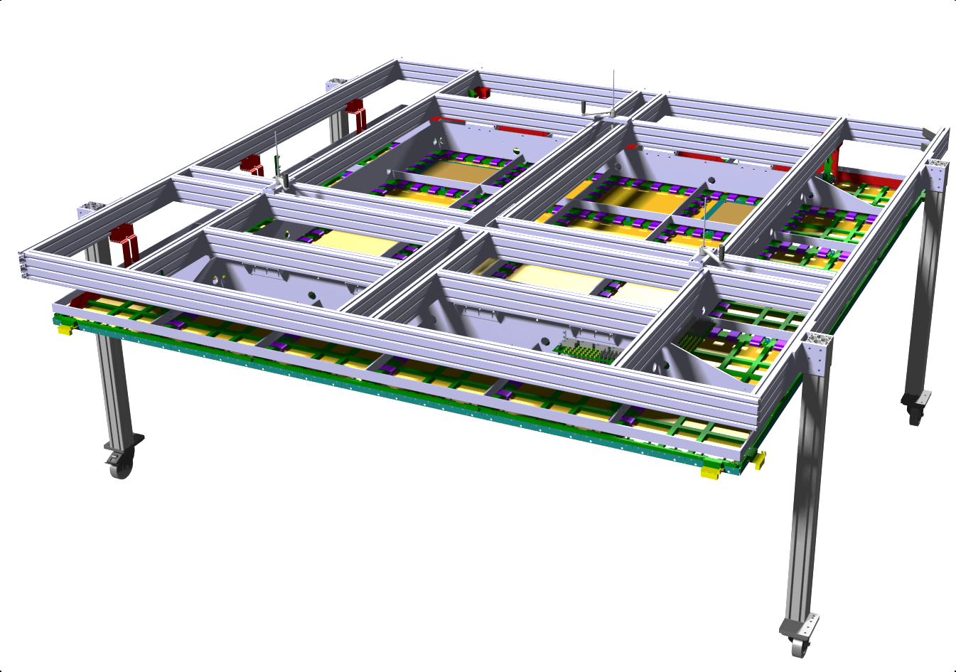
Supporting structure
Supporting structure is also :
The Top of the Transport Box
The Crane in the clean room
The Scaffolding to access the center of the module during assembly

Slide 3
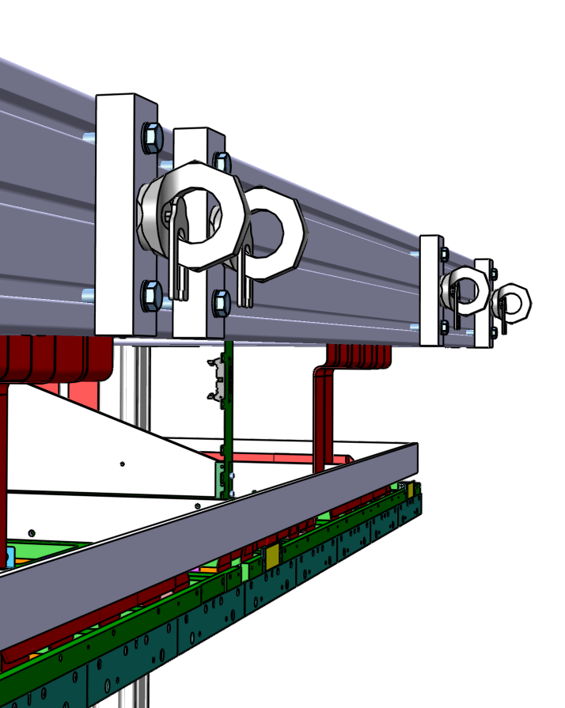
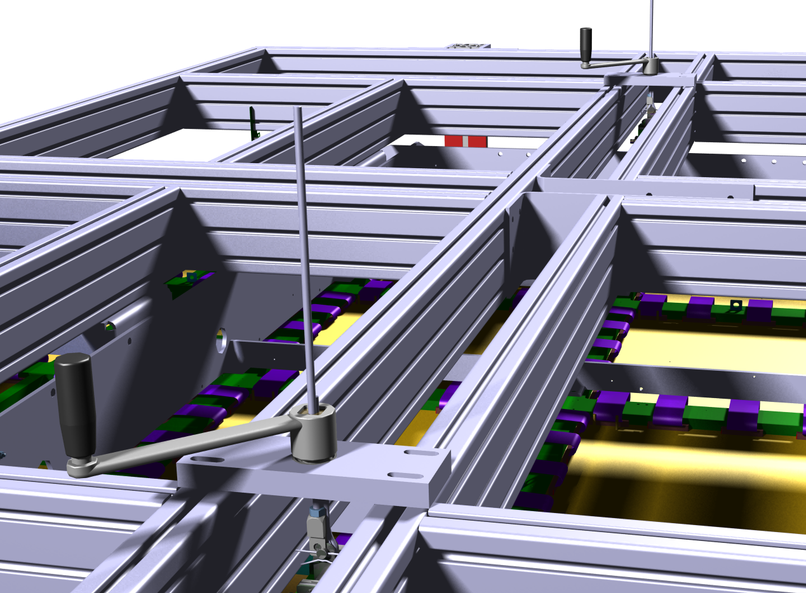
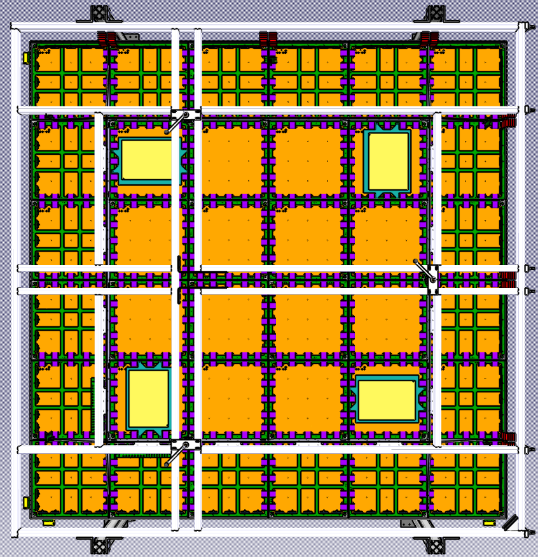
Supporting structure
It features :
Very stiff shape to avoid any CRP deformation during transport
Special cranks to rise accurately the CRP during assembly
Special shape to be easily removed inside of the cryostat
Solid anchoring systems on one side for insertion in the cryostat
Bottom of the box can be added between foot

Slide 4
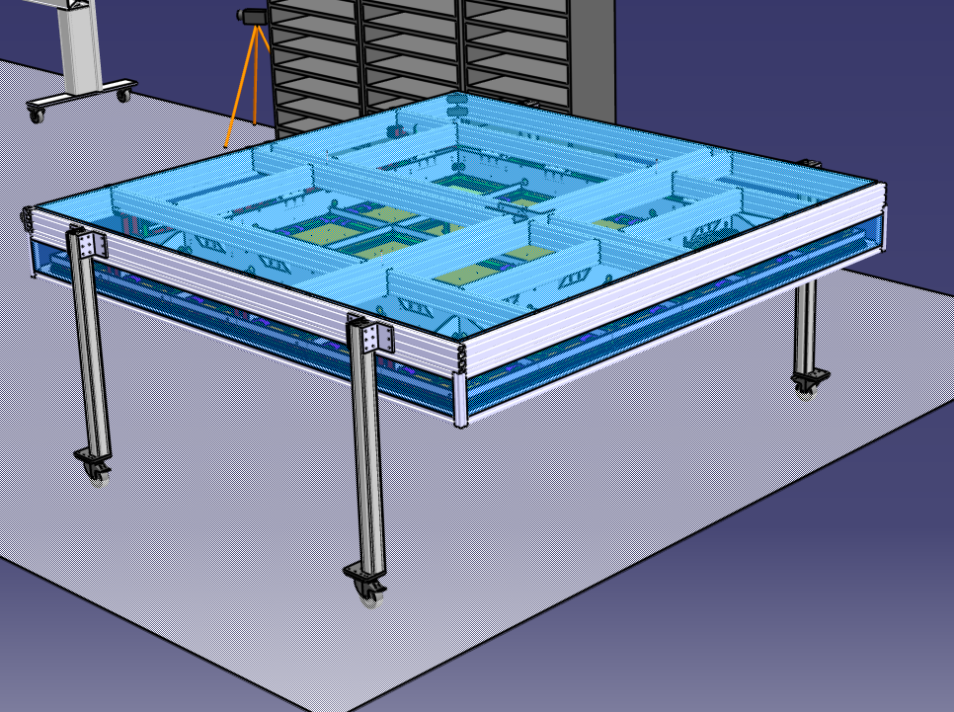
Box for transport

Slide 5
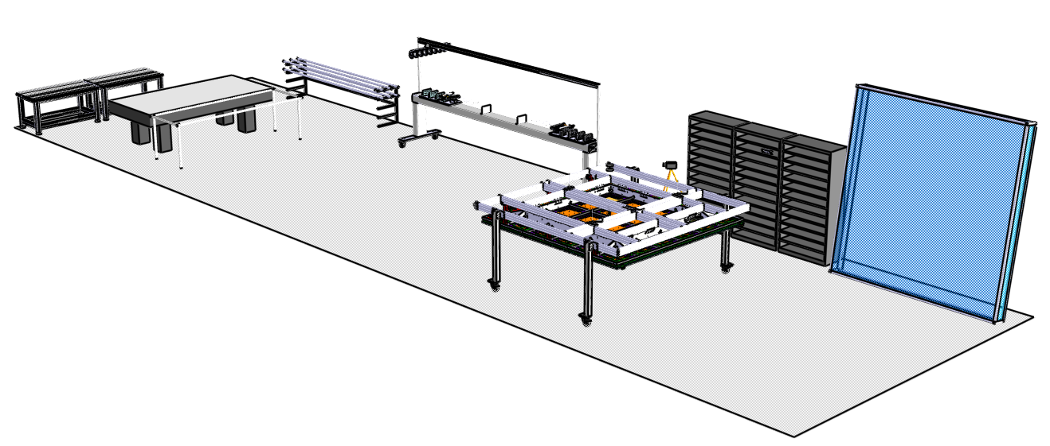
Assembly in Clean Room 185
See the animation of the assembly

Slide 6
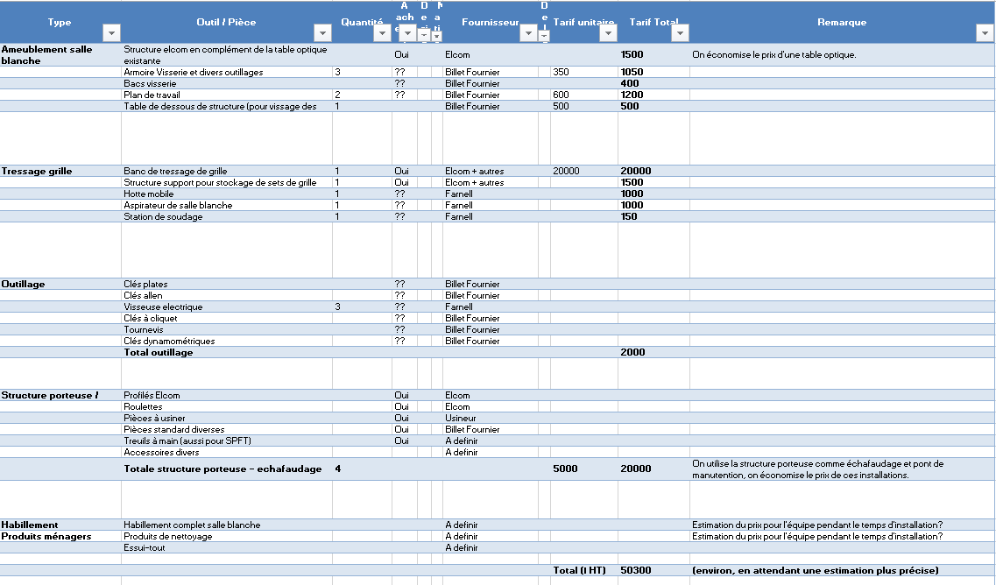
Assembly in Clean Room 185
Tooling list has been set for order
CRP parts orders are in imminent
Detailed installation planning planning is currently being discussed and will be presented soon

Slide 7
Spares slides
(in case of pb with the animation…)

Slide 8
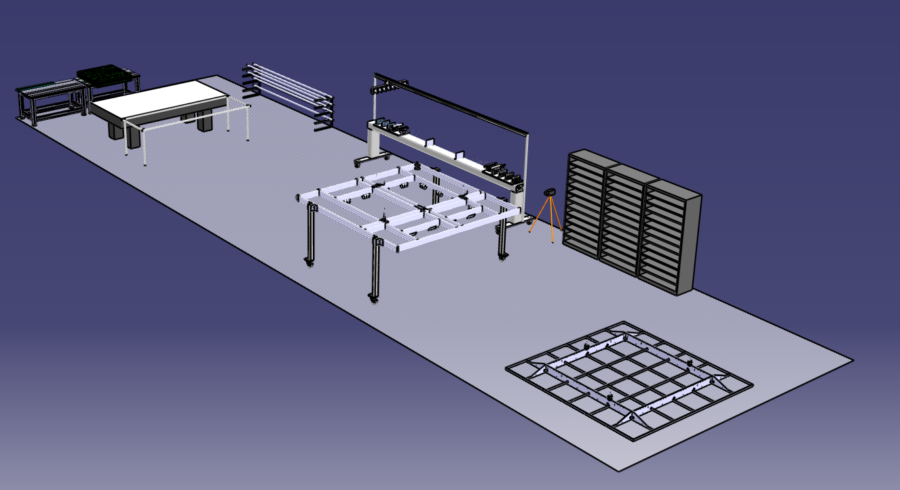
CRP Assembly

Slide 9
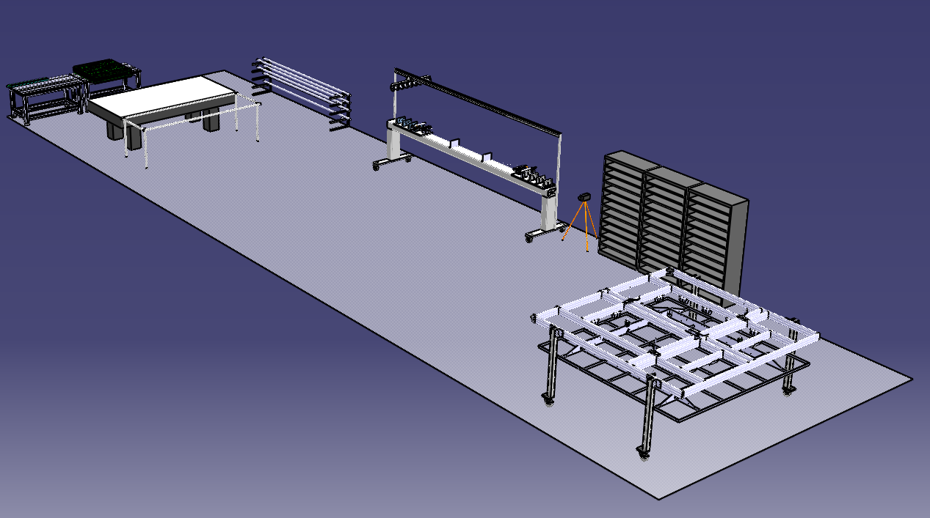
CRP Assembly

Slide 10
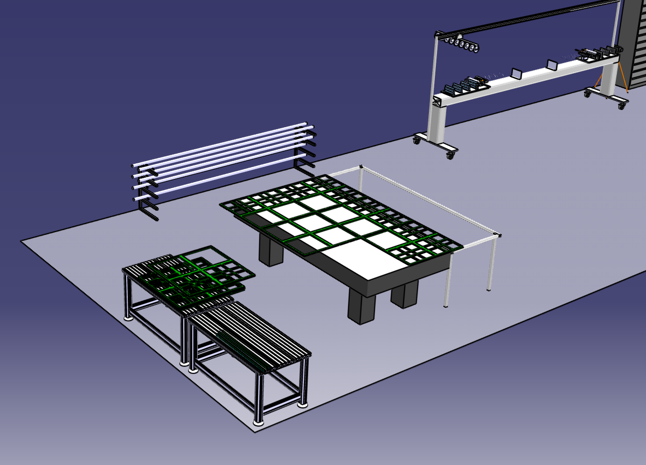
CRP Assembly

Slide 11
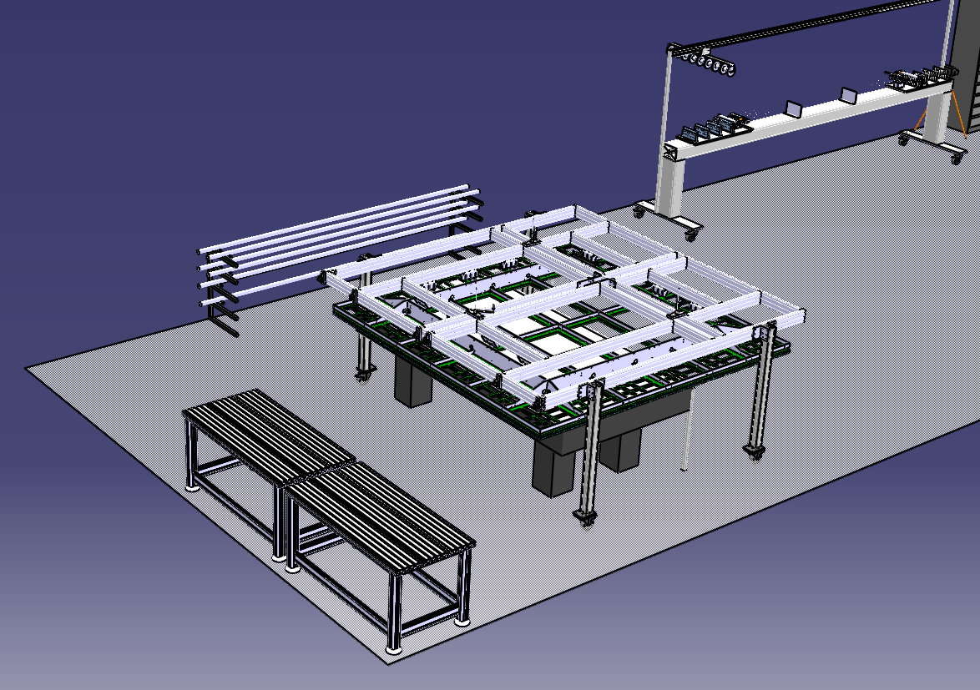
CRP Assembly

Slide 12
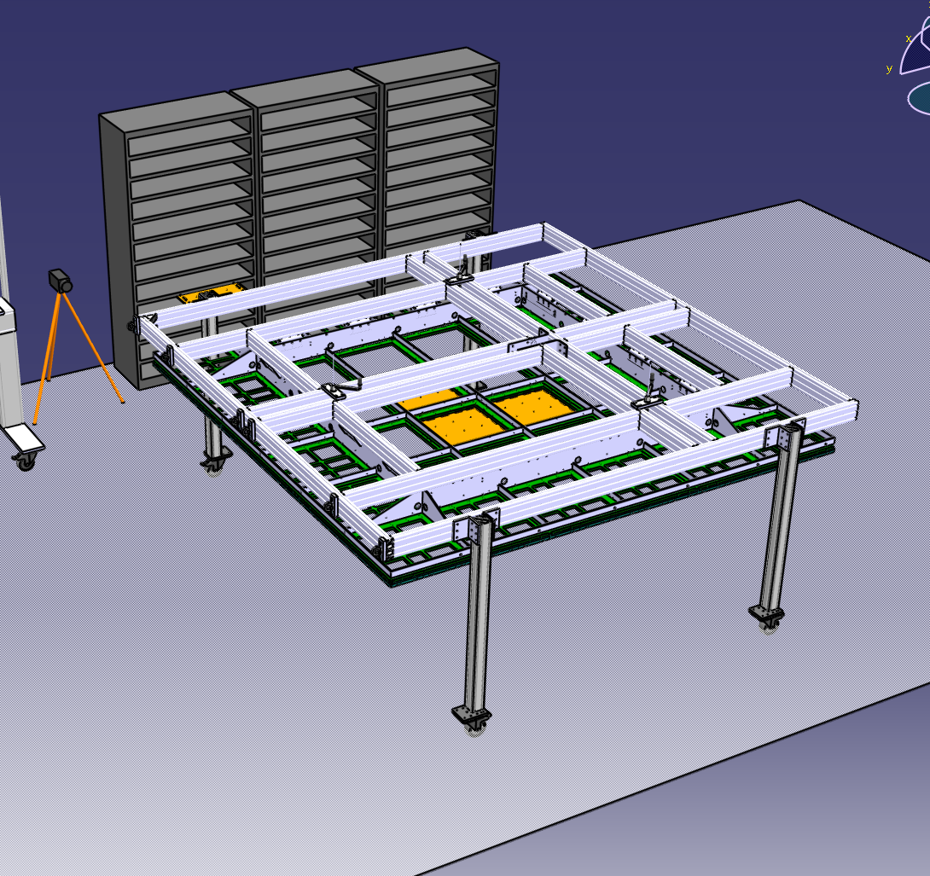
CRP Assembly

Slide 13
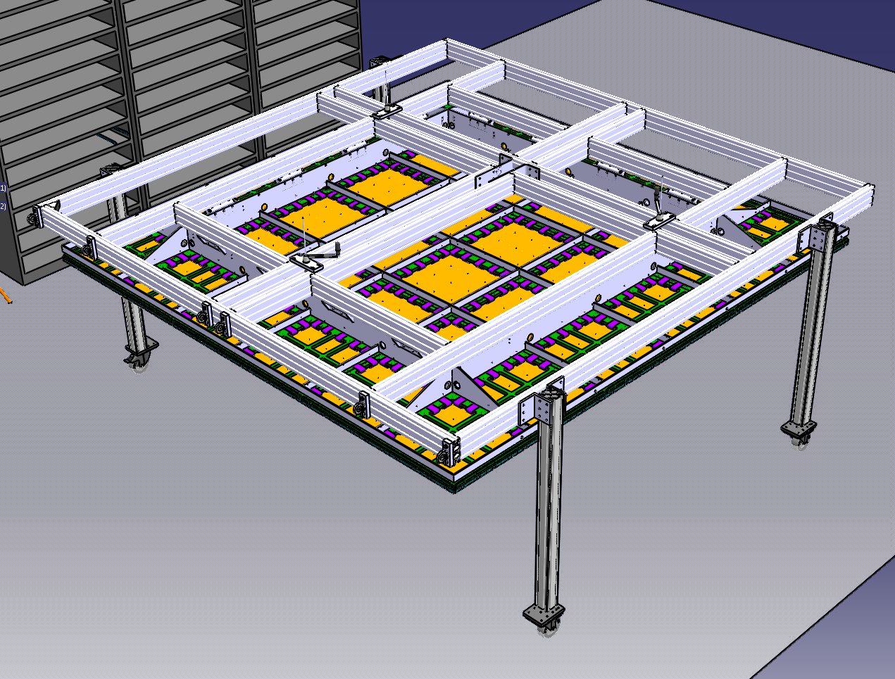
CRP Assembly

Slide 14
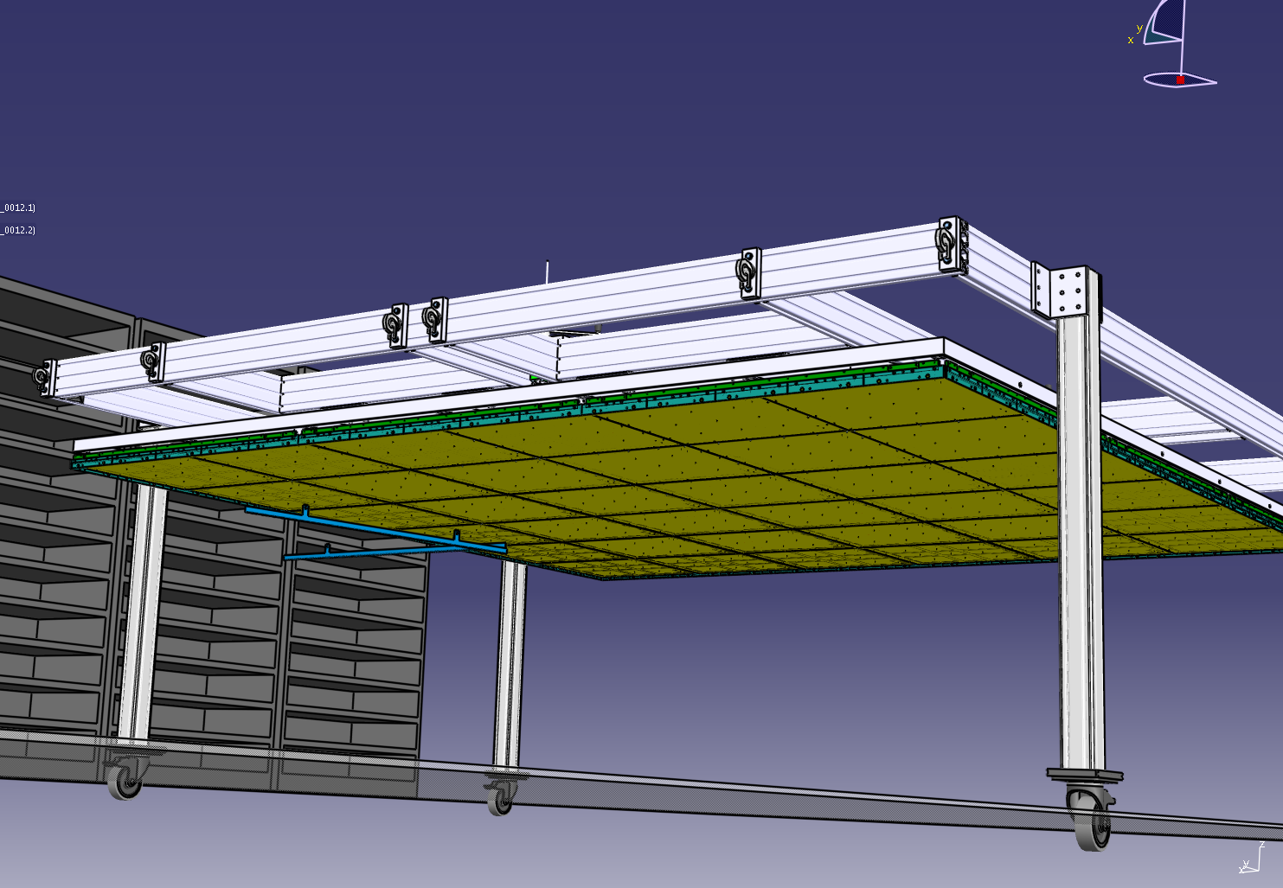
CRP Assembly

Slide 15
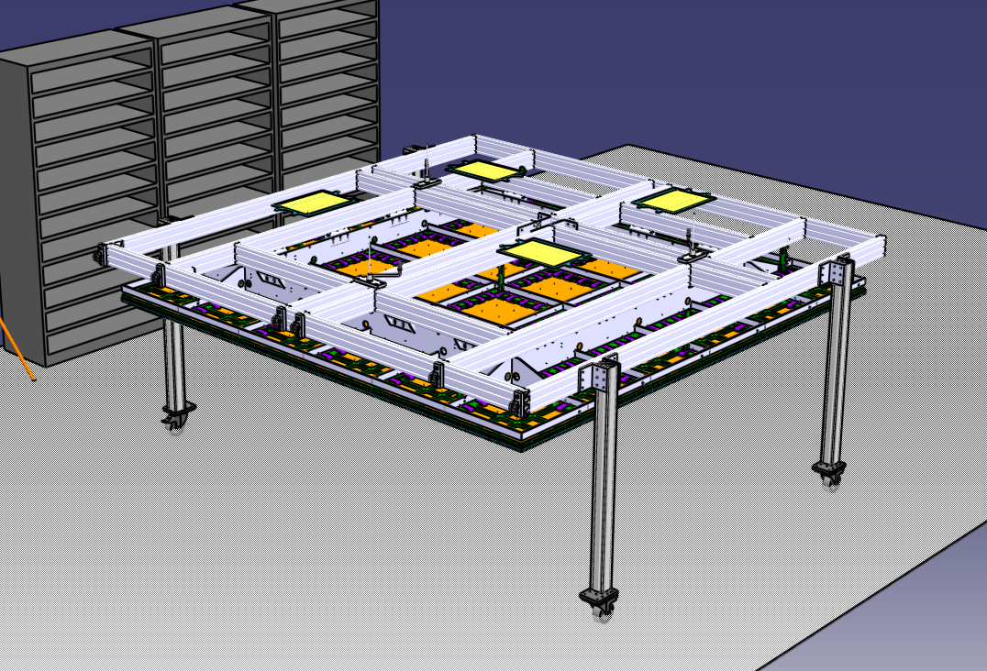
CRP Assembly

Slide 16
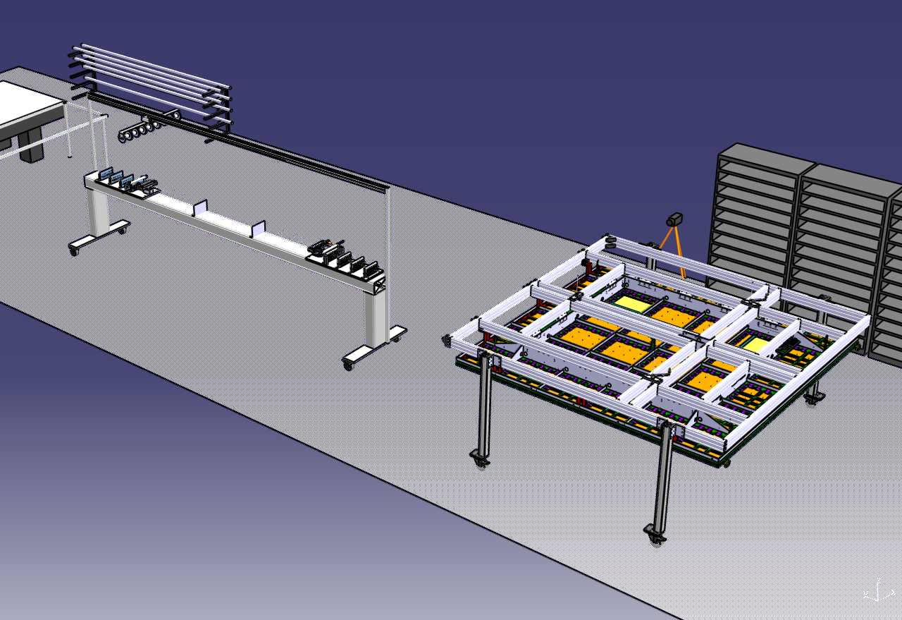
CRP Assembly

Slide 17
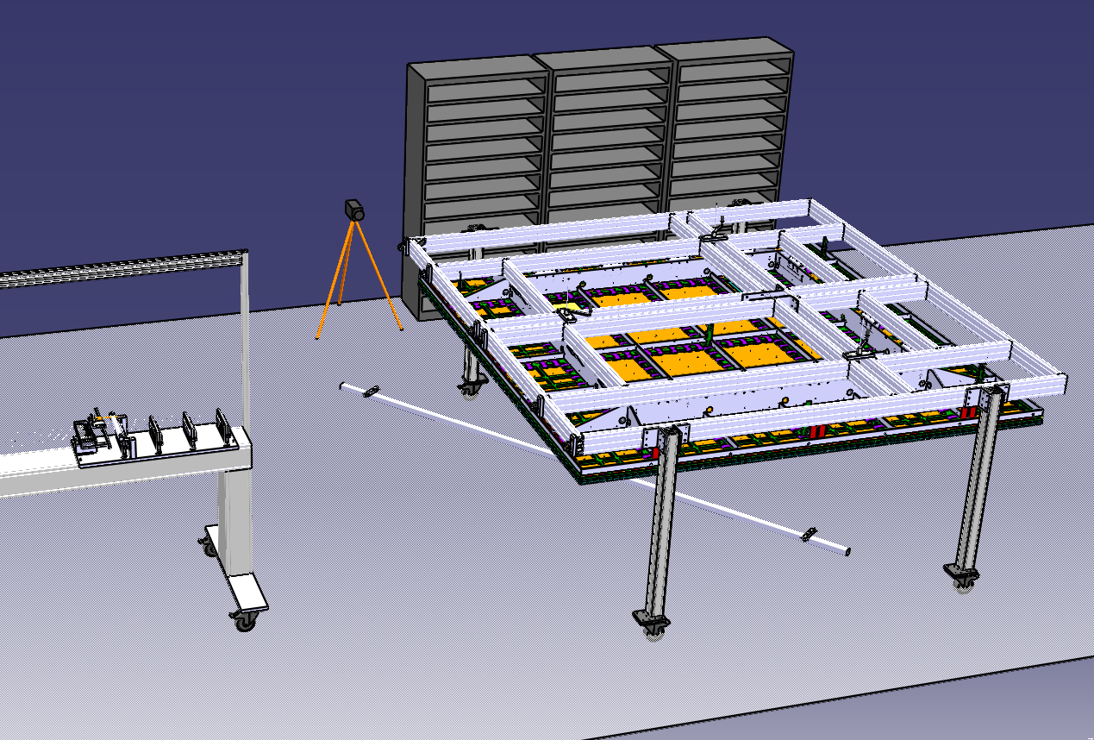
CRP Assembly

Slide 18
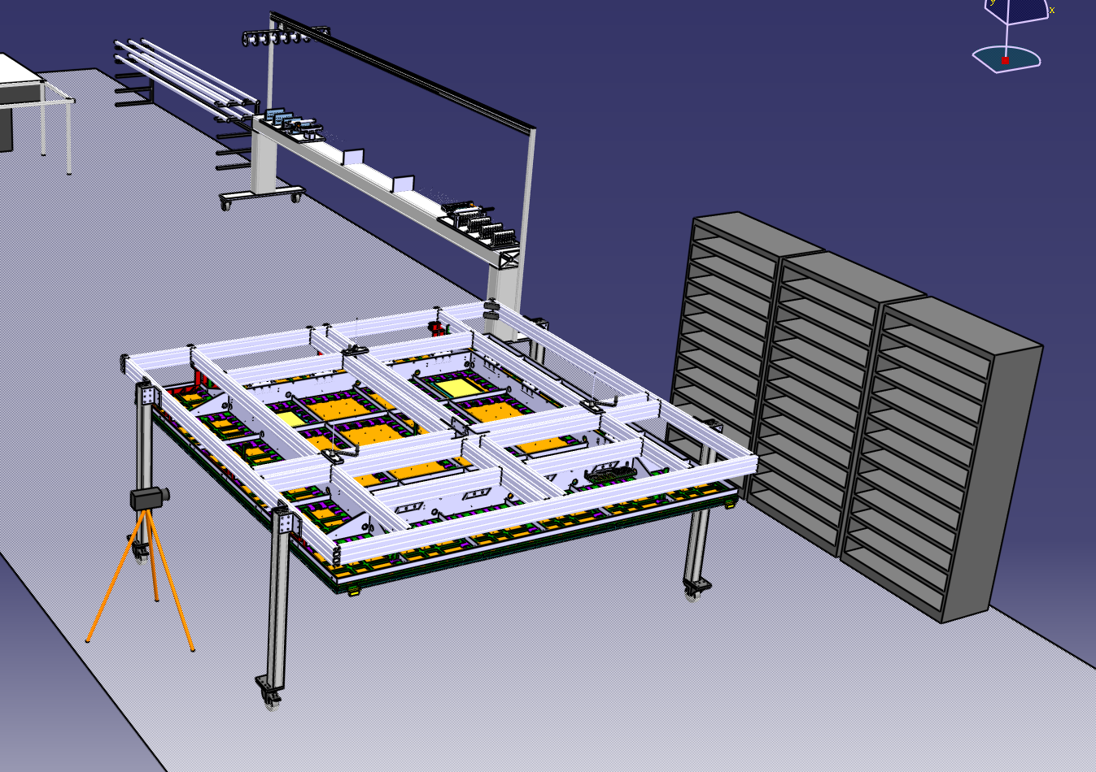
CRP Assembly

Slide 19
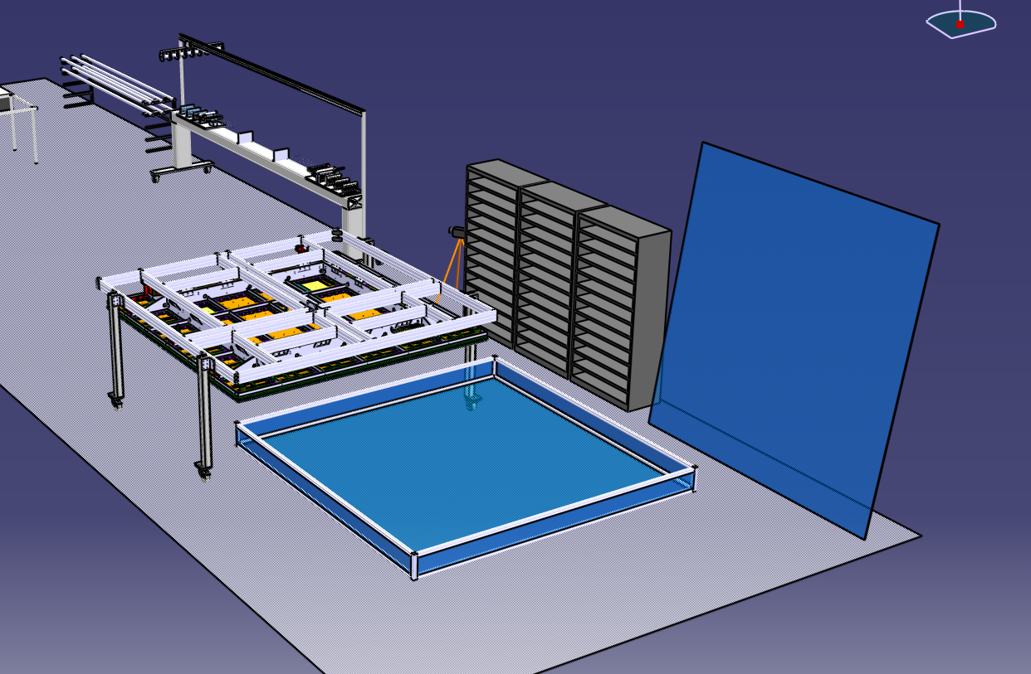
CRP Assembly

Slide 20
CRP Assembly

