Slide 1
Wednesday 9:00
2017-02-15

Slide 2
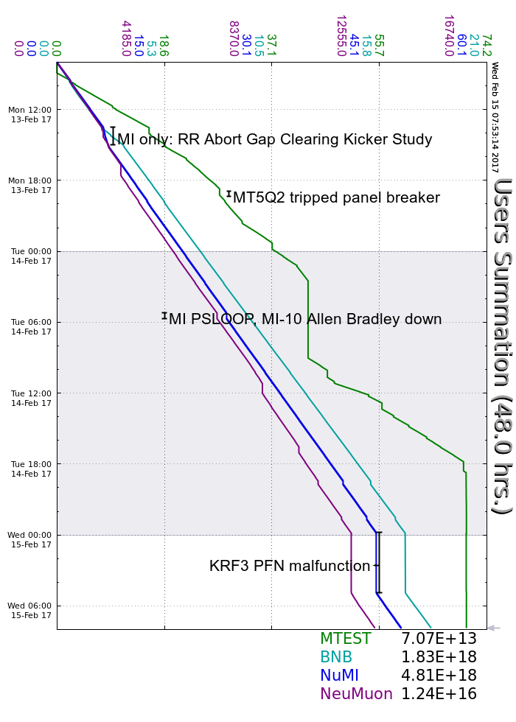
Monday
Muon Campus Instrumentation Testing
MI Only running during RR GCK adjustments
RR 30 Cavity Tuning
RR Damper Phasing
Booster Quad Bump studies
MT5Q2 breaker trip, reset
Tuesday
Continued to adjust GCK timing
MI PS loop dropped, rebooted MI-10 PLC
NS2LCW Tower maintenance
KRF3 PFN filter smoked itself without tripping, experts replaced
Burning G10 smell throughout footprint
Wednesday
M02 Vacuum pumps tripped off, techs aware
BRF19 PA water flow trip, running without
Current conditions
Beam to NuMI, BNB & Neutrino Muon

