Slide 1
48 Hour Summary
Beau Harrison
Friday 09:00 Meeting
17 February 17

Slide 2
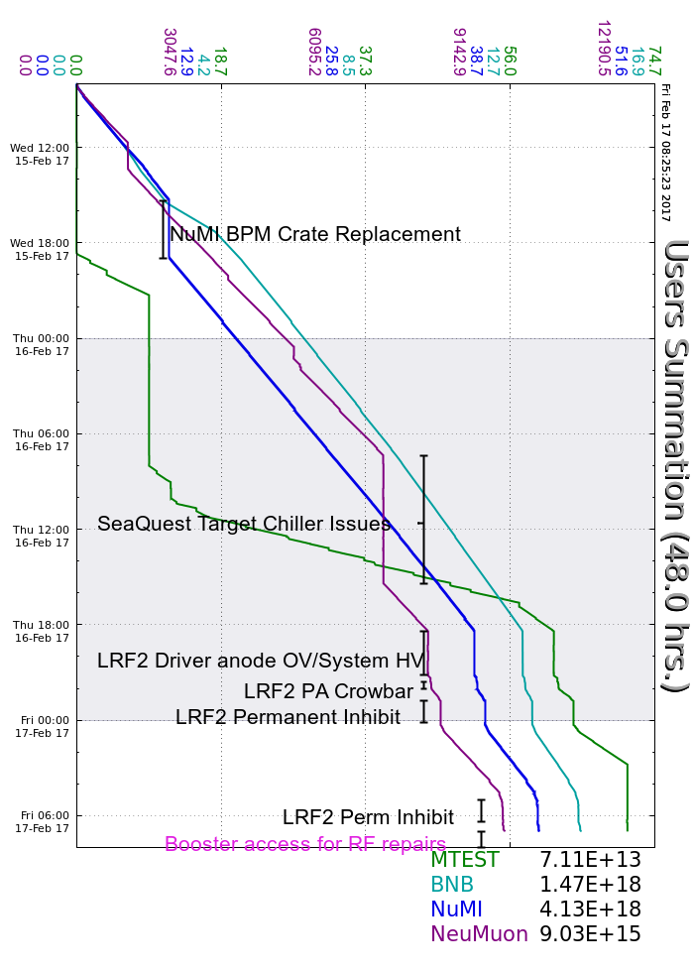
Wednesday
NuMI BPMs
Thursday
SeaQuest Chiller
LRF2 Trips
Friday
Continued LRF2 Issues/Repairs
Booster RF Repairs

