Slide 1
Main Injector/Recycler
Friday, 9:00 meeting
M.J. Yang,
Main Injector dept.
Feb 17, 2017

Slide 2
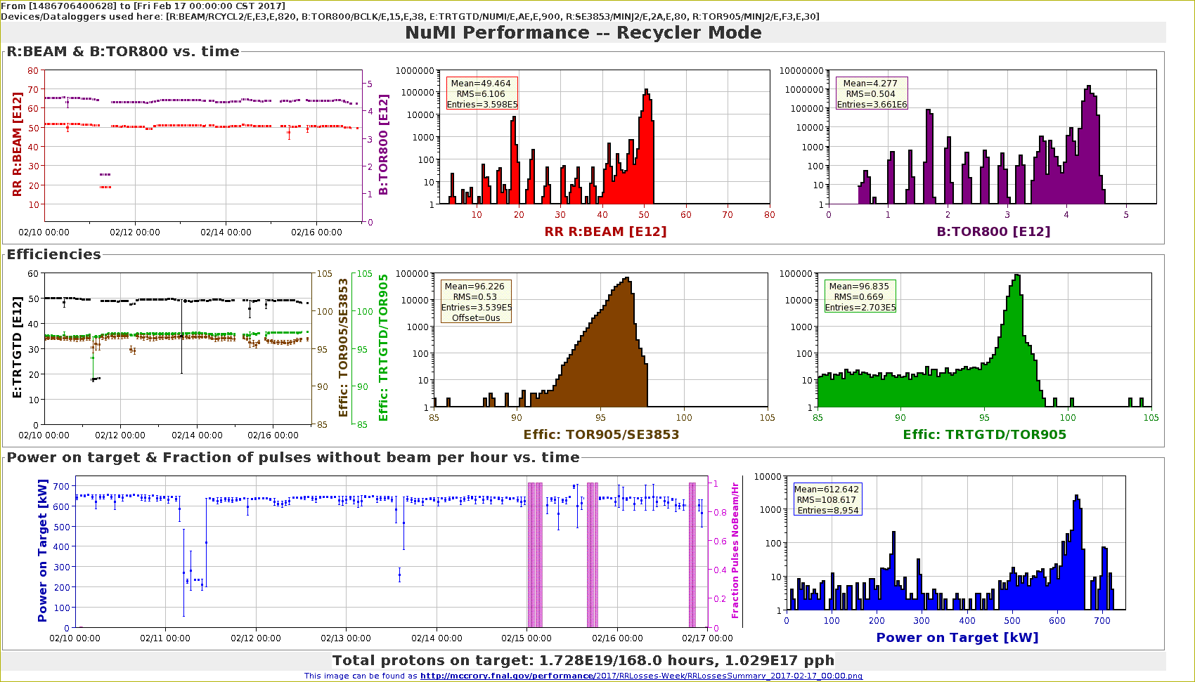
NuMI Performance RR

Slide 3
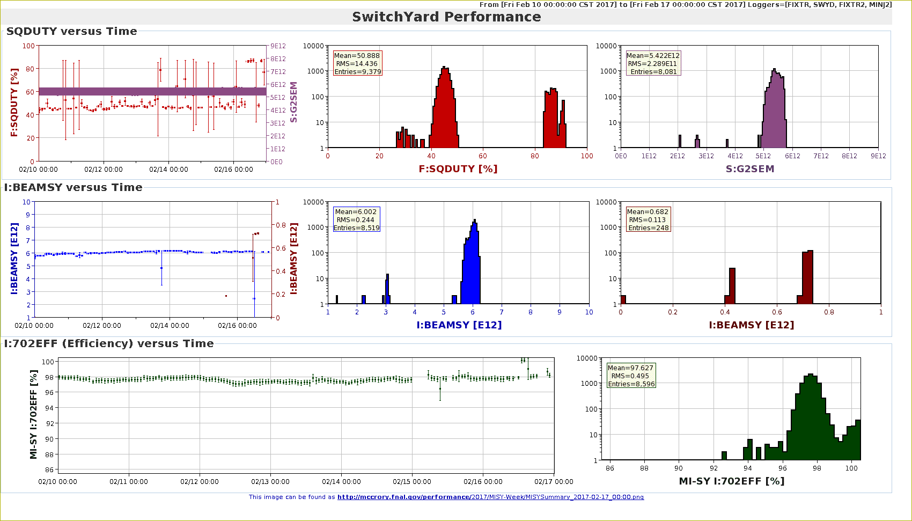
NuMI 1-hour beam power

Slide 4
MI beam inhibit downtime

Slide 5
RR beam inhibit downtime

Slide 6
Issues
MI DCCT
  Signal oscillates causing
    BEL calculation goes wild.
  Spare board is being modified.
RR Gap Clearing Kicker, R:KPS4C
  Failing thyratron is believed to be the problem.
Slow spill ramping down earlier than expected
  LAM52 and others.

Slide 7
Gap Clearing Kicker, bucket scan

Slide 8
Studies
Gap clearing kicker study
  Verify length of kicker waveforms.
RR loss tuning
  Injection phase
  Chromaticity.
RR30 transfer line study
  Beam profile measurement
    Vary # of Booster turns.
    Vary # of batches.
  Need RR $E1 cycle
    And MI cycle $2B.

