Slide 1
protoDUNE – single-phase Cryogenic and Argon Instrumentation - Overview
Stephen Pordes, Fermilab

Slide 2
protoDUNE – single-phase Cryogenic and Argon Instrumentation - Overview
1. Does the Cryogenic Instrumentation design meet the requirements? Are the requirements/justifications sufficiently complete and clear?
2. Does the design represent a good development path towards DUNE?
3. Does the design lead to a reasonable production schedule, including QA/QC, transport, installation and commissioning?
4. Is the installation plan sufficiently far advanced to assure that the detector can be installed as designed?
5. Are all internal interfaces between components (cryostat, cryogenics, TPC) documented, clearly identified and complete?
6. Are the interfaces with the slow control system well defined and understood?
7. Is the grounding and shielding of the Cryogenics Instrumentation understood and adequate?
8. Are operation conditions (when will/can instrumentation be turned on) listed, understood and comprehensive?
9. Are the analyses of the Cryogenics Instrumentation components sufficiently comprehensive for safe handling, installation and operation at the CERN Neutrino Platform?
10. Is the Cryogenics Instrumentation quality assurance, quality control and test plan adequate? Have applicable lessons-learned from previous LArTPC devices been implemented into the device testing and into the system design?

Slide 3
protoDUNE – single-phase Cryogenic and Argon Instrumentation - Overview
From the protoDUNE-SP TDR
The protoDUNE-SP apparatus includes instrumentation beyond the TPC and the photon detectors to ensure that the condition of the liquid argon is adequate for operation of the TPC. This instrumentation includes gas analyzers to monitor the purge of the cryostat and ensure that any remaining atmospheric contamination is sufficiently low, thermometry to monitor the cryostat cool-down and filling, purity monitors to provide a rapid assessment of the electron drift-lifetime independent of the TPCs, and a system of internal cameras to help locate any sparks due to high voltage breakdown in the cryostat.
In addition, two sets of precision temperature sensors are being deployed to measure the temperature gradients inside the protoDUNE cryostat. These temperature measurements exploit the opportunity protoDUNE-SP provides to check the predictions of the Computational Fluid Dynamics models being used to design the argon flow in the (much larger) DUNE cryostat.

Slide 4
protoDUNE – single-phase Cryogenic and Argon Instrumentation - Overview
Lead Scientists Involved:

Slide 5
protoDUNE – single-phase Cryogenic and Argon Instrumentation - Overview
Instrumentation functions:
Provide fast and continuous feedback on the state of the argon and the cryostat:
  Temperature; pressure*: level*; contamination levels of oxygen, nitrogen, and water; drift-lifetime;
Provide information on potential source(s) of problems/verification of correct functioning
  Vendor deliveries; purification failure; high voltage breakdown; mechanical failures; leaks
Provide data that will inform the cryogenic design of DUNE
  Temperature distributions in the liquid and the ullage since temperature distribution drives the argon flow.
We are developing a rather more ambitious system than originally conceived.
* Provided by Neutrino Platform (plus environmental data (ambient pressure and temperature))

Slide 6
protoDUNE – single-phase Cryogenic and Argon Instrumentation - Overview
Instrumentation functions:
Provide fast and continuous feedback on the state of the argon and the cryostat:
  RTDs – on membrane for cool-down,
  – on argon inlet and outlet pipes, and above top ground plane for operations
  Oxygen, Nitrogen, Water Analyzers with a range of sensitivity – connected to argon delivery,
  to cryostat liquid and ullage, and to flow through feedthroughs
  Purity Monitors – three in cryostat itself, one at the output of the purification system
  – in the cryostat: follow the purification of the argon, assure that the argon is TPC quality (or not) in case the TPC reconstruction is not ready and look for variations in lifetime with depth
  – at the output of the purification system: validate the operation of the purification system

Slide 7
protoDUNE – single-phase Instrumentation - Overview
Instrumentation functions:
Provide fast and continuous feedback on the state of the argon and the cryostat:
Gas Analyzers monitoring the gas purge and recirculation phase of cryostat preparation –
Leak found when recirculation phase did not produce rapid improvement.
Leak identified
Volume changes

Slide 8
protoDUNE – single-phase Cryogenic and Argon Instrumentation - Overview
Instrumentation functions:
Provide information on potential source(s) of problems/verification of correct functioning
  Gas Analyzers – check levels of oxygen, nitrogen, and water in delivered argon,
  follow the gas purge and recirculation phases, follow the initial stages of liquid purification,
  Camera System - identify locations of sparks in case of HV breakdown, general internal inspection
  Purity monitor at the output of the purification system - validate functioning of purification system and alert on saturation of purification filters before much liquid has entered the cryostat

Slide 9
protoDUNE – single-phase Cryogenic and Argon Instrumentation - Overview
Instrumentation functions:
Provide data that will inform the cryogenic design of DUNE
  Temperature gradient monitors - measure the (small) temperature gradients that drive the argon flow and thereby determine the distribution of impurities.
  CFD calculations are being used to inform the cryogenics for DUNE and protoDUNE is a good opportunity to check their validity – path to DUNE

Slide 10
protoDUNE – single-phase Cryogenic and Argon Instrumentation - Overview
Impurity distribution along the length of a DUNE cryostat for a given contamination rate from the ullage
Example of CFD calculation provoked by question of whether DUNE needs pumps at both ends of the cryostat;
the manifold solution is considered satisfactory .. it had better prove so ..
Single Inlet
Manifold of Inlets
17% spread
4 % spread

Slide 11
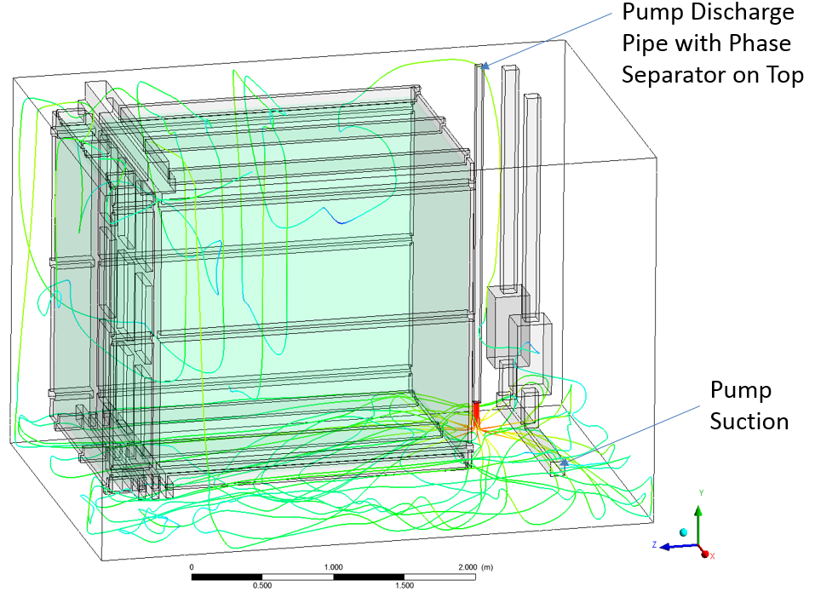
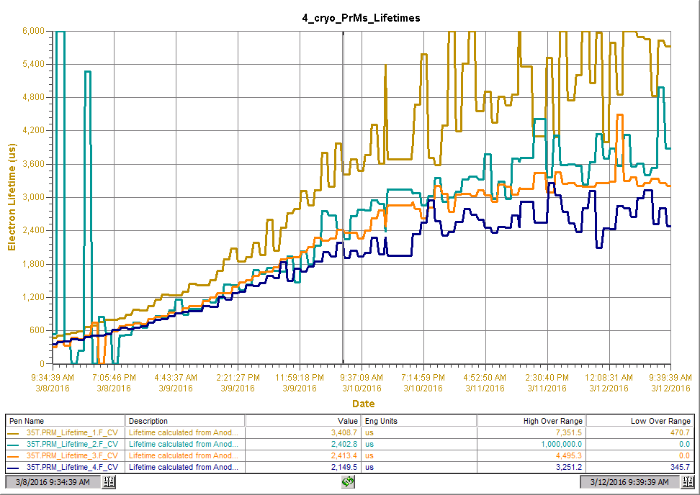
protoDUNE – single-phase Cryogenic and Argon Instrumentation - Overview
The whole is more than the sum of the parts:
observation and understanding of lifetime differences at different depths in 35 ton (membrane) cryostat at Fermilab.
Original arrangement
Lifetimes at different heights
- quite different
5.4 ms
(PRM1)
PRM4
PRM3
PRM4
2.4 ms
(PRM4)
PRM2
PRM3
A. Hahn
E. Voirin
PRM1
PRM2
PRM1

Slide 12
protoDUNE – single-phase Cryogenic and Argon Instrumentation - Overview
The whole is more than the sum of the parts:
observation and understanding of lifetime differences at different depths in 35 ton (membrane) cryostat at Fermilab.
PRM4
PRM3
6ms
(PRM1)
PRM2
PRM1
3ms
(PRM4)

Slide 13
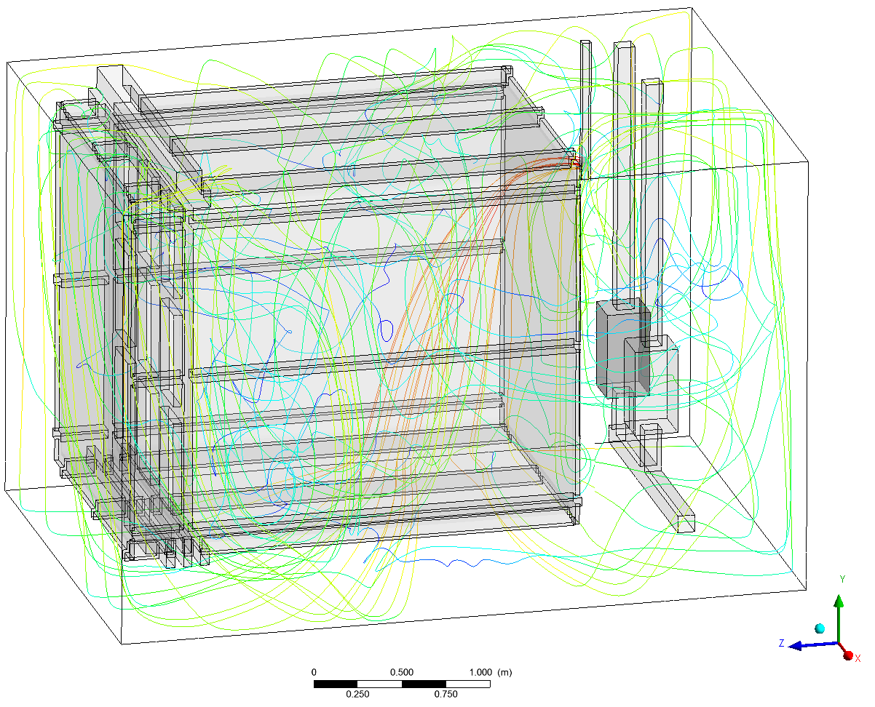
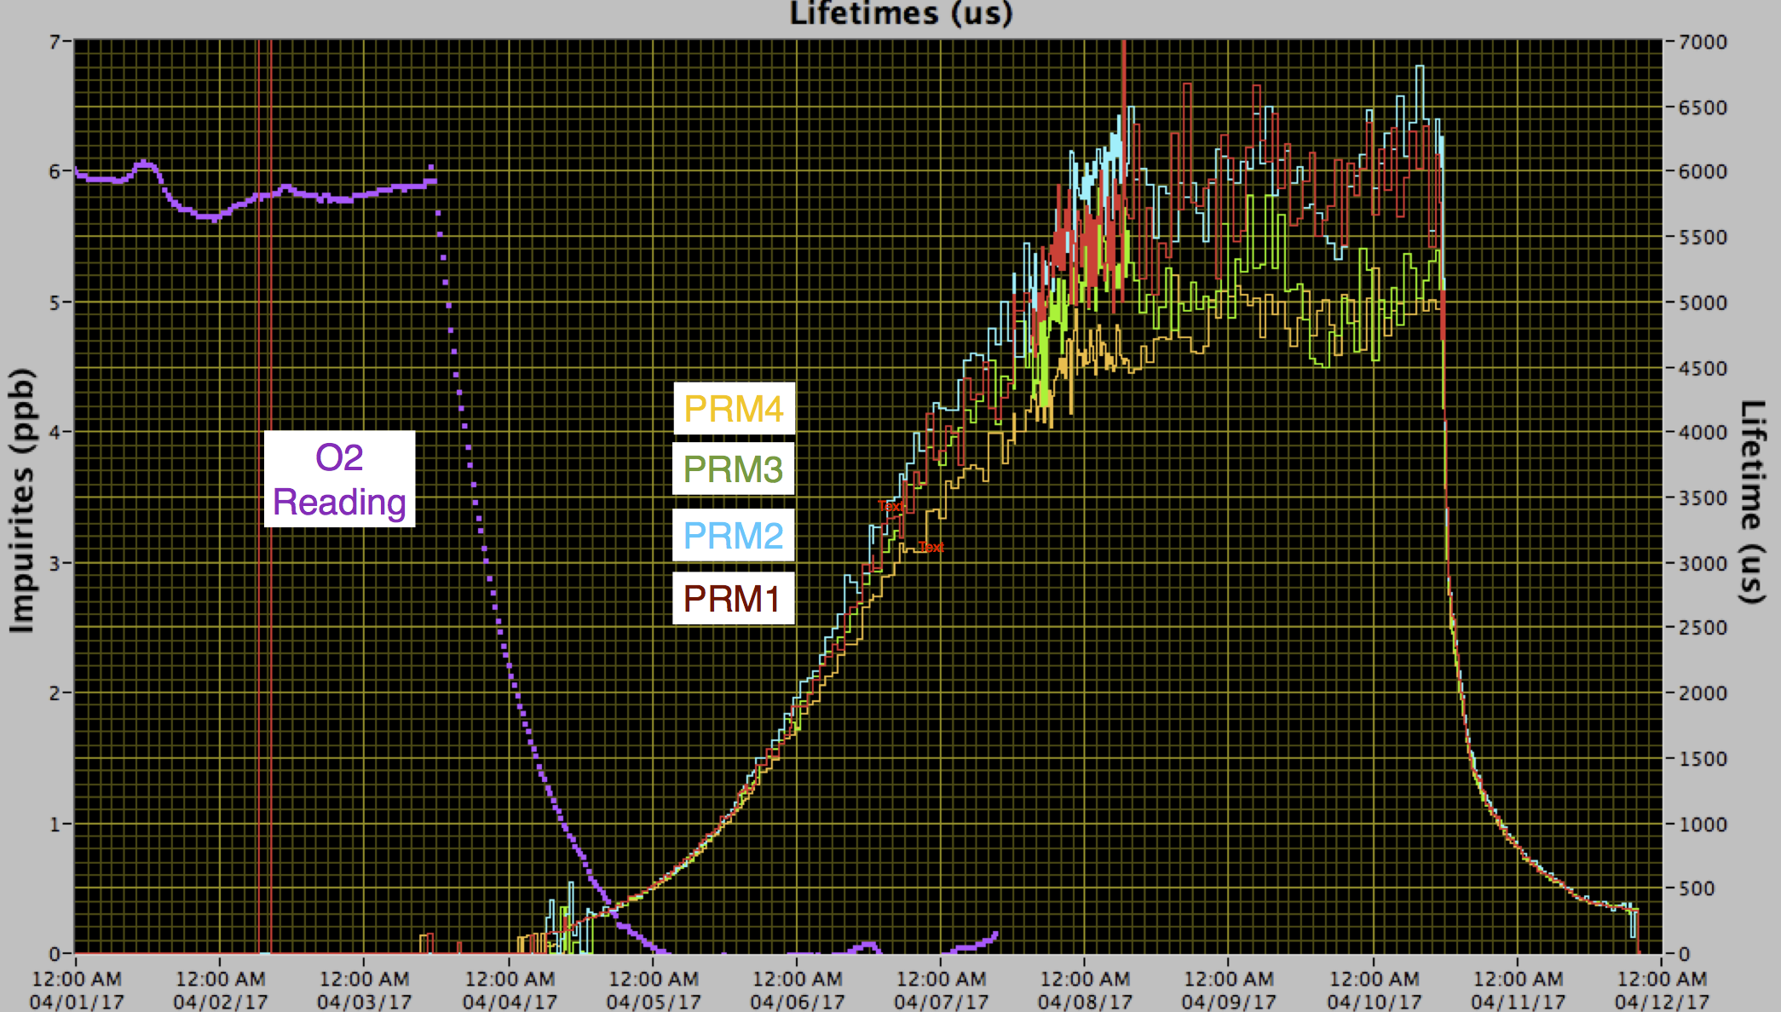
protoDUNE – single-phase Cryogenic and Argon Instrumentation - Overview
The whole is more than the sum of the parts:
observation and understanding of lifetime differences at different depths in 35 ton (membrane) cryostat at Fermilab.
New arrangement (cold liquid at 2/3 height)
Lifetimes at different heights
- quite similar
PRM4
PRM3
PRM2
PRM1
A. Hahn
E. Voirin

Slide 14
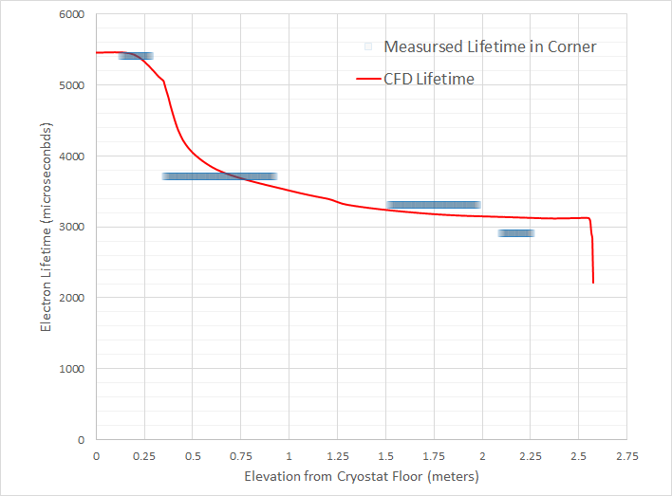
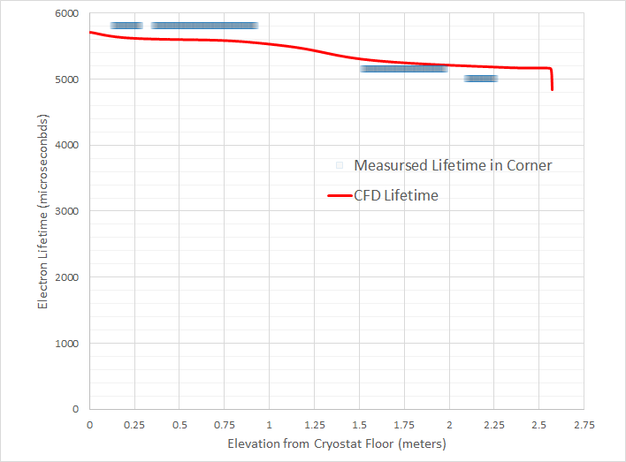
protoDUNE – single-phase Cryogenic and Argon Instrumentation - Overview
The whole is more than the sum of the parts:
observation and understanding of lifetime differences at different depths in 35 ton (membrane) cryostat at Fermilab.
Old arrangement (cold liquid at bottom)
New arrangement (cold liquid at 2/3 height)
Lifetimes at different heights
- quite similar
PRM4
PRM3
PRM2
PRM1
A. Hahn

Slide 15
Cryogenic and Argon Instrumentation interfaces
Items which exploit devices inside the cryostat - tightly coupled to other installations both mechanically and logistically
Items which come as assemblies and are installed into the cryostat – coupled logistically to detector schedule and mechanically to specific ports and general infrastructure
Items which are external to the cryostat and interface with the external cryogenics
All items have some required interface to the detector controls system
Items type 1 & 2 require identified ports on the cryostat

Slide 16
Cryogenic and Argon Instrumentation interfaces
Items which exploit devices inside the cryostat - tightly coupled to other detector installations both mechanically and logistically – temperature sensors on piping, on the TPC, and on the cryostat membrane; cameras
Items which come as assemblies and are installed into the cryostat – coupled logistically to detector assembly schedule – in-cryostat purity monitors (3); Hawaii temperature profiler; Valencia temperature profiler
Items which are external to the cryostat and interface with the external cryogenics – purity monitor after purification system; gas analyzers
Items type 1 & 2 require identified ports
All items interface with the detector controls system

Slide 17
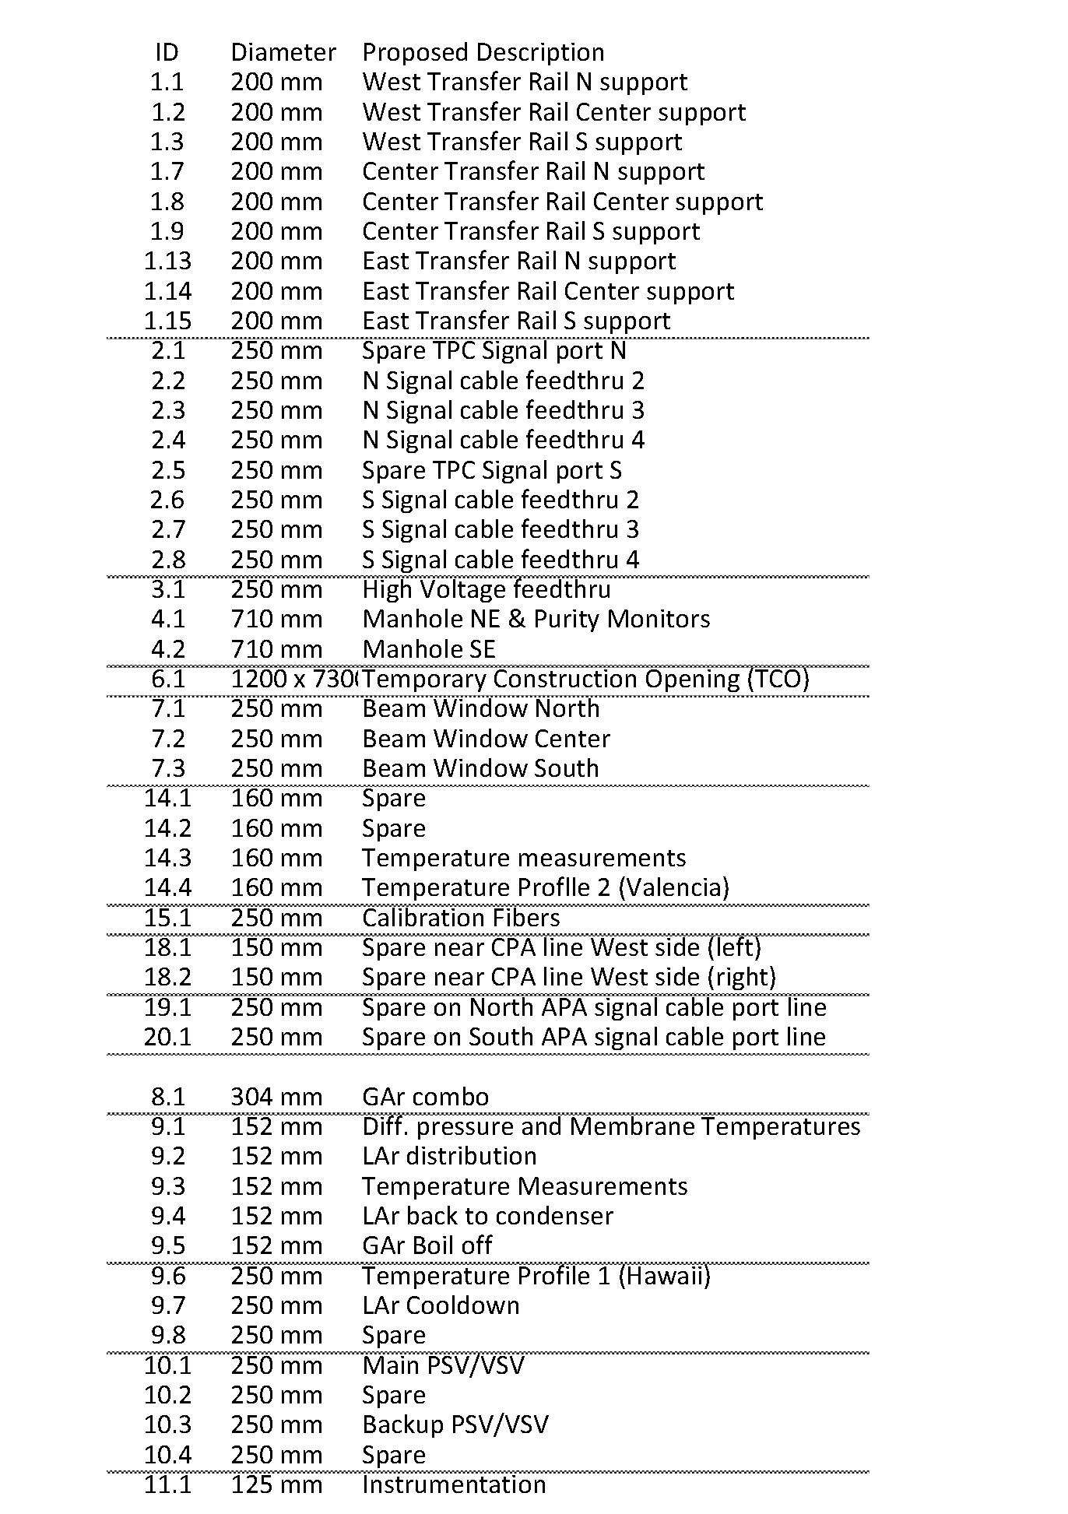
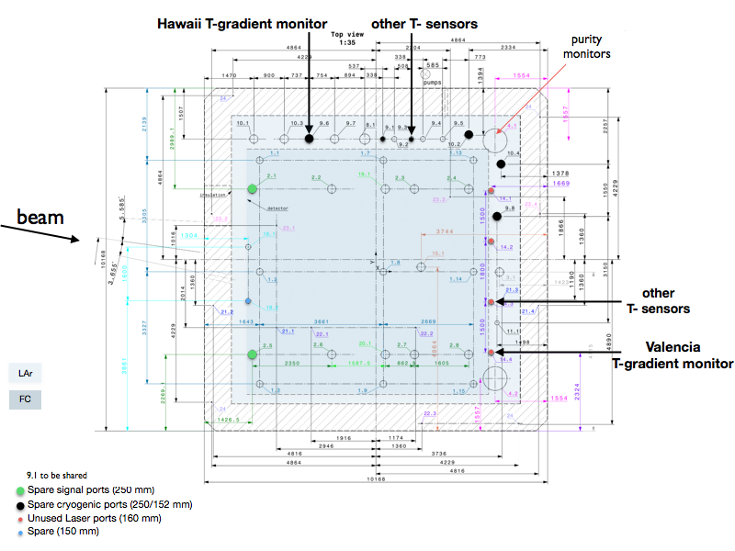
Proposed assignment of ports for Instrumentation ..
Anselmo Cervera
CENDUNCR0078 https://edms.cern.ch/ui/file/1543241/3/NP04_penetrations_drawing.pdf
NOTE: ports have not been assigned for the cameras

Slide 18
Temperature Sensors.. ~100 total ..
16 membrane, 22 Hawaii profiler, 36 Valencia profiler, 12 low in cryostat, 8 on top ground plane
Technical challenge is achieving a system with relative (sensor to sensor) calibration stable to ~ 10 mK (not needed for membrane sensors) – also part of a path for DUNE - CERN development project
Installation and interface issues are: schedule, how to place membrane and volume sensors, how to preserve calibration, how to route cables inside the cryostat, (cannot weld anything to the walls (unlike the IHI cryostats)) external cabling and connection to the DCS
Services required per sensor – 4 wire readout of RTD resistance
Anselmo Cervera and his team for the membrane and bulk temperatures and the Valencia gradient monitor - presentation
Jelena Maricic (Hawaii) for the Hawaii temperature profile measurement (TP) - presentation

Slide 19
Cameras
Mike Kordosky (William & Mary)
Technical challenge is getting a camera system that works in the cold, with sufficient sensitivity (acceptance x gain) and with flexible software..
Installation issues to be resolved: where and how to place, and when
35 ton experience with system from ETHZ has been invaluable – behavior in cold, cable-type and sensitivity to cable-length, streaming and preserving data for inspection.

Slide 20
Purity Monitors (4 total)
Jianming Bian (UC Irvine) & Andrew Renshaw (Houston)
Refurbishing Icarus purity monitors – using Fermilab electronics ..
One recently brought to Fermilab from UC Irvine and tested in relatively clean argon – worked quite nicely
See https://indico.cern.ch/event/630004/ for PrMon test signals
From cryostat
CENDUNCG0002
Connection points for monitor after purification system
PrM vessel
To cryostat

Slide 21
Purity Monitor Interfaces and operating conditions ..
Cryostat Monitors:
Space on cryostat near feedthrough for flash-lamp system – electrical box 50 cm x 30 cm x 20 cm
Power for flash lamp system 24 V, 3 A
Space and power for 3 signal amplifiers - 3 double wide NIM modules, 0.5 A +/- 12V
Purification System:
Space near inline vessel for flash-lamp system – electrical box 50 cm x 30 cm x 20 cm
Power for flash lamp system 24 V, 3 A
Space and power for 1 signal amplifier – 1 double wide NIM module running at 0.5 A +/- 12V
In front-end racks: not too far (<30 m)
HV power supplies per purity monitor -20V to - 400V (10 uA) and +200V to +4,000V (10 uA)
Windows computer running LabVIEW or equivalent containing digitizing electronics, 2 channels per purity monitor (we use ALAZAR 310 2-channel 12 bit 20 MS/s), with access to HV supplies and 24 V supply to flash-lamp.
DCS
Permission to flash lamp, permission to turn on HV, connection for recording of signal parameters and lifetimes

Slide 22
Gas Analyzers
These are all commercial devices ..
Installation & Services required:
Space and power for devices (0.5 relay rack) (NP)
Clean 6 mm (1/4 inch) lines to the rack (NP)
Switchyard to allow analysis of different streams by any given instrument (protoDUNE-SP)
DCS
Most devices provide 4-20 mA readout – some offer ethernet and/or RS232. We would prefer digital readout where possible.
Example
Switchyard skeleton
Preliminary Switchyard IO list (6 x 7)

Slide 23
Recognize:
Need to complete designs .. Clarify interactions with other apparatus
Need to define QA/QC procedures at CERN
Need to develop requirements for above at CERN (facilities, people)
Need to refine/verify schedules ..
Need to refine interface with DCS
Please see:
https://indico.cern.ch/event/617303/attachments/1420922/2231423/Cryogenics_instrumentation_overview.pdf
for a more complete response to the charge questions

