Slide 1
ProtoDUNE Cryogenic Instrumentation Review:
Purity Monitor System
Jianming Bian (UCI)
and
Andrew Renshaw (UH)

Slide 2
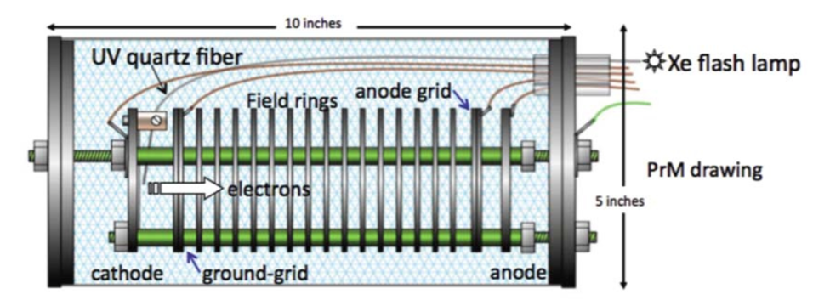
Purity Monitor (PrMon) System Description
Individual PrMon:
Xe flash lamp light source
Al-Ti-Au photocathode for drift electron generation
Cathode/anode gates for charge screening at readout
All cable shields tied to faraday cage/cryostat
M. Adamowski et al., JINST 9, P07005 (2014).
Vertical string inside cryostat placed through port 4.1 on Cryostat
One PrMon will be mounted to a plate attached to the floor of the cryostat
Two PrMons will hang from the flange by the use of rods and joints for ease of installation

Slide 3
Inline PrMon
Inline PrMon in cryogenic vessel was included in original cryogenics system layout
LAr to cryostat
This is option has gone back and forth, and has yet to get a definite answer since the largest cost here will be the cryogenic vessel and the various bypass lines, valves, and additional instrumentation that are required for this to be present

Slide 4
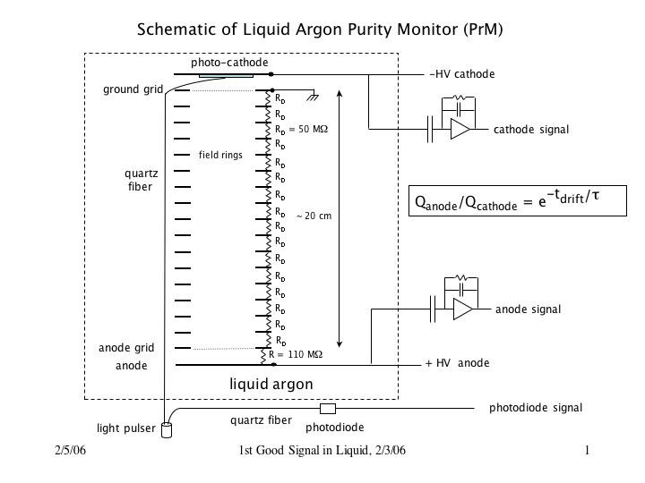
How Does A PrMon Work?
Schematic provided by FNAL, thanks Stephen

Slide 5
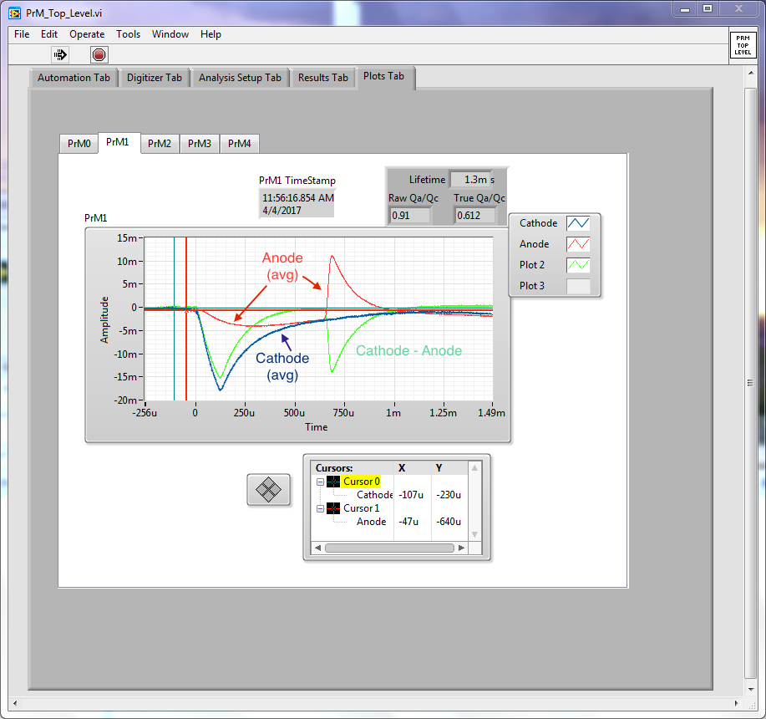
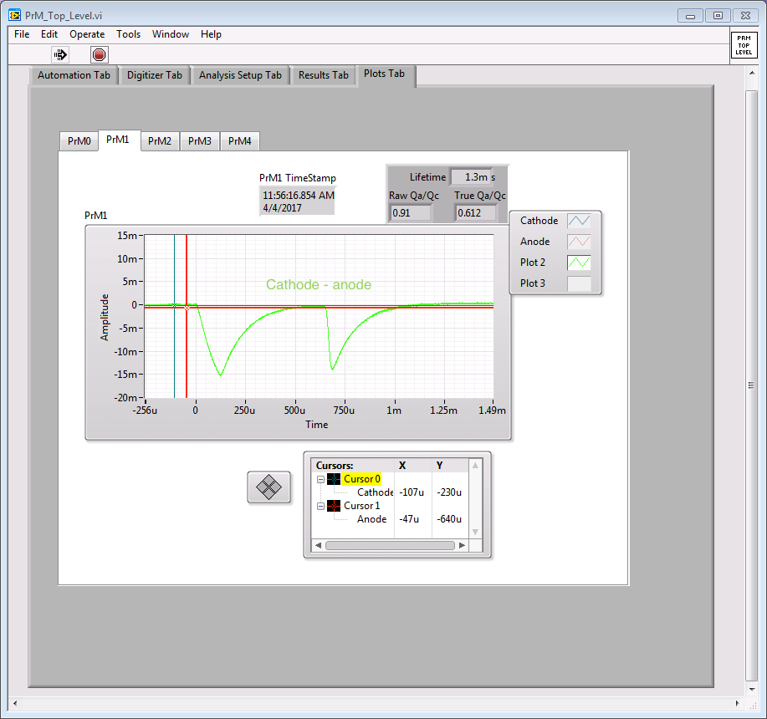
How Does A PrMon Work?
Raw data is seen as the red anode signal and the blue cathode signal, these are averaged waveforms
Subtracting Cathode-Anode eliminates signal from the image charge and gives nice waveform for analyses
Thanks to Stephen for screen grabs

Slide 6
Purity Monitor (PrMon) System Description
HV bias for anode, cathode and anode grid
HV bias for anode, cathode and anode grid
PrMon
PrMon Fron-End
HV Power Supply
Anode/cathode readout on same cable as HV bias
Anode/cathode signal after amplification
Waveform Digitizer
The PrMon front-end decouples the signal from the HV and amplifies it before sending it along to the digitizers
LabVIEW-based analysis on digitized waveforms, but program can also control hardware
Xe flash delivered to PrMons via optical fiber fed-thru the cryostat
Anode/cathode digitized signal for analysis
Xe Flash Lamp
PrMon Software
Signal to turn on flash lamp
Signal to turn on HV power supplies

Slide 7
Timeline

Slide 8
Timeline

Slide 9
1. Does the Cryogenic Instrumentation design meet the requirements? Are the requirements/justifications sufficiently complete and clear?
Requirement: Measure purity of LAr inside the cryostat during filling and commissioning and the purity of the LAr being injected into the cryostat during normal operations to ensure it is adequate for the TPC physics data taking.
  First part of requirement is met by single vertical string of purity monitors inside the cryostat
  Second part of requirement met if a purity monitor is installed inline with the cryogenic filtration system, after the filter, otherwise we will depend on the vertical string inside the cryostat to make this measurement as best as possible
Design of the system is a duplicate of that used in 35-ton system with great success, so expected performance is known and meets the necessary requirements

Slide 10
2. Does the design represent a good development path towards DUNE?
In DUNE, we will use them to at least monitor the LAr coming into and exiting the cryostat from points outside the cryostat where they will be accessible
  Inline purity monitor at ProtoDUNE (dependent on budget)
  would be very good experience in moving towards DUNE
ProtoDUNE gives one more chance for R&D and gaining experience operating the delicate devices inside the cryostat (expected to operate for at least 20 years in DUNE)
Important for ProtoDUNE in its own right, will provide the measurement of the LAr purity during period when there would be no other way to make the measurement

Slide 11
3. Does the design lead to a reasonable production schedule, including QA/QC, transport, installation and commissioning?
Individual components are small and easy to procure/manufacture
  One monitor completely operational, one close to final
Have testing programs at UCI/UH/FNAL
  UCI and UH vacuum testing (full electronics readout at UCI)
  LAr test done at FNAL in TallBo (this was also a test of the installation of the system at a distant location)
Need to address how to test them at CERN
  Note: these tests should include effects of turning on the flashlamp on other equipment, particularly the TPC readout and the photon-detectors

Slide 12
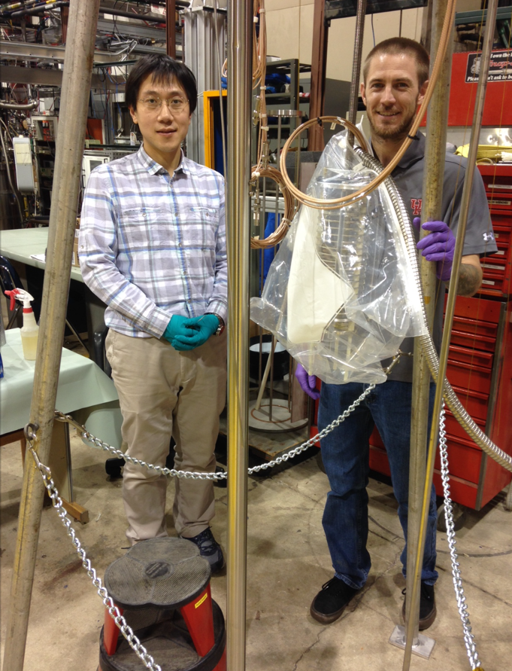
UCI Refurbished Purity Monitor Attached to TallBo Cryostat Flange

Slide 13
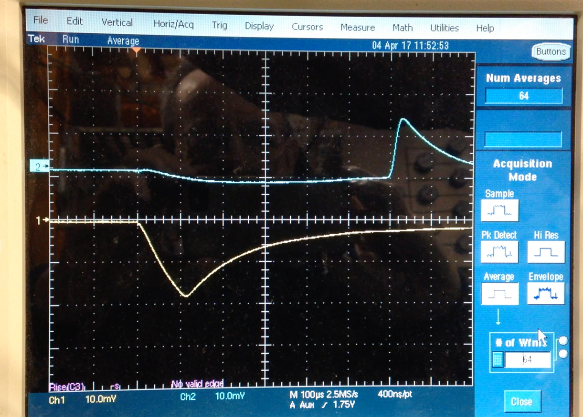
TallBo PrMon Test: Vaccum

Slide 14
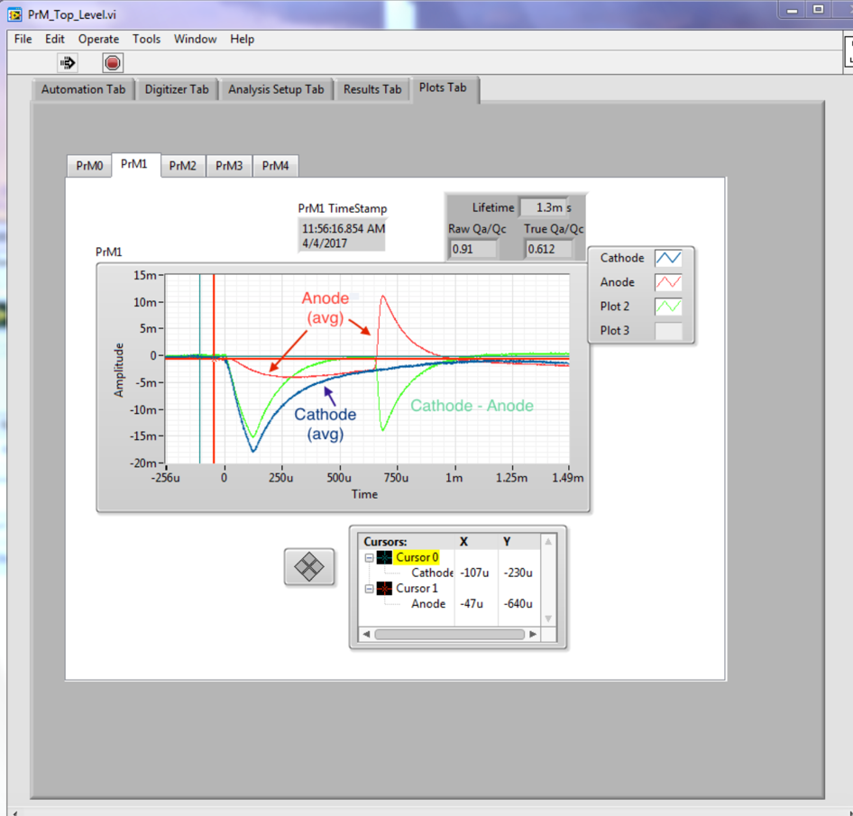
TallBo PrMon Test: LAr
1.3 ms lifetime measured in TallBo

Slide 15
4. Is the installation plan sufficiently far advanced to assure that the detector can be installed as designed?
We intend to install a total of 3 in the cryostat and one just downstream of the purification plant inline with the cryogenic system
Intend to follow the scheme used at 35-ton for the top two PrMons in cryostat
Bottom PrMon will be mounted to a plate that is attached to the membrane cryostat floor (similar for DP) (~1.8 kg mass)
Inline PrMon will be similar to top two PrMon in cryostat (dedicated vessel required with PrMon hanging from flange)
Flash lamp and front-end will go on top of the cryostat (24 V DC for both)
Need to integrate with slow control, cryostat and cryogenics groups

Slide 16
5. Are all internal interfaces between components (cryostat, cryogenics, TPC) documented, clearly identified and complete?
Cryostat port and flange for PrMon has been selected, feedthroughs for PrMon system will attach here
Plate for bottom PrMon will be welded to cryostat floor
Some small equipment needs to be as close to the port as possible, this is now being negotiated with the CERN team
  Flash lamp: to avoid loss of light (UV) in fibers taking light to photo-cathode
  Receiving amplifiers: to avoid noise pickup

Slide 17
6. Are the interfaces with the slow control system well defined and understood?
Present System
  Was controlled by windows-based digitizing scope – moved to LabVIEW
  HVs and light source power supply are turned on by Relays
  Relays are contained in an `automation’ module
  The `automation’ module is controlled by a PC running LabVIEW
  The system runs on a schedule (e.g., every hour)
  The waveforms from the cathode and anode are digitized and analyzed in the LabVIEW program
  About 12 parameters (lifetime, peak heights, drift time etc) are passed to the historical database
Would propose to keep similar structure with run control allowing runs, slow controls turning on and off devices, local analysis, output of analysis to experiment database
  Discussion still needed
  Finalize electronics format for coherence with slow control system (in contact)
  Control of PrMon system by slow control system (in contact)
  Technical details about how results will be stored and utilized (in contact)

Slide 18
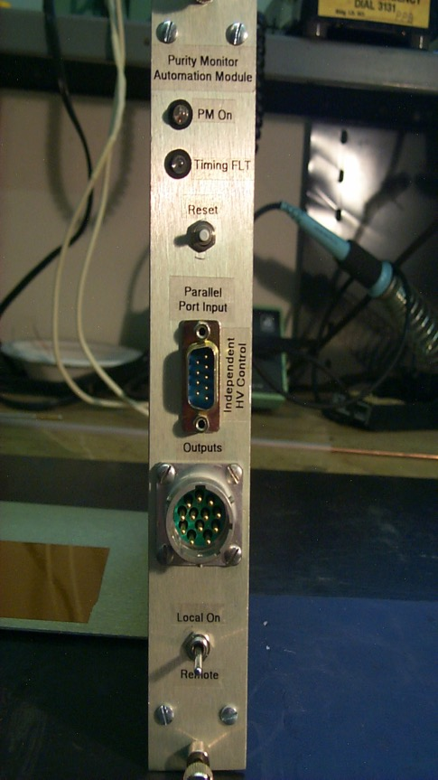
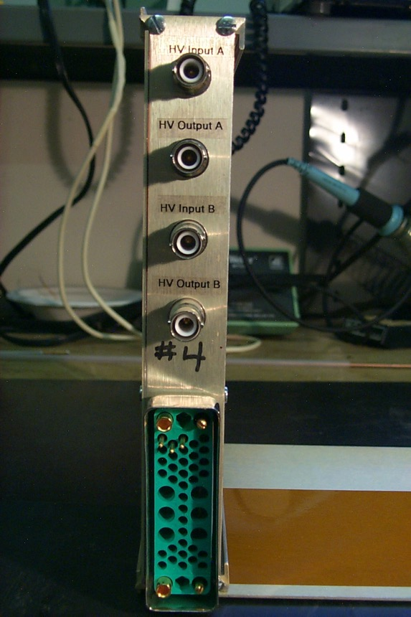
Front and Back Panel of Automation Model

Slide 19
Front and Back Panel of Automation Model
Smart equipment selections will allow the existing modules to be incorporated into the software which will directly control the power supplies and light source (hardware selection is now underway and will conclude by the end of summer)

Slide 20
7. Is the grounding and shielding of the Cryogenics Instrumentation understood and adequate?
PrMons
Inside the cryostat:
All cable ground shields at the PrMon side are connected to the case of the PrMon, this is inherently connected to the flange of the cryostat
The other end of all these is connected directly to the inside of the feedthrough flange, ground grid connected to case of PrMon
Outside the cryostat:
Cathode, Anode and Anode grid cables are connected to the front-end module ground
Flash Lamp
The flash lamp modules are in a metal box, with one power supply that is connected to ground through its power cord
The metal box should be connected to…
Discussion about this topic is ongoing and a final design will be realized soon

Slide 21
8. Are operation conditions (when will/can instrumentation be turned on) listed, understood and comprehensive?
Determined by the needs of the experiment
  Initially during filling the PrMon system should monitor the quality of the LAr being injected into the cryostat
  During commissioning phases the PrMon system should be run as continuously as possible, without interfering with TPC commissioning
  During normal operations PrMons system should be run as often as seen fit, such that it does not interfere with physics data taking
Recognized that it may/will make electrical noise – needs to be tested specifically at CERN to understand full effect, but working to mitigate this as mush as possible (see question 3)
But, in the end, slow control will be able to run system at a convenient time to not interfere with physics data taking (details of this implementation are still being understood and discussion will continue through the summer)

Slide 22
9. Are the analyses of the Cryogenics Instrumentation components sufficiently comprehensive for safe handling, installation and operation at the CERN Neutrino Platform?
Present electronics, including flash lamp, have been reviewed at FNAL, propose to use similar systems at CERN
  Flash lamp, power supplies, feedthrus, digitizers and cables are commercial objects
  Front-end is custom built, but has been reviewed and used at FNAL
The cables outside the cryostat need to meet CERN requirements (working on this now)
Propose to continue using RG-316 cable inside cryostat
Installation procedure needs development and approval – no heavy pieces, basically from outside of cryostat at the end of detector installation sequence

Slide 23
10. Is the Cryogenics Instrumentation quality assurance, quality control and test plan adequate? Have applicable lessons-learned from previous LArTPC devices been implemented into the device testing and into the system design?
Test stand at UCI for vacuum testing first
  All PrMons will be tested here in a first stage
LAr Test in TallBo/BLANCHE at PAB@Fermilab
  One PrMon has already been successfully tested in TallBo, can continue this experience with the other later this year
  Second option is to build LAr recirculation system at UCI/UH, this might be done this summer and then would be capable of handling the LAr testing
Experience from ICARUS, LAPD, 35-ton et al. has been taken into account in everyway possible
  This has led to the precision that these devices are able to achieve and much credit is due to those who have worked on these systems before us
  Many many thanks to Alan Hahn, Stephen Pordes, Sarah Lockwitz and all the FNAL-PAB techs for all the help and knowledge transfer they have provided!

