Slide 1
Access and Safety team of the Neutrino Platform Hall

Slide 2
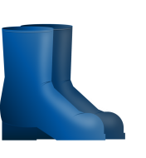
HOW TO ACCESS THE NP HALL
ADaMS
1. Be registered at CERN
2. Request access permission
3. Follow the required safety trainings
4. Have a valid IMPACT
5. Wear required Personal Protective Equipment (PPE)

Slide 3
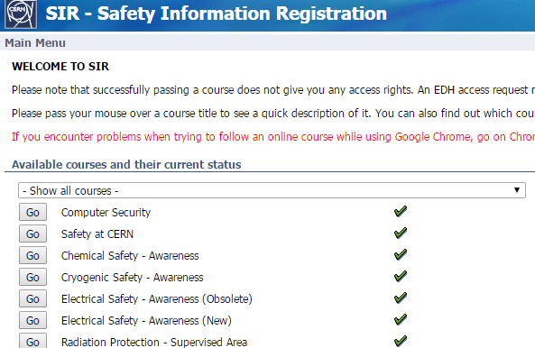
REQUIRED ON LINE TRAININGS
On line trainings:
https://sir.cern.ch/
Only once registered at CERN
Required trainings:
Safety at CERN (15 min)
Electrical Awareness (30 min)
Neutrino Platform Hall (1 h)
access, practical information, activities organisation, risks in the hall, emergency procedure, etc.

Slide 4
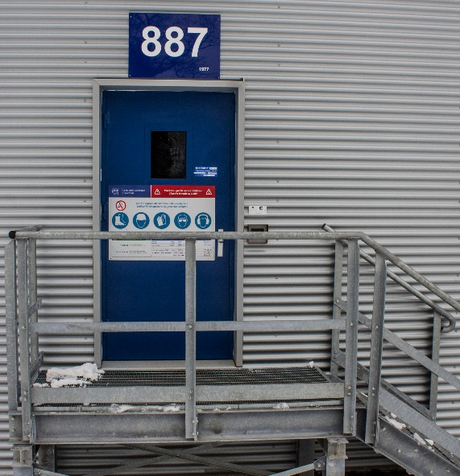
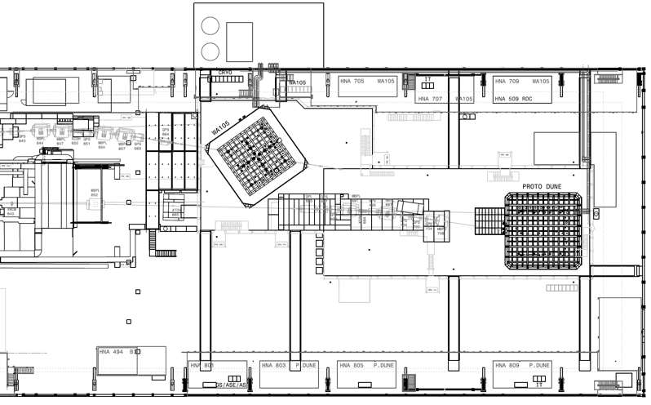
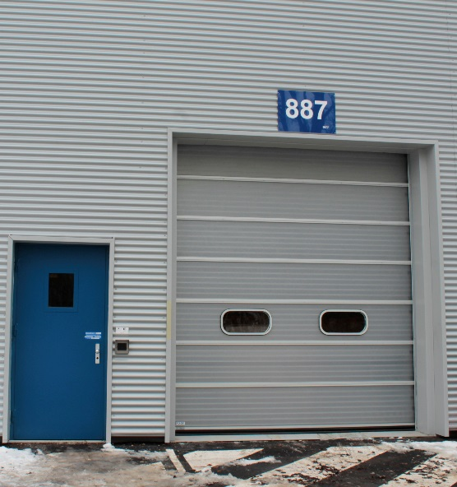
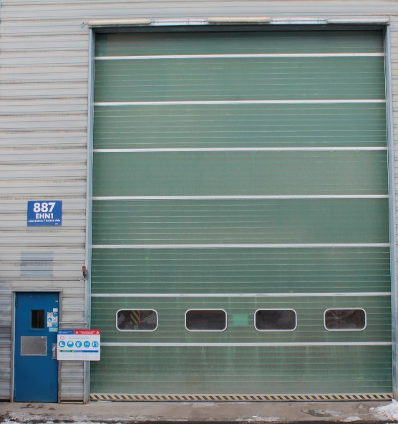
Badge to enter!
3 main access doors to the NP Hall
Jura Side
Salève Side

Slide 5
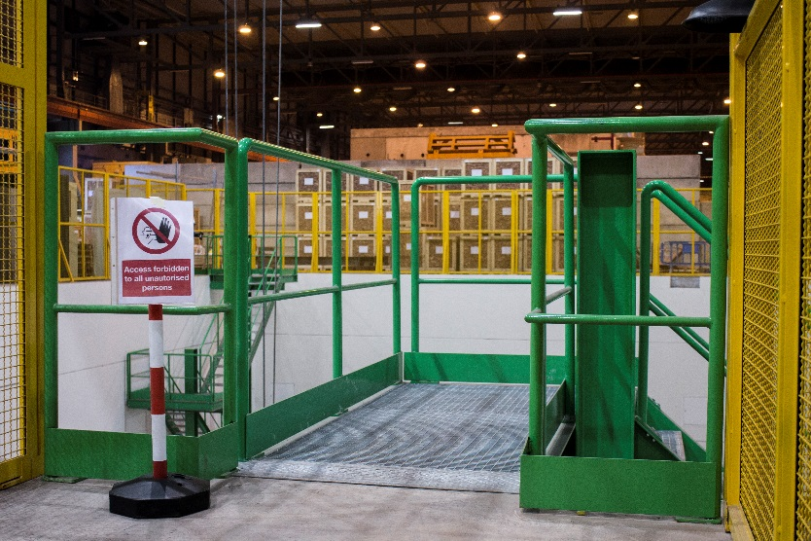
3 access points to the trenches
Badge to enter (specific access rights)
No access during cryostat filling
Only maintenance once stable
Jura Side
Salève Side

Slide 6
2 access points to the top of the cryostats
Jura Side
Badge to enter (specific access rights)
Always accessible
Salève Side

Slide 7
THE SAFETY TEAM
PSO
Project Safety Officer
Safety of the construction yard (installation phase)
TSO
Territorial Safety Officer
… plus:
Safety of the building and premises
HSE
Health & Safety and Environmental Protection Department
DSO
Departmental Safety Officer
Safety of the experiment and experimental area
EXSO
Experimental Safety Officer
Safety in situ of the experiment (commissioning and operational phase)

