Slide 1
Introduction to H4 for NP04

Slide 2
Beam instrumentation WG
Joint NP02 and NP04
Co-conveners: Y. Karyotakis (NP02, CERN), P. Sala (NP04, CERN), J. Paley (NP04, FNAL)
Choose, develop, install, readout devices for beam monitoring, momentum measurement, particle identification in the H2 and H4 very low energy beamlines
Development of hardware
Beam simulations
Beam halo/ shielding simulation and design
Detector simulations
DAQ interface

Slide 3
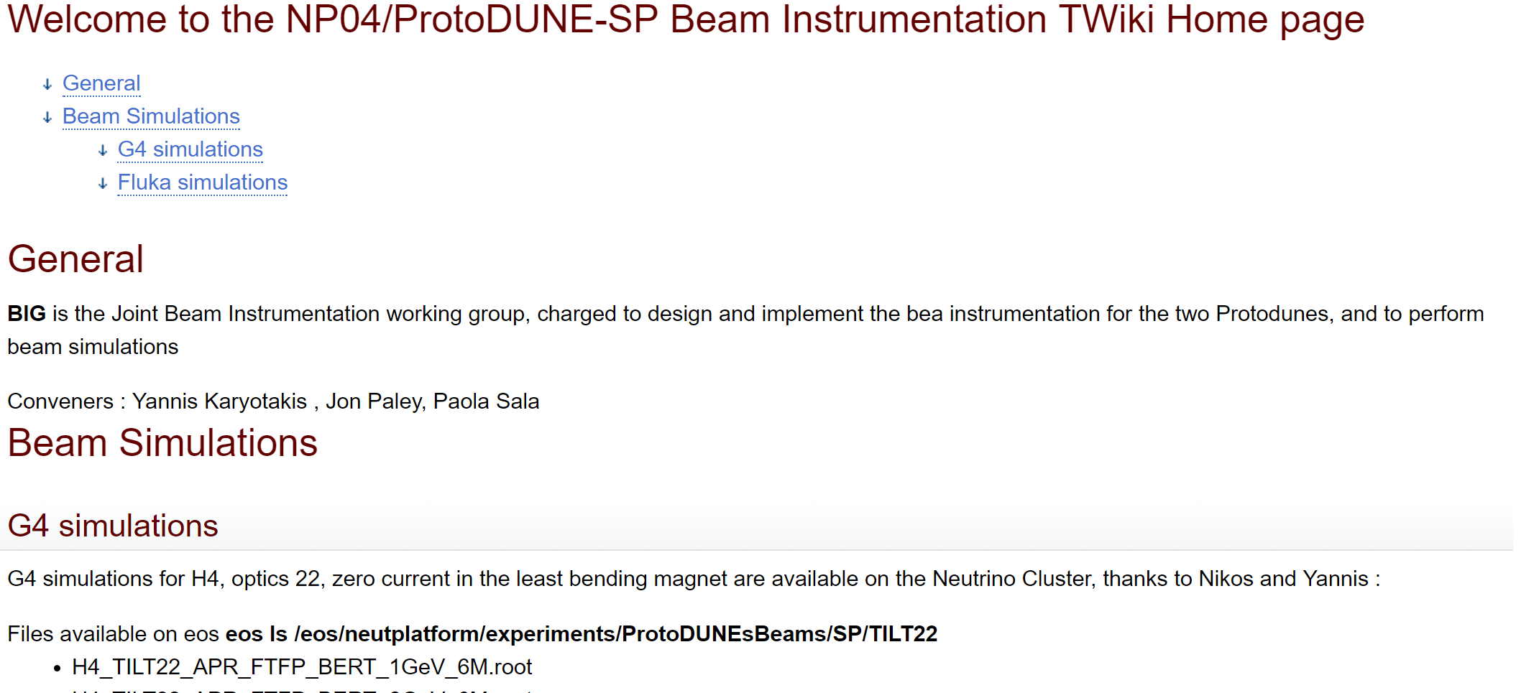
Web page
https://twiki.cern.ch/twiki/bin/view/CENF/DUNEProtSPBeamInstr
Or : from www.cern.ch/cenf --> projects → np04 → subprojects

Slide 4
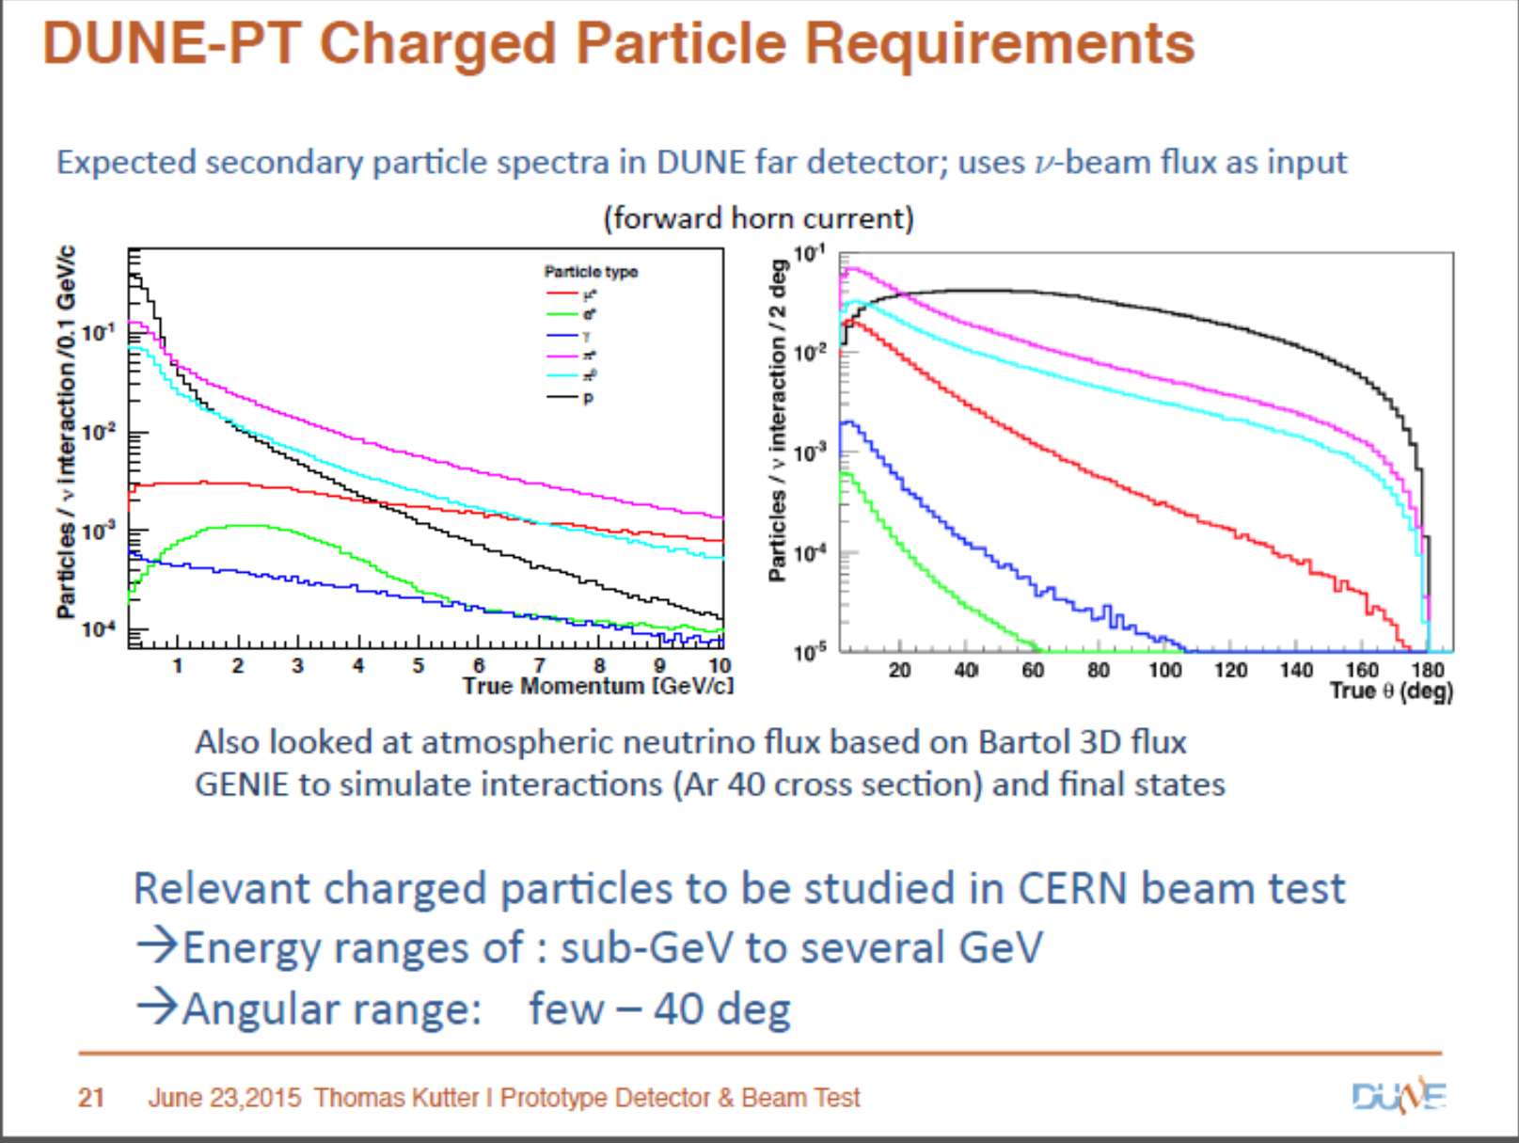
Similar for NP02
NP04 : p,π,K,e
0.5- 7 GeV/c
NP02: p,π,K,e
1- 10 GeV/c
Rate: ≈25-50 Hz

Slide 5
Requirements from TDR
Phyisics might need
better (~1%), measure with spectrometer
Beam window is much larger (~20 cm diameter). Particle track
In addition, from LAR1AT experience: particle trajectory to match LAr track

Slide 6
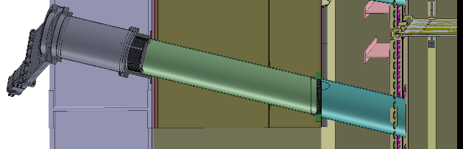
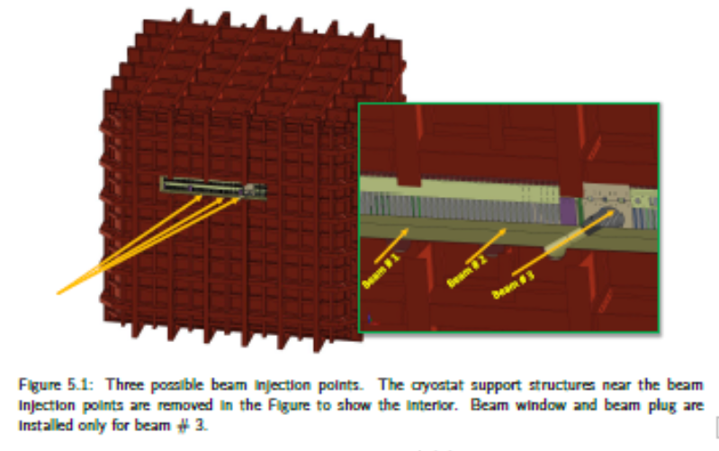
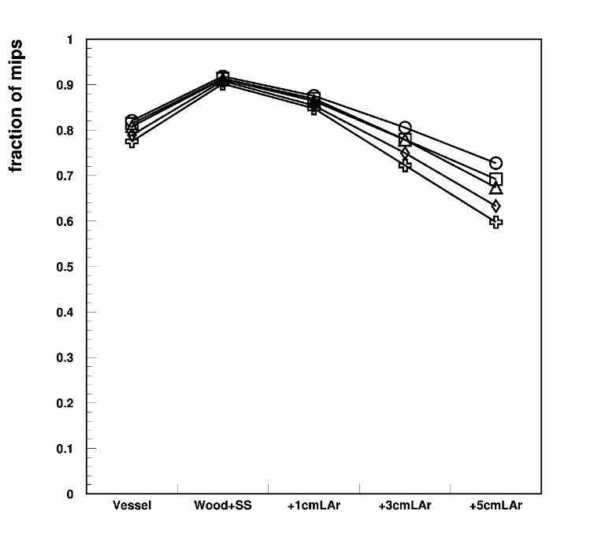
Beam penetrations
plug
penetration
Penetration in the insulation and
Plug in LAr up to active Lar
Necessary for electrons and low mom Hadrons
Only for one of the beam spots
Fraction of non-showering electrons
Only primary membrane
All cryo layers
Prim. Memb. plus a few cms inactive LAr

Slide 7
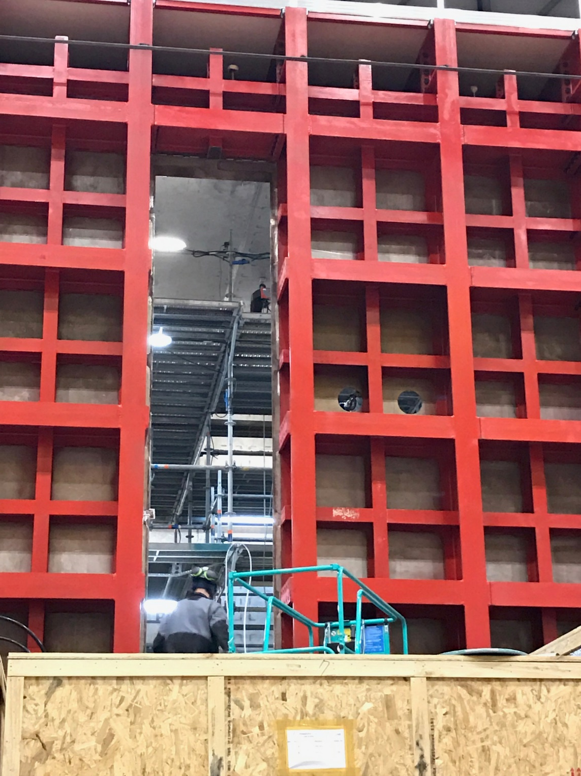
Beam holes NP04
December 2016:Two beam holes drilled and measured by survey group
New version of the optics (27)

Slide 8
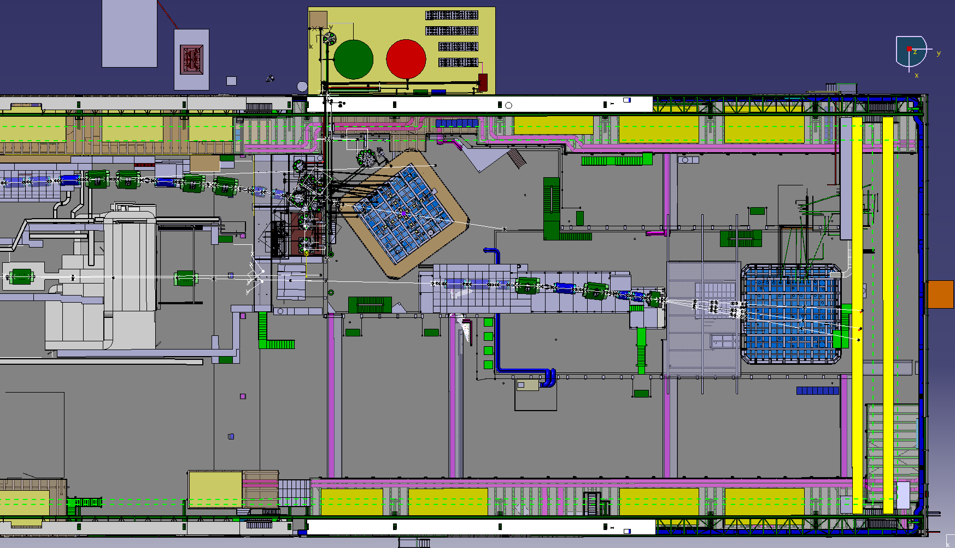
Integration drawing with beam lines
H2 beamline to NP02,
Entrance from one corner
H4 beamline to NP04,Three possible entrance positions

Slide 9
Hadron beam
Full details in Nikos talk
Hadron rate: few Hz at 0.5 GeV/c , ~150 Hz at 7 GeV
Mixed composition, however few Kaons at low momenta (decay…)
Overwhelming electromagnetic contamination at low momenta
Intrinsic momentum spread ~5%, to be reduced with collimator closing or measured with spectrometer
Electron beam
Full details in Nikos talk
Expected 99% purity

Slide 10
Needs/constraints for beam instrumentation
Beam steering and monitoring
Trigger of BI itself and ProtoDUNE
Momentum measurement to reduce the momentum spread
Particle ID : electron veto, pion/K/p separation
Particle tracking to match track in ProtoDUNE (only NP04)
Low material budget
Large area ( beam pipe ~200mm diameter, can be filled by beam envelope)
Fit in short and crowded beam line (total length approx. 32m)

Slide 11
Monitor/ tracking devices CERN BI group
layers of scintillating fibres
Polystyrene, 1mm square fibres, one or two (X and Y) layers
Can cover whole beamline area
Inserted in beamline with special flange, do not break vacuum
3 devices for spectrometer, single layer, oriented according to deflection
2 device beam monitor, two layers
1 device tracking, two layers
Will give sub-millimetre space resolution
Might do ToF 1ns
In collaboration with EP-DT
See talk by Inaki

Slide 12
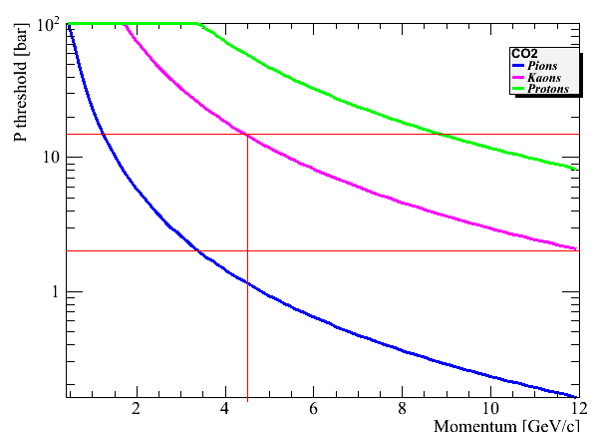
PID
Two possibilities: Cherenkov and ToF
Cherenkov works for electrons
For Pions only above 2 GeV
For Kaons only above 5 GeV
Here: threshold pressure for Cv emission vs particle momentum, CO₂
Max pressure 15 bar, standard <3.5
Investigations ongoing with different gases (Freon-like)
Note: high-pressure CV will NOT be in the beamline for low momenta runs
Need ToF for low momenta!

Slide 13
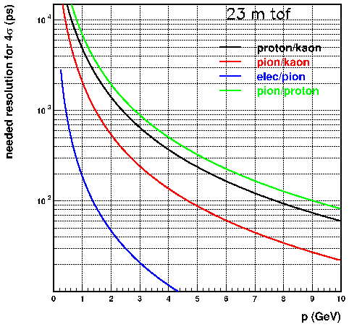
Requirements for ToF
From here π with Cv
From here K with Cv
Needed resolution for 4 σ discrimination, assuming 23 m ToF (ps)
Below 2 GeV : pion/proton need ~ns
2-5 GeV : kaon/proton needs ~100 ps
With a 50ps device pion/kaon up to 6 GeV
proton/k up to 10 GeV
Here almost no K
1 Cv used for electrons

Slide 14
PID-Tof
Proposal from FNAL: pLAPPD
better than 50 ps timing resolution
≈ 1mm position resolution
6x6cm area
Hope to integrate in the same box as beam monitors
Under test see Jon’s talk
Alternative for low p (1ns timing)
Same devices as for beam monitors
Different electronics: ASIC for SiPM readout, called STiC, https://www.kip.uni-heidelberg.de/hep-detektoren/readout?lang=en
( implementation in Daq to be studied)
Or simply readout by fast PMT
Why two tof systems?
Material budget: pLAPPD too thick at low p
Efficiency: small area, again a problem for low intensity low momentum (see later)

Slide 15
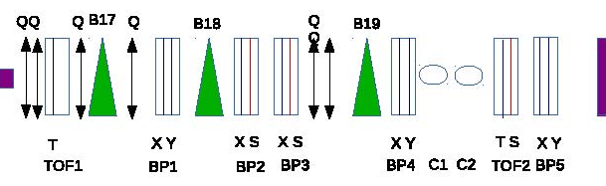
Layout of H4-VLE
XY = layers of scifi monitors
S =scifi for trigger
T = ToF system, either scintillator or pLAPPD
C=Cherenkov, one or two, depending on selected momentum/available ToF

Slide 16
H4 det. layout, option 1 – with pLAPPD
All tracking and trigger monitors will be always present in the beamline, for a total of 8 sci (XBPF) layers and three trigger planes
For PiD:
p ≤ 2GeV/c : XBPF ToF + standard CO2 Cherenkov for electron discrimination
2 < p ≤ 7GeV/c : pLAPPD ToF + standard CO2 Cherenkov for electron discrimination
Total instrumentation needed: 8 XBPF layers with standard electronics, 2 XBPF layers with ToF electronics, two pLAPPD stations, one standard Cerenkov, and three trigger planes, plus spares.

Slide 17
H4 det. Layout, option 2 – without pLAPPD
For PiD:
p ≤ 2GeV/c : XBPF ToF + standard CO2 Cherenkov for electron discrimination
2 < p ≤ 3GeV/c : XBPF ToF + standard CO2 Cherenkov for electron discrimination. Kaons cannot be distinguished from protons
3 ≤ p ≤ 5GeV/c : standard CO2 Cherenkov for electrons, high pressure Cherenkov for π( < 10 bar) Kaons cannot be distinguished from protons
p > 5GeV/c: standard CO2 Cherenkov for pions, high pressure (10-15 bar) CO2 Cherenkov for kaons. Electron content will not be tagged.
Total instrumentation needed: 8 XBPF layers with standard electronics, 2 XBPF layers with ToF electronics, one standard Cherenkov, one high pressure Cerenkov with non-standard distribution system, and three trigger planes, plus spares.

Slide 18
Effect of materials on beam quality
Full FLUKA simulation of beam line, beam materials, cryo, beam windows
To evaluate effect of materials: inject beam just downstream of target
  Monochromatic
  Parallel
  1cm diameter
Spectra at cryo face and at LAr active surface (after beam window)
Attenuation with respect to “no materials” (counting “good” particles)

Slide 19
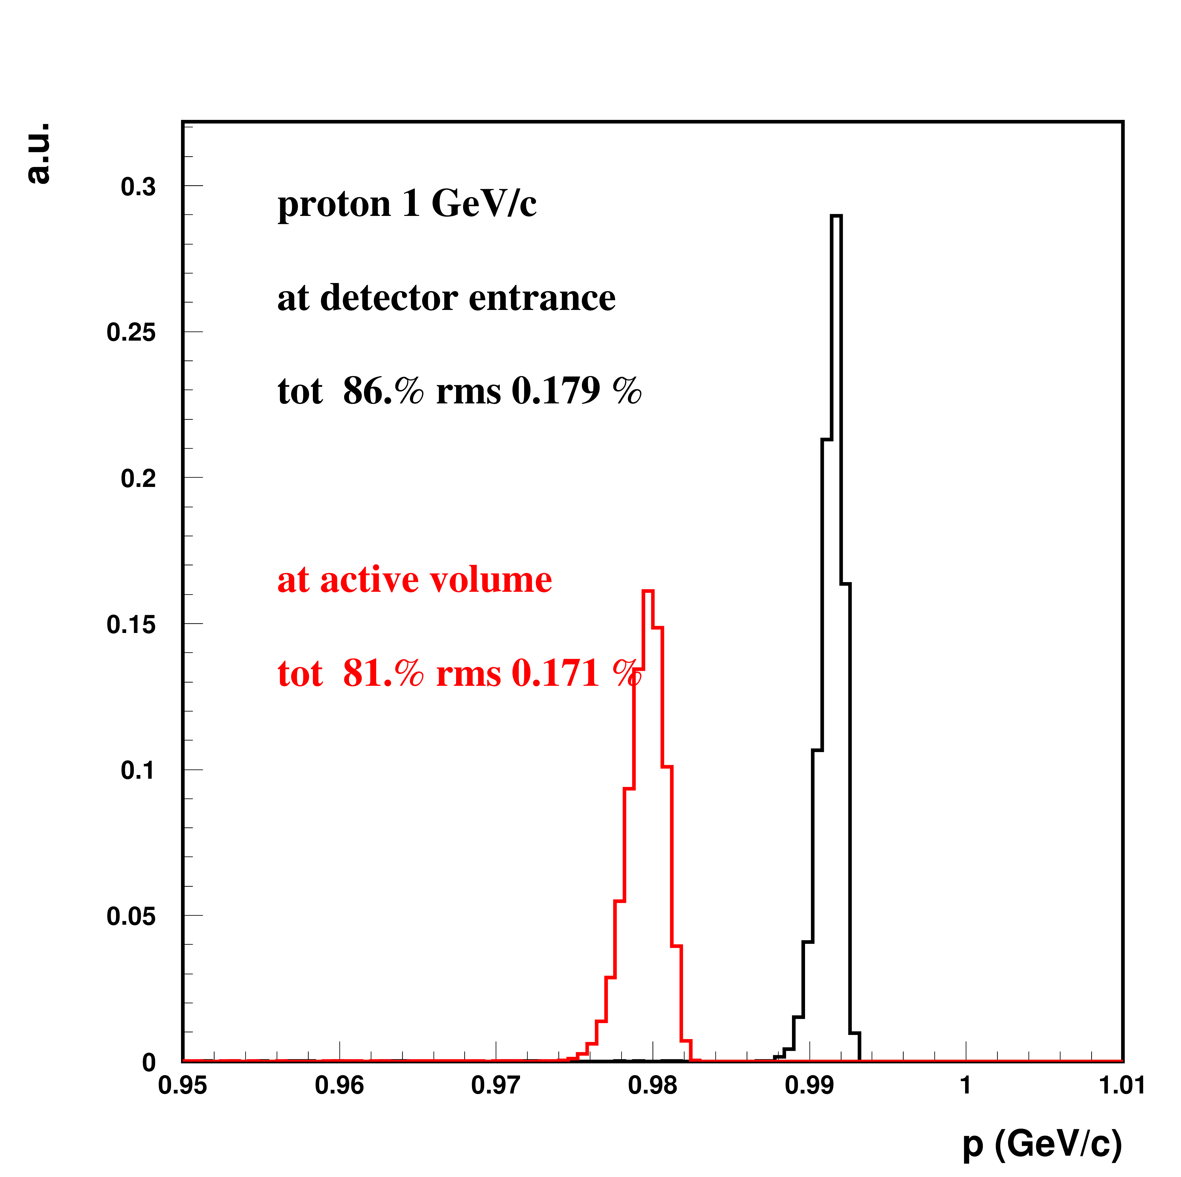
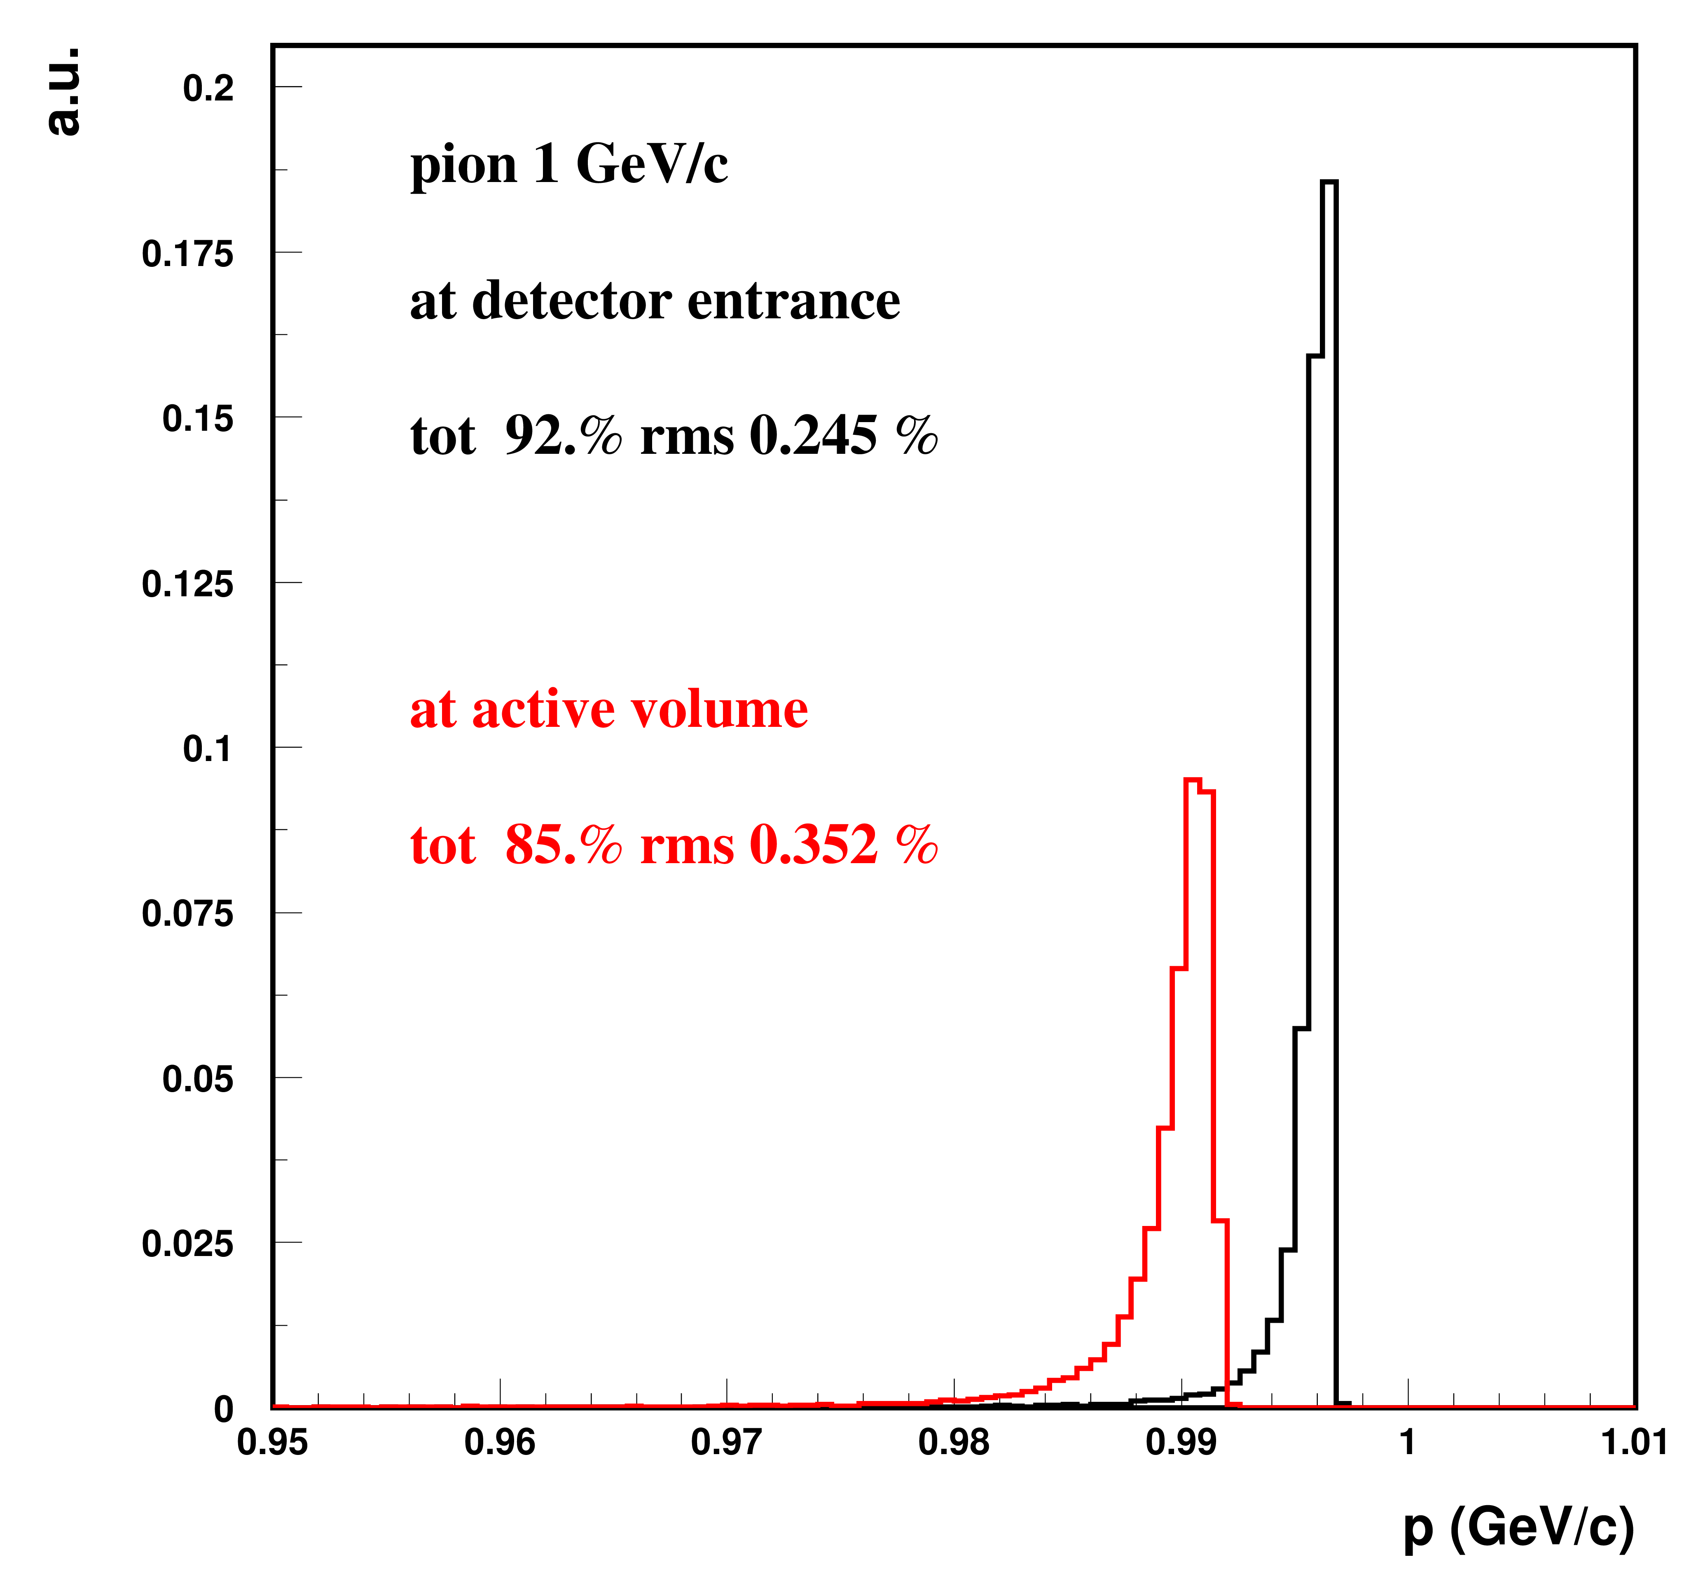
Low momenta: scintillators + low pressure CV
2 %
3 %
Small energy degradation – can be corrected by MC with small uncertainty
Momentum spread < 1% - small (15-20 % ) intensity reduction

Slide 20
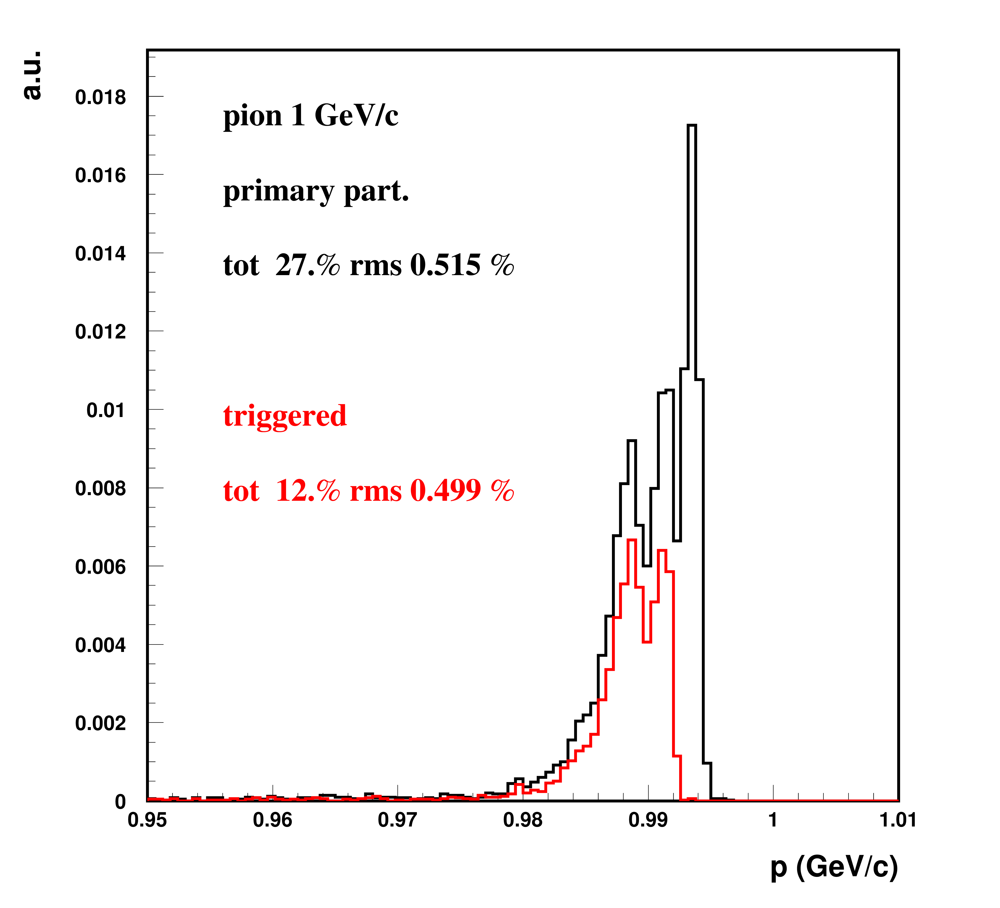
What if pLAPPD?
Black: all ”good” (uncollided ) at cryo
Red: only good that passed through pLAPPD active areas (note: here small parallel beam from target)
Scattering in pLAPPD layers throws pions out of beamline acceptance ➔ only 27% left
If pads geometrical acceptance included➔ only 12% left (could be improved by doubling the devices)

Slide 21
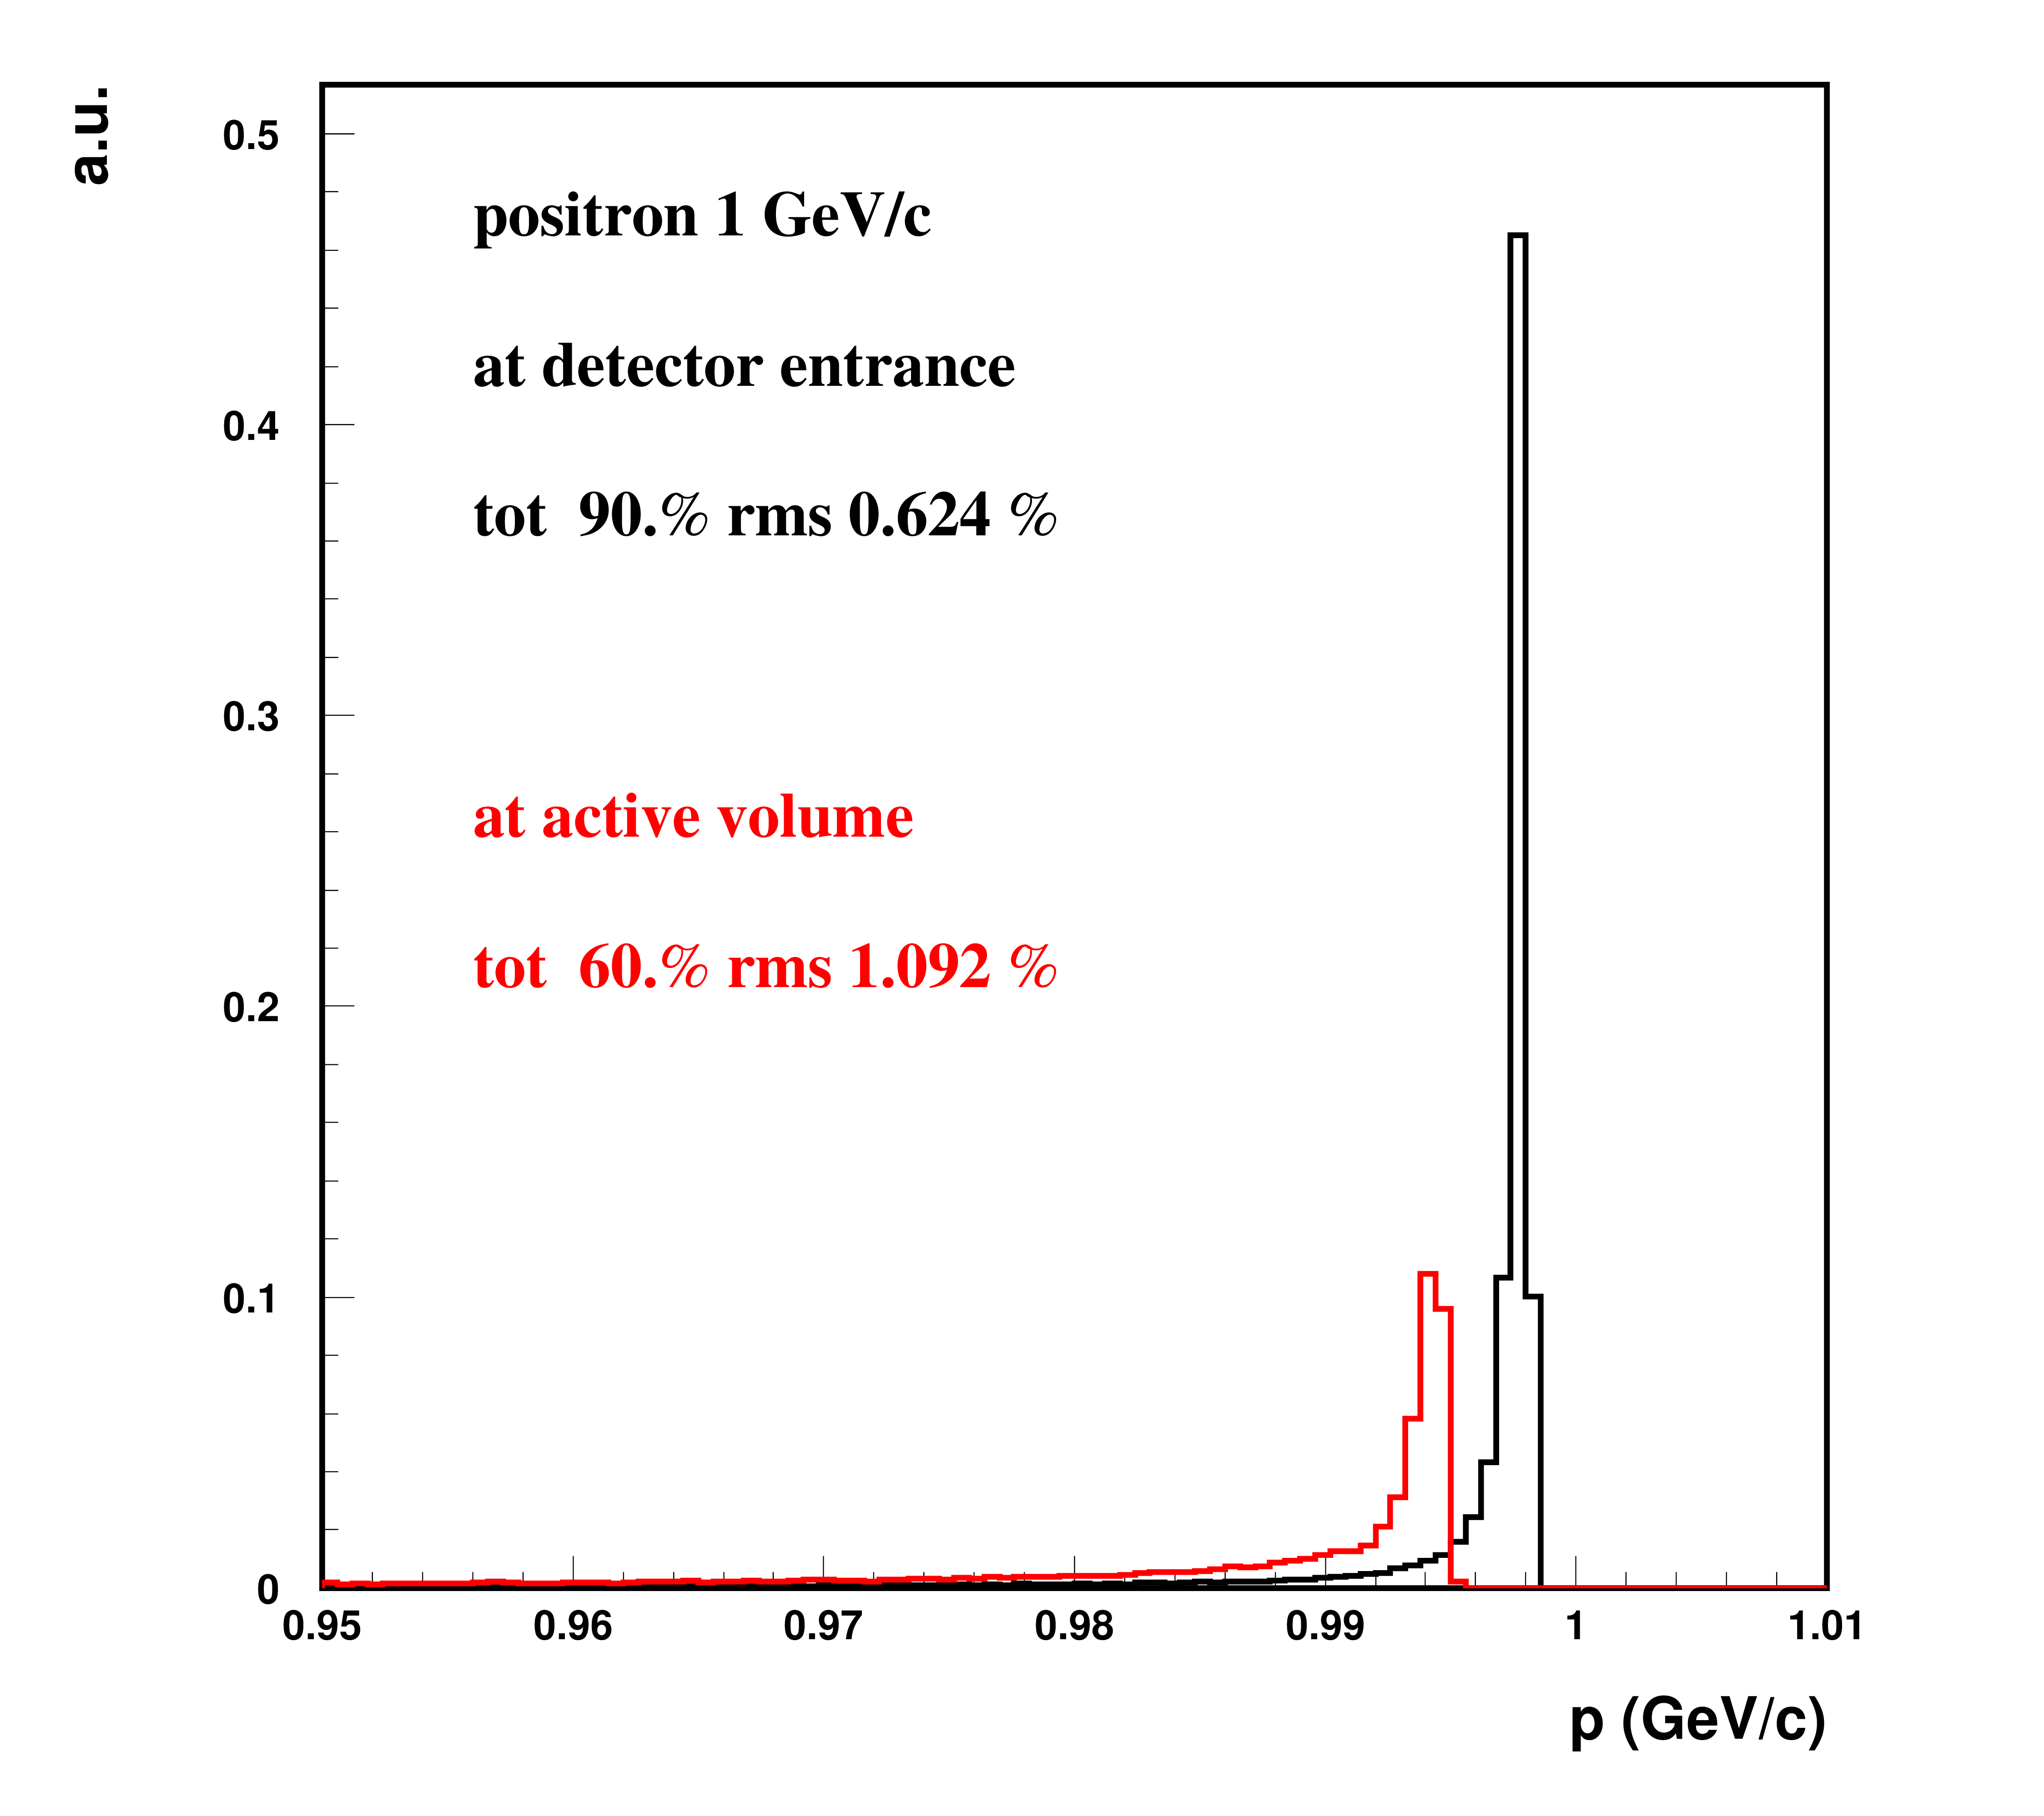
Low momenta: scintillators, electron beam
Combined effect of Beam Instr + baem window still allows for good statistics of unperturbed electrons
2 %

Slide 22
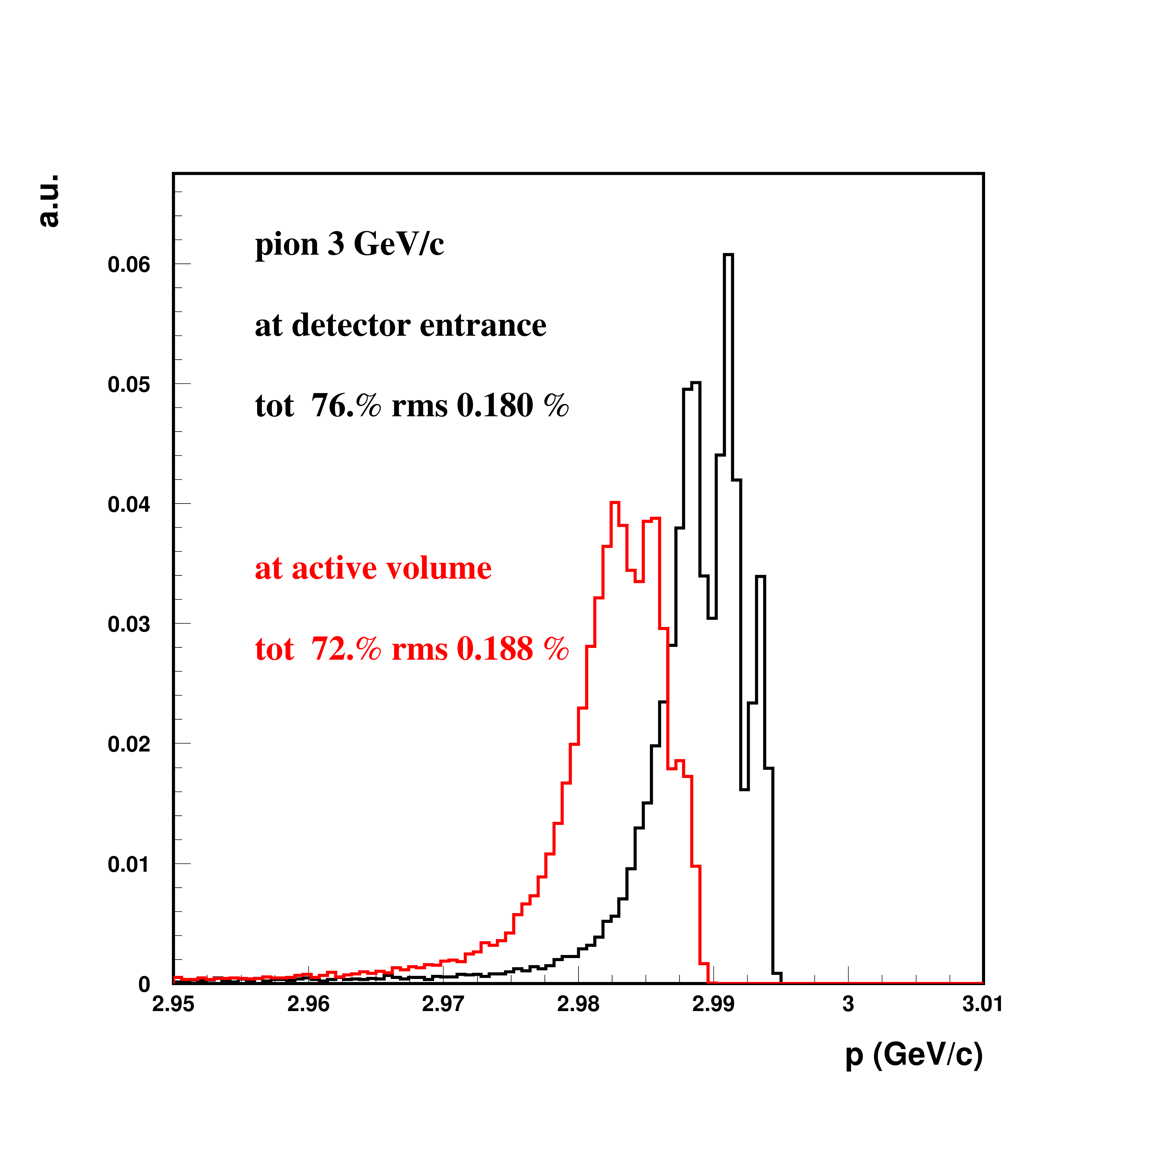
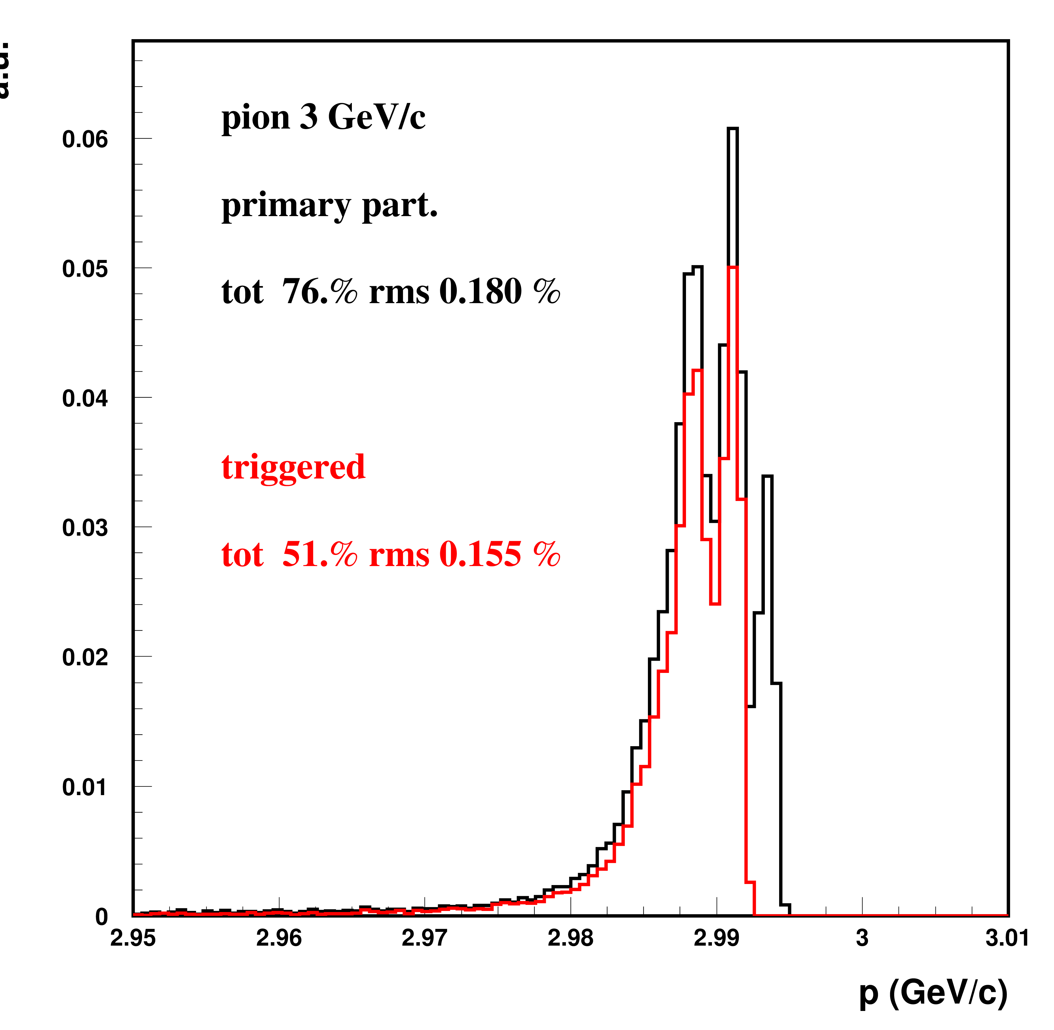
Intermediate: use pLAPPD
1 %
Pion scattering acceptable,
Energy loss fine,
efficiency to be checked (double device?)

Slide 23
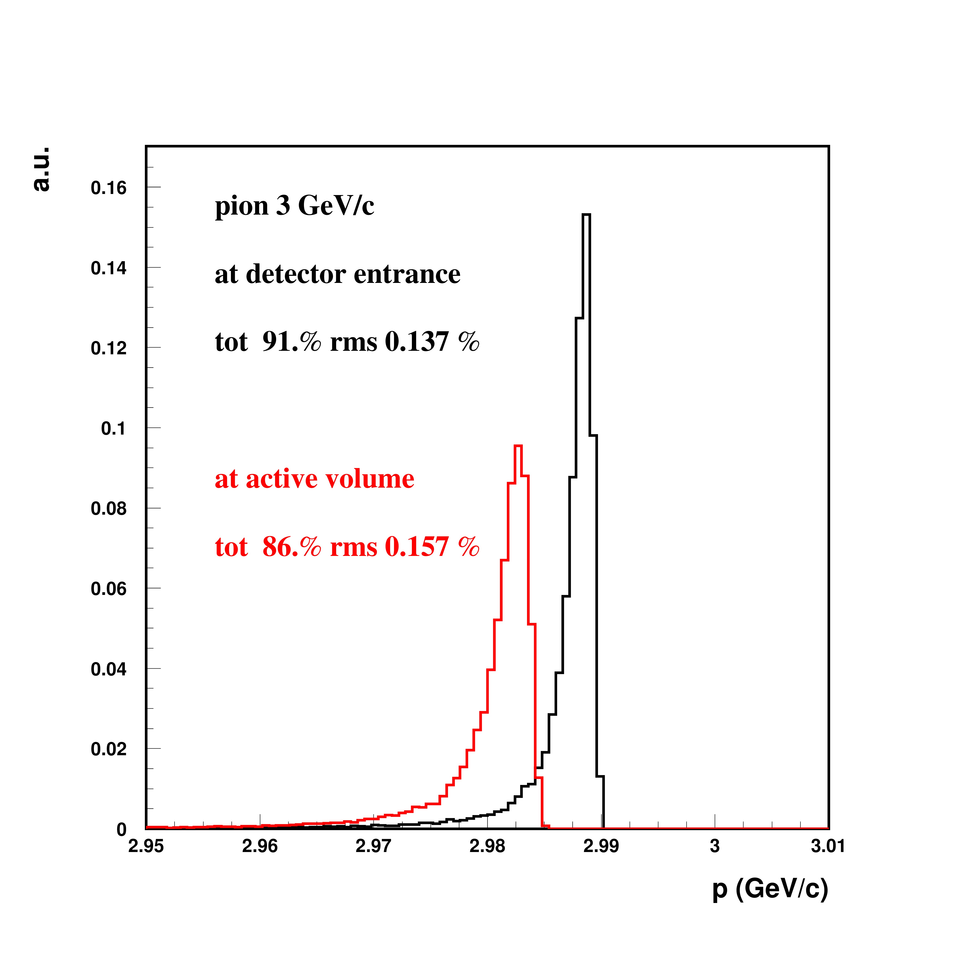
Intermediate: if no pLAPPD : 2 CV
Here:
1 low pressure CV for e⁺ discrimination
1 10bar CO₂ CV for pions
Small energy and efficiency degradations
1 %

Slide 24
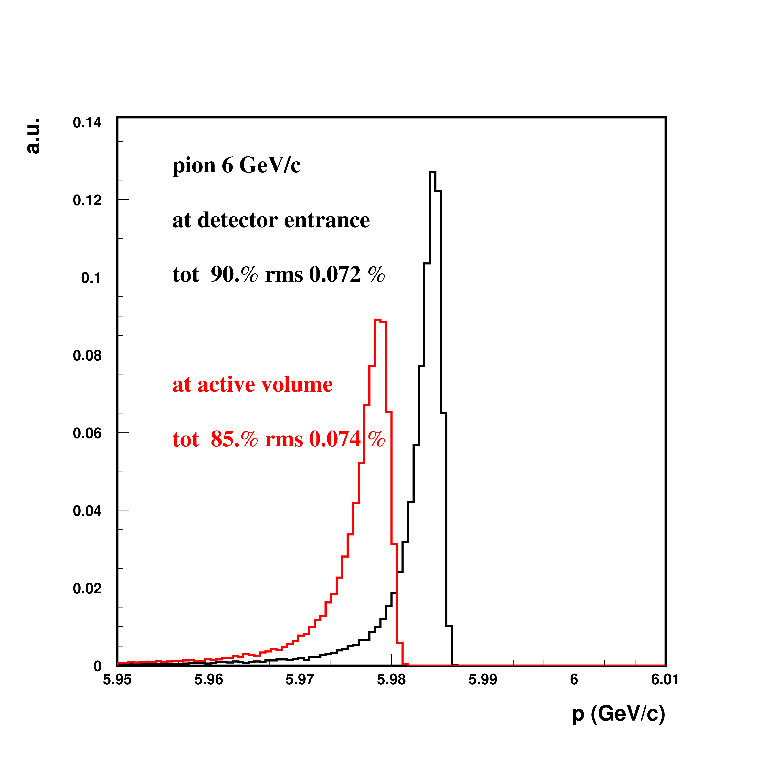
If High pressure CV is needed
Hig momenta: K id by 15 bar CV if pLAPPD not available: fine
0.5 %

Slide 25
Conclusion on material budget
Beam instrumentation and beam window allows to keep the beam quality within requirements

Slide 26
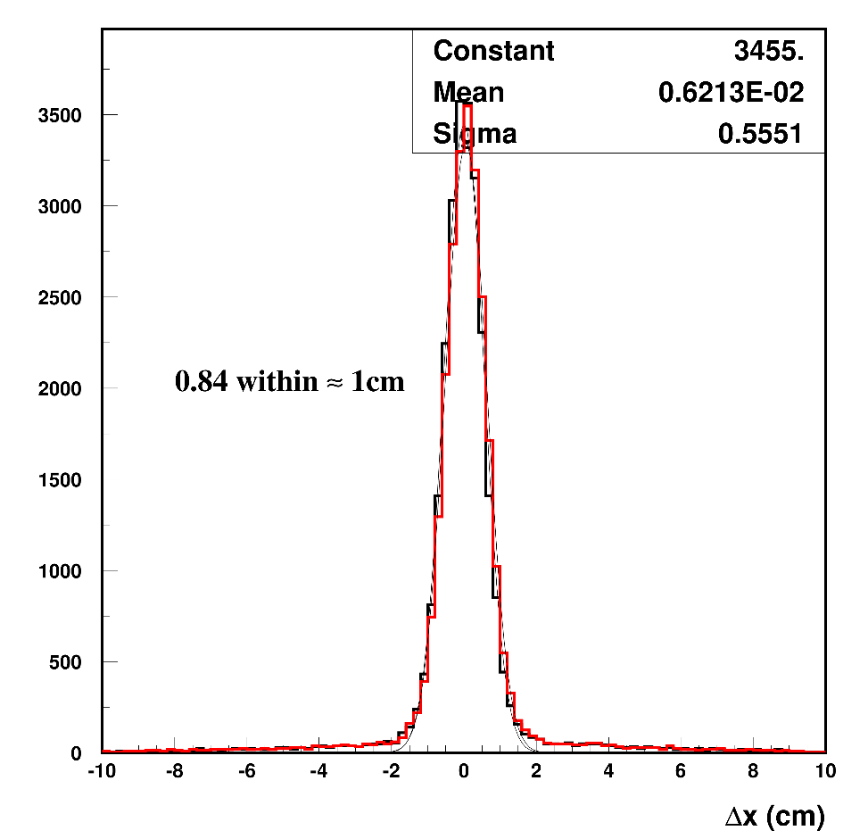
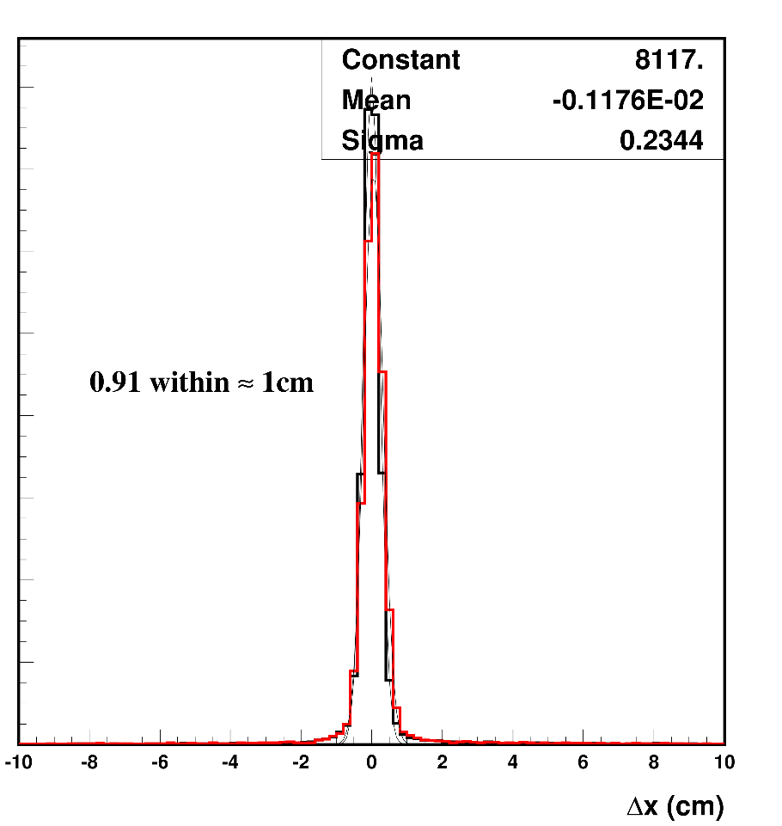
Tracking
The two last beam monitors should allow track matching with LAr data
Possible disruptions: space resolution and scattering in materials
Simulated Difference between
x-coordinate at LAr entrance
And
x extrapolated from last two monitors
For two different energies (and beam line materials)
Red histo: add 1mm rms (huge) smear on monitors
80% to 90 % of events reconstructed within +-1cm
Pions 1 GeV
Pions 6 GeV
According to simulation, particle track matching is feasible in the current configuration

Slide 27
Momentum selection/measurement
Details of the methods and preliminary results in Nikos talk
Reduction of the momentum spread by closing the collimator: can achieve ~2.5% dp/p with ~factor 3 reduction in particle rate → can be used at high momenta
Momentum measurement particle-by-particle with trackers+bending magnet : better than 2% for p>2 GeV/c. Deteriorates at lower momenta due to multiple scattering.
In both cases, “downstream” effect of materials to be corrected for
➔ Momentum determination within 2.5% achievable for p>2GeV/c, will deteriorate up to the intrinsic 5% at lower momenta

Slide 28
Schedule
Details in Nikos, Quentin and Inaki’s talks
Beam line + Cerenkovs: spring2018
Sci-fi : Full prototype by September, test in beam lines Oct-Nov, full production April 2018
Warning on scint ToF: if custom electronics cannot be integrated, use trigger layers with pLAPPD logic. Decision in next month

Slide 29
Backgrounds
See dedicated talk.
Shielding design ongoing, to be validated by integration and RP teams.
Present guess: about 1kHz charged particles at LAr active face for high p beam, same order of magnitude for fast neutrons,
High energy muon halo is being evaluated. Will need interaction with the Cosmic Ray Tagger group.

Slide 30
DAQ Architecture
Synchronization will be ensured by time stamping of data with the White Rabbit (WR) system
WR timestamps have a precision of +/-700 ps
A common GPS signal will come from a WR master switch in the CCR (Cern Control Room), same GPS as for LHC
Offline interface: see Jon’s talk
Trigger signals and Cherenkov logic signals to NP04 trigger board (cables-NIM )
See also DUNE-doc-1651-v3

Slide 31
Grounding Isolation
Detector
Building
Connected to building ground
No connection to detector
Other DAQ equipment
Ethernet switch
Beam Instrumentation
SSP
Trigger Board
Timing
CRT
WIB

