Slide 1
Background and shielding
Paola Sala, Elzbieta Nowak
Design Rewiev of the ProtoDUNE-SP Beam Instrumentation
CERN, 27.04.2017

Slide 2
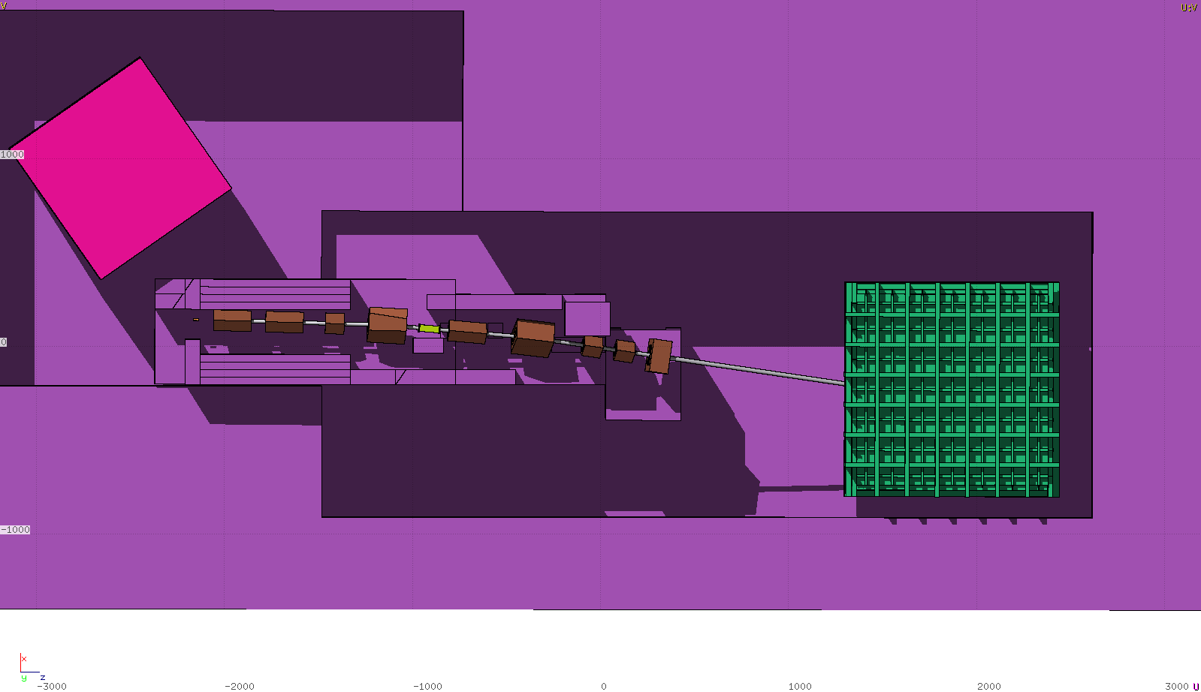
Top view, shield v0
Initial shielding design: only target area plus beam dump
NPO2
target
dump
last bend
NP04

Slide 3
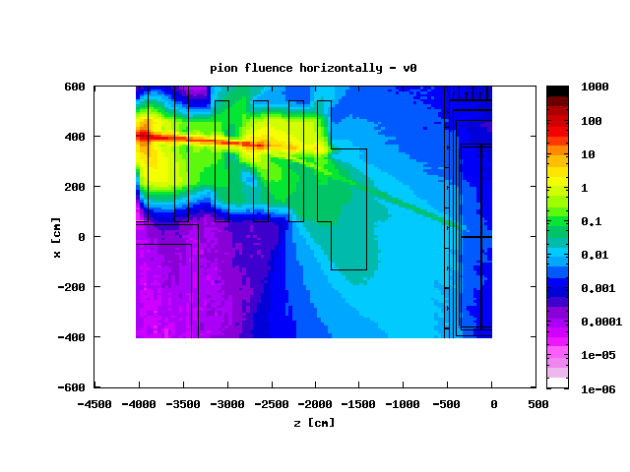
Particle fluence - v0
Beam dump
Needs more work
Cryo
1e6 particles @T2 target
Seen from the top

Slide 4
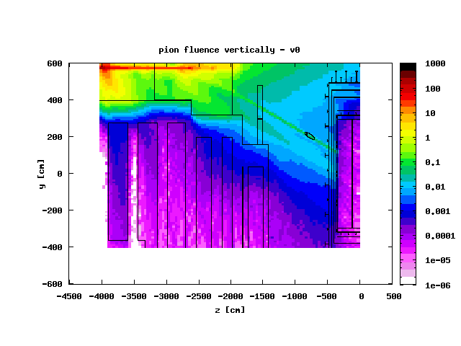
Particle fluence – v0
Needs more work
1e6 particles @T2 target
Seen from the side

Slide 5
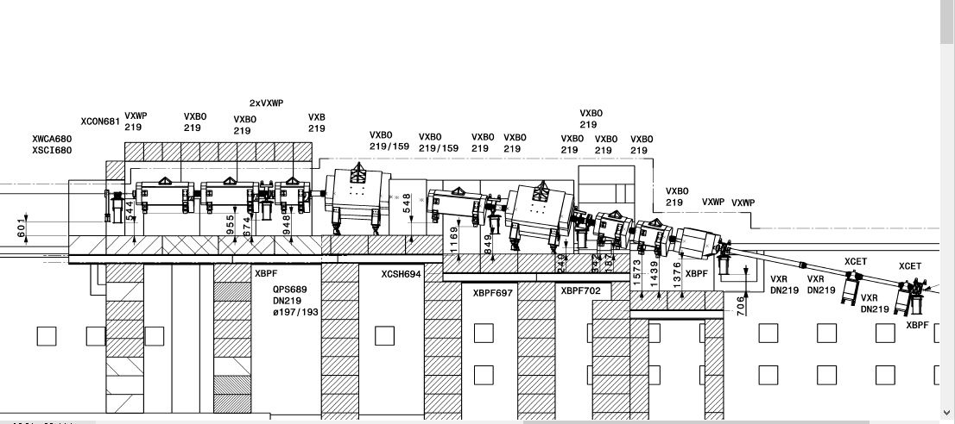
Filling up the space
… not so much space…

Slide 6
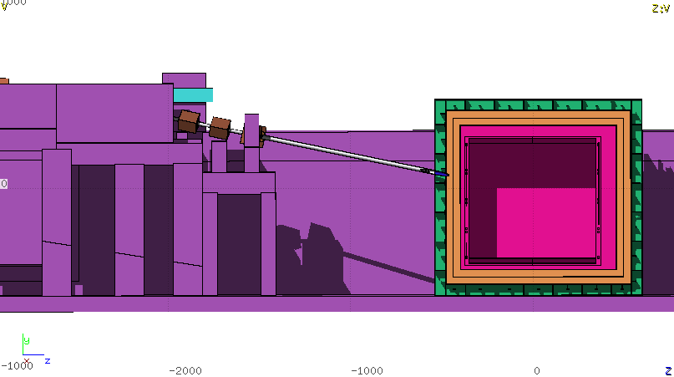
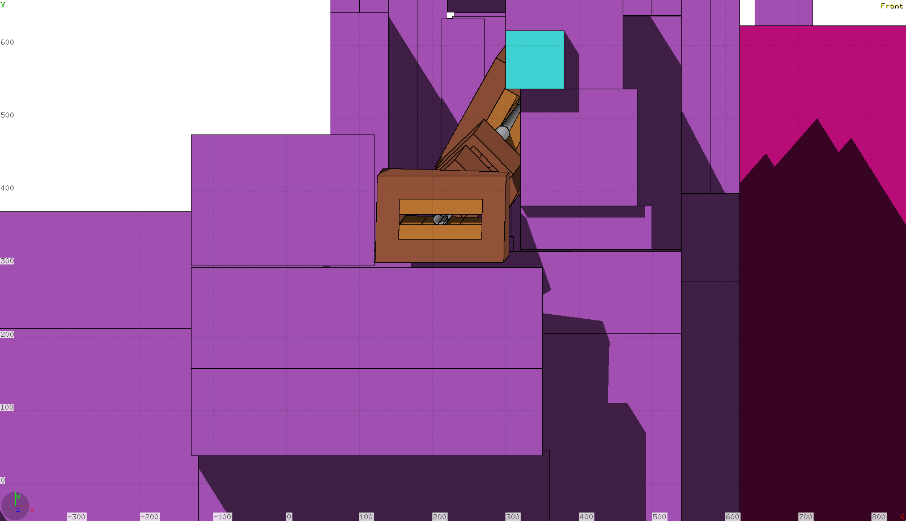
New shielding proposal
60cm, 1.6m
Top view
Extended by 3.2m
Side view
Seen from the detector

Slide 7
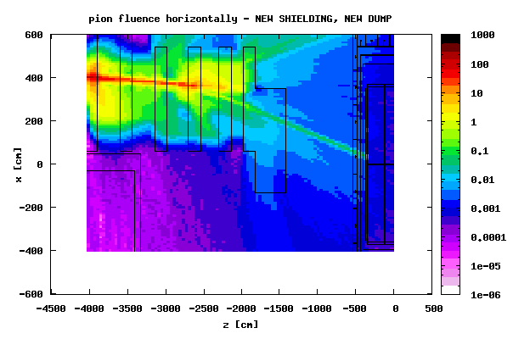
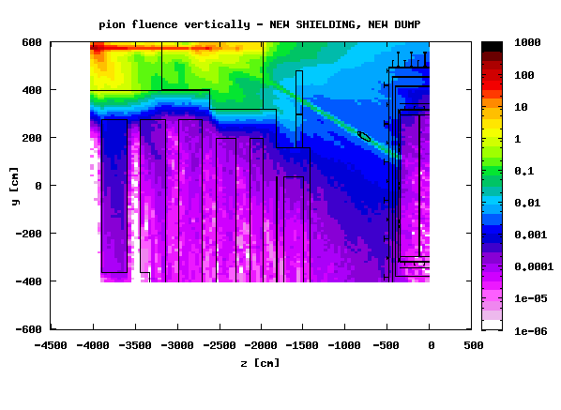
Shielding proposal: results (maps)

Slide 8
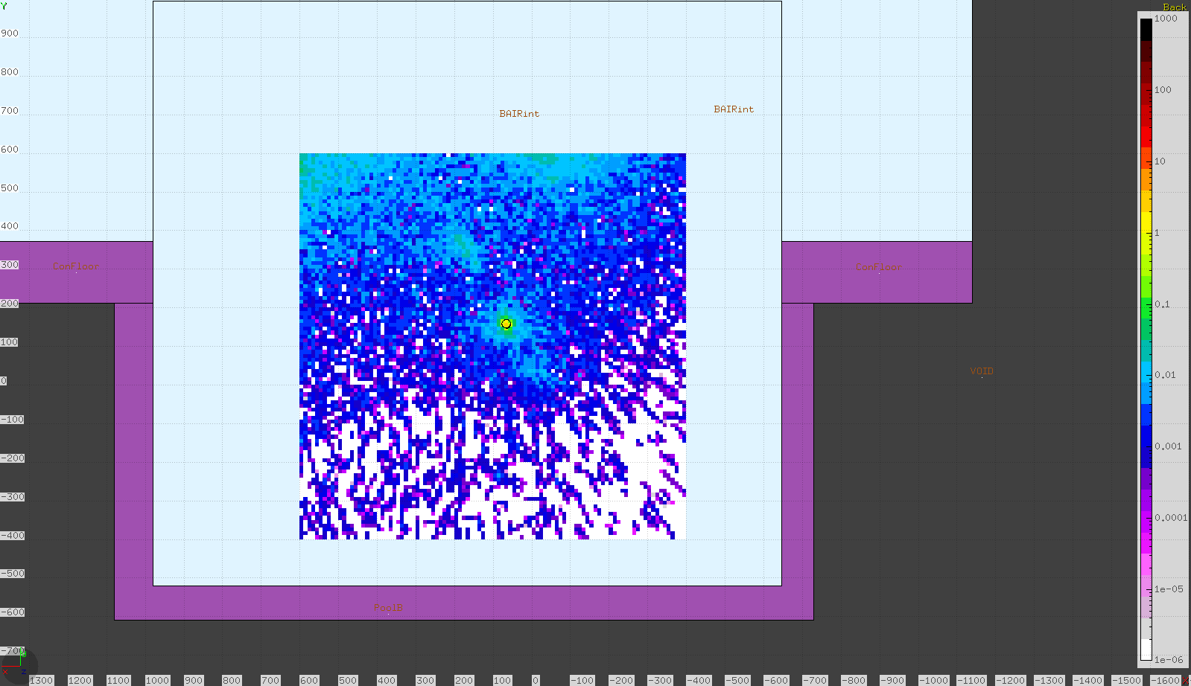
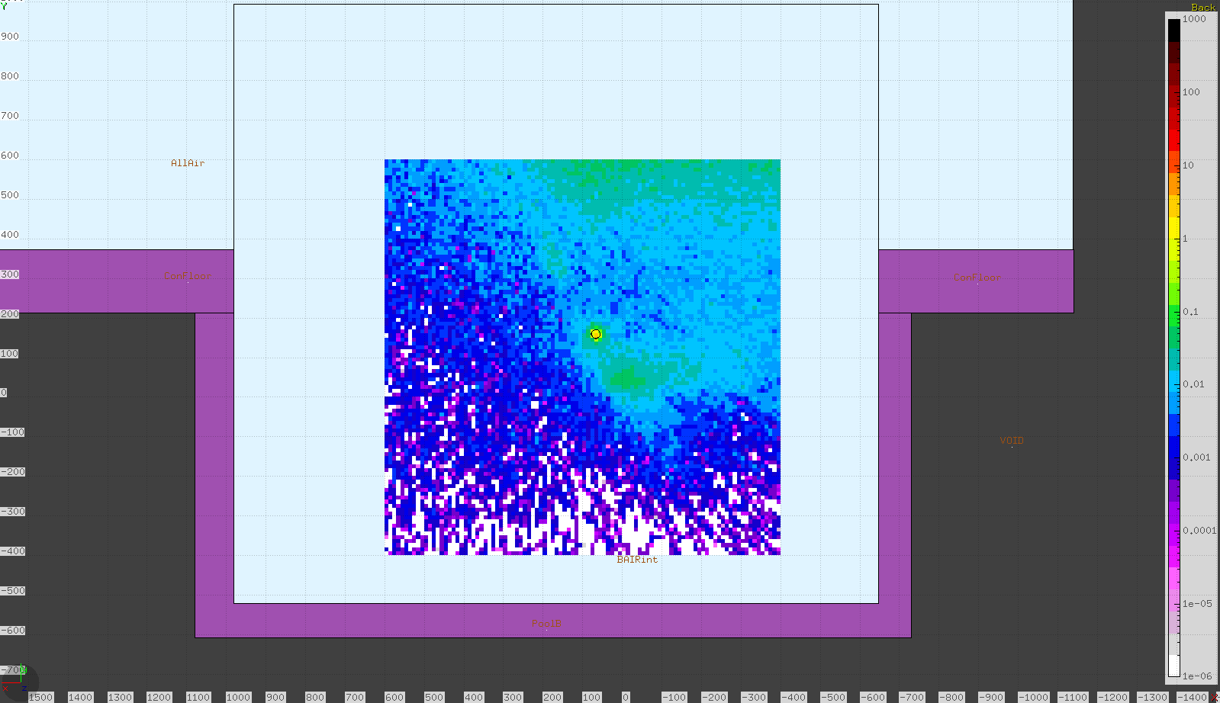
Pions at the cryostat
New shielding
v0
Active LAr surface: 7.2m x 5.9m
Cryostat surface: 10m x 9.7m

Slide 9
Shielding proposal: results
Assuming 10^⁶ particles/spill from the primary target, 4.8 s spill
Calculate total rate of particles at cryostat face and entering LAr active volume – excluding muons from secondary H4 beam - :
NOTE: these are backgrounds from secondary target+tertiary beam line
Muon halo from secondary beam line is not included (see last slide)
NOTE: This shielding proposal is still pending validation by the integration team
Work done in collaboration with CERN Radiation Protection

Slide 10
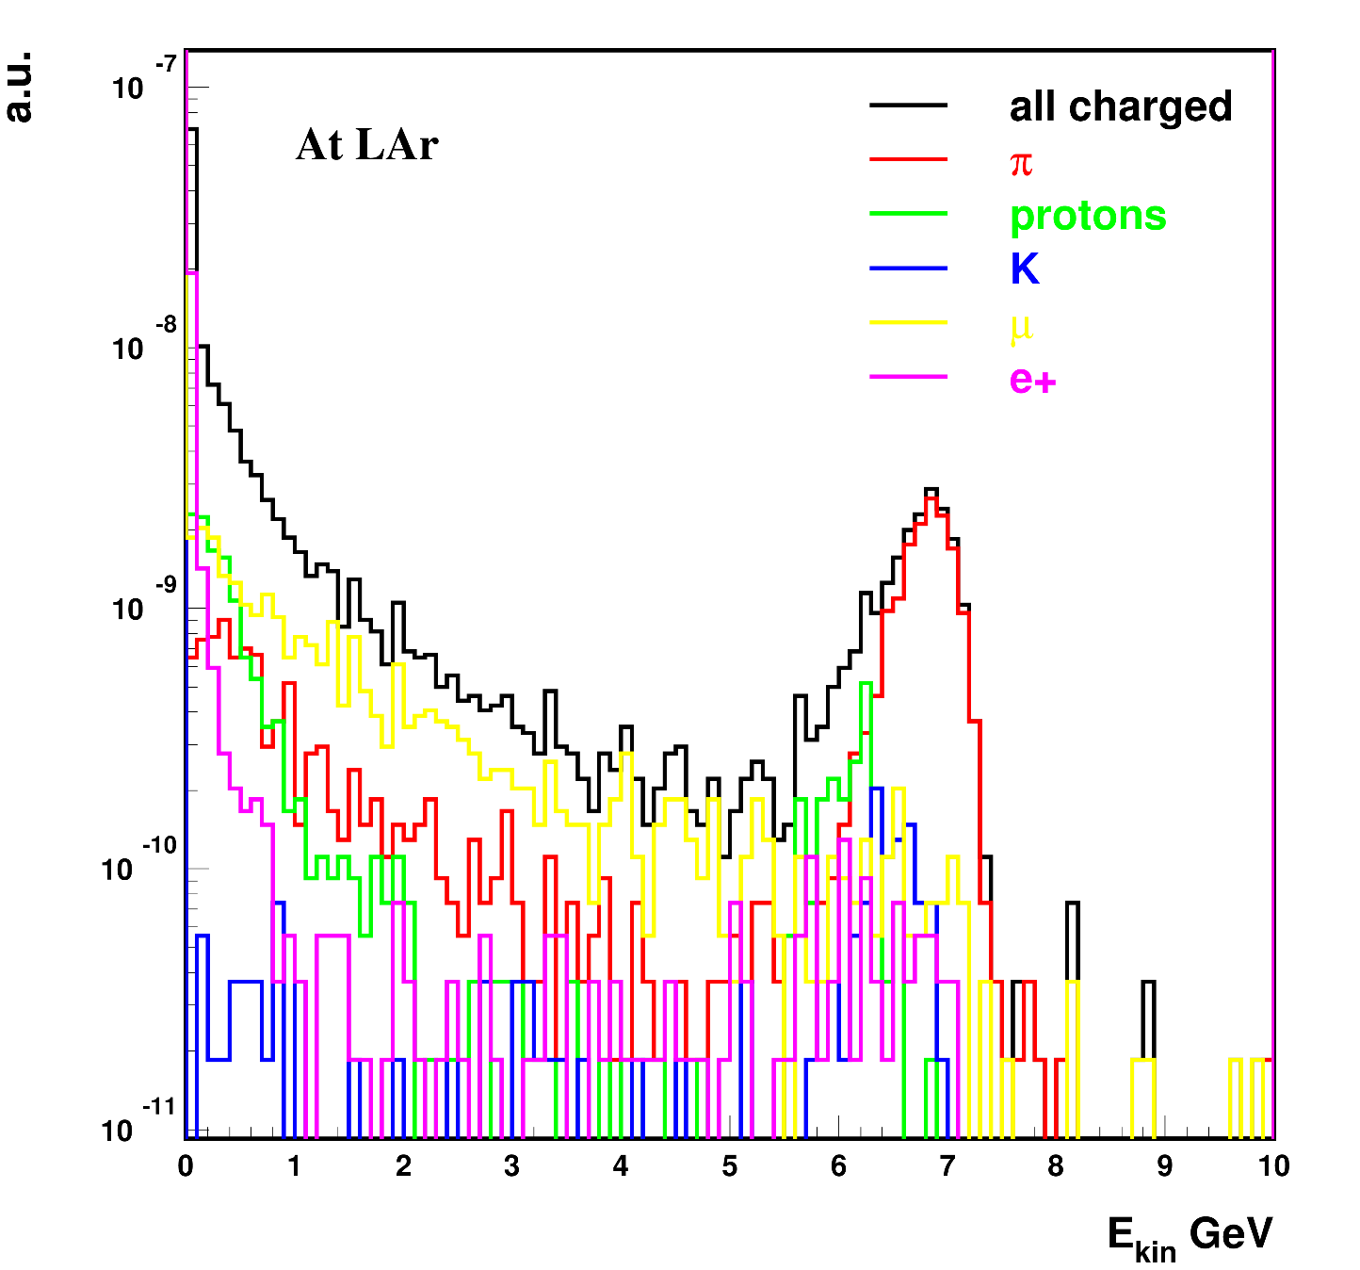
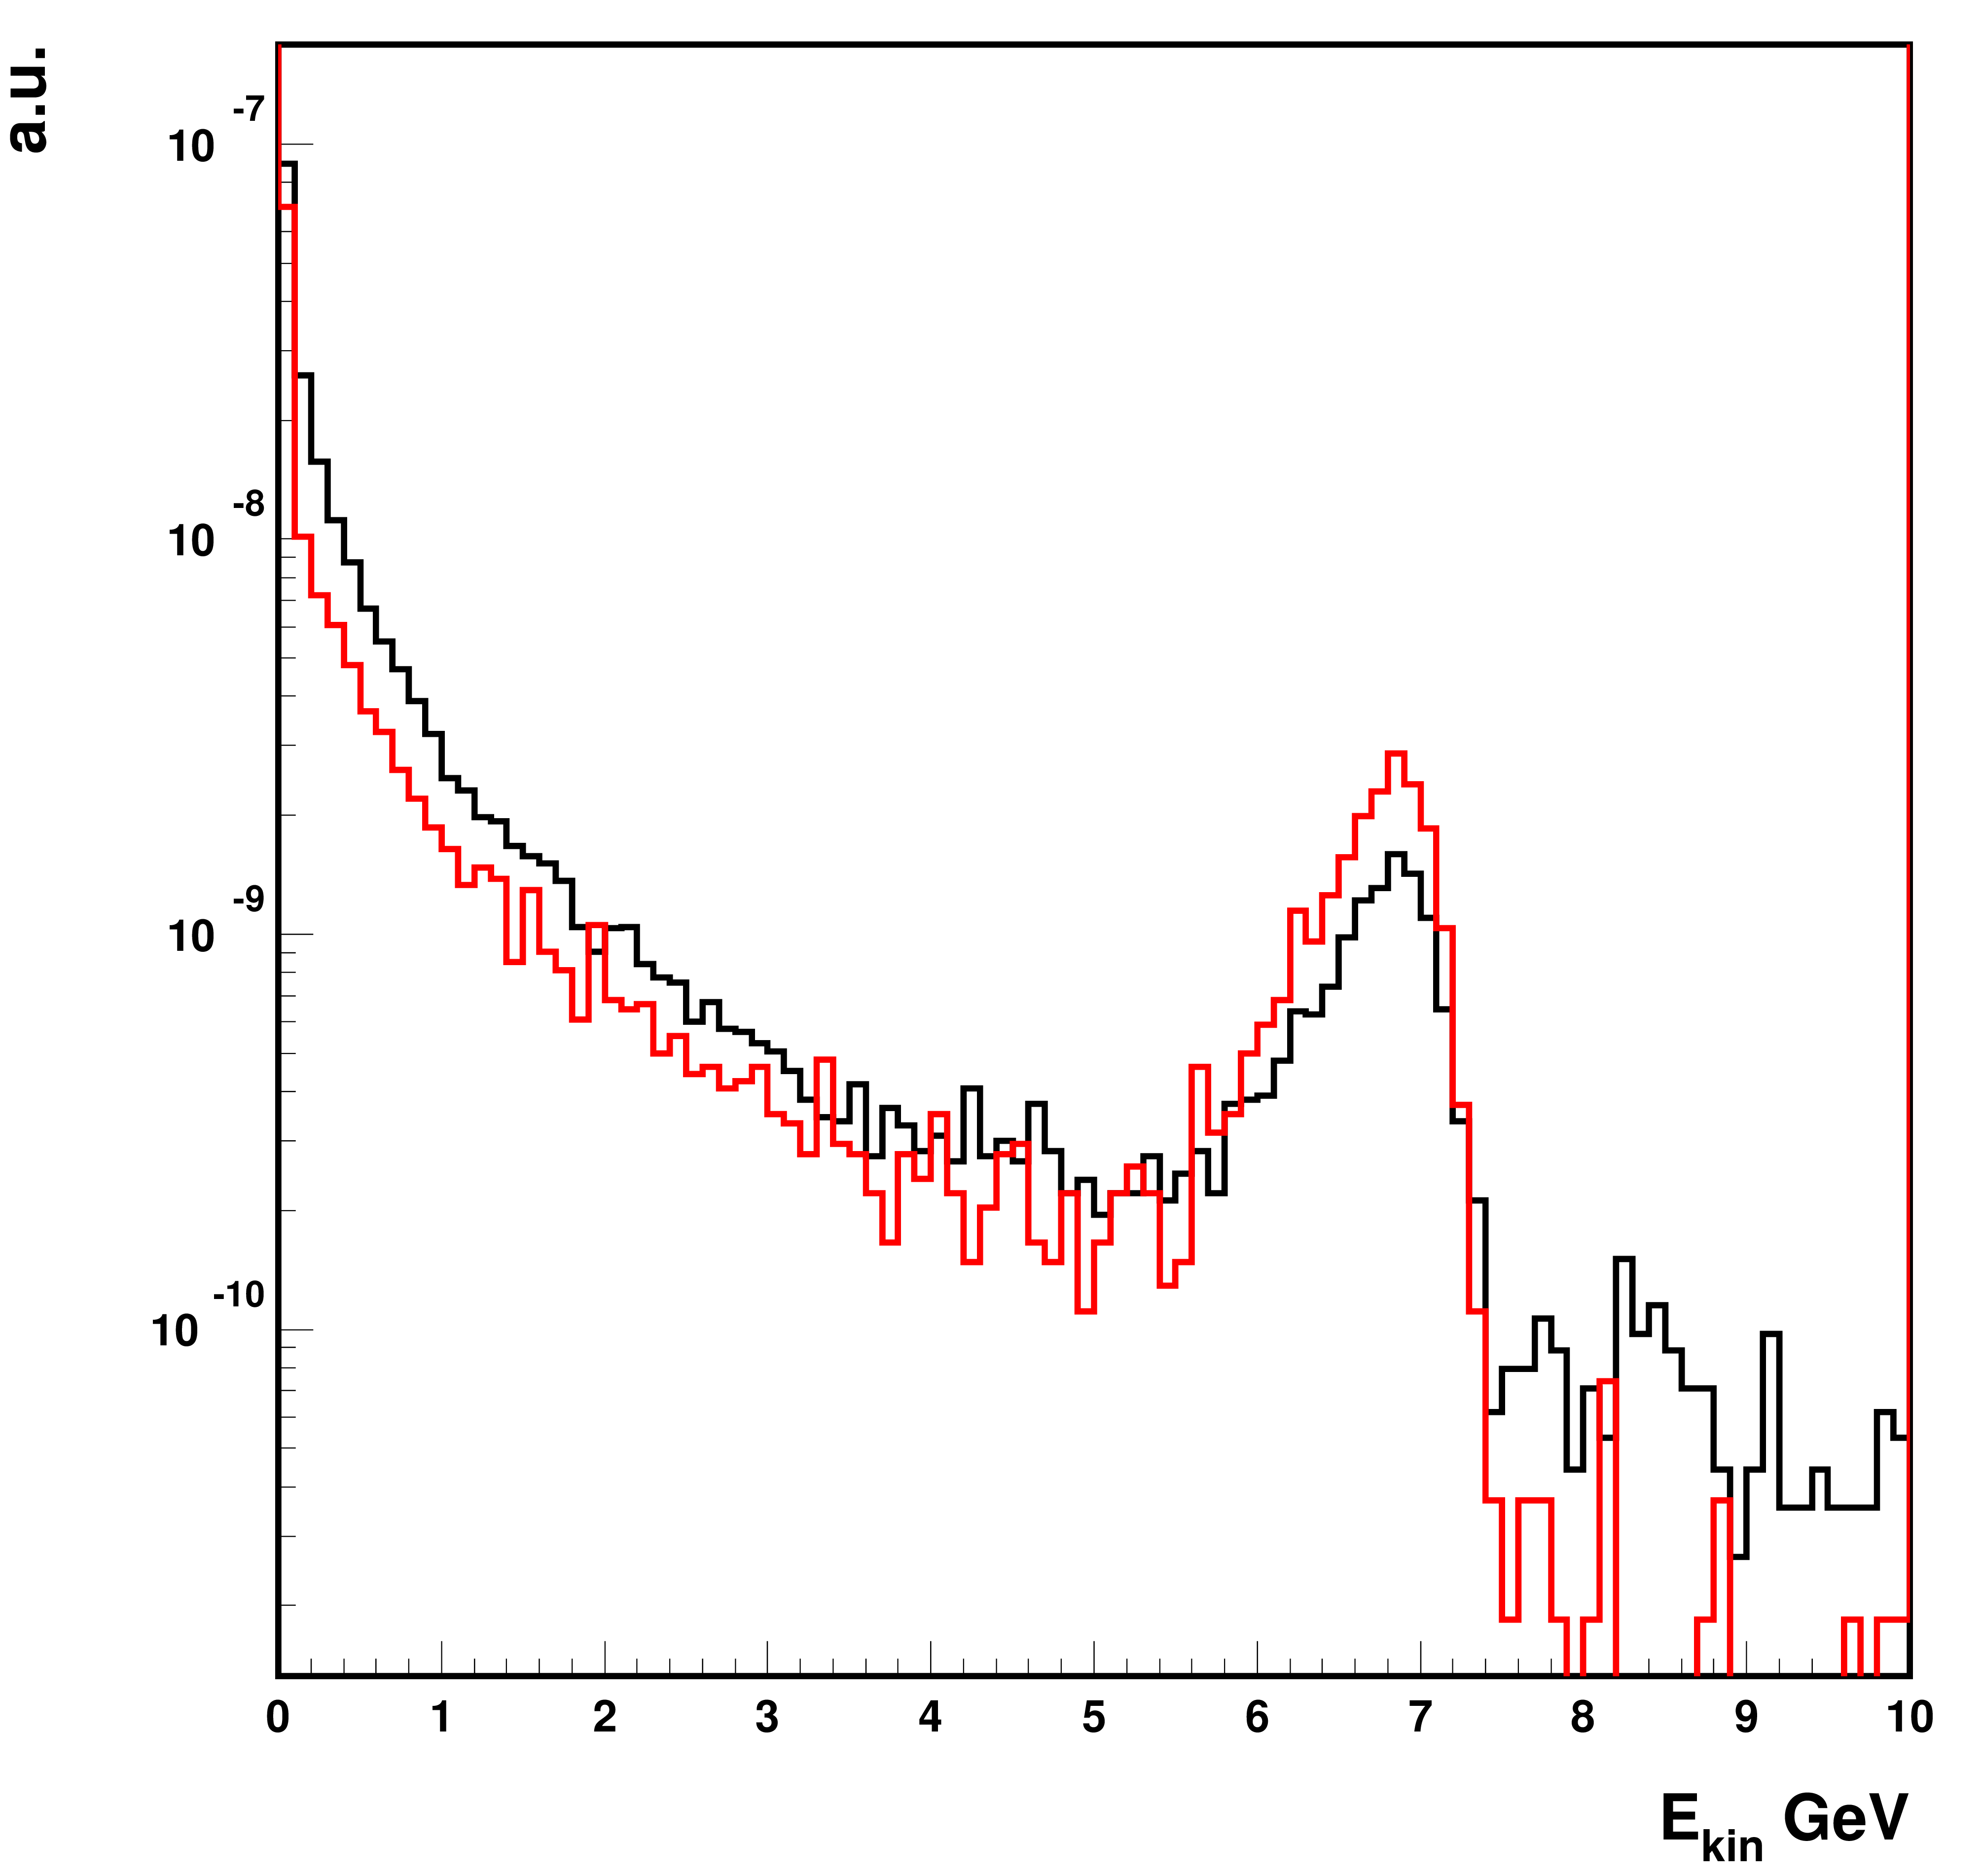
Charged particles, 7 GeV focus
Background is mostly at p<pbeam
50% below 100 MeV kinetic!
Black: at cryo
Red: at LAr
Norm to unit area
High en. tail is at corner of cryo

Slide 11
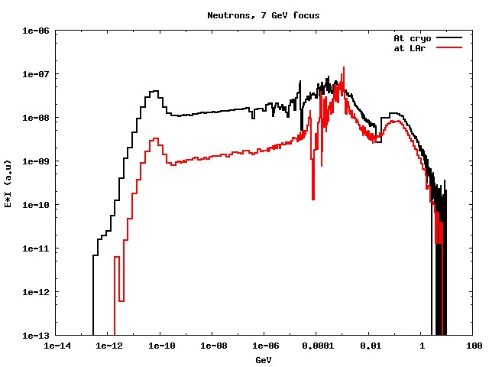
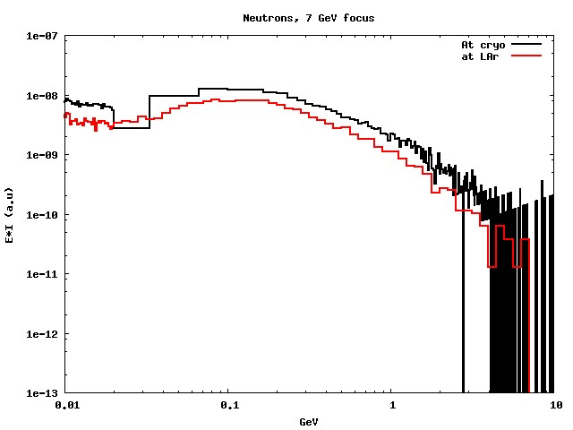
Neutrons, 7GeV
Neutrons: mostly low energy
Insulation is a good neutron shield!
Note extended E-range!

Slide 12
Background: particle rates
At 7 GeV/c focus:
1kHz of all charged particles (background) at the LAr detector – reduction by a factor of 2.4 wrt base layout (v0)
0.5kHz charged background > 100 MeV kinetic
3.38 kHz of all charged particles at the cryostat (reduction by a factor of 2.2 wrt v0)
5kHz neutrons at the LAr (reduction by a factor of 2.2 wrt v0), of which
0.8 kHz above 20 MeV
Photons:
very soft spectrum at the cryo,
Re-generated by charged in the cryo layers
At LAR: 0.5kHz above 100 MeV
Software and reco group will provide feedback

Slide 13
At 1 GeV focus:
Charged particles: 180Hz at LAr, 1kHz at cryo
Neutrons > 20 MeV at LAr 200Hz
Photons > 100 MeV at LAr 8Hz
Larger reduction wrt v0, up to a factor of ~4 for charged particles and neutrons

Slide 14
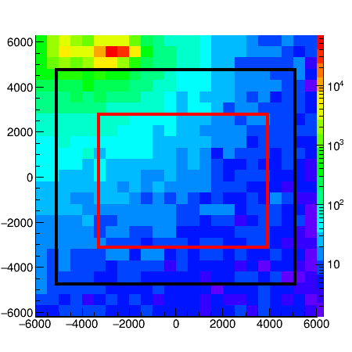
High energy Muon halo
Nikos’ simulations include high energy beam halo from secondary H4
Here: high energy (>4 Gev/c) muon halo in NP04 according to latest G4 beam ntuples
Units are muons/m²/spill
Black : cryo
Red: active LAr -> O 200 Hz PRELIMINARY
Muon detectors will be installed on the cryo front face

Slide 15
Thank you for your attention Questions?

Slide 16
Starting point V0:
Minimal shielding: target area plus beam dump
Total rate of particles entering LAr active volume – excluding muons from secondary H4 beam - :
Charged particles : 0.8-2.4 kHz (depending on focused momentum)
Neutrons : 7-10 kHz BUT: very low energy
Neutrons E>20 MeV : 1-1.5 kHz
NOTE: these are backgrounds from secondary target+tertiary beam line
Muon halo from secondary beam line is not included (see last slide)

