Slide 2
NP02
-Proximity Cryogenics
-Internal piping
Johan Bremer & Michel Chalifour on behalf of Cryogenics team

Slide 3
Proto DUNE-NP02 status
Requirements
Schedule
Installation sequences
Chimneys interfaces
Internal piping
Return of experience

Slide 4
Requirements for NP.02
 | Parameter | Value | Notes
 | GAr purge flow rate | 88 m³/hr | From 1.2 m/hr
 | Maximum cool-down rate TPC | 40 K/hr 10 K/m | T sensors to be defined and placed by Internal Cryogenics/Detector
 | Maximum Delta T between any two points in the detector | 50 K | T sensors to be defined and placed by Internal Cryogenics/Detector
 | Design Pressure | 1345 mbar | Design Pressure
 | Operating gas pressure | 1000 mbar | Operating gas pressure with a cold compressor
 | LAr filling flow rate | 18 l/min | Assuming 2 trucks/day
 | Cryostat static heat leak | 3.0 kW | GAr boil-off (18 g/s)
 | Other heat loads (estimate) | 5.0 kW | Total estimate is ~ 8 kW (50g/s)
 | LAr circulation (5 days turnover) | 1.63 kg/s | Nominal value (1 pump)
 | Max emptying (w both LAr pumps) | 3.2 kg/s | Limited by size of tank/truck
 | Condenser size | 16 kW

Slide 5
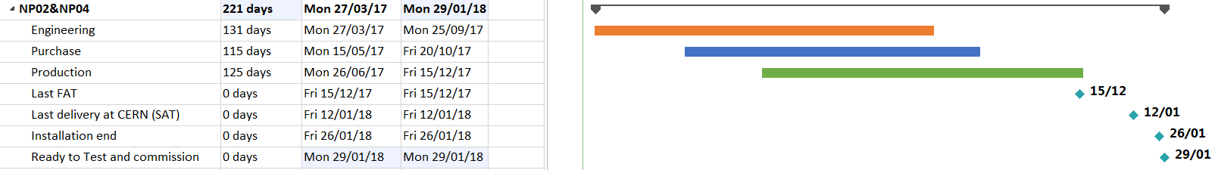
NP02-Schedule Demaco

Slide 6
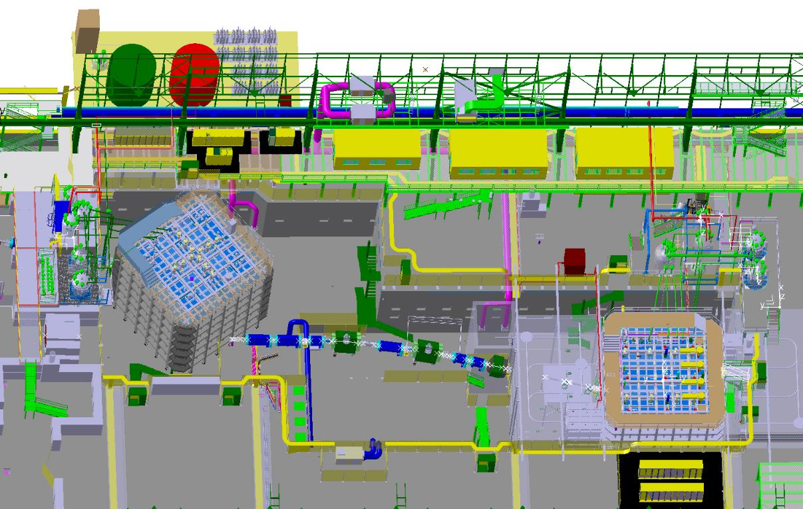
Installation Sequence: Overview
H2 beam
NP-02
H4 beam
NP-04

Slide 7
Installation Sequence: NP-02
March 2017- installed cryostat

Slide 8
Installation Sequence: NP-02
platforms
July 2017- platforms installed

Slide 9
Installation Sequence: NP-02
cable trays and field boxes
September 2017- racks & cable trays
October 2017 – cabling to field boxes

Slide 10
Installation Sequence: NP-02
valve boxes are delivered and installed in a staggered schedule
August-December 2017- valve boxes

Slide 11
Installation Sequence: NP-02
Cold lines
December 2017-January 2018 - cold lines

Slide 12
Installation Sequence: NP-02
Warm valve panel and warm piping
January 2018 - warm lines

Slide 13
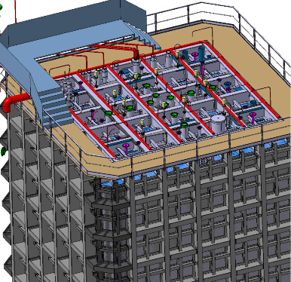
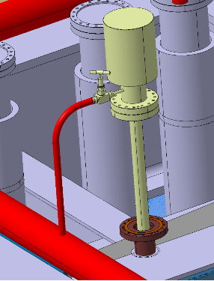
CHIMNEYS manifold Interfaces (artistic view)
Manifold layout and interfaces are still under discussion with the collaboration

Slide 14
Internal Cryogenics – Info
The Internal Cryogenics is a set of pipes and manifolds located inside the cryostat.
Its goal is:
  To distribute the LAr inside the cryostat during fill and LAr recirculation
  To cool down the cryostat and the detector (possible according to the requirements?) with two set of sprayers (LAr/GAr mixture and GAr momentum)
  To remove air from the cryostat prior to the start of the cryogenics operations (argon purge)
  To send the boil-off GAr to the Proximity Cryogenics
  To send the GAr to the Pressure Safety Valve (PSV) in case of a release event

Slide 15
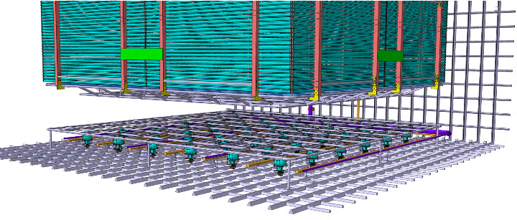

Slide 16
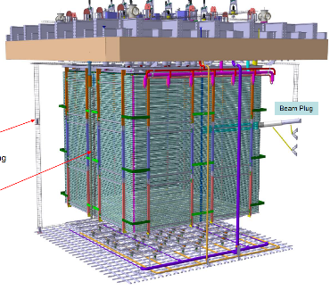
From yesterdays presentation from Adamo:
to discuss how to make the cool-down within the limits given?

Slide 17
Internal Cryogenics – Status
Conceptual Design and location of pipes approved by NP-04. ✓
Contract awarded to Kriosystem: Feb 17, 2017. ✓
Kick-off meeting: Feb 27, 2017. ✓
Preliminary Design in progress.
Current estimated delivery: Jun 16, 2017.
Current estimated duration of installation: 3 weeks.

Slide 18
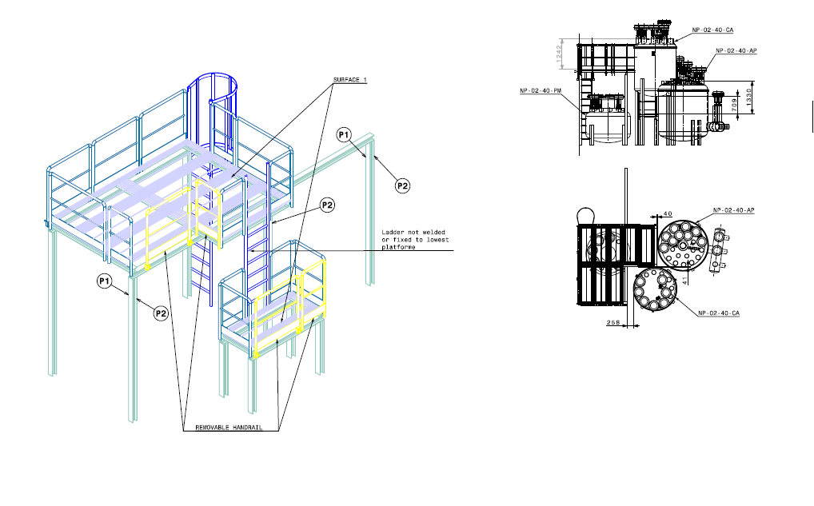
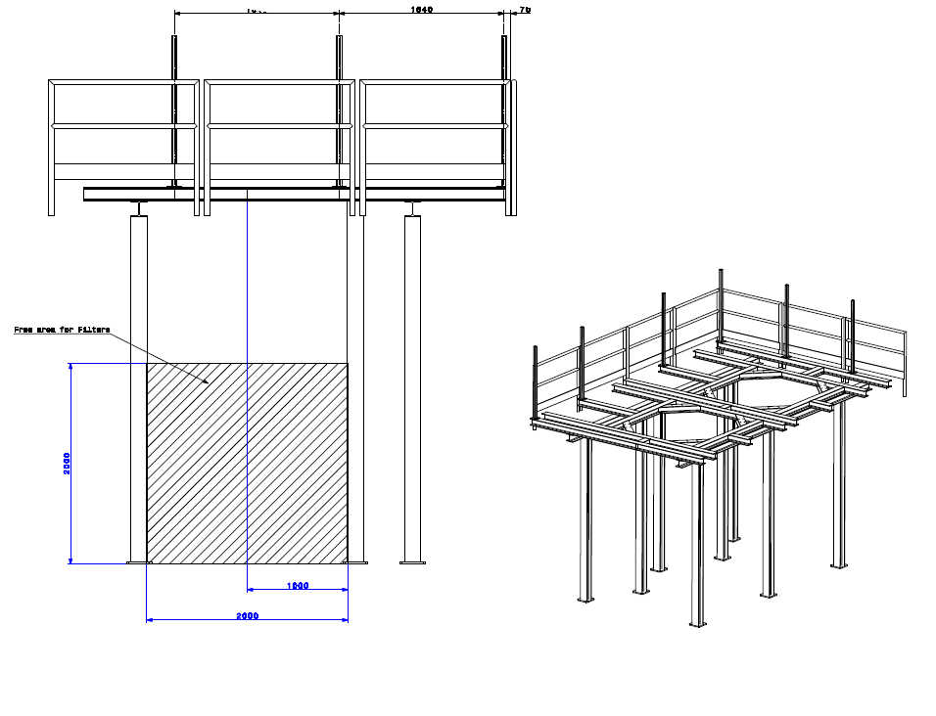
Platforms for the NP02 boxes
For the CVB and PSVB
For the filters boxes
Design is approved
Cable trays and cable laying is following the schedule

Slide 19
Return of Experience of WA 3*1*1
  To go to welds and limit the quantity of gaskets (e.g: interfaces with the chimneys)
  For convenience in EHN1 there are three LAr filtration vessels per cryostat (SP, DP), 1 filled with Mole Sieve and 2 filled with Copper beds in series.
  The initial plan was to regenerate them as a single unit, but it is now possible to regenerate them independently and then place the EH outside the boxes (risk mitigation).
  Consolidate the choice to place a LN2 phase separator at the inlet of the HEX condenser.
  Consolidate the choice to place the cool-down nozzles at the top part of the cryostat.
  Carefully check if there is any obstacle in front of the cool-down nozzles location.

