Slide 1
WA105/ProtoDUNE dual-phase General Meeting
CERN, 22/3/2017
Introduction:
General status and towards the 10 kton
Dario Autiero, IPNL Lyon

Slide 2
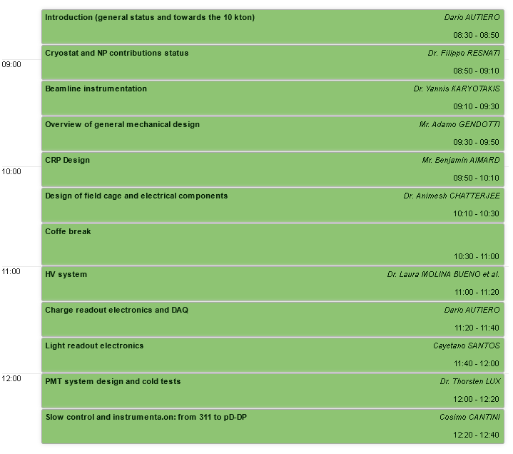
TB session (this morning)

Slide 3
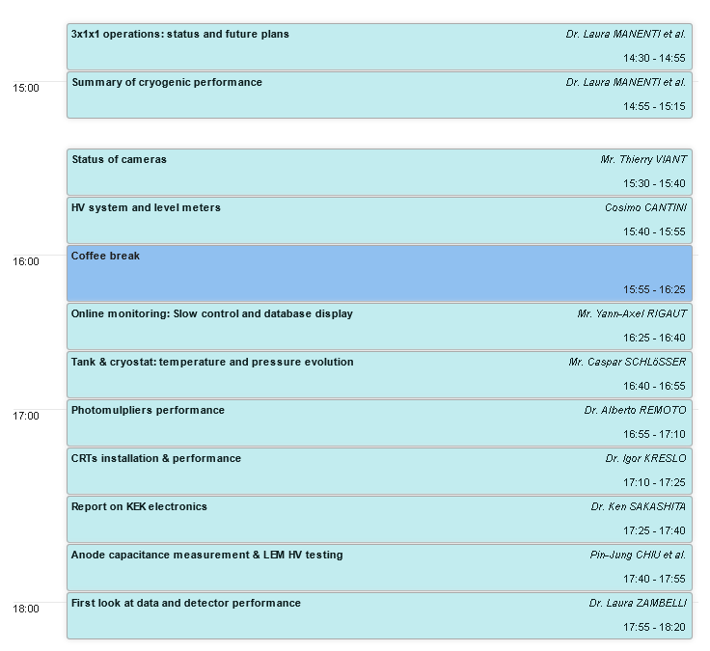
3x1x1 commissioning/operation session (this afternoon)

Slide 4
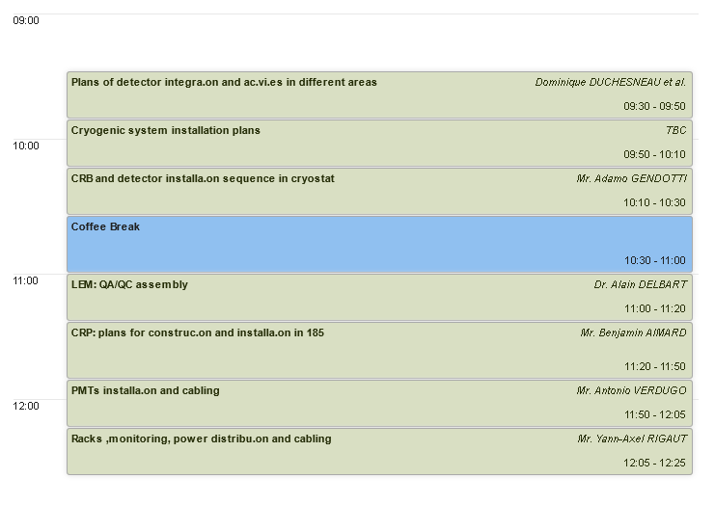
Installation session tomorrow morning

Slide 5
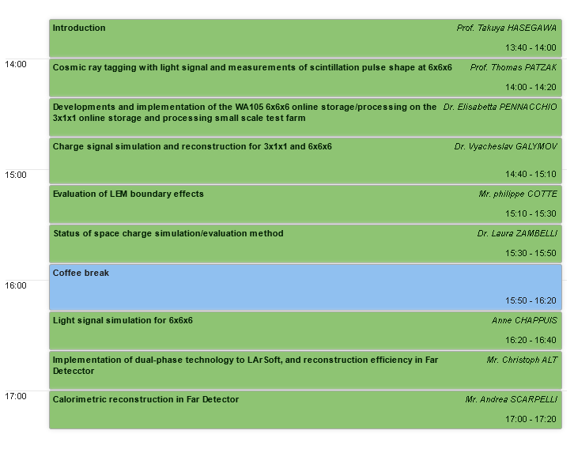
SB session tomorrow afternoon

Slide 6
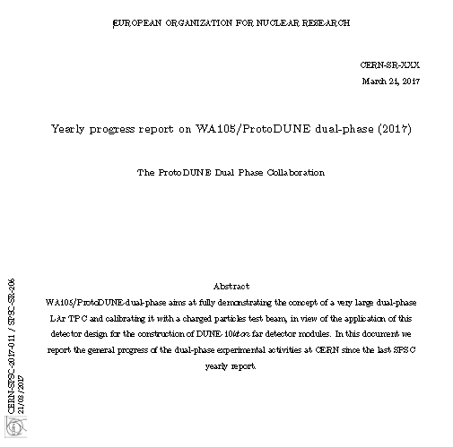
One year of progress documented in the report submitted yesterday to the SPSC annual review of April 4th

Slide 7
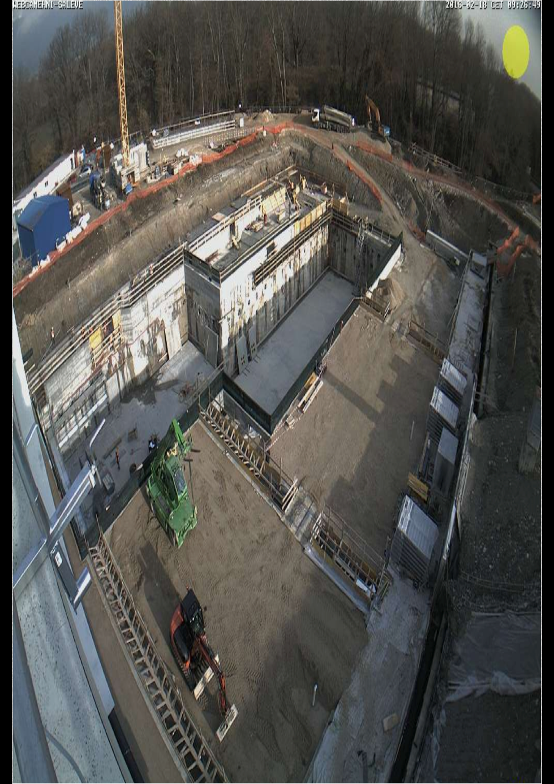
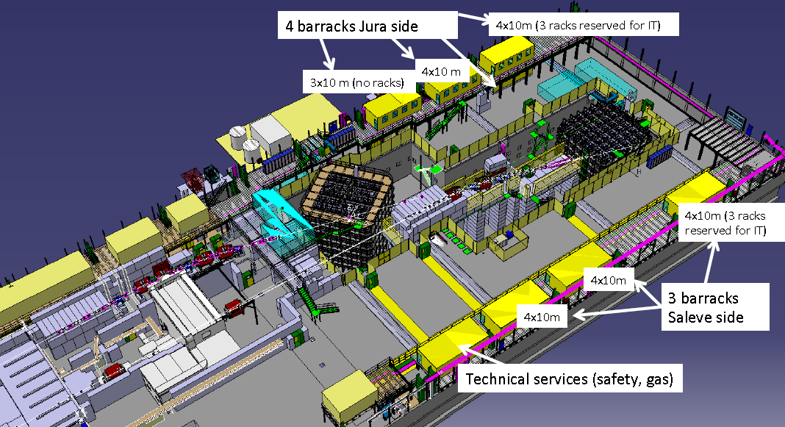
EHN1:
23/2/2016
6x6x6 will be here
March 2016 general meeting

Slide 8
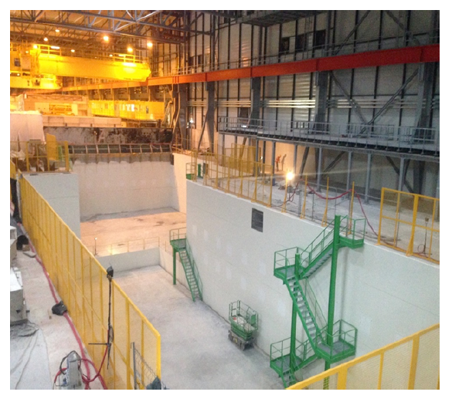
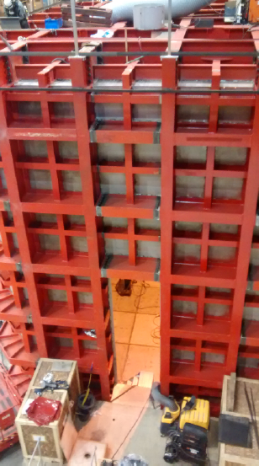
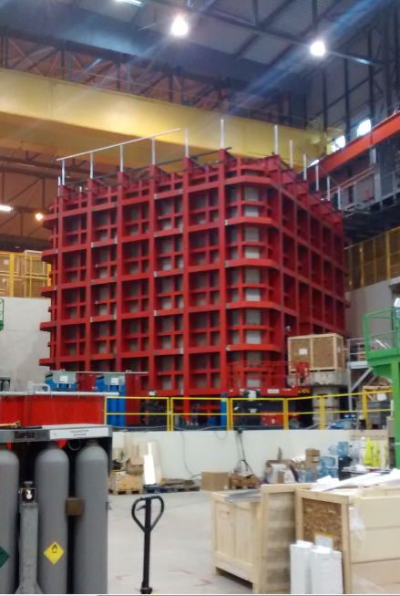
Now: exoskeleton cryostat installation concluded, insulation panels installation started
→ Cryostat should be available for detector installation in June
September 2016
Welcome to Filippo Resnati the recently hired Neutrino Platform technical coordinator who will give the next talk and attend this meeting with us
(with also some news from yesterday on the understanding of the 3x1x1 ice spot formation problem)

Slide 9
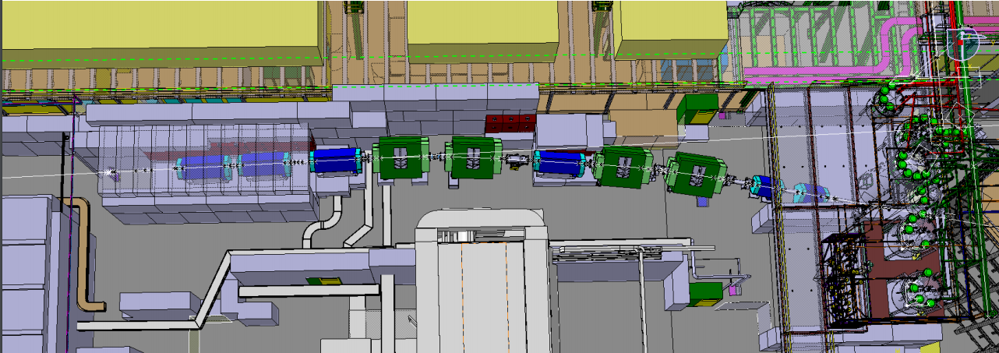
Design of the beamline and of its instrumentation and integration with ProtoDUNE-DP DAQ completed, moved to construction phase (see talk by Yannis)

Slide 10
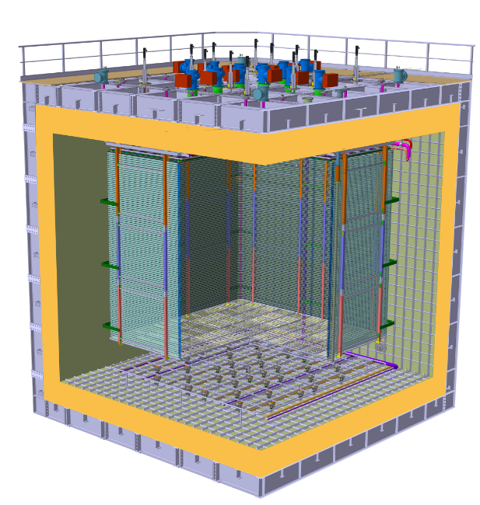
Detector–Cryostat integration
Finalization by the end of November 2016 of executive design of: CRPs, field-cage and cathode (see talk by Adamo)
Charge Readout Planes
6 m
Field Cage (common structural elements with SP)
Cathode
6 m
Full 3D electrostatic simulations completed for HV feedthrough, field-cage, cathode, ground grid

Slide 11
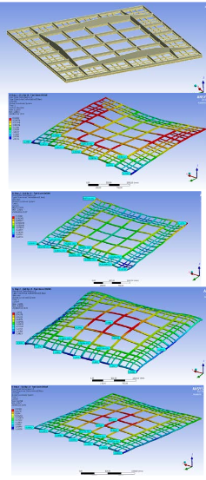
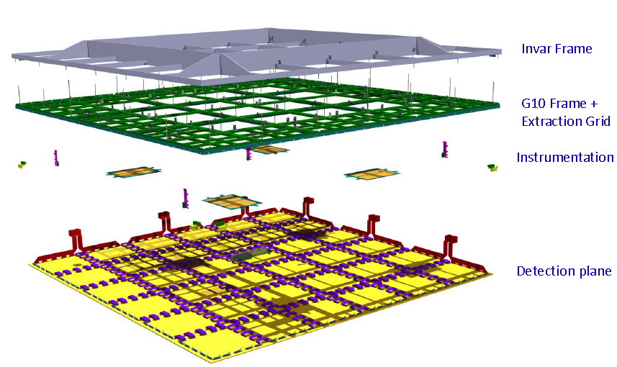
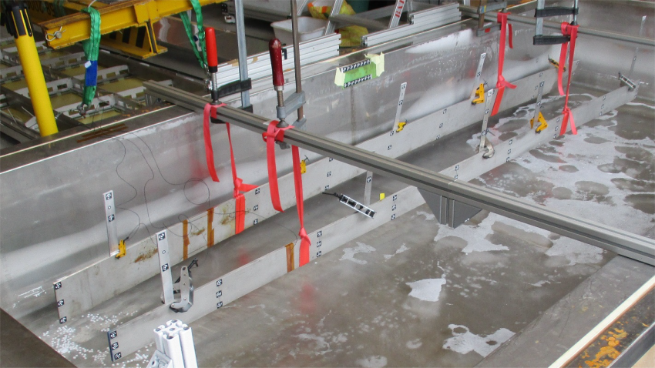
3x3 m² CRPs integrating the LEM-anode sandwiches (50x50 cm²) and their suspension feedthroughs
→ Invar frame + decoupling mechanisms in assembly in order to ensure planarity conditions +-0.5 mm (gravity, temperature gradient) over the 3x3 m² surface which incorporates composite materials and ensure minimal dead space in between CRPs
→See talks by
B. Aimard (CRPs)
CRP mechanical structure design:
→ campaign of cold bath tests + photogrammetry on differential effects in thermal contraction, design of decoupling mechanism

Slide 12
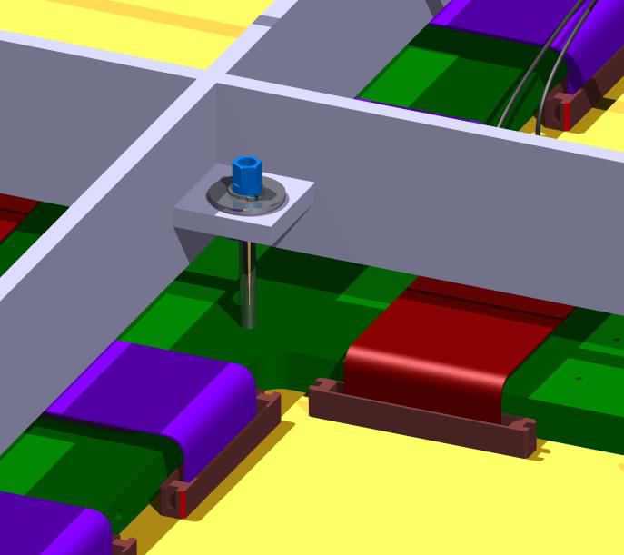
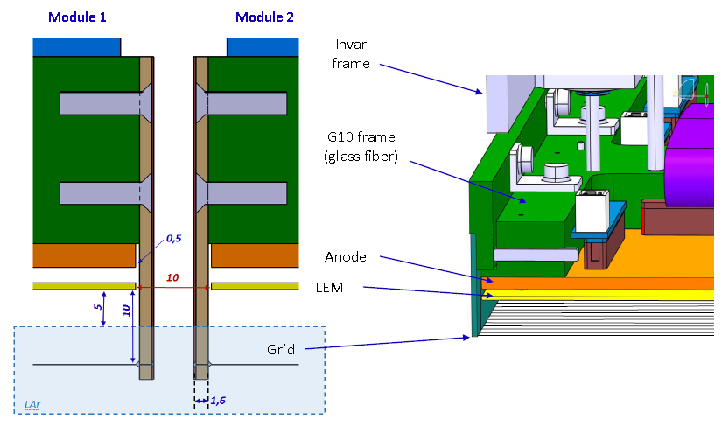
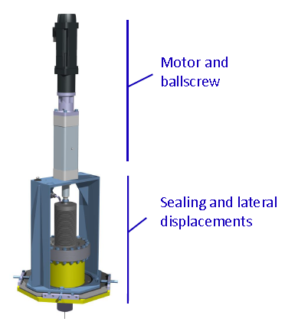
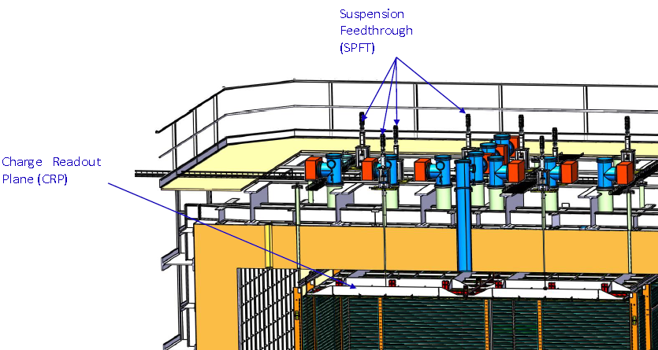
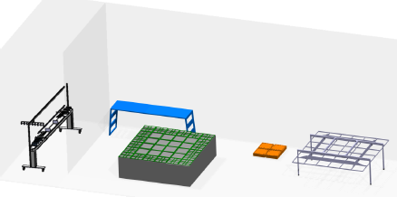
Thermal decoupling supports of G10 frame on invar frame
Integration of the grid of submerged extraction wires in the frame minimizing dead space in between CRPs. Tests for the wires system design
Suspension feedthroughs
Tooling, assembly and installation procedures defined → getting ready for production
CRPs

Slide 13
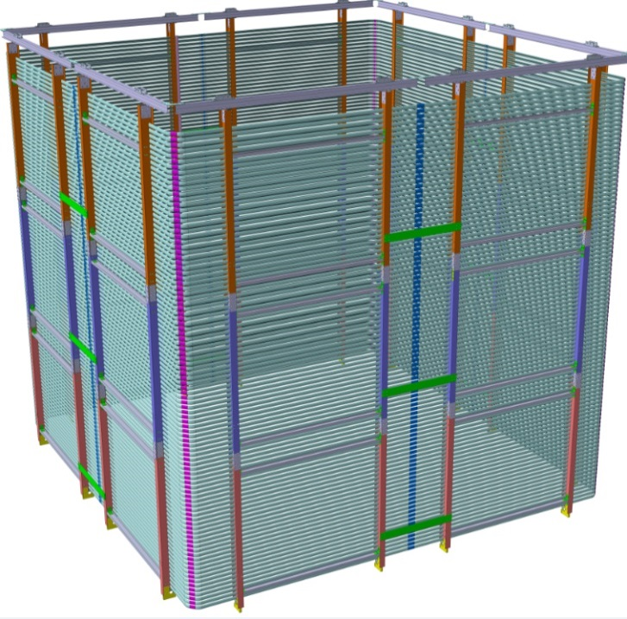
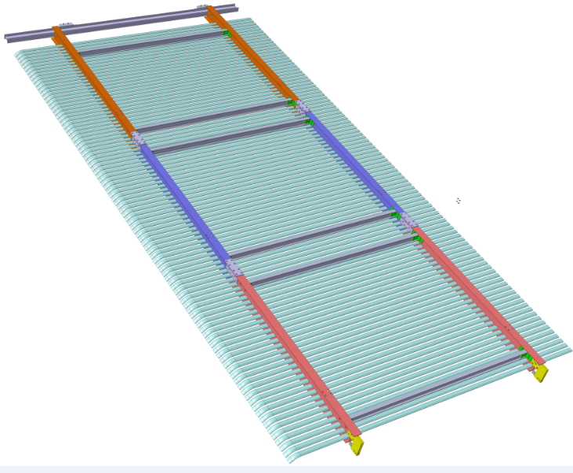
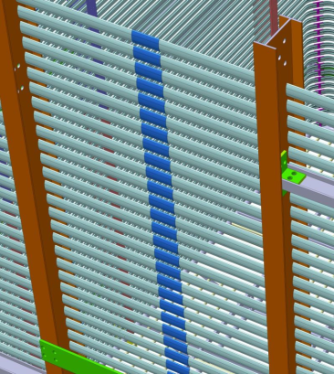
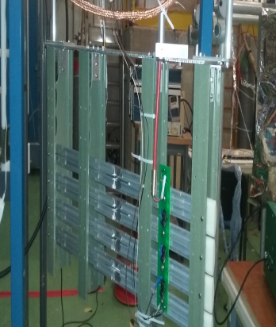
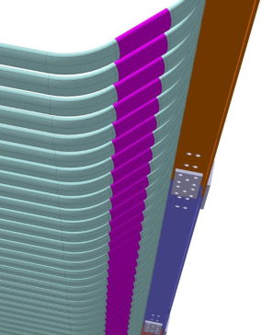
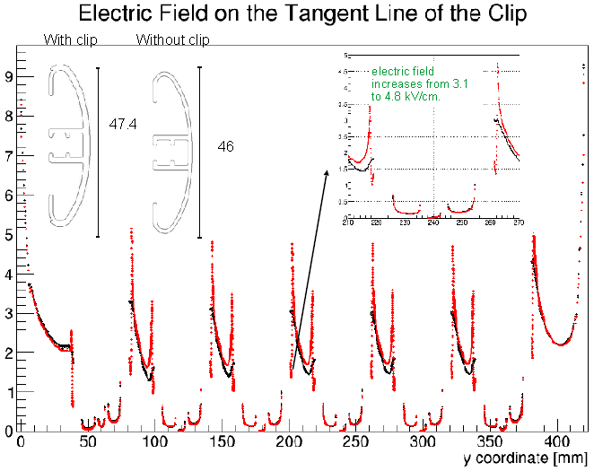
Field cage shares common basic structural elements (extruded profiles and FRP beams) with the single-phase ProtoDUNE (see talk by A. Chatterjee)
Assembled in 8 vertical modules of 6238x3017 mm
(2 modules per detector face).
Each module is assembled out of 3 sub-modules
→ 98 profiles/module with 60 mm pitch
Sub-module 1
33 profiles
Sub-module 2
33 profiles
Sub-module 3
32 profiles + cathode
Continuity at center and borders (bent at 45 degrees) with clipping profiles
Detailed electrostatic simulations performed for profiles/clips
Test setup at CERN for clips and electrical elements
Adaptation from SP beam plug design being finalized

Slide 14
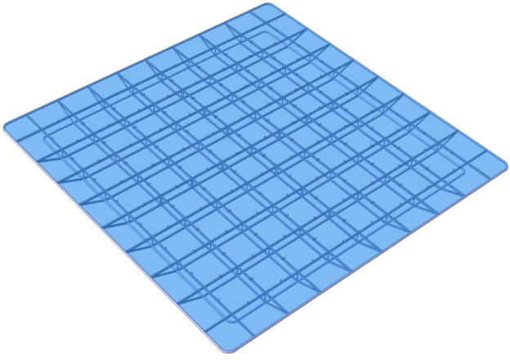
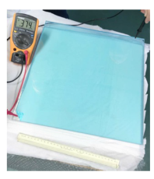
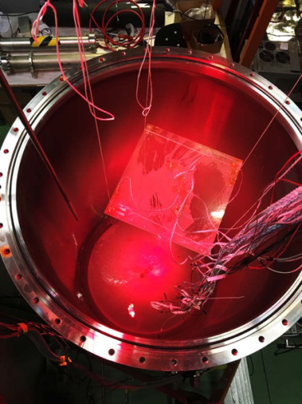
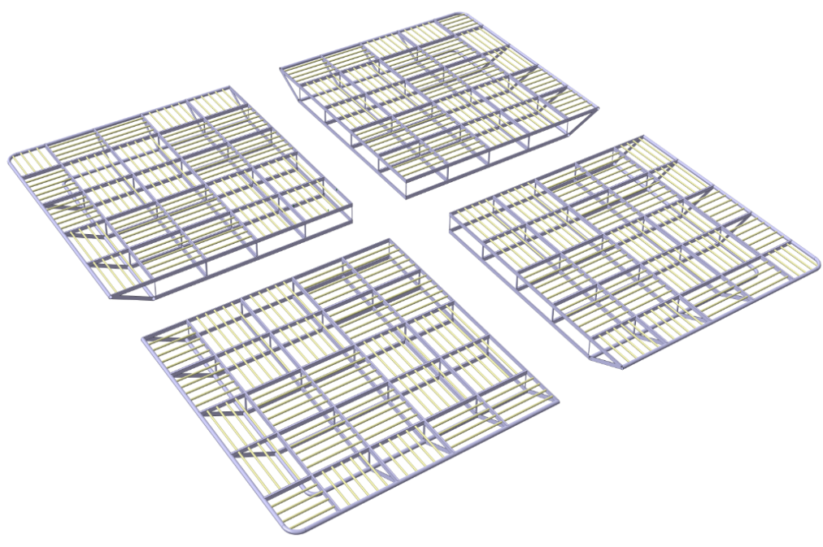
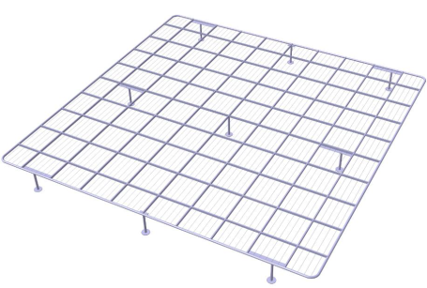
Transparent cathode with ITO (Indium-Tin-Oxyde) resistive coating on two sides of PMMA plates + TPB deposition at the top side:
R&D and conceptual design for plates integration in cathode structure completed
Infrastructure set up for TPB evaporation coating
Tested ITO coated PMMA plates up to 850x600 mm²
(produced by industry) → chosen size 650x650x10 mm³
Transparent cathode
LBNC meeting of October 2016: PMMA cathode, despite all successful R&D, introduces many elements of novelty in the 6x6x6 design and possibly some risks which will not be retired by the 3x1x1 operation
decided to reactivate the baseline design of the cathode, based on a mesh of pipes (extensively studied in the LAGUNA-LBNO DS and WA105 TDR)
Minimal changes to the structure made for PMMA inserting 20 mm SS pipes with 105 cm pitch, completion of executive design, full simulations showing E<30 kV/cm
Ground grid above the PMTs, 2mm wires embedded in a SS frame 40/20 mm pipes, assembled in 4 modules
Cathode in 4
modules

Slide 15
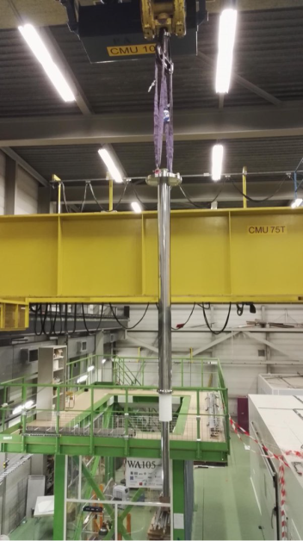
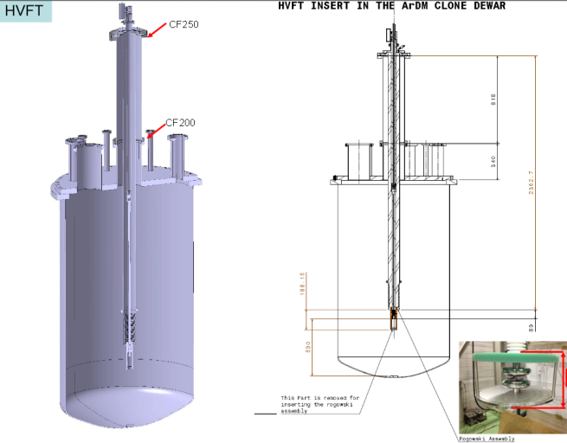
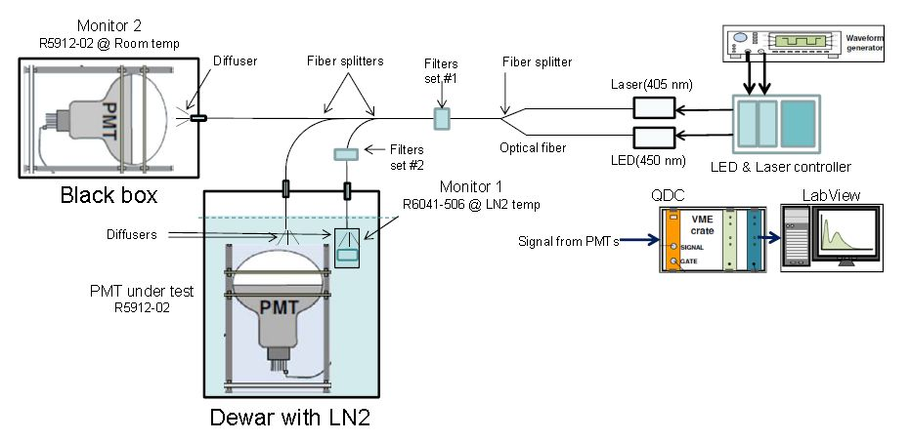
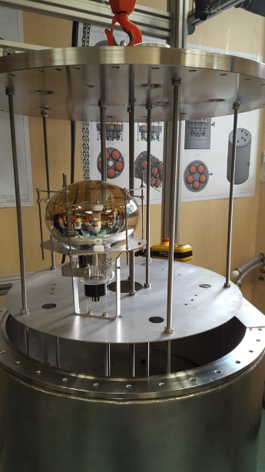
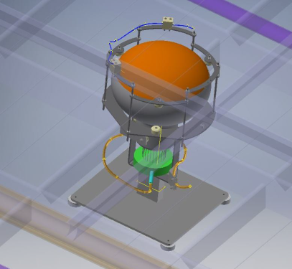
Cathode HV system:
HV power supply for 300 kV already available Heinzinger
HV feedthrough deployed on 3x1x1 but designed to work up to 300 kV (300 kV milestone achieved in September in dedicated test setup, https://arxiv.org/abs/1611.02085.)
(see talk by L.Molina)
Preparation for PMTs installation:
(see talk by T. Lux)
40 PMTs procured in December 2016
Calibration/characterization system at warm/cold
TPB coating at CERN (Icarus facility)
Mechanical supports for installation on the cryostat floor in between corrugations (arrangement compatible with cryo-piping)
Cryostat for test in batches of 10 PMTs
(April 2017)

Slide 16
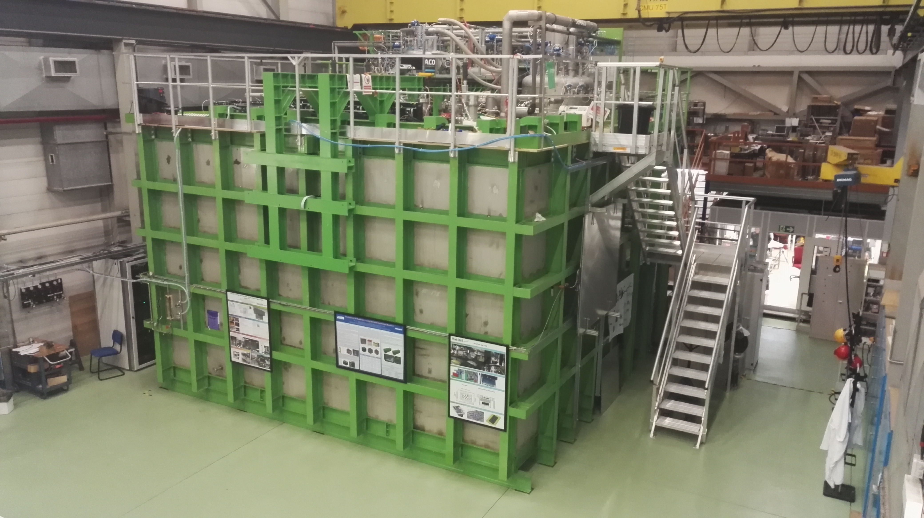
3x1x1 has been a large construction/installation/commissioning effort during this last year
Experience useful to refine the production and installation procedures of the 6x6x6

Slide 17
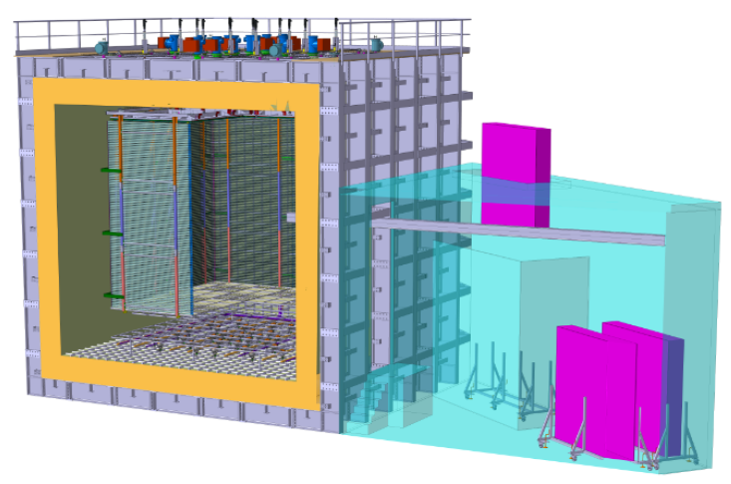
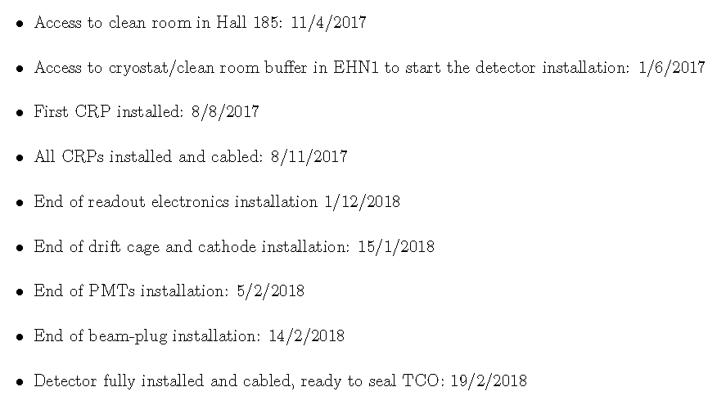
Clean Room in hall 185, used so far by Icarus, is going to be freed by April 11th in order to host the CRP assembly activities
Cryostat+ clean room buffer should become available in June to start the detector installation activities
The installation working group has started to organize the assembly activities (see dedicated session tomorrow)
For the SPSC annual review of April 4th we had a revision of the schedule including the information from the availability of the infrastructure, the detector executive design (CRP, field cage, cathode) which is also related to a more precise definition of the construction procedures and refinements related experience from the 3x1x1
→ end of detector installation in February 2018

Slide 18
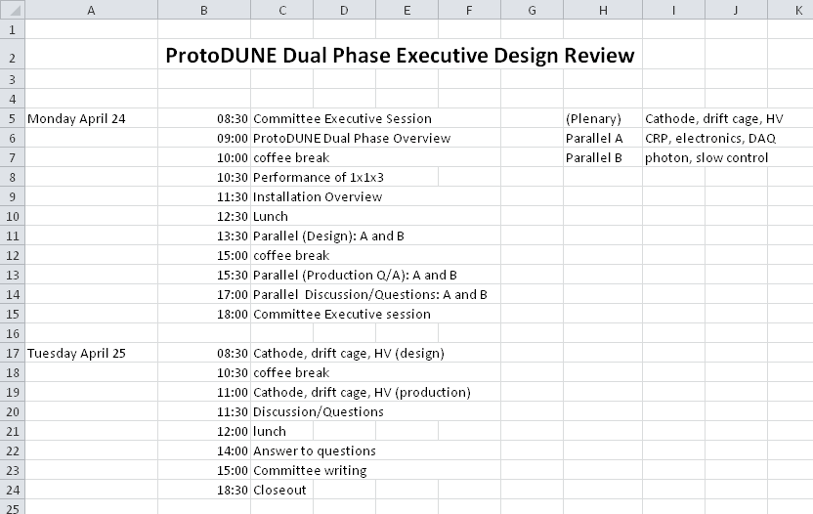
Next step after SPSC review: ProtoDUNE Dual phase executive design review (April 24-25th at CERN, 1.5 days) already foreseen by the end of 2016 and then January 2017 but moved to April due to delay in 3x1x1 cryogenics
Reviewers: Francesco Terranova (chair), Stephen Pordes, Olga Beltramello, Jack Fowler, Terri Shaw, Henrique Araujo, Giovanna Lehmann Miotto
focused on the technical details of the design and readiness for production. Sessions are subdivided in a Design and a Production parts. (LEM, CRP, Feedtroughs, FE electronics, DAQ, drift cage, cathode, HV system, photons detection system, slow control)
See details and schedule shown at last TBs of March 1st and March 15th
(charge document repeated in next page)

Slide 19
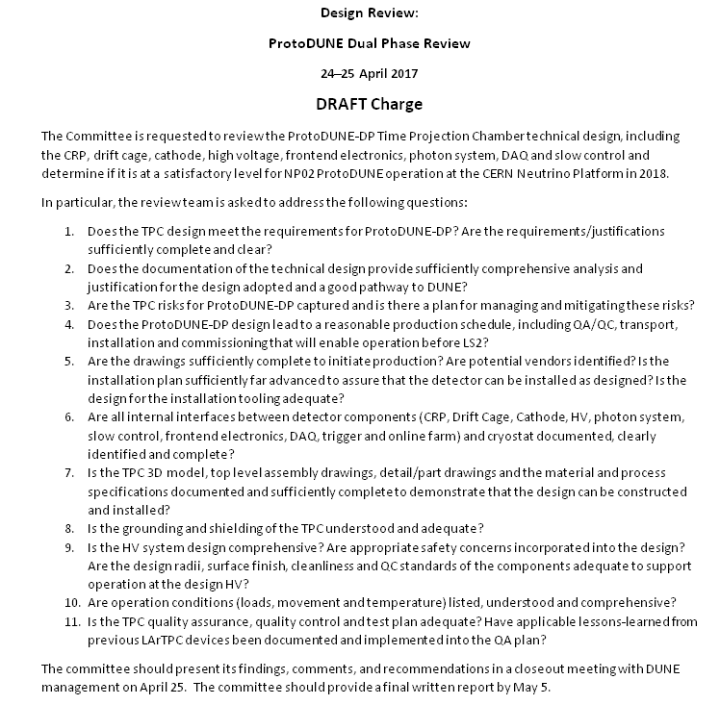

Slide 20
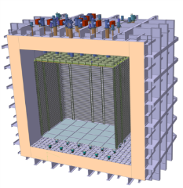
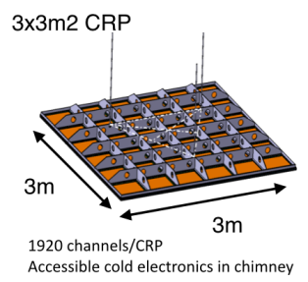
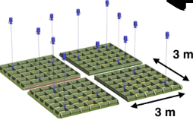
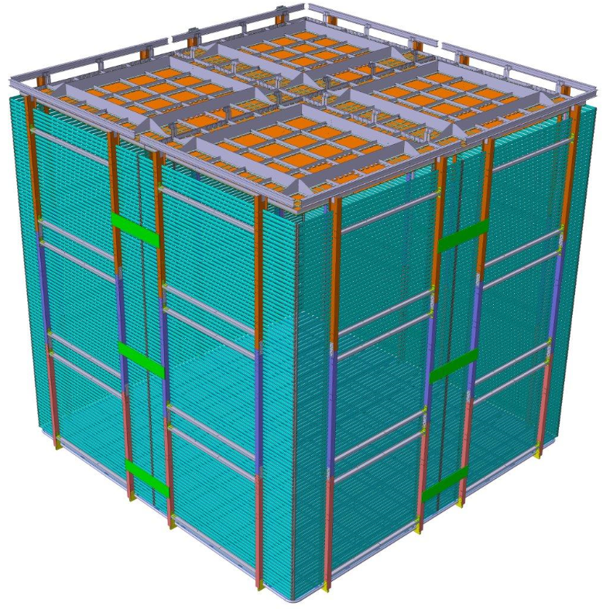
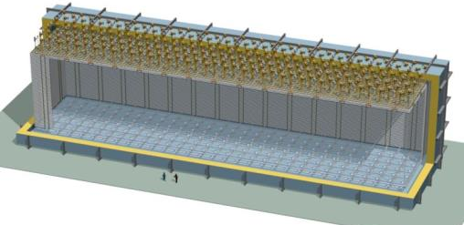
The Dual-Phase ProtoDUNE/WA105 6x6x6 m³ detector is built out of the same 3x3m² Charge Readout Plane units (CRP) foreseen for the 10 kton Dual-Phase DUNE Far Detector (same QA/QC and installation chains)
Further progress in the definition of the installation procedure and connection to LBNF
Work in the direction of the 10kton
CDR+6x6x6 experience → DP TDR (2019)
4 CRP
10 kton: 80 CRP
6 m
12 m
6 m
6 m
60 m
20

Slide 21
EOI process for the formation of sub-detector consortia for the construction of the 10 kton modules and the preparation of the SP and DP TDRs in 2019
Discussed at the January DUNE meeting at CERN
Launched already for the Single Phase and delayed for the Dual Phase by a few weeks waiting for a revision of the strategy for the first two 10 kton modules including also dual-phase
Launching the EOI for the dual-phase should be imminent
Mark has kindly accepted to provide a short update concerning the status of this process (see next slides)

Slide 22
DP Expressions of Interest
Single-Phase EoIs launched in January
  Start defining responsibilities that can be taken to Funding Agencies
  Five areas (consortia) under a FD-SP TB
Technical Coordinator
FD-SP Technical Board
APA Consortium
FC/HV/CPA Consortium
Electronics Consortium
DAQ Consortium
Photon System Consortium
IPO
Dual-Phase EoIs
  Deferred launch of DP EoIs at request of WA105 IB
    There were valid concerns about value of EoIs without a firmer “commitment” to pursuing DP as the second FD module
    Without a stronger commitment, it would be hard to engage with FAs
  We should try to move forward

Slide 23
Planning for second FD module
No quick answer - needed to follow due process
  Also wished to have 2nd Co-Spokesperson in place
Detailed discussion of 2nd FD module will happen as part of DUNE strategy update
  Major topic of Face-to-Face EC meeting on 27th March
  Will also include discussion of decision-making process for first two FD modules
    applies equally to Single-Phase dual-phase
However, we have already moved to a more symmetric treatment of SP and DP
  Committed to producing SP and DP TDRs on same timeline as options for the FD
Committed to further symmetrization

Slide 24
Planning for second FD module
So what can we say today?
  Co-spokespersons support idea of planning for DP to be 2nd FD mod.
    MT and EB discussed this topic last week and are of similar opinions
    Discussed at EC meetings (during last collab. mtg. and on Monday)
    General EC consensus, but still need a full discussion
  The EC needs to agree on precise wording (also applies to SP)
    “DUNE is basing its planning on the assumption that …”
  Need to define the decision process/timetable for 1st & 2nd FD module
    e.g. PD-SP & PD-DP performance and how funding folds in
Timeline (assuming consensus)
  Agreement in principle at the EC meeting on 27/3/2017
    Drafting of strategy statement and sign off in a few weeks
  Ideally launch DP EoIs in parallel with the EC discussion

