Slide 1


Beam Studies
Yannis Karyotakis and Nikos Charitonidis
WA105 general meeting
March 22nd, 2017

Slide 2
The beam for WA105
Requirements /
  Beam momentum ~1GeV to 12 GeV/c, π, K, p, e
  Trigger for WA105
  Particle Id
  Momentum measurement
  Beam profile for beam tuning
  Log and use off-line beam data
Implementation
Use a set of dedicated (material and size) targets Cu, W
3 Scintillator plates & Cherenkov
2 Cherenkov counters and moderate TOF
Spectrometer with 3 position measurements
x,y position measurements at different z values
Use White Rabbit to synch Lar + Beam data

Slide 3
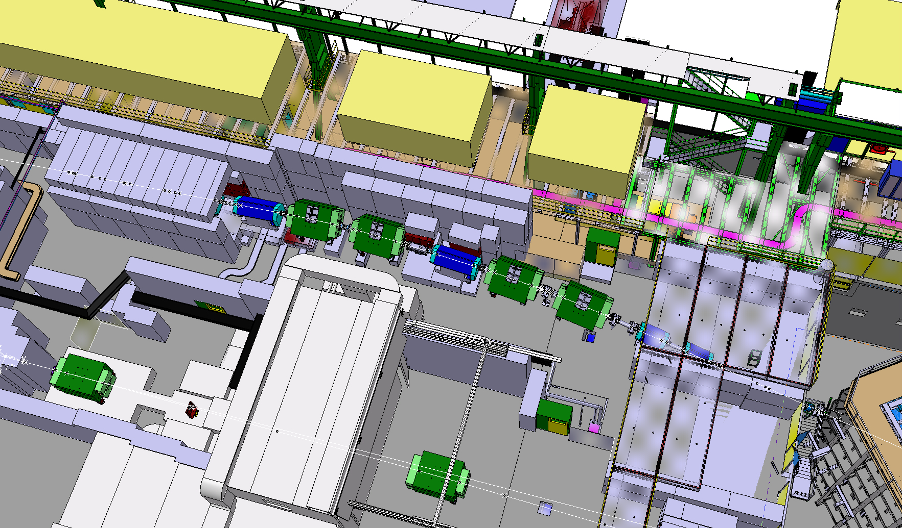
Courtesy: V. Clerc

Slide 4
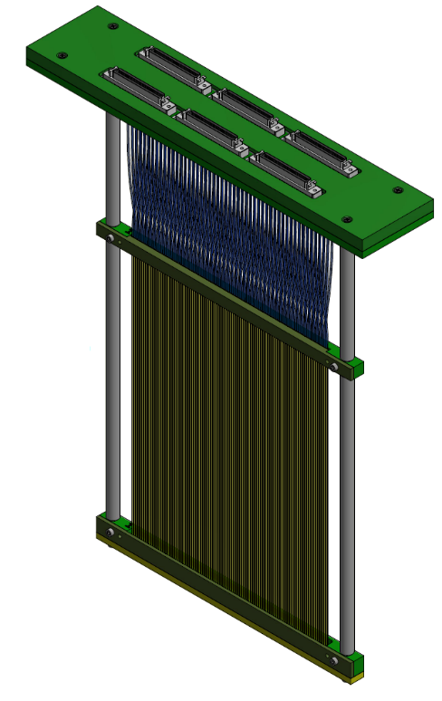
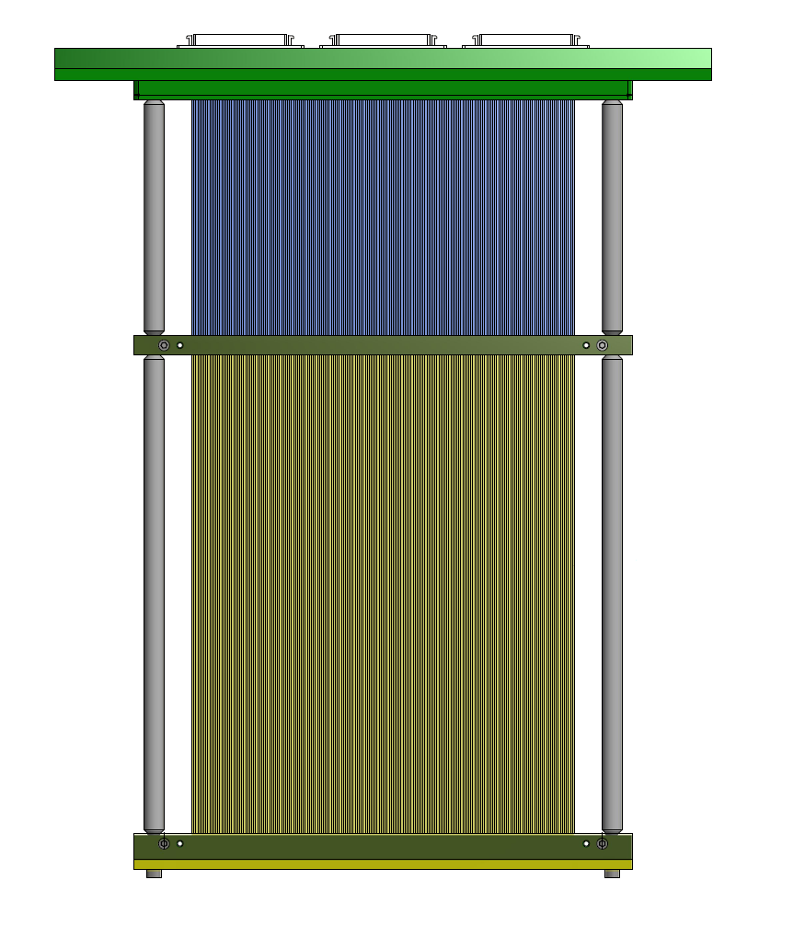
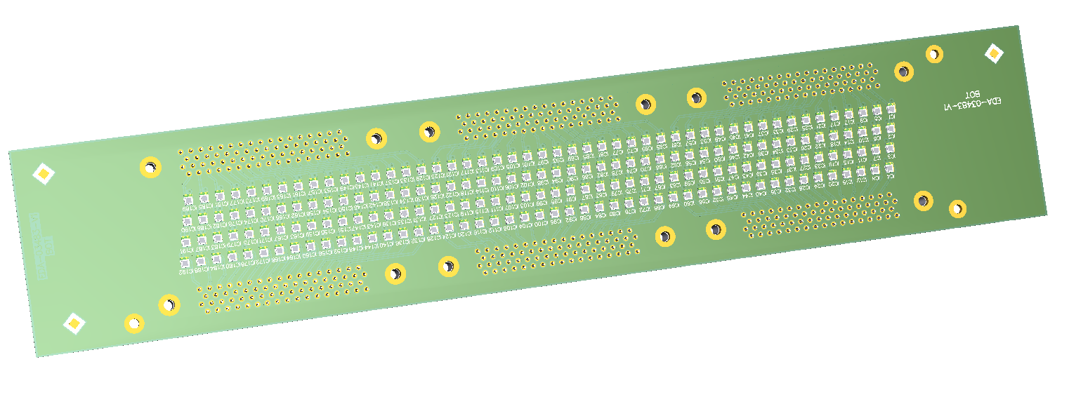
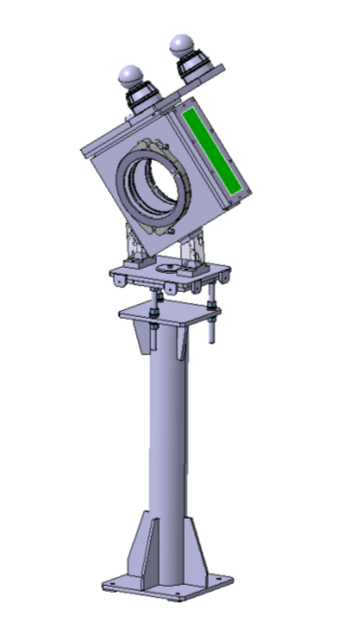
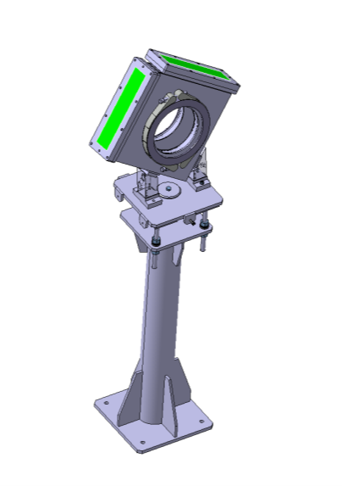
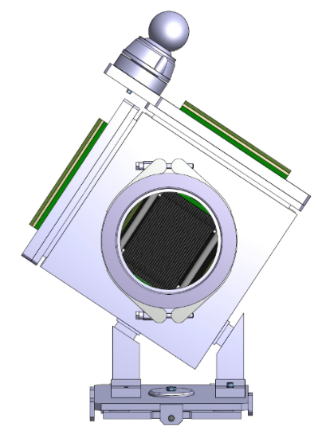
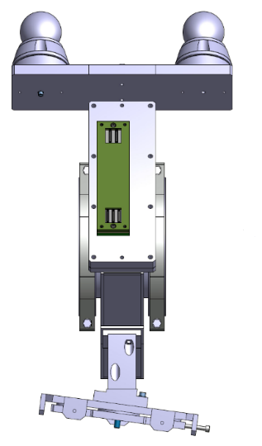
Position detectors based on scintillating fibres read out with silicon photomultipliers.
One layer of 1mm square fibres.
200 channels.
Individual MPPC for every fibre.
SiPM board
Scintillating
fibres
Courtesy: CERN BE/BI & EN/EA

Slide 5
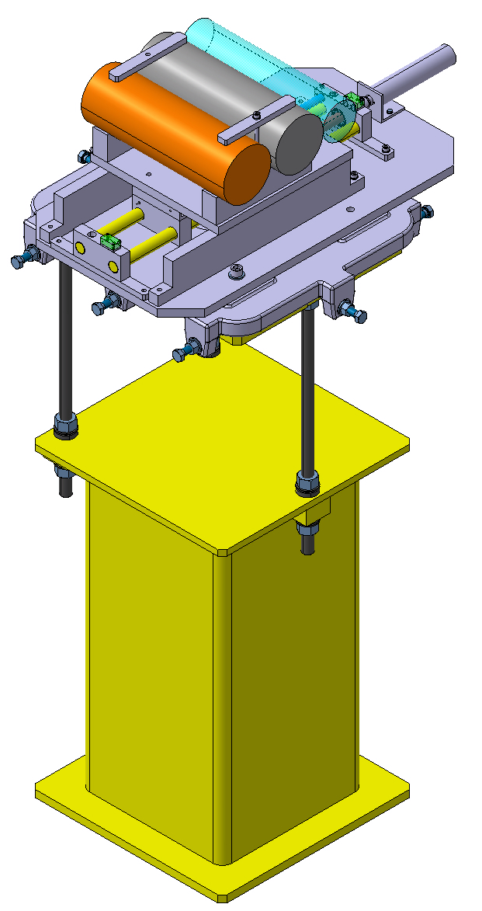
Target station
3 targets (2 hadron and one electron targets)
  → Implementation under study
Horizontal remote configuration
Table / design/ integration by EN/EA, adjusted to the dimensions of the targets for H2/H4.
One of the two targets easily removable if needed (1/2h intervention)
Targets cut in order to easily change the length in order to enchance/suppress several particles if needed.
Courtesy: D. Brethoux

Slide 6
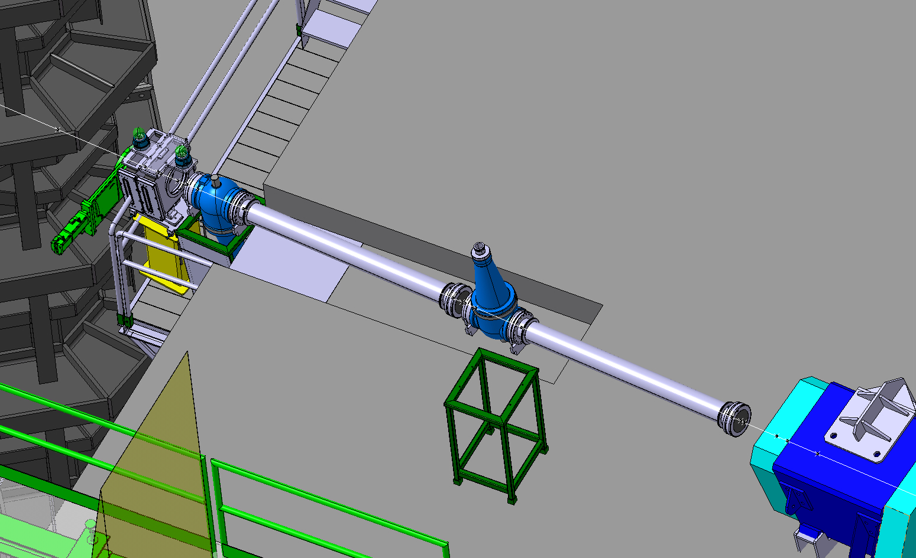

Slide 7
H2 Final PID Schema
TOF with BPROF’s – distance ~32 m
1 “low pressure” XCET - < 3 bar pressure (“C1”)
1 “high pressure” XCET - ≥ 15 bar pressure (“C2”)
No K/p separation between 3 - 5 GeV
No e- tagging in the ‘high energy’ regime 5-12 GeV

Slide 8
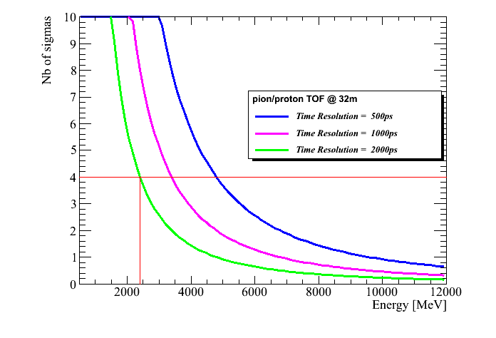
H2 PID Schema – TOF
‘Moderate’ TOF needed
  If σ = 2ns → p/π up to 2 GeV
  If σ = 0.5 ns → p/π up to 4.5 GeV

Slide 9
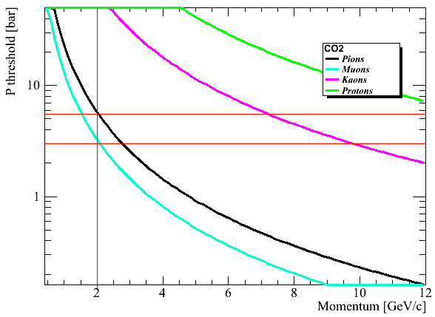
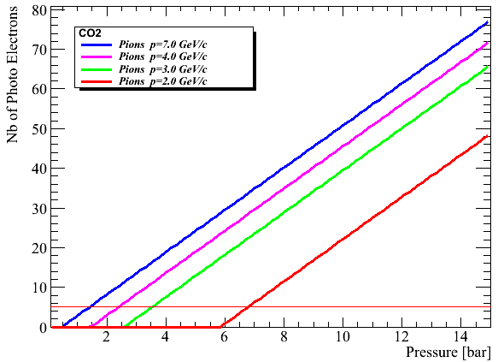
H2 PID Schema – XCET – Only CO₂
1 high and 1 low pressure XCET
p/π from 2 GeV – C2 @ 6-7 bar
p/π from 3 GeV – C2 @ 3.5-5 bar
5 p.e

Slide 10
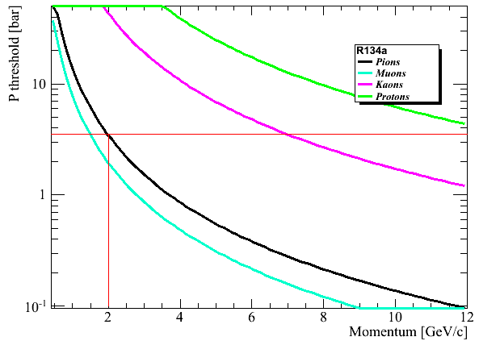
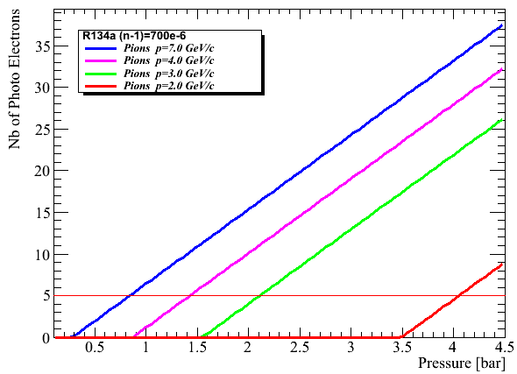
H2 - If TOF fails – Backup solution with R134a
If TOF fails then we can ‘salvage’ with R134a :
p/π from 2 GeV – C2 @ 3.5 – 4 bar
T > 30 deg (cover of the gas system)
Maybe R134 (not “a”) could be tested in May @ T9 ?

Slide 11
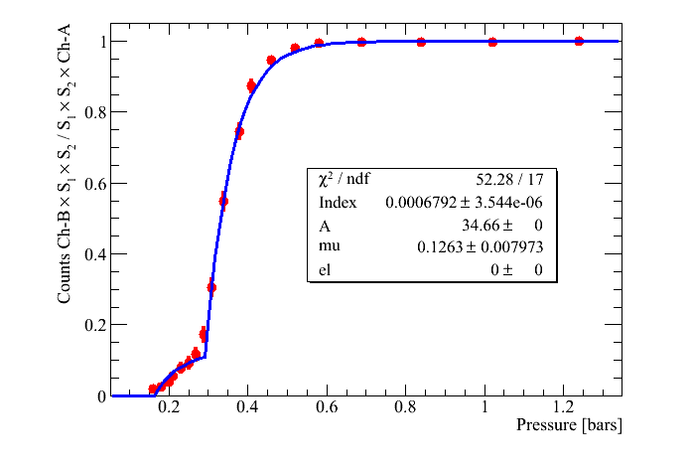
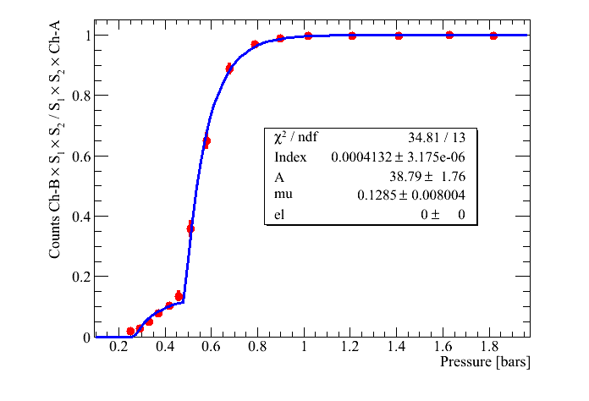
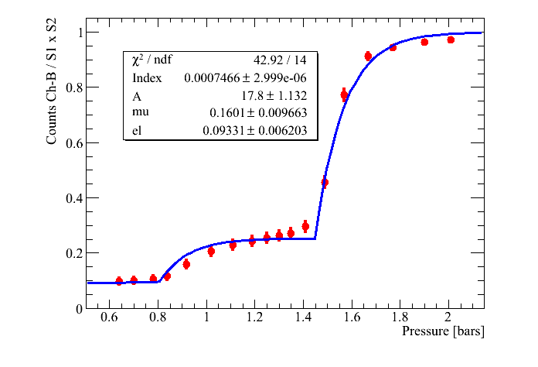
Estimating the R134a index
7GeV/c
Ch-B filled with R134a
Dedicated experiment at PS, T9, November 2016
Scint 1,2
Both Cherenkovs filled with CO₂ n-1=425×10⁻⁶
R134a n-1=700×10⁻⁶
-3GeV/c e- enhanced target

Slide 12
Hardware status
CERN BE-BI and EN-EA groups are responsible to produce the detectors, and provide the data
  Cherenkov needs all decided, green light to produce and install
  Position monitors : mechanics ok, electronics under development, 1st prototype Sept 2017, test on beam Oct 2017.
  TOF same mechanics as position monitors, dedicated electronics and DAQ
  Install electronics barrack
WA105 responsibility
  Build the trigger
  Install a dedicated TOF electronics
  Beam data handling
  Aim to install the system by fall 2017 for a fake beam test

Slide 13
Improved G4BeamLine simulation
Exact beam layout implemented, tilted magnets, …..
Included all shielding in place
Background characterization and shielding

Slide 14
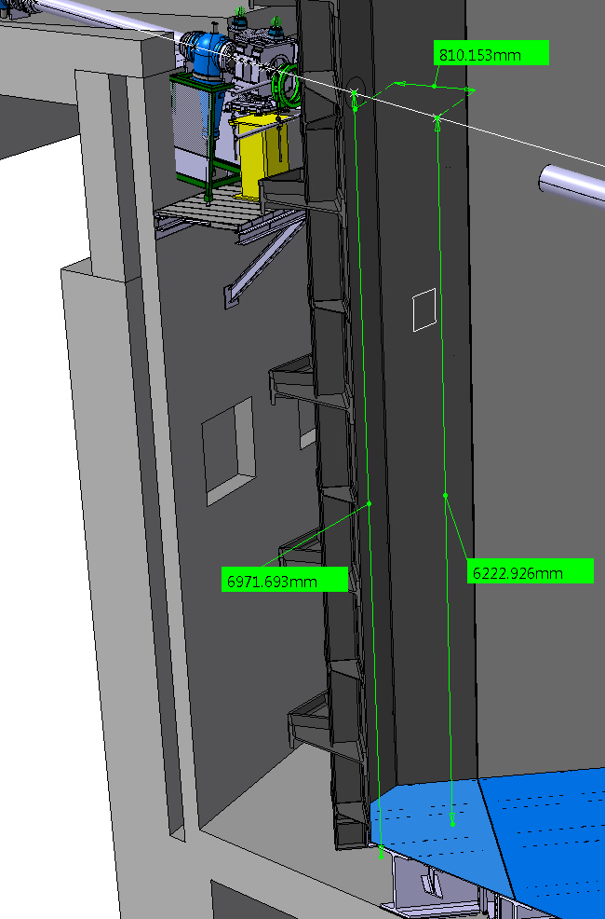
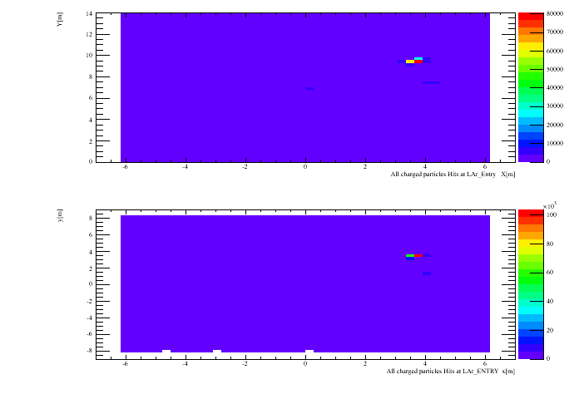
Muons and other Background
High energy muons from primary/secondary target and other beams
Low energy muons, hadrons and electrons
Updated numbers for the LAr position, survey is coming soon
12 GeV beam

Slide 15
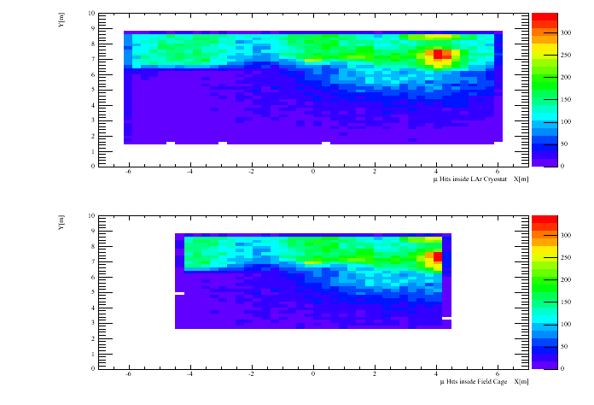
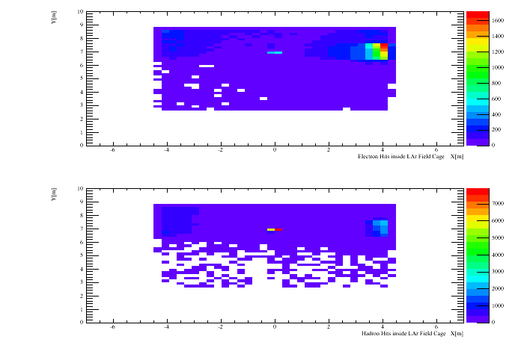

Slide 16
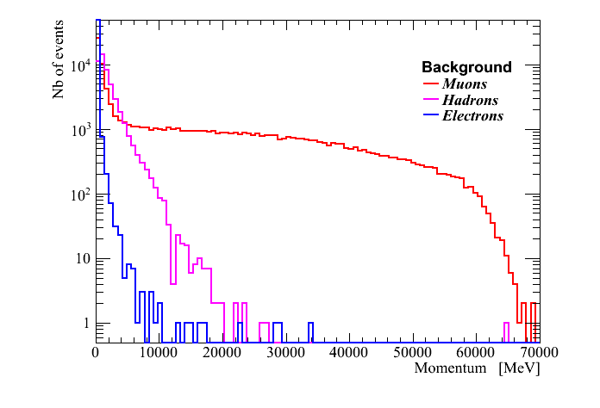
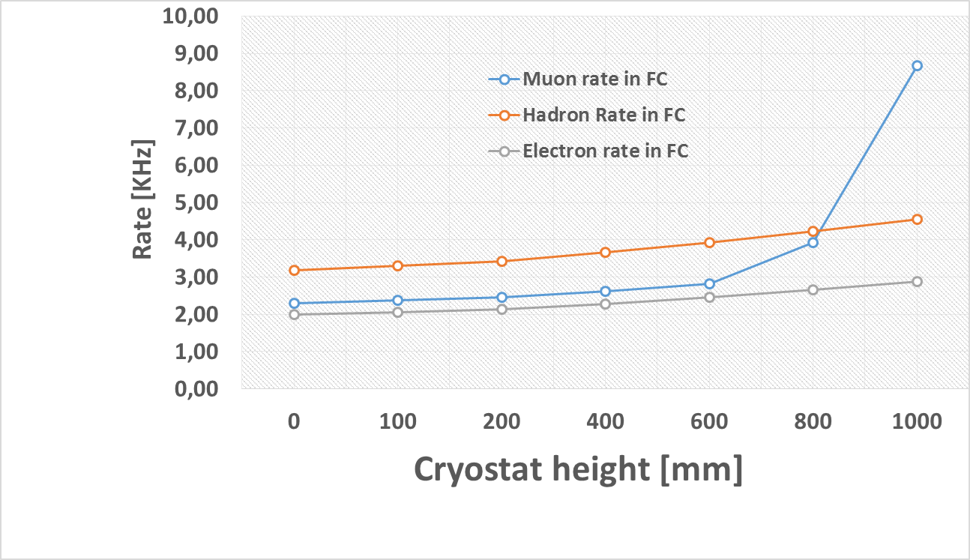
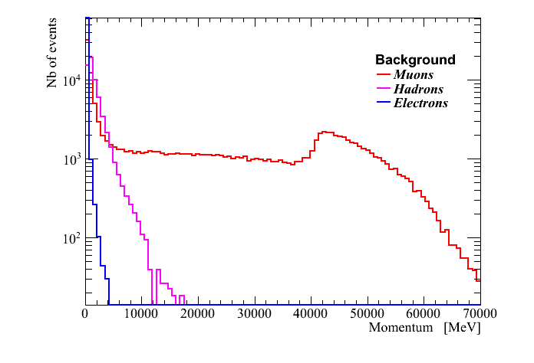
Background for cryostat height = 100mm
~2.2KHz μ,e π ~3 KHz, Total ~ 7.5KHz
Height=100mm
Height=800mm
More detailed simulations to follow soon (+ electron beams)

Slide 17
Conclusion
Beam instrumentation well defined
Next priorities
  Follow up construction
  Integrate beam signals to WA105 control room
  Integrate Beam Data to LAr data
  Continue background studies

