Slide 1
Charge readout front-end electronics, DAQ and online storage/computing facility
Dario Autiero, E.Bechetoille, B.Carlus, F.Doizon, S.Galymov, C.Girerd, J. Marteau, H.Mathez, E. Pennacchio, D.Pugnere, W.Tromeur, T. Viant
22/3/2017

Slide 2
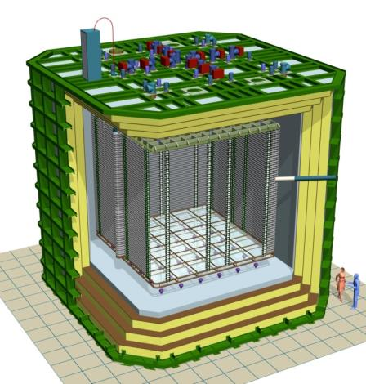
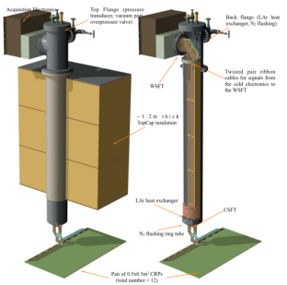
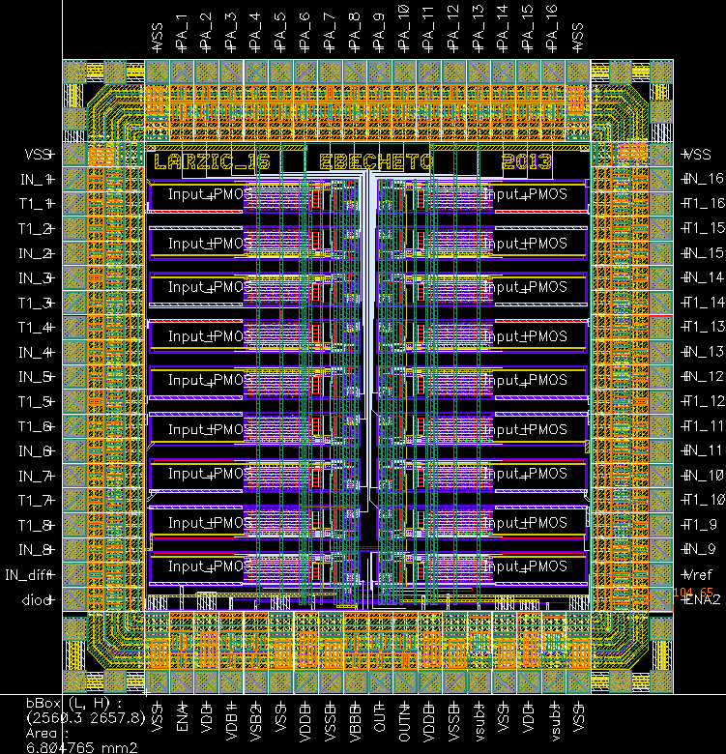
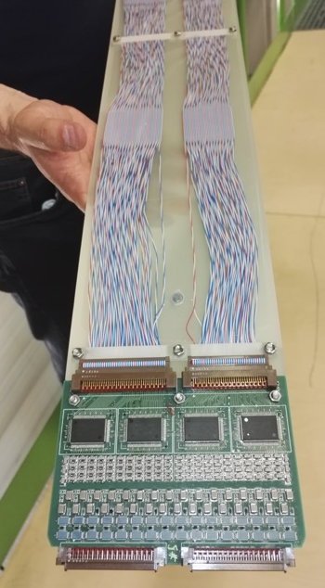
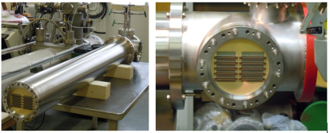
WA105 Accessible cold front-end electronics and uTCA DAQ system 7680 ch
Full accessibility provided by the double-phase charge readout at the top of the detector
Digital electronics at warm on the tank deck:
Architecture based on uTCA standard
1 crate/signal chimney, 640 channels/crate
→ 12 uTCA crates, 10 AMC cards/crate, 64 ch/card
Cryogenic ASIC amplifiers (CMOS 0.35um) 16ch externally accessible:
Working at 110K at the bottom of the signal chimneys
Cards fixed to a plug accessible from outside
→Short cables capacitance, low noise at low T
Warm
FE cards mounted on insertion blades
ASICs 16 ch.
(CMOS 0.35 um)
uTCA crate
Cold
CRP
Signal chimney
2

Slide 3
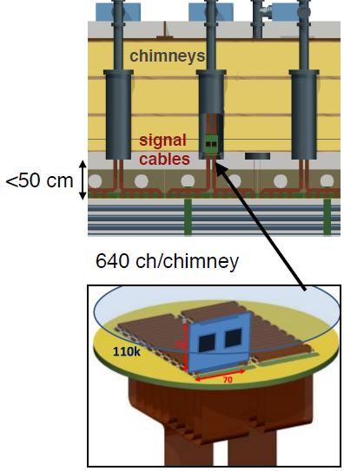
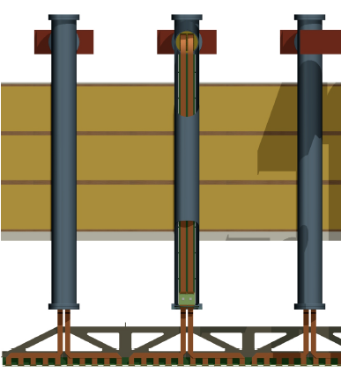
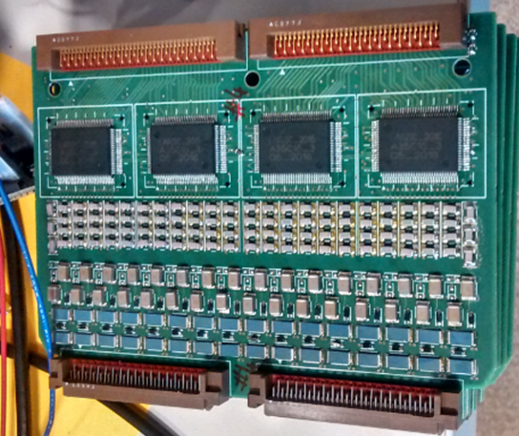
Cost effective and fully accessible cold front-end electronics and DAQ
Ongoing R&D since 2006→ in production for 6x6x6 (7680 readout channels)
ASIC (CMOS 0.35 um) 16 ch. amplifiers working at
~110 K to profit from minimal noise conditions:
FE electronics inside chimneys, cards fixed to a plug accessible from outside
Distance cards-CRP<50 cm
Dynamic range 40 mips, (1200 fC) (LEM gain =20)
1300 e- ENC @250 pF, <100 keV sensitivity
Single and double-slope versions
Power consumption <18 mW/ch
Produced at the end of 2015 in 700 units (entire 6x6x6)
1280 channels installed on 3x1x1
DAQ in warm zone on the tank deck:
Architecture based on uTCA standard
Local processors replaced by virtual processors emulated in low cost FPGAs (NIOS)
Integration of the time distribution chain (improved PTP)
Bittware S5-PCIe-HQ 10 Gbe backend with OPENCL and high computing power in FPGAs
Production of uTCA cards started at the end of 2015, pre-batch already deployed on 3x1x1
ASIC 16 ch.
CMOS 0.35um
Analog FE cards
(64 ch)
Large scalability (150k channels for 10kton) at low costs

Slide 4
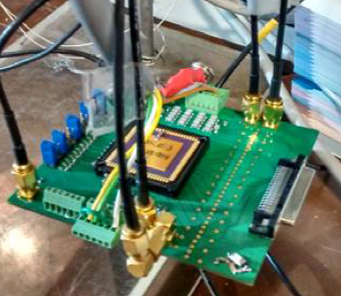
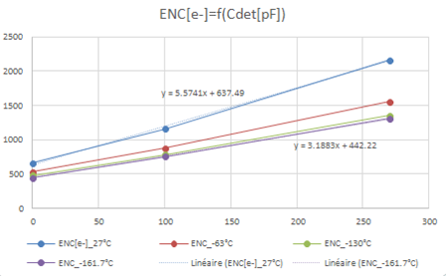
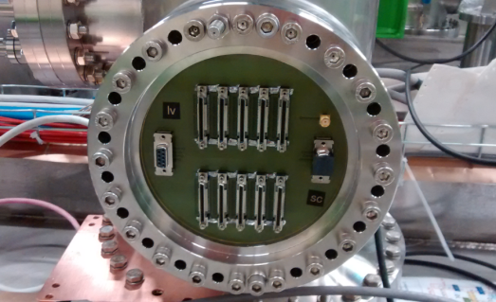
Cryogenic FE electronics :
Dual-slope ASICs final version
16 channels
Double slope gain with “kink” at 400 fC
1200 fC dynamic range
(batch of 25 circuits) tested in January 2016, fully satisfactory. Full production for 6x6x6 produced and purchased (700 chips).
FE-cards designed in 2016 together with chimneys warm flanges PCBs
Warm flange PCB
20 FE cards (1280 channels) produced and installed on 3x1x1 pilot detector at CERN

Slide 5
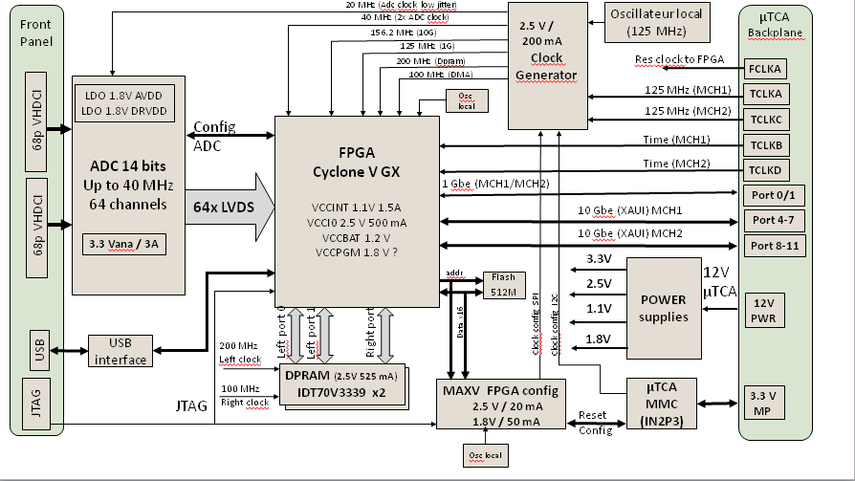
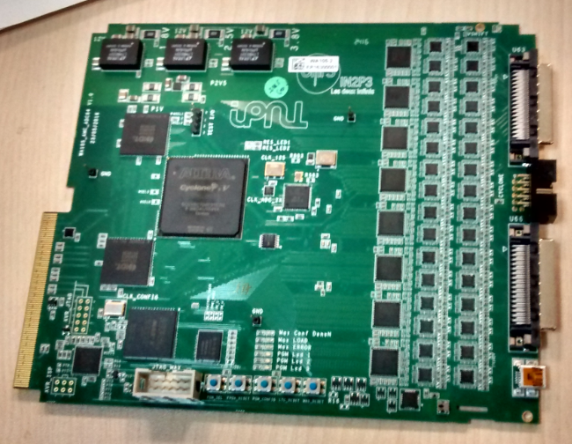
uTCA DAQ system:
64 channels AMC digitization cards (2.5-25 MHz, 12 bits output, 10 GbE connectivity
Demonstrator card with 64 ADC channels built and tested in 2015 for the definition of the final card
Purchase of main components (ADCs, FPGAs, IDT memories) of the final cards by end of 2015 to equip the entire 6x6x6
Final design of digitization PCBs May 2016
First assembled cards received in August 2016.
20 cards produced by September 2016 to equip the 3x1x1
Cards production going to be completed with the 2017 budget of remaining 100 FE and uTCA cards for 6x6x6 (main components available)
The warm flange PCB design is based on an extension of the ones of the 3x1x1 being worked out now on the basis of the mechanical design from Franco

Slide 6
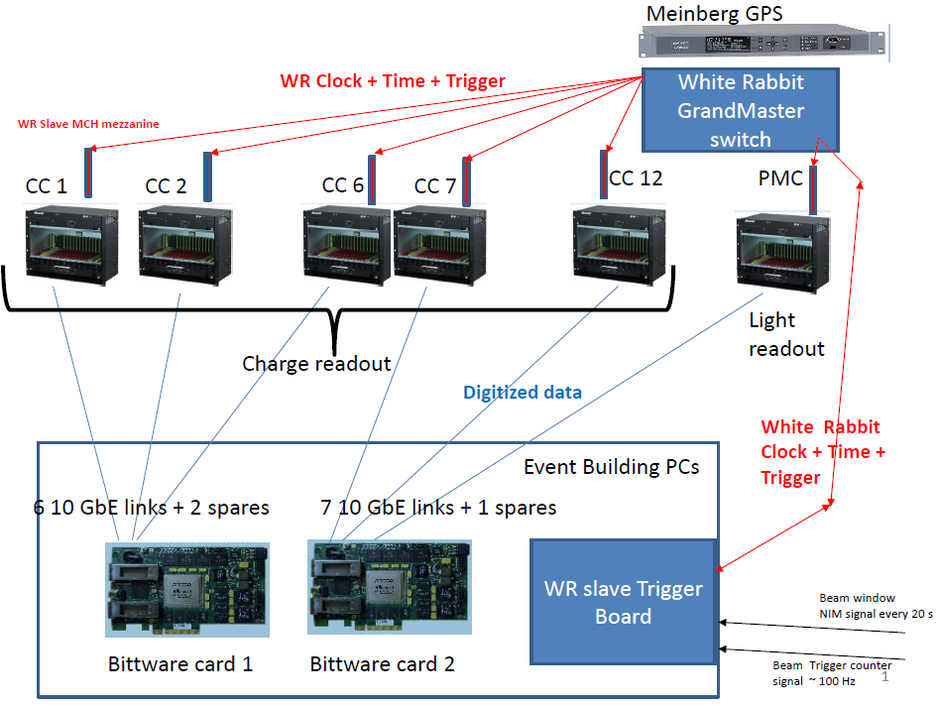
Global uTCA DAQ architecture
integrated with « White Rabbit » (WR) Time and Trigger distribution network
+ White Rabbit slaves nodes in uTCA crates +
WR system (time source, GM, trigger system, slaves)

Slide 7
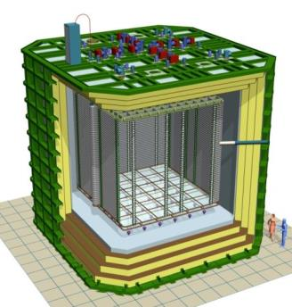
DAQ timing-trigger integration
uTCA crate of LRO
x12 Charge readout WR links
Trigger counter
Cosmic muon
Start of spill signal (cable)
External trigger plane
for cosmics
Light
Crate with NIM logic
PMTs
for light readout
PC with WR time stamping card
Time stamps:
Beam trigger
Start of spill
External cosmic trigger
Calibration pulses
Light readout WR link
WR switch
(optical links 1 Gbps)
Beam triggers from SPS
Tertiary beam line ~100Hz

Slide 8
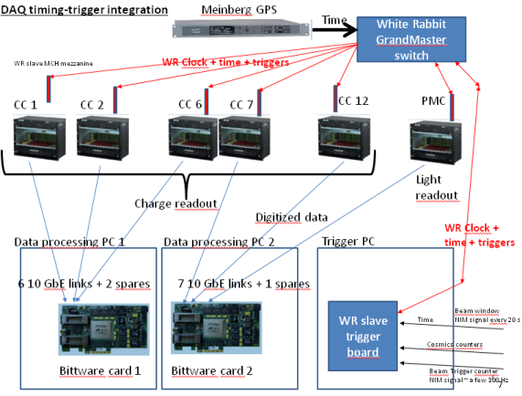
Beam instrumentation
detectors
electrical signals
VME crate for beam DAQ
NIM crate for trigger logic
Beam trigger logic signals
SPS start of spill
WR card
WR network
Beam instrumentation DB
Protune-DP offline or online processing
Beam data
output
queries

Slide 9
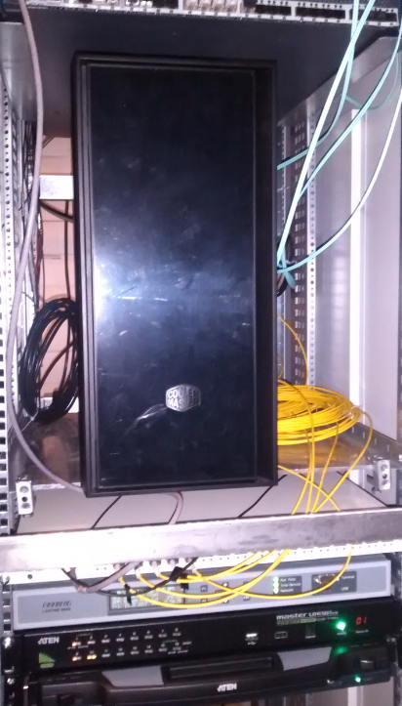
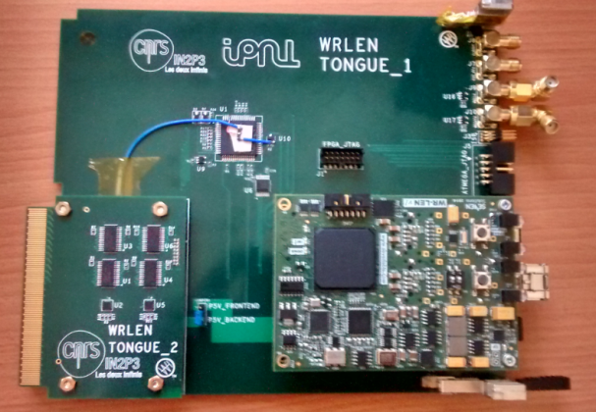
White Rabbit trigger time-stamping PC (SPEC + FMC-DIO)
White Rabbit Grand-Master
GPS unit
White Rabbit uTCA slave node based on WRLEN developed and produced for entire 6x6x6
Other components of the chain (GPS receiver, WR grandmaster, SPEC+ FMC-DIO + 13 WRLEN ) available commercially

Slide 10
White Rabbit trigger time-stamping PC (SPEC + FMC-DIO)
White Rabbit Grand-Master
GPS unit
White Rabbit uTCA slave node based on WRLEN developed and produced for entire 6x6x6
Other components of the chain (GPS receiver, WR grandmaster, SPEC+ FMC-DIO + 13 WRLEN ) available commercially

Slide 11
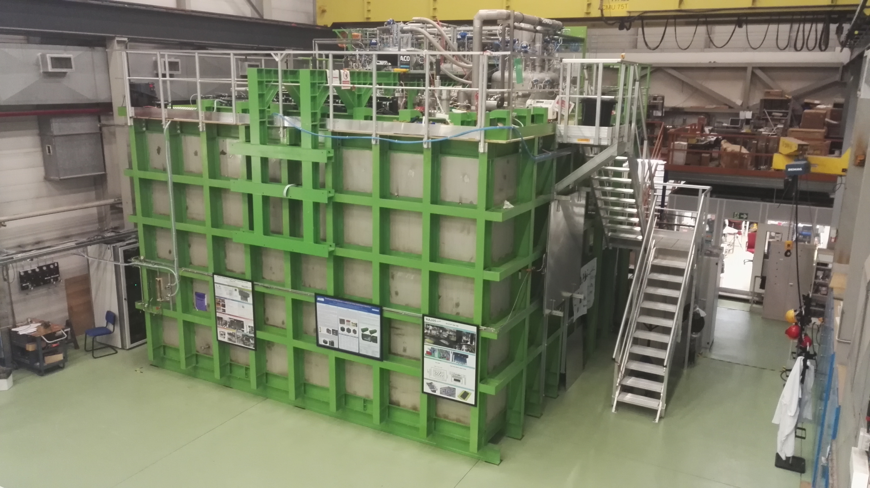
6x6x6: 12 uTCA crates (120 AMCs, 7680 readout channels)
3x1x1: 4 uTCA crates (20 AMCs, 1280 readout channels)
Event builder, network, GPS/White Rabbit GM,
WR Trigger PC
Signal Chimneys and uTCA crates

Slide 12
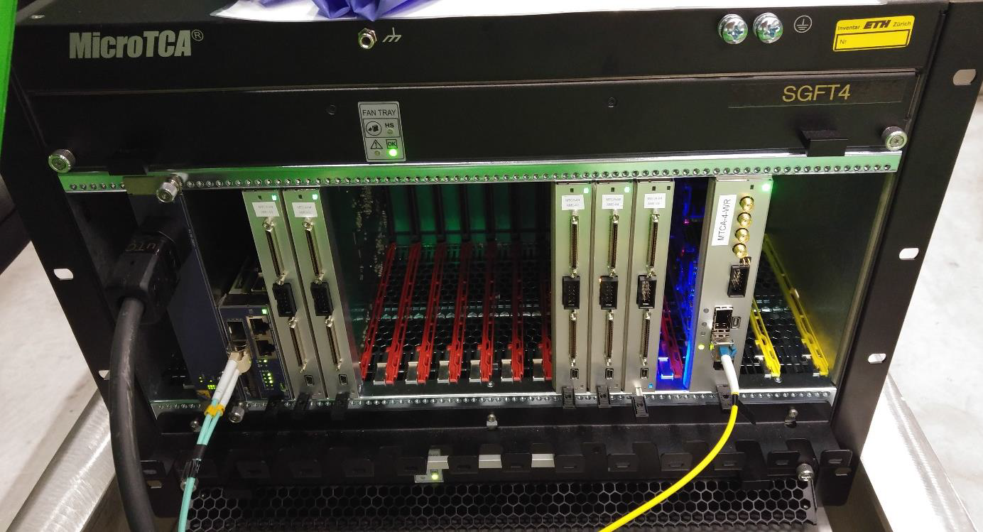
How a crates was looking like before VHDCI signals cabling to the warm flange
WR uTCA slave
card node with WRLEN mezzanine
MCH
AMC 64 channels
digitization cards
10 Gbit/s data link
White Rabbit optical link

Slide 13
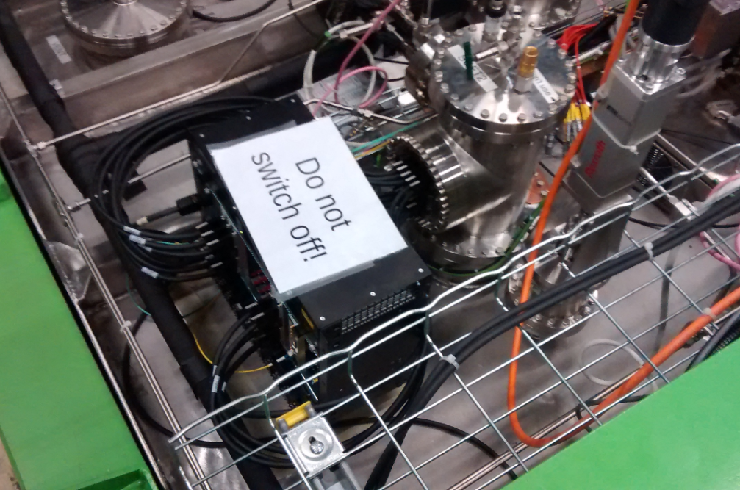
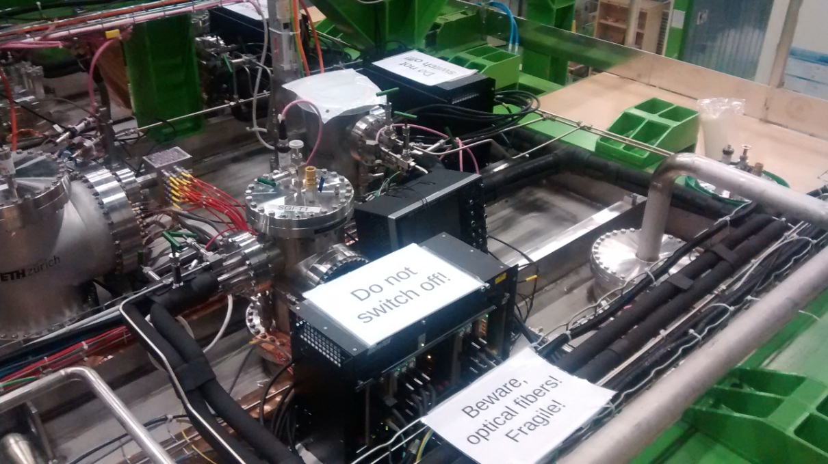
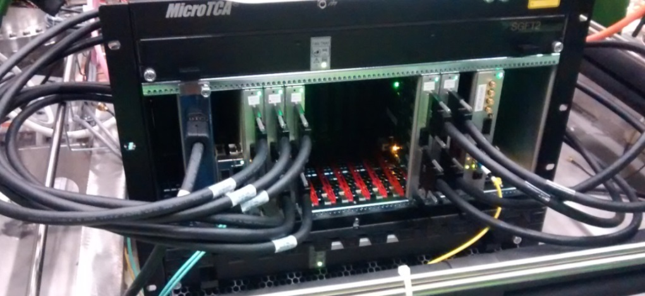
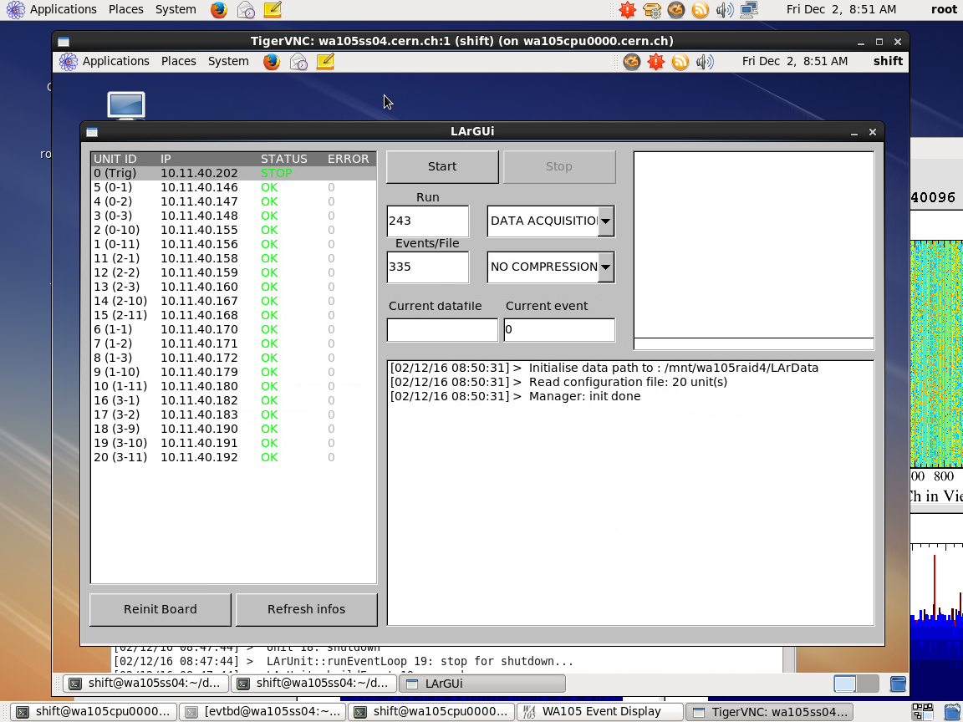
Top cap picture with uTCA crates cabled to signal chimneys
Run control with 20 AMCs
Automatic data processing on online storage/processing farm for purity and gain analysis + data transfer on EOS
Stable system, noise conditions at warm 1.5-1.7 ADC counts RMS

Slide 14
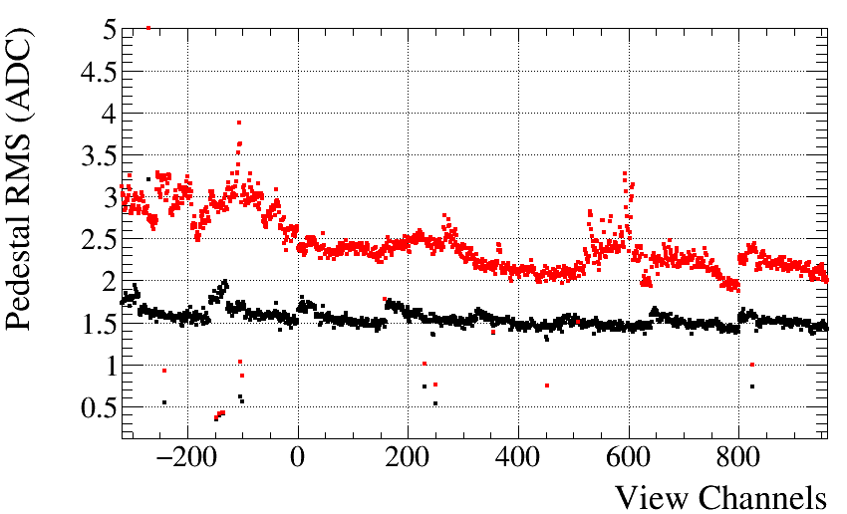
Noise at warm RMS~1.5 ADC channels (0.73 mV) (all SC and HV disconnected apart cathode)
Increases to RMS~2.4 ADC channels (1.17 mV) when the detector slow control cables are connected (slow control cabling and grounding not optimal in 3x1x1)
Noise, slow control cables connected
Noise, no slow control connections
Discontinuities at the anode boundaries (0.5 m == 160 ch)

Slide 15
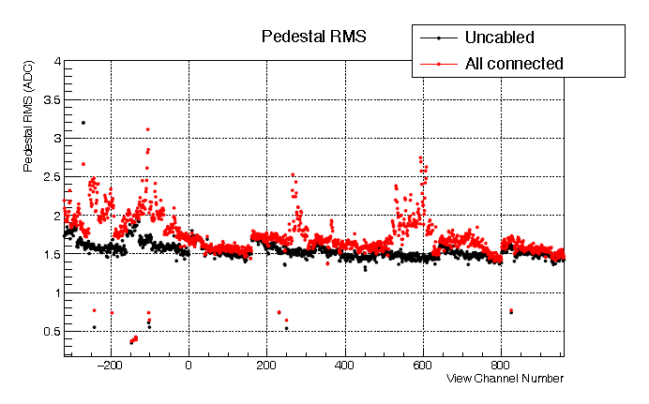
We had several campaigns of checking of the grounding conditions/noise measurements since June 2016 which pointed out issues related to the slow control grounding and cabling (see presentation given at the 3x1x1 commissioning meeting on 19/1/2017 for more details on the installation and on these measurements)
All these measurement campaigns are detailed on the e-log
The situation further improved with additional work performed in February on the entire final configuration with all devices attached before running which identified an additional issue related to the temperature probes cabling
→ Average RMS noise 1.7 ADC (0.82 mV) counts at warm
The grounding scheme for the 6x6x6 is more sophisticated with the cryostat, FE electronics and slow control completely insulated from external environment and only referred to cryostat ground

Slide 16
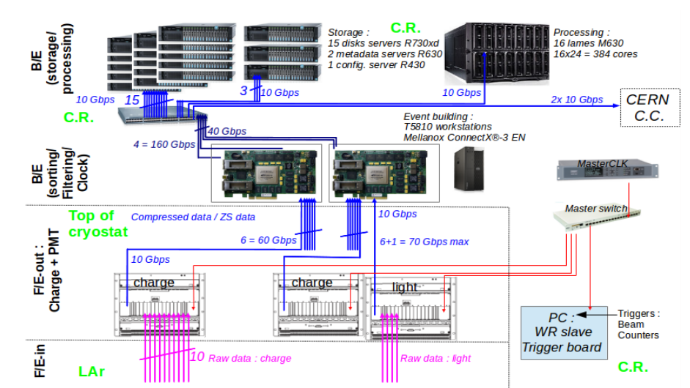
Online processing and storage facility: internal bandwidth 20 GB/s, 1 PB storage, 384 cores: key element for online analysis (removal of cosmics, purity, gain, events filtering)
C.R. stands for Counting Room

Slide 17
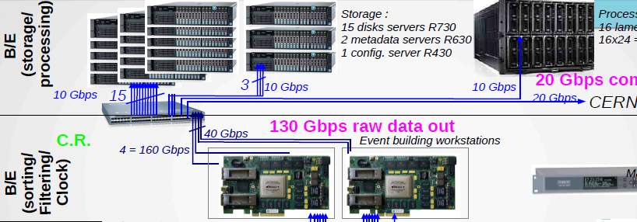
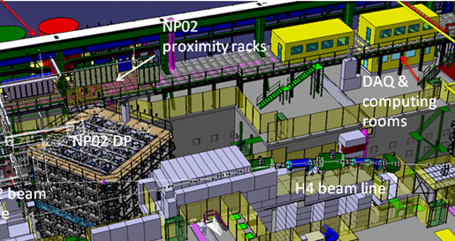
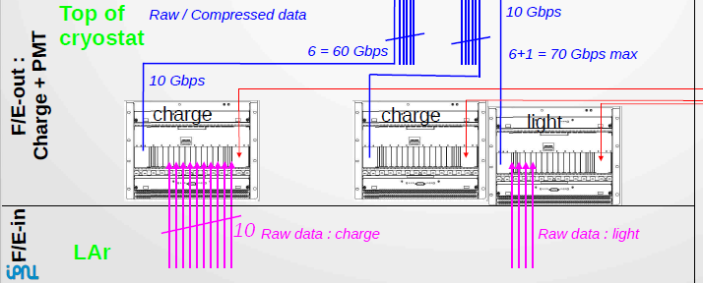

Slide 18
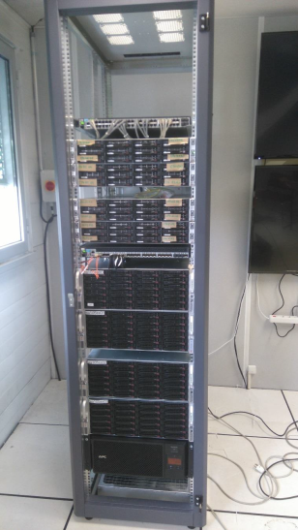
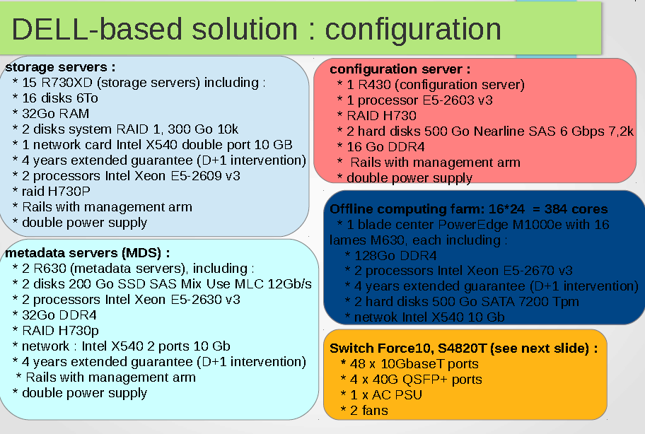
First design of online storage/processing DAQ back-end farm performed in 2016 (1PB, 300 cores, 20Gb/s data flow),
Smaller test scale system already installed and operative for 3x1x1
Tests to finalise the architecture of final online storage/processing facility.
Thanks to CERN/IT support

Slide 19
Online storage and data processing system also fully operative since the beginning of December
EOS storage file system/metadata server
Batch system: Torque
Files transfer to EOS for users analysis access on lxplus
Scripting and software developed for automatic files handling, storage, dispatching to batch workers and analysis
Online analysis software for purity/gain determination, storing of results on EOS
Beyond use for 3x1x1 online monitoring (which has a rather modest data flow) this system is a prototype/test bench in order to study the design and perform the development of the final online data storage and processing system foreseen for the 6x6x6 via mock data challenges at high rate with both simulated and real data
See detailed presentation given by Elisabetta at the SB meetings in the last months
“Development and implementation of the WA105 6x6x6 online storage/processing on the 3x1x1 online storage and processing small scale test farm”
and the presentation that Elisabetta will give tomorrow at the SB session

Slide 20
x24 40Gbits/s links
Further evolution of the network backbone architecture for 6x6x6 taking into account 40 Gbit/s connectivity
X 4 DAQ
x1 CERN IT
40 Gbit/s
Nexus 9236C
…
X4 Second switch uplink
x15 storage servers
Nexus 93120TX
x4 links 40Gbit
+96 1/10Gbis/s
CPU blades + x2 Metadata and x1configuration server
Other services
20

Slide 21
Extensive tests during the last year (see past TB presentations by J.Marteau and D. Pugnere) have show the validity of use a local EOS implementation as high performance distributed file system to build up a storage backend at the 20 GB/s level
This is already implemented at the level of the 3x1x1 which provided also very good experience for all the software and system management developments)
Procurement of computing material (disk servers, CPU and network architecture) for 6x6x6 online computing and storage facility already started in collaboration with the Neutrino Platform people (Filippo presented also the offline resources this morning).
Very strong collaboration and support from the IT division
Very good infrastructure with counting rooms racks and cooling power (about 350 kW), 40 Gbit/s connectivity to IT for each one of the protoDUNE detectors
Other more critical components like the DAQ backend machines, metadata server etc, being finalized). All the backend hardware should be finalized for procurement in the next two months.
→ Looking forward to the start of the FE-DAQ installation in October 2017 !

